Slide 1


THE CONSTITUTION OF THE REPUBLIC OF POLAND
Dorota Mierzejewska

Slide 2
THE PERSENTATION INCLUDES
- a brief history of the Constitution
- composition and content of the Constitution
- description of the preamble
- the most important regulations
- Constitutional guarantees

Slide 3
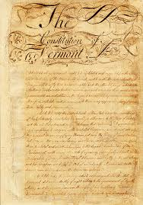
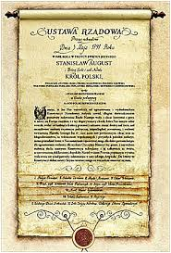
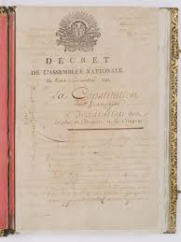
THE OLDEST CONSTITUTIONS IN THE WORLD
The American Constitution of 17th September , 1787
The Polish Constitution of 3rd May ,1791
The French Constitution of 3rd September , 1791

Slide 4
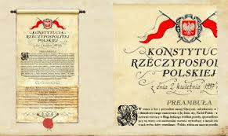
Current document
Current document about constitutional character is
THE CONSTITUTION OF THE REPUBLIC OF POLAND
adopted 2 April 1997

Slide 5
COMPOSITION AND CONTENT
PREAMBLE
Chapter I : THE REPUBLIC
Chapter II : THE FREEDOMS, RIGHTS AND OBLIGATIONS OF PERSONS AND CITIZENS
Chapter III : SOURCES OF LAW
Chapter IV : THE SEJM AND THE SENATE
Chapter V : THE PRESIDENT OF THE REPUBLIC OF POLAND
Chapter VI : THE COUNCIL OF MINISTERS AND GOVERNMENT ADMINISTRATION
Chapter VII : LOCAL GOVERNMENT
Chapter VIII : COURTS AND TRIBUNALS
Chapter IX : ORGANS OF STATE CONTROL AND FOR DEFENCE OF RIGHTS
Chapter X : PUBLIC FINANCES
Chapter XI : EXTRAORDINARY MEASURES
Chapter XII : AMENDING THE CONSTITUTION
Chapter XIII : FINAL AND TRANSITIONAL PROVISIONS

Slide 6
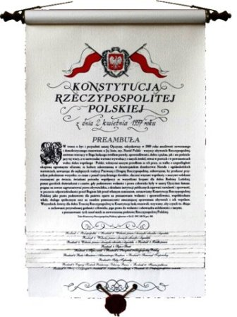
THE PREAMBLE
Contains three paragraphs accenting :
- the bitter human rights experiences of the past
- making a firm commitment for the future
- underlining the fundamental significance of human rights principles to the Polish constitutional framework

Slide 7
The most important chapters for citizens of pOLAND
CHAPTER I
THE REPUBLIC
CHAPTER II
THE FREEDOMS, RIGHTS AND OBLIGATIONS OF PERSONS AND CITIZENS

Slide 8
The constitution of the republic of poland as the supreme polish legal document guarantees
GENERAL :
- civil rights and freedoms
- determines the relationships between the legislative, executive and judiciary powers
- decides about the structure and method of appointing the highest state institutions
- regulates issues related to the organization of government and administration, public finance and extreme situations

Slide 9
The constitution of the republic of poland as the supreme polish legal document guarantees
FOR ALL POLISH CITIZENS :
- equality in the eyes of the law
- personal freedom and inviolability
- freedom of conscience and religion
- right to a fair trial
- right protection of life
- rights to appropriate safety conditions in the workplace
- affords special protection for the welfare of families and the rights of children

Slide 10
THANK YOU FOR YOUR ATTENTION

