Slide 1
Globalization
of art and culture
Presented by Anna Brodowicz

Slide 2


Glossary
contradictory - sprzeczny
worldwide - na całym świecie
diverse origins - różnorodne pochodzenie
on forefront of world - na czele świata
paradigm - paradygmat (sposób postrzegania, lub zbiór założeń/pomysłów)
homogenizing - homogenizacja (ujednolicenie)
homogeneous space - jednorodna przestrzeń
dystopian future - dystopijna przyszłość (antonim utopii)
“taking over” view - „przejmujący” widok
cultural heritage - dziedzictwo kulturowe
contemporary - współczesny
contemporary art – sztuka współczesna
counter-demand - przeciwne żądanie
clash of civilizations - zderzenie cywilizacji (lm.)
cultural fluidity - płynność kulturowa
broader audience - szersza publiczność
hegemony - hegemonia/przewodnictwo
inextricable - nierozwikłany

Slide 3
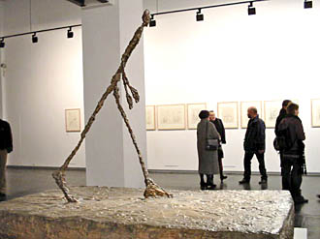
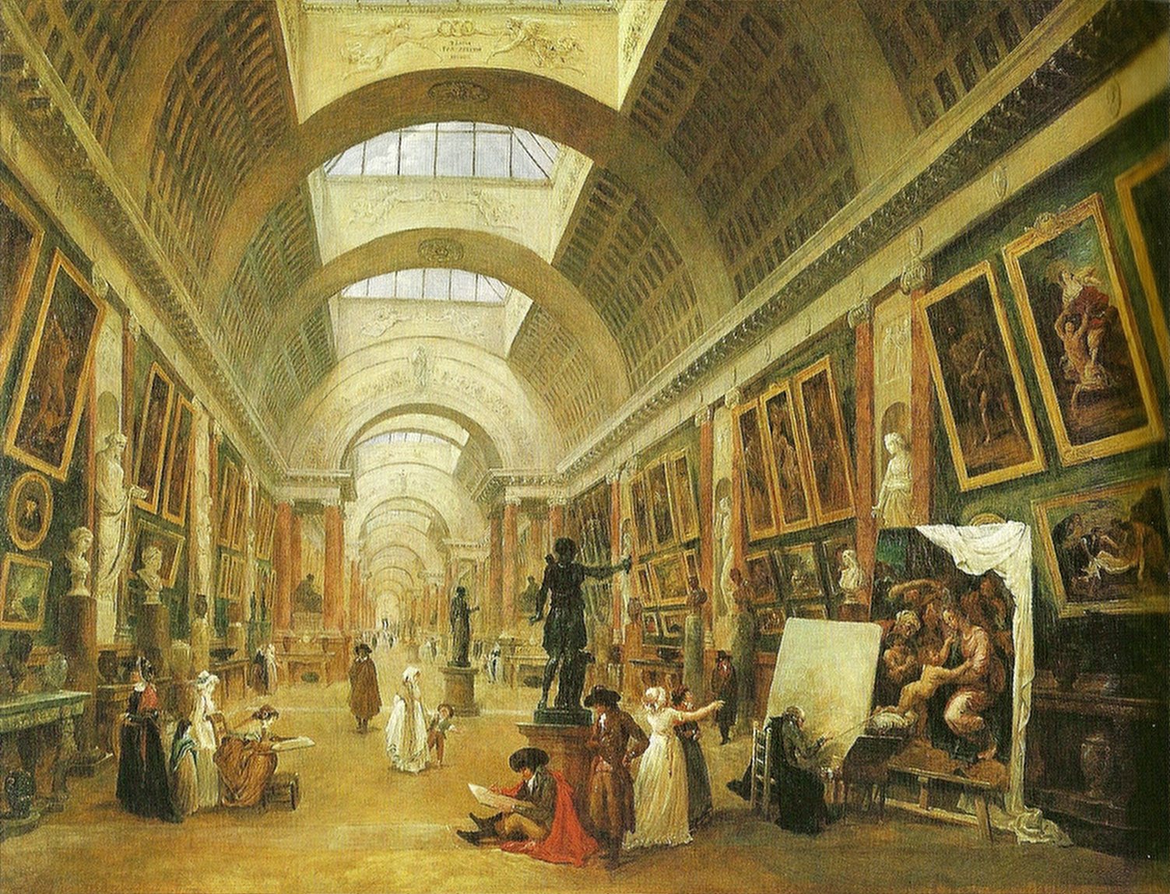
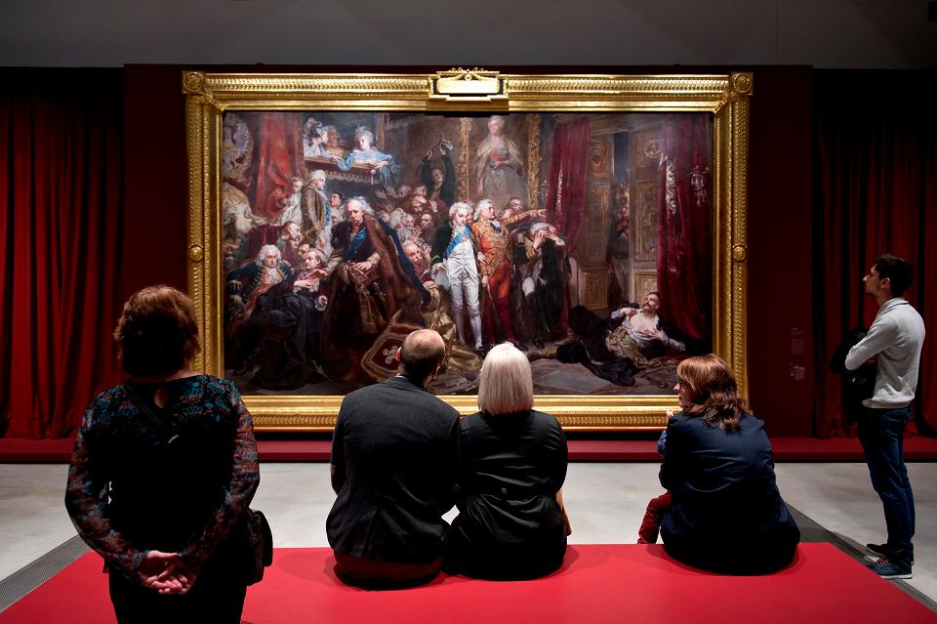
The globalization of art isn’t a new phenomenon
Museums around the world have collaborated for a long time, loaning and sharing their most well-known pieces with other museums for special exhibits and shows. But now globalization has reached the next, more profound level.
Alberto Giacometti wystawa
w krakowskiej Galerii STARMACH
International exhibitions of artists at the Louvre in Paris have been around since the 18th century

Slide 4

The economic infrastructure of the art world is also changing as a result of technology
and globalization
Internet is allowing artists to showcase their work to a broader audience.

Slide 5

Wrr…
3 paradigms
Through which the future of globalized cultures can be viewed:
clash of civilizations A dystopian future (and present), in which differences in culture become points of conflict
McDonaldization is that one view of the world is adopted by cultures across the globe
hybridization the rise of cultural sharing

Slide 6
Positive and negative impacts
The bringing of different experiences coming from various geopolitical contexts into one common world
Globalization creates uniformity and erases cultural identities
Today, the desire to create a global community, while remaining sensitive to differences and conflicting visions of the world, is still the positive, creative contradiction at the heart of global art
Arts and culture are joining a growing global market and mainstream culture, profiteering from local specificities and exoticizing local communities, also creating new global elites

Slide 7
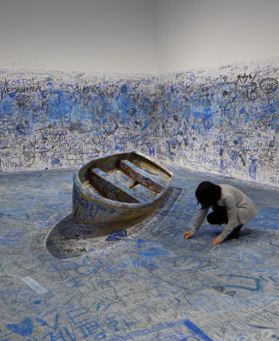
Contemporary art is global art, and vice versa – truly global art can only be
contemporary
Tezukayama Gallery

Slide 8

Technology is bringing us art from around the world. And as technology’s continues to open new pathways.
I believe that we can learn from art’s relationship to globalization is that there are no static communities, no fixed identities and no “authentic” cultures.
Notes:
Summary

Slide 9
Bibliography
https://artinfo.pl/pl/blog/relacje/wpisy/alberto-giacometti-wystawa-w-galerii-starmach2/ [dostęp: 02.01.2021r]
https://commons.wikimedia.org/wiki/File:Hubert_Robert_-_Die_Grand_Galerie_des_Louvre.jpg [dostęp: 02.01.2021r]
https://bi.im-g.pl/im/df/19/18/z25272031V,Widzowie-ogladaja-obraz--Rejtan-na-sejmie-warszaws.jpg [dostęp: 02.01.2021r]
https://touristjourney.com/best-contemporary-art-galleries-osaka/ [dostęp: 02.01.2021r]
https://www.behance.net/gallery/5866933/McDonalds-Fries-Box-Art-by-Camille-Junio [dostęp: 02.01.2021r]
Art Papers - Sylvie Fortain
2006 Biennal at the Whitney Museum of American art in New York City - Chrissie Iles and Phillippe Vergue
The global 500 - Edition Selene, 1999 - Olivier Ressler
For “diggit magazine” by Valeria Villalabos Campos, Jiyong Chai, Victor Hugo Rocha, Joanna&Ceilidh Newbury
“Globalization and Cultural Identity - The Perspective of Contemporary Art”, 2017 - Dessistova Dimova and Eckhart J. Gillen

