Slide 1
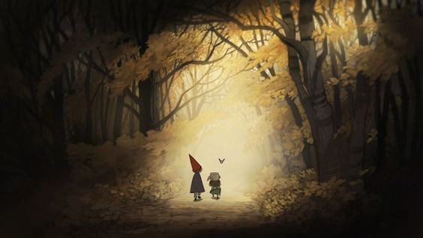
Over the Garden Wall
art of animation
Aleksandra Łysiak-Szumska
Patrycja Szywała
Uniwersytet Rzeszowski
Instytut Sztuk Pięknych

Slide 2
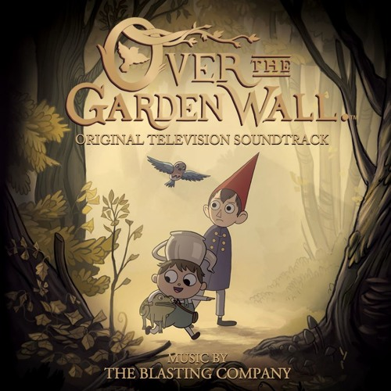
THE BASICS
● American 2D animated television miniseries ● Created by Patrick McHale for Cartoon Network ●The first miniseries on the network ● consists of 10 episodes, each 11 minutes long

Slide 3
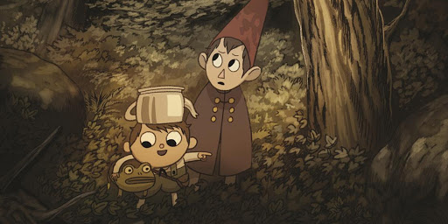
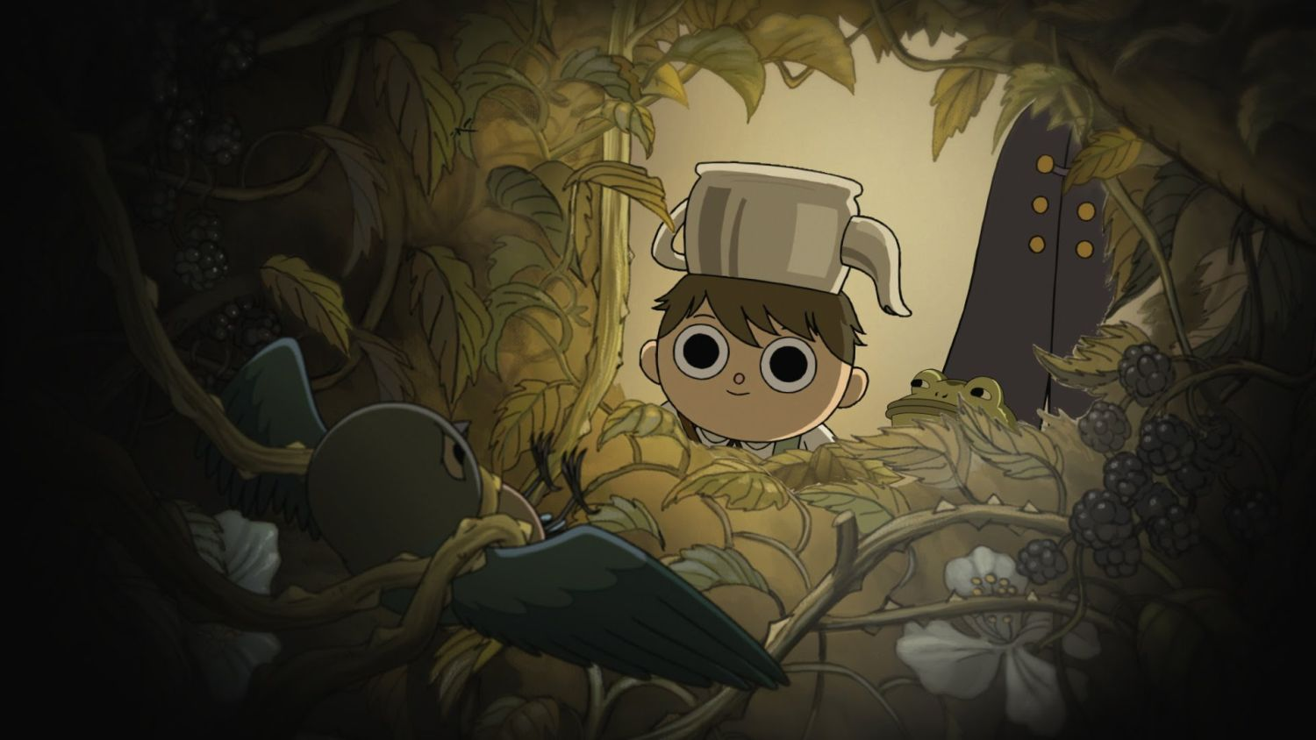
PLOT
The series follows two half-brothers, Wirt and Greg , who become lost in a strange forest called the Unknown. To find their way home, the two must travel across the seemingly supernatural forest with the occasional help of the wandering.
The show has the traditional art style, reminding of 80′s and 90′s animation.

Slide 4
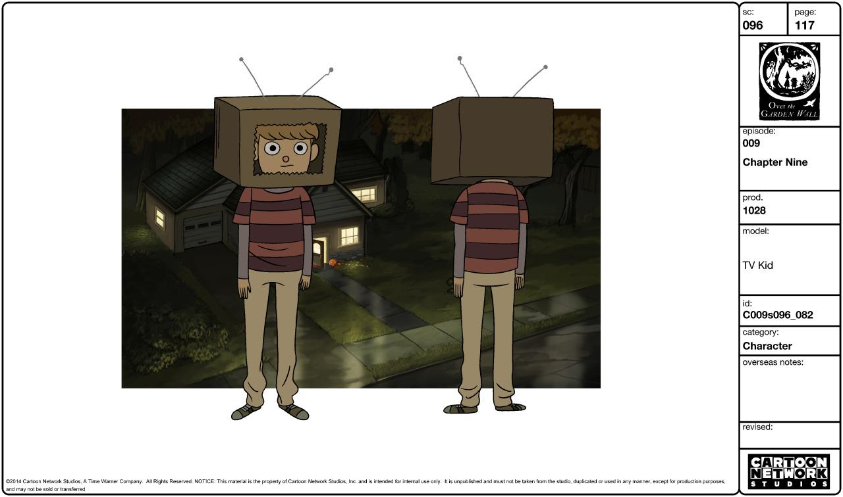
CHARACTERS CONCEPTS
A character designer creates the entire concept, style, and artwork of a character from scratch. This often includes a deep look into the character's personality to develop a visual idea of the character's physical features.

Slide 5
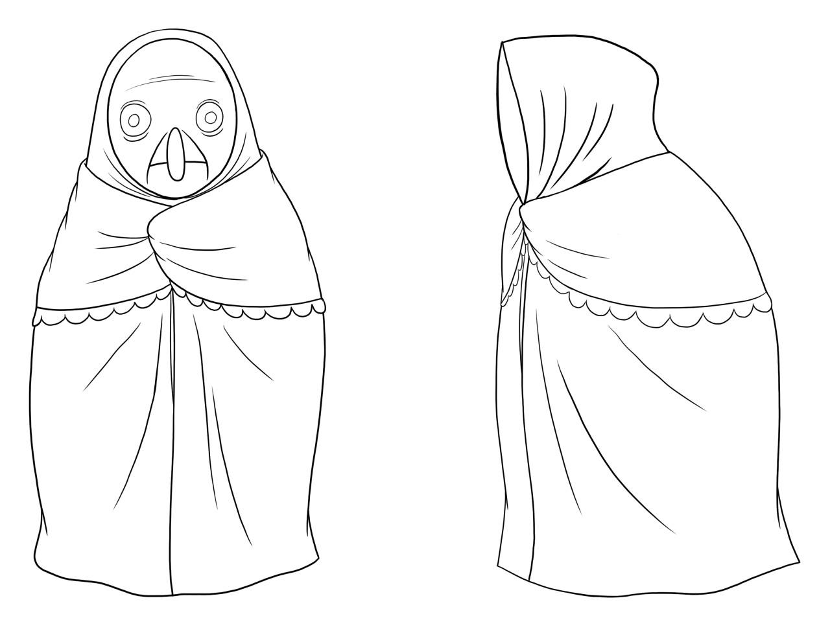
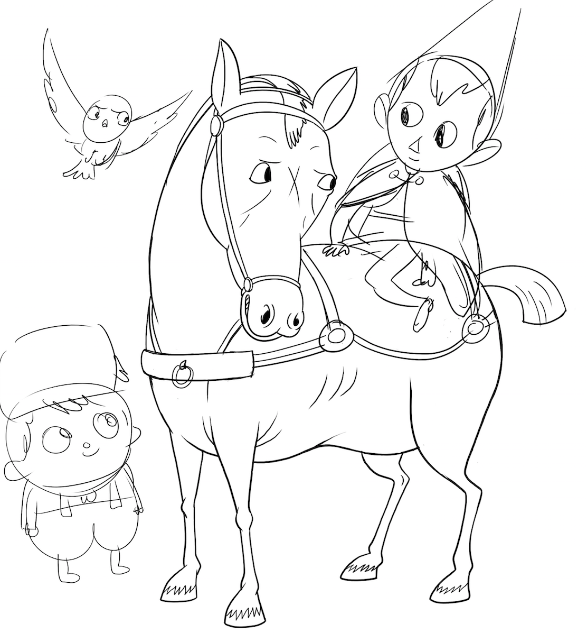
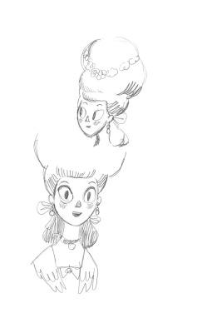
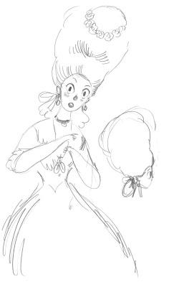

Slide 6
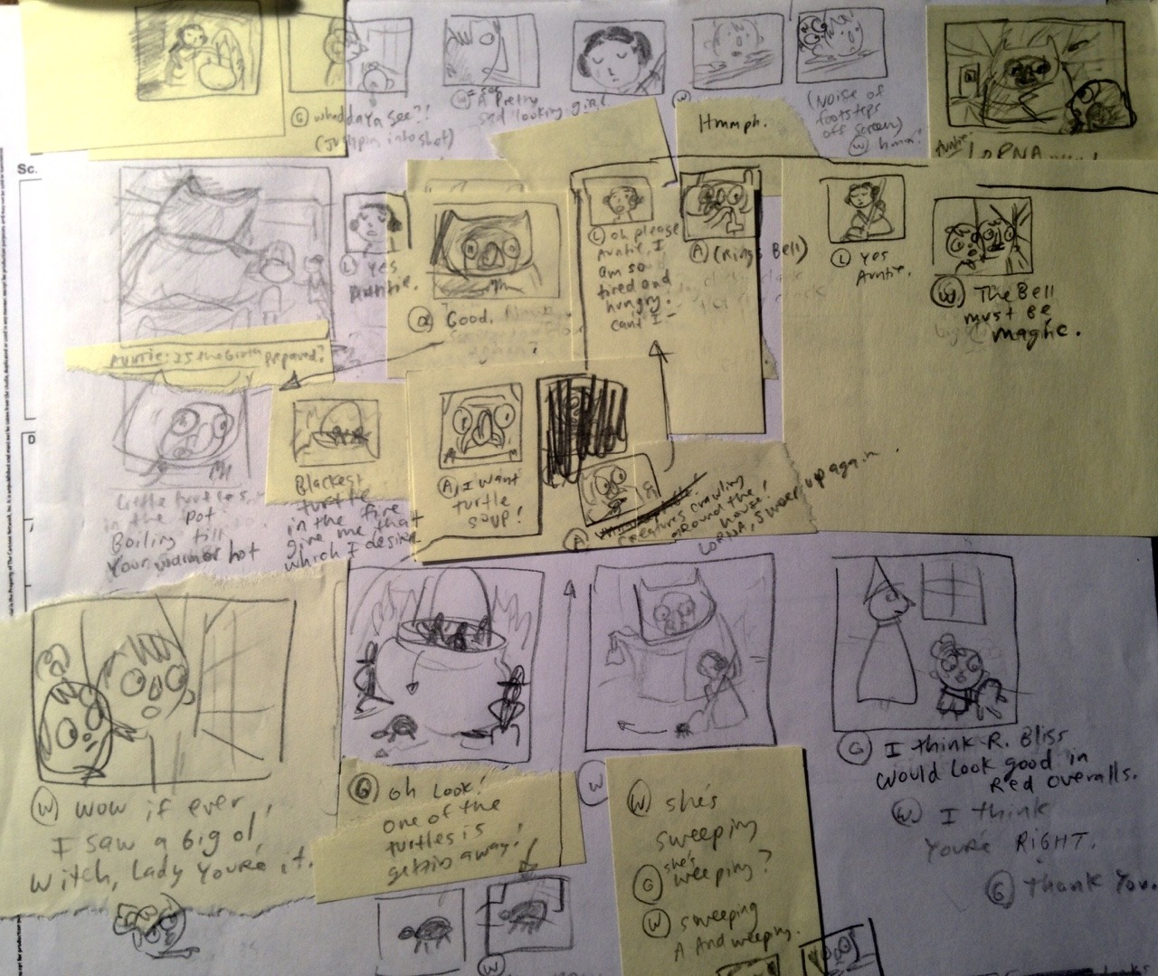
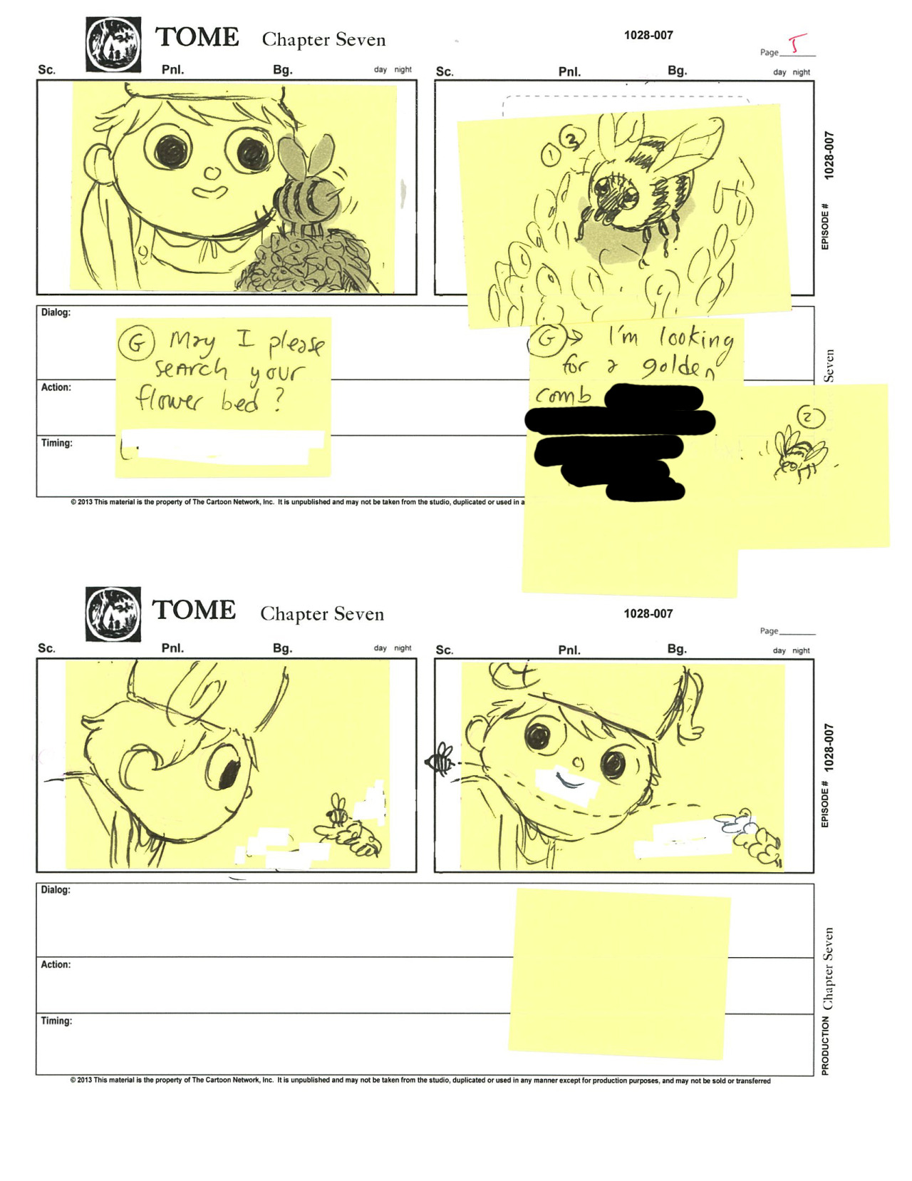
BEAT BOARD OR STORYBOARD?
STORYBOARD - a sequence of drawings, typically with some directions and dialogue, representing the shots planned for a film or television production.
BEAT BOARD - the same as a storyboard but with less detail.

Slide 7
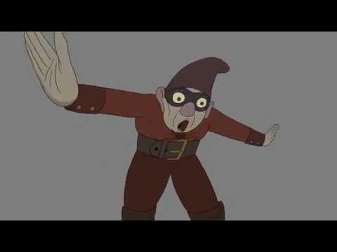
Animation create process
1. Animatic 2. Key animation 3. Revised animation 4. Cleaned up animation 5. Final animation

Slide 8
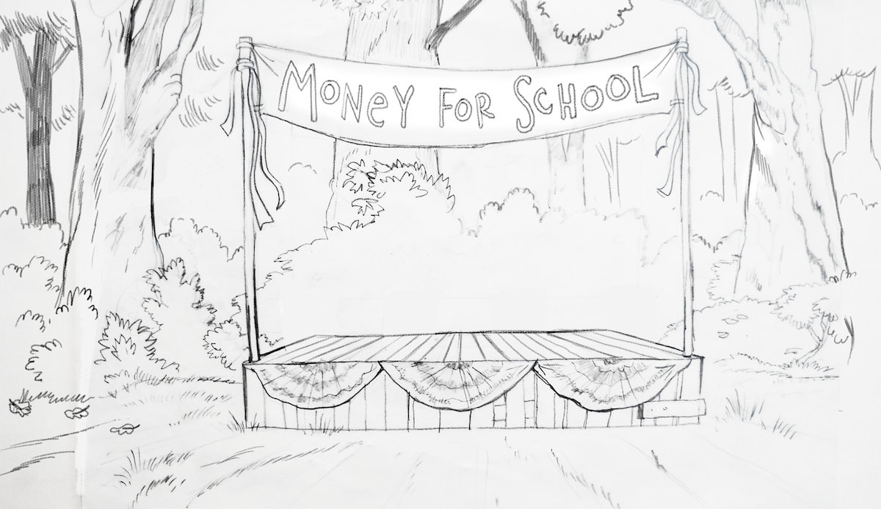
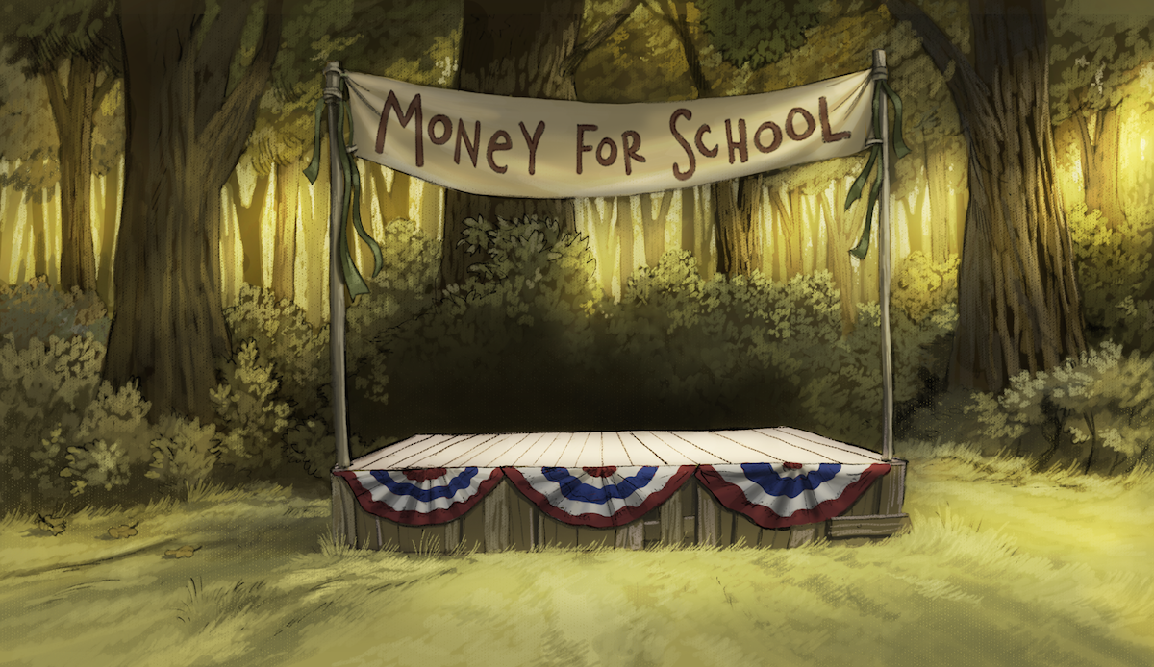
DIGITAL PAINTED BGs
1. LINEART 2. FIRST SHADING 3. ADDING COLOURS 4. SECOND SHADING 5. DETAILS PAINTING 6. FINAL FIXES https://jasonfunderburker.tumblr.com/post/108181445222/ncrossanimation-heres-a-background-tutorial

Slide 9
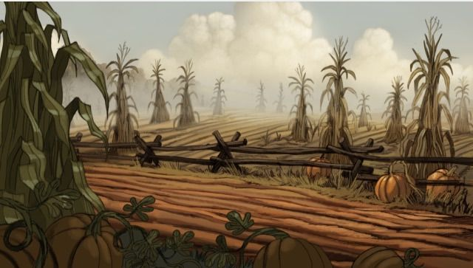
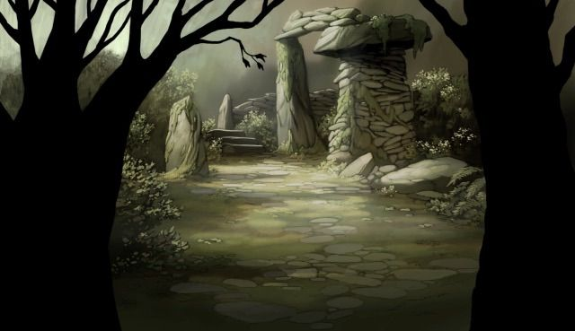

Slide 10
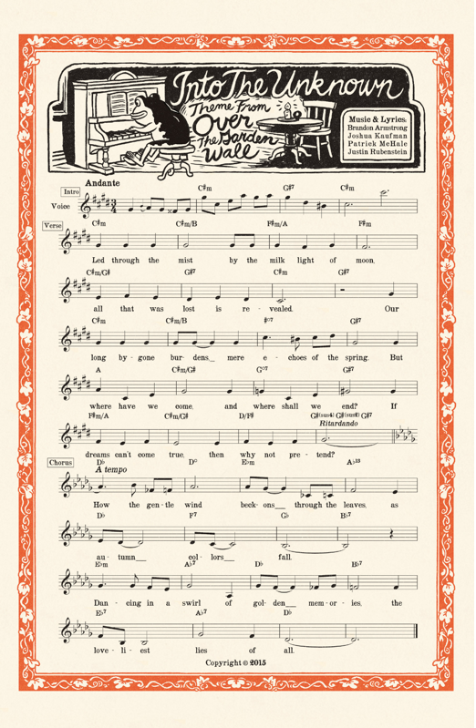
MUSIC
Various melodies and songs based on pre-1950s music are heard throughout the series.
An extended version of the soundtrack, featuring 32 tracks and totaling around 44 minutes in length, was released in the form of a vinyl record

Slide 11
KEY WORDS
● 2D animation - animation, created when two-dimensional images are rapidly sequenced to create the illusion of lifelike motion ● Miniseries - a television drama shown in a small number of episodes, often on consecutive nights ●Plot - the main events of a play, novel, film, or similar work, devised and presented by the writer as an interrelated sequence. ●Key frame - drawing or shot that defines the starting and ending points of any smooth transition ● Key animation - animating a graphics object by creating smooth transitions between various keyframes. ● Lineart- any image that consists of distinct straight or curved lines ● BGs - shortcut of background ● Character design - create the entire concept, style, and artwork of a character from scratch. This often includes a deep look into the character's personality to develop a visual idea of the character's physical features.

Slide 12
SOURCES
https://jasonfunderburker.tumblr.com/ dostęp z dnia 22.10.2020
https://animationessentials.weebly.com/blog/beat-board-or-storyboard dostęp z dnia 22.10.2020 https://en.wikipedia.org/wiki/Over_the_Garden_Wall dostęp z dnia 22.10.2020
https://rhetoricofafangirl.tumblr.com/post/164499504058/aesthetic-appreciation-over-the-garden-wall dostęp z dnia 22.10.2020

