Slide 1
The Ancient Art of Tattooing
Made by Gabriel Kołodziej

Slide 2
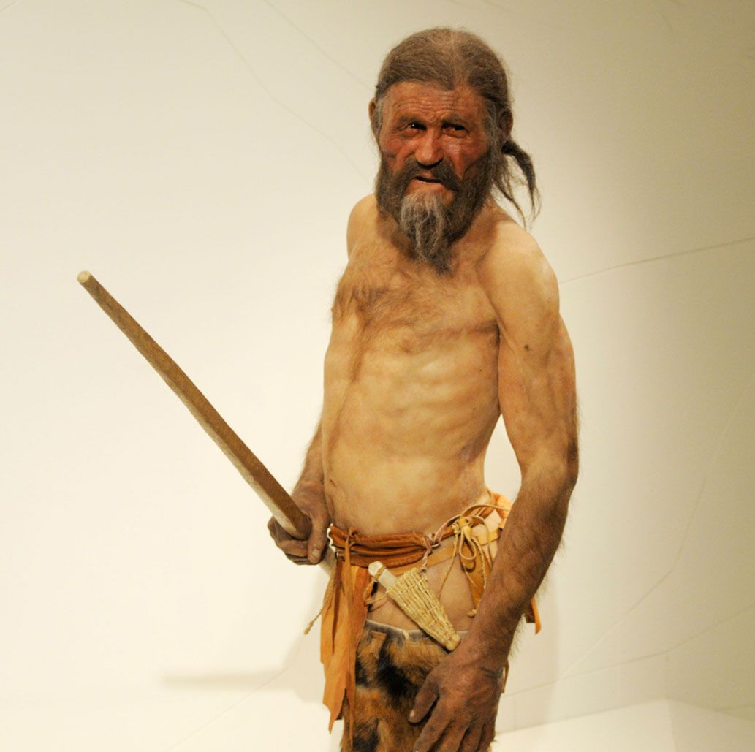
The Oldest
Back in 1991 two tourists discovered a well-preserved body near the Italian-Austrian boarder, in the Alps. Ötzi the Iceman is speculated to be around 5300 years old. Most of his tattoos are located on his spine and knee and ankle joints, they consist of mostly lines and crosses.

Slide 3
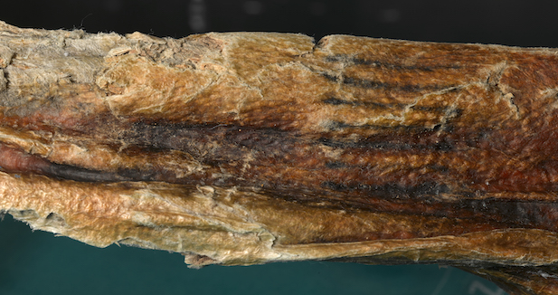

Slide 4
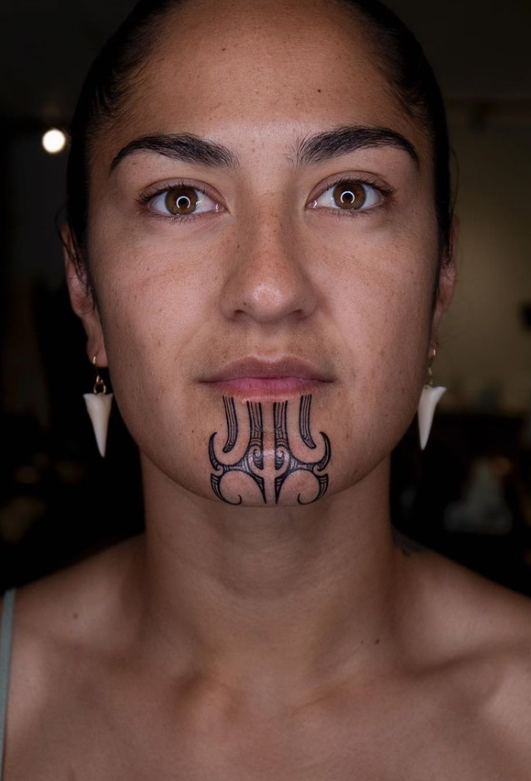
Tatau
The word tattoo comes from the Indigenous Polynesians, specifically from a Samoan word tatau which means to strike.
For Indigenous tribes like Māori the proces of tattooing (tā moko) something to be celebrated. During the tattooing itself fellow Māoris would sing.
They have different meanings, Mataora, or the female version Moko Kauae, represens nobility, whānau (family) and spirituality.

Slide 5
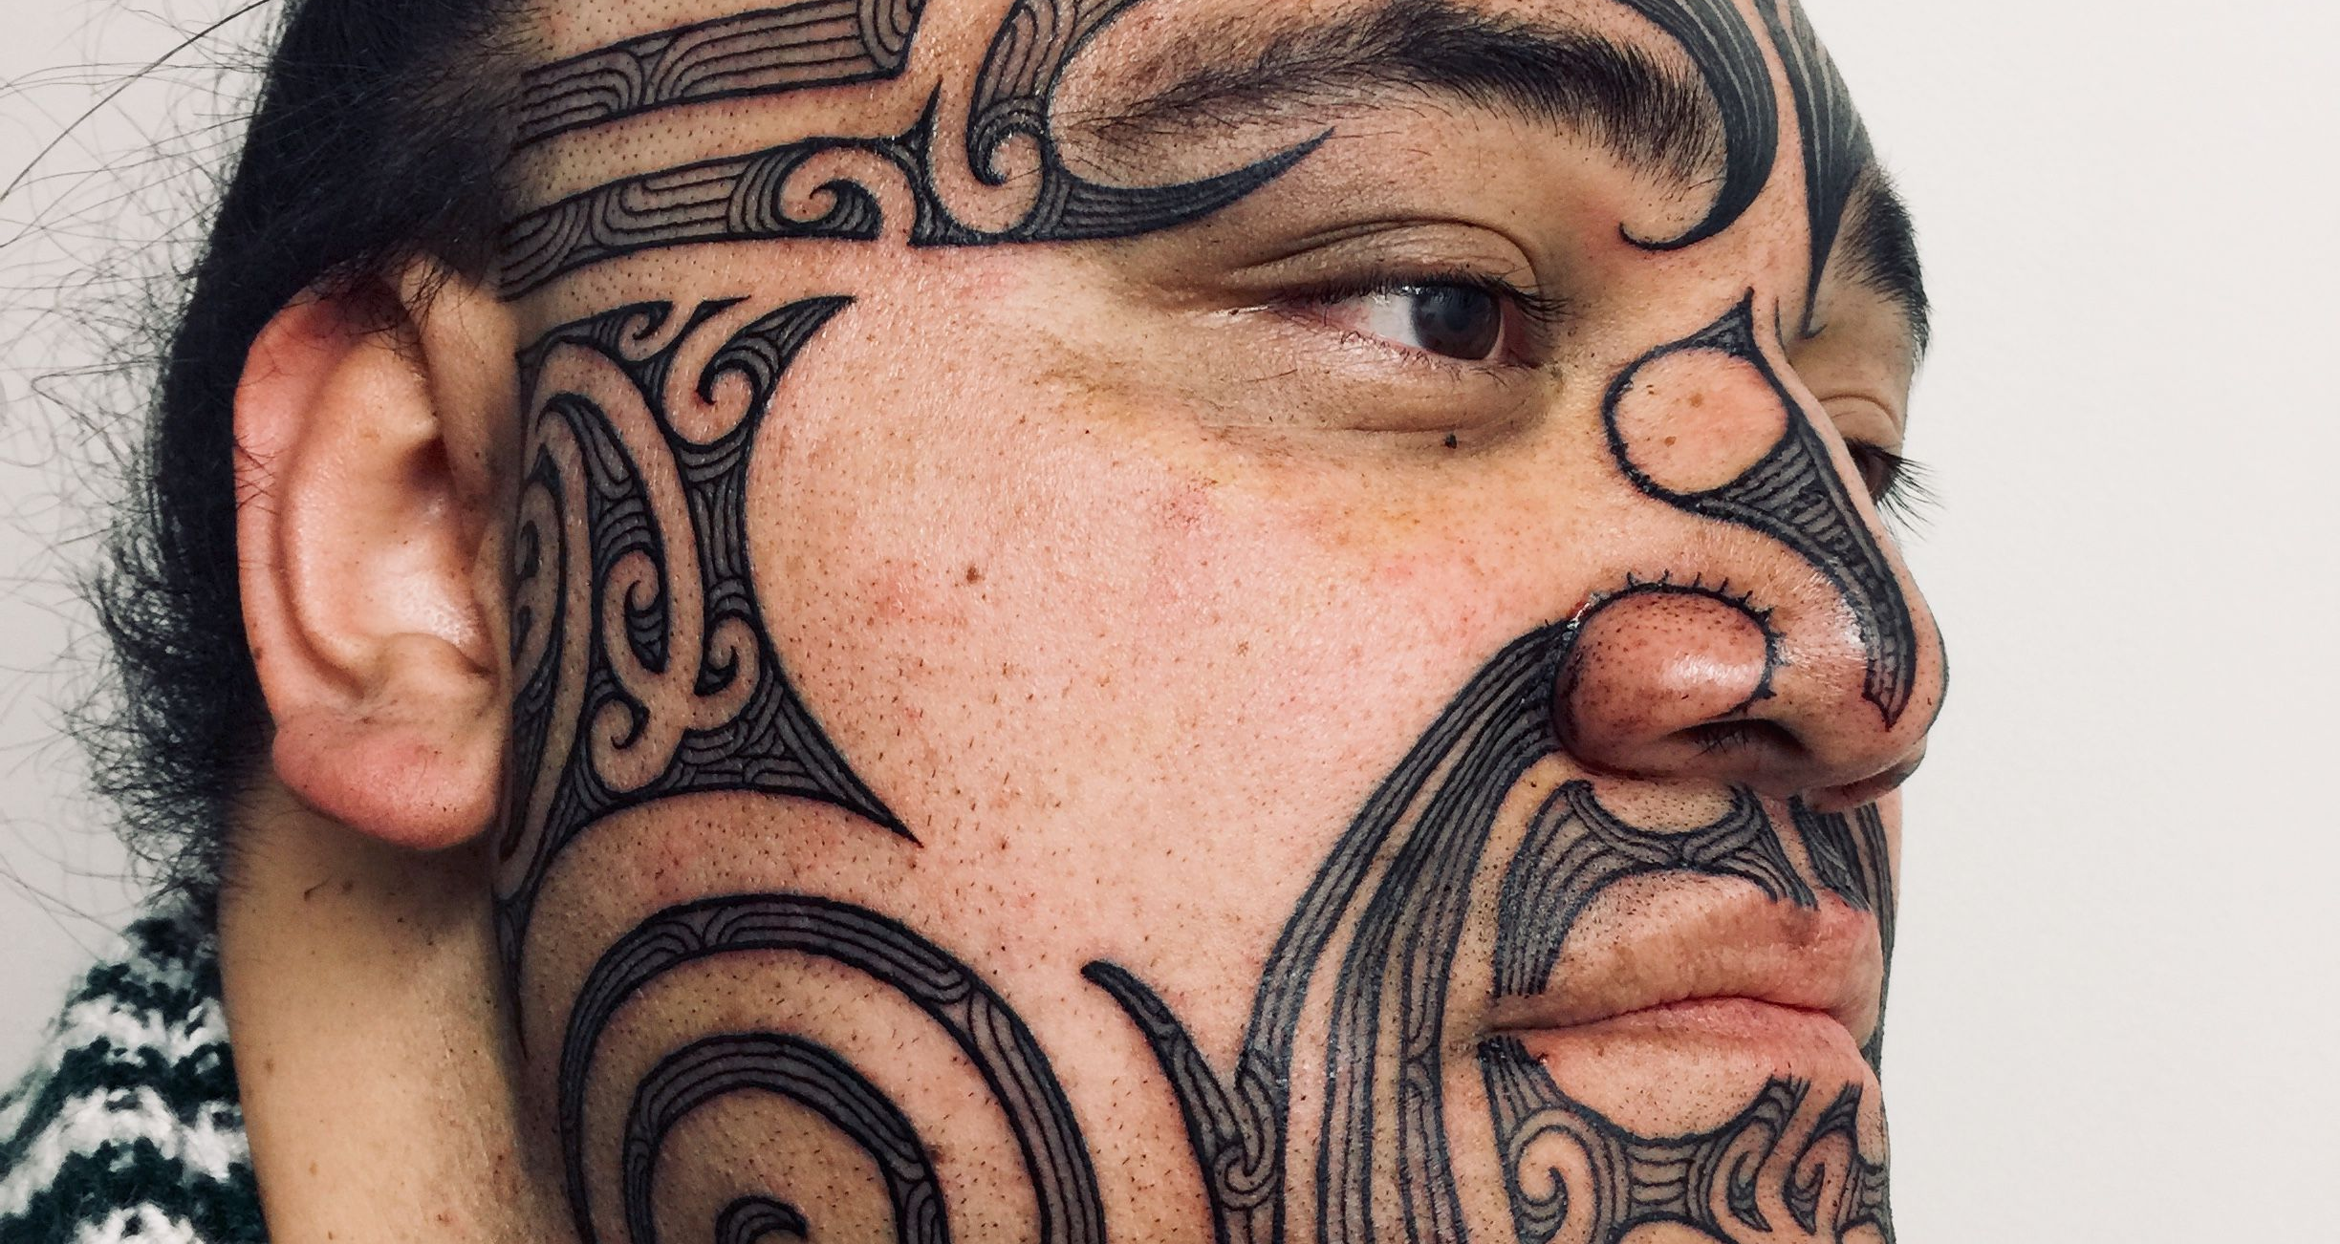

Slide 6
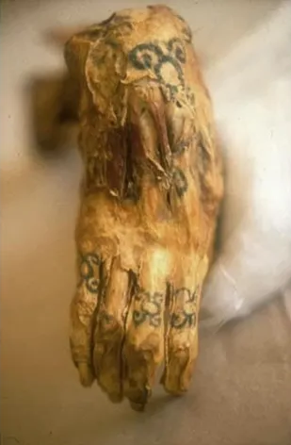
Ancient Egyptians
Most of tattoos had protective meaning – women who got tattooed often had them around their abdomen. These patterned dotts served to protect the fetus and future mother from death at childbirth and diseases.
Egyprians used tattoos like permament amulets.
Some women were also branded as so called ladies of the night by tchem.

Slide 7
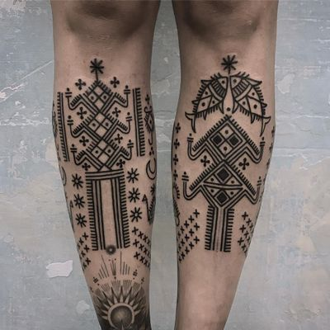
American Indian
Tattoos were considered a sacred and spiritual ritual across all Native American groups. People were often marked with symbols of protection and guardian spirit emblems. Some groups associated tattoos with healing powers, like the ability to cure a wound or mend a broken bone

Slide 8
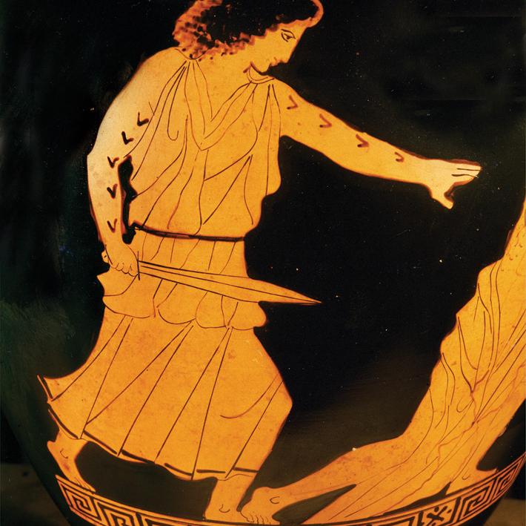
Greeks and Romans
Greeks and Romans often used tattoos as a way of showing one’s belonging to somewhere or someone. Churches had their brandings, sects and, unfortuantely, slave owners.
Tattoos were also used to mark criminals.

Slide 9
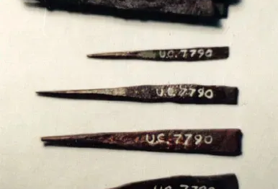
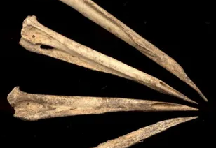
The Tools

Slide 10
Thank you for your attention.

Slide 11
Words
Preserved – zachowany
Spirituality – duchowość
Ancient – starożytny
Mend – naprawić
Associated – powiązany
Permament – stały

