Slide 1
Modern Animation
by Natalia Szlęk
Institute of Fine Arts, Rzeszów University, Visual Art
07.03.2022

Slide 2
Key Words
frames [klatki]- are a combination of the image to be displayed and the time the image is to be displayed. A sequence of frames makes an animation, which display frame by frame
stop motion animation [animacja poklatkowa]- this kind of animation relies on frame by frame sequences
inanimate objects [przedmioty nieożywione]- things that don’t live, like furnitures, toys, clothes
cgi [computer-generated imagery- obrazy generowane komputerowo] application of computer graphics to create or contribute to images in art, printed media, special effects, simulators and animation, 3D or 2D
layers [warstwy]- every art (drawing, painting, animation, movie) consist a sequence of layers. In every layer there is different part of the images. F.e in the animation, every detail on the face could be on different layers, like eyes, mouth, nose
post-production [ post-produkcja]- the period following filming in which a motion picture or animation show is readied for public presentation
render[render]- In digital art- turning 3D data into 2D images, Video Editing- process of merging media files into a single file
solid [bryła]- full objects by surface, empty inside
digital media [media cyfrowe]- any form of media that uses electronic devices for distribution

Slide 3
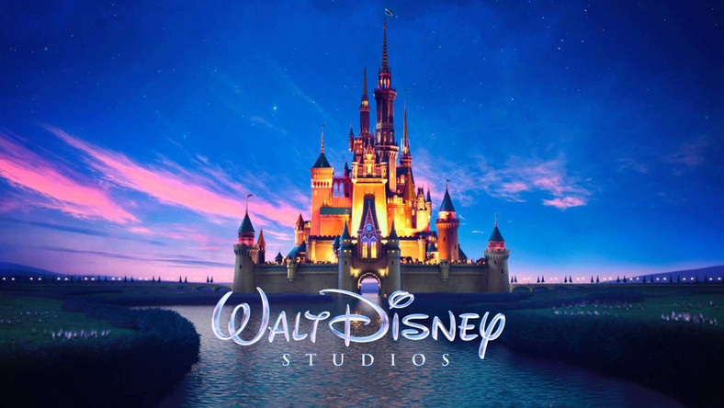
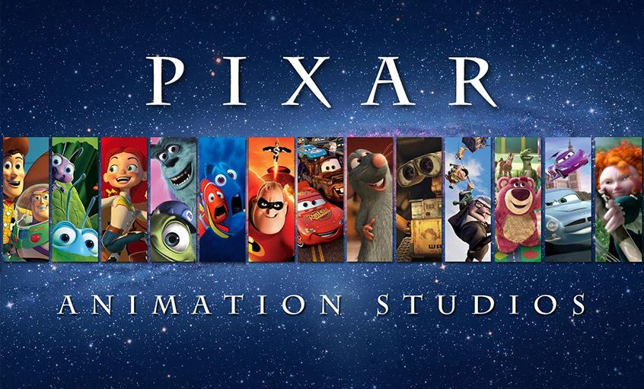
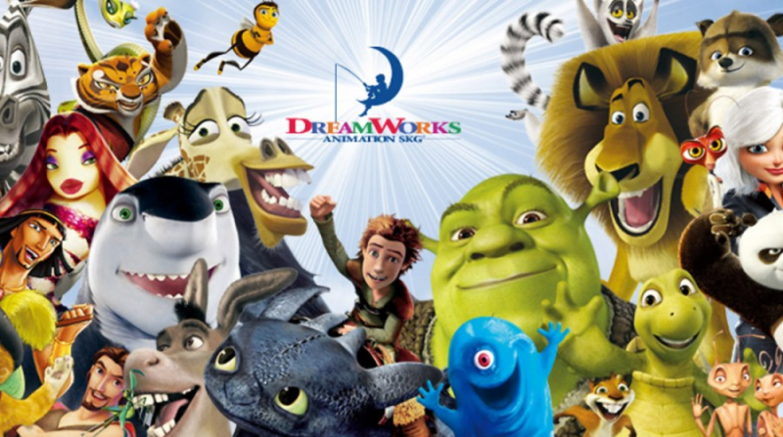
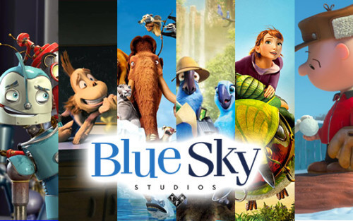
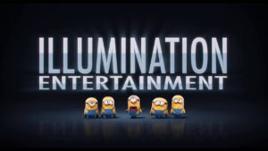
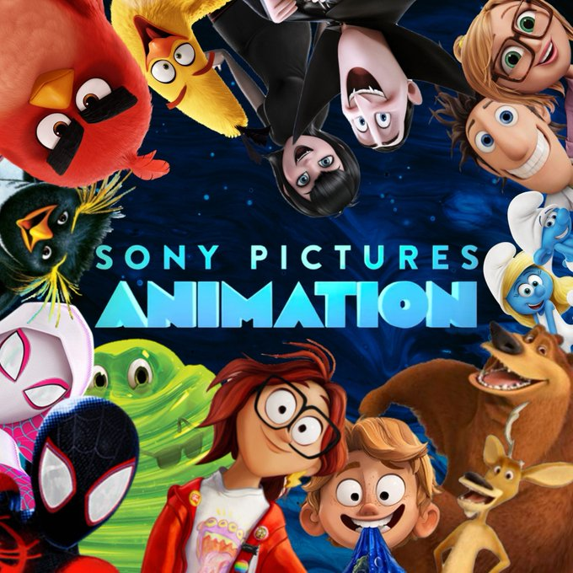
3D animation
https://www.youtube.com/watch?v=7EWLeynJ5_w&t=339s
https://www.youtube.com/watch?v=K-gPD00ksxQ&t=189s

Slide 4
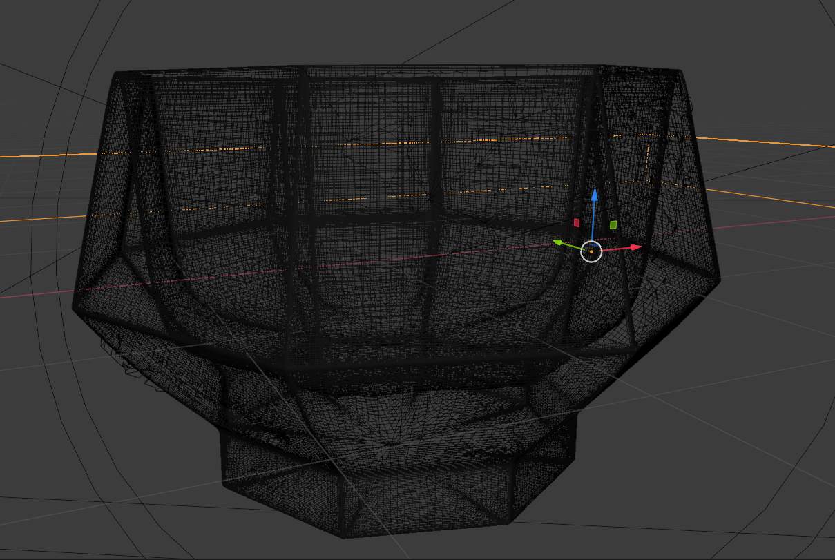
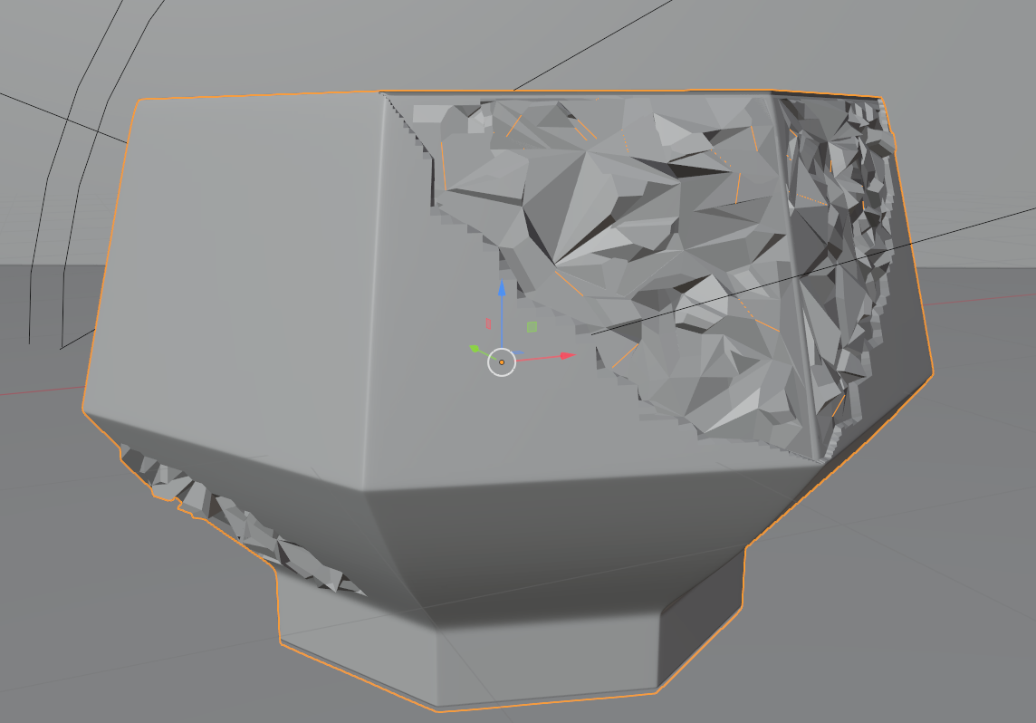
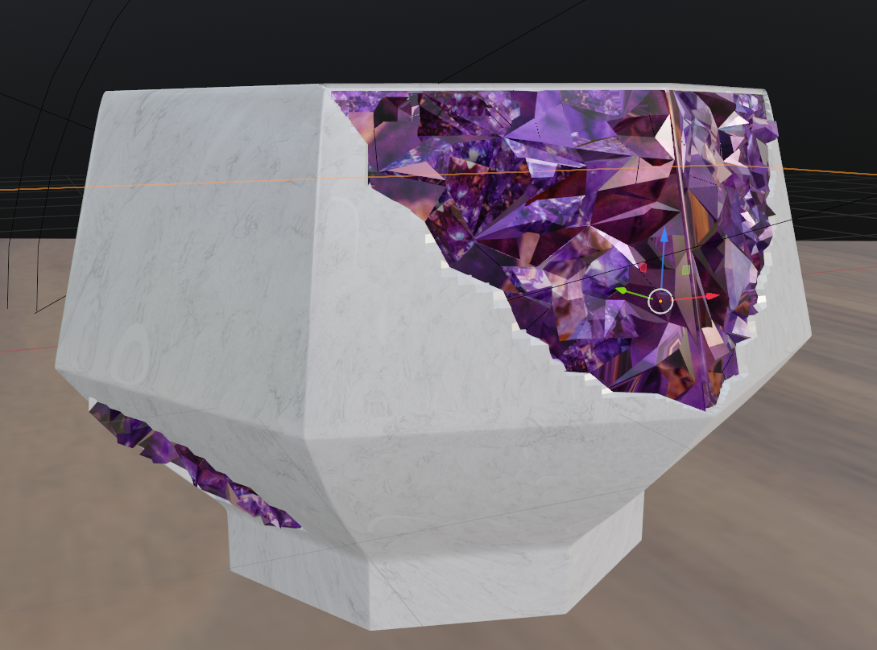
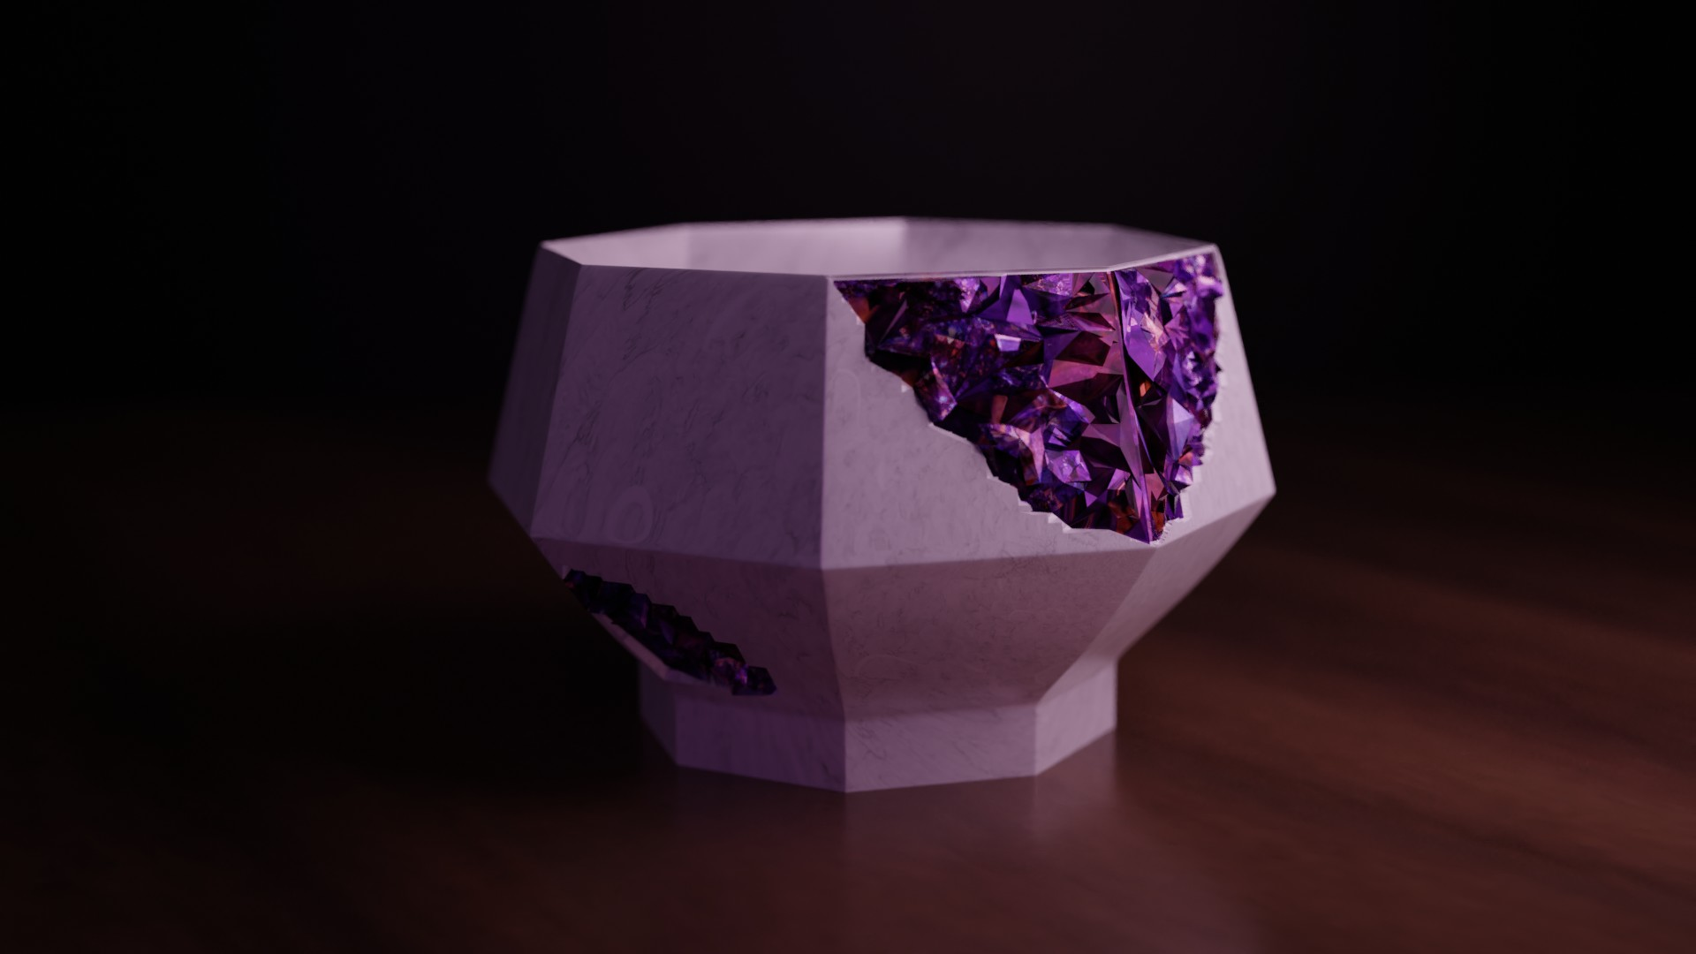
Stages of 3D design

Slide 5

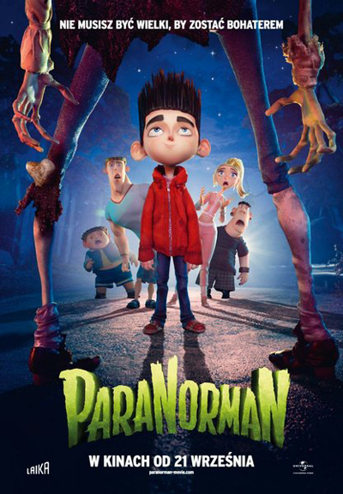
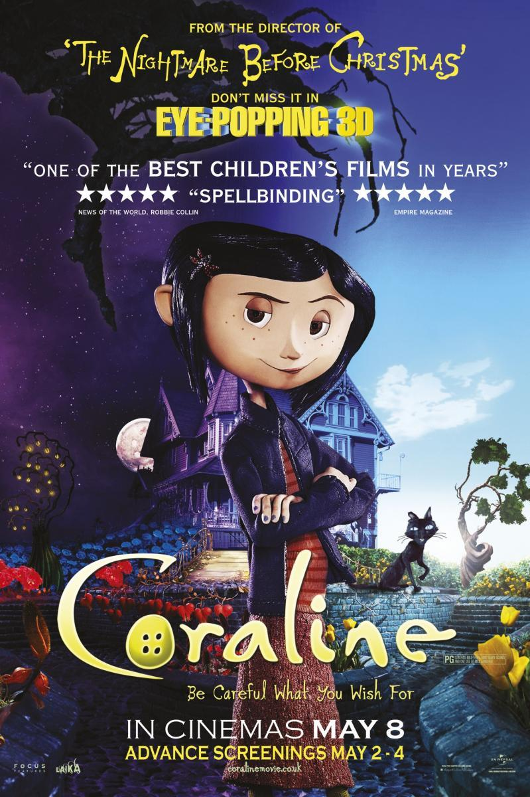
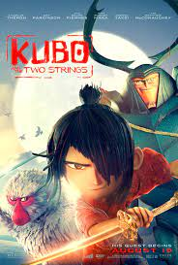
Laika Studios
https://www.youtube.com/watch?v=f1e_OdUzBeY&t=31s
https://www.youtube.com/watch?v=azdzJs-Y6DQ

Slide 6
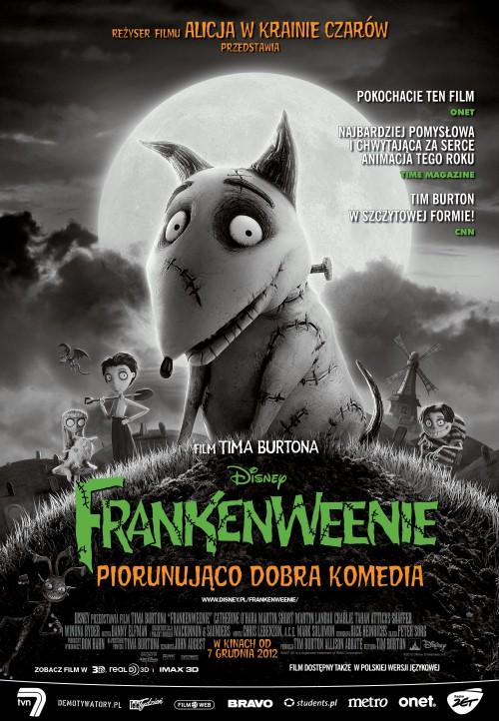
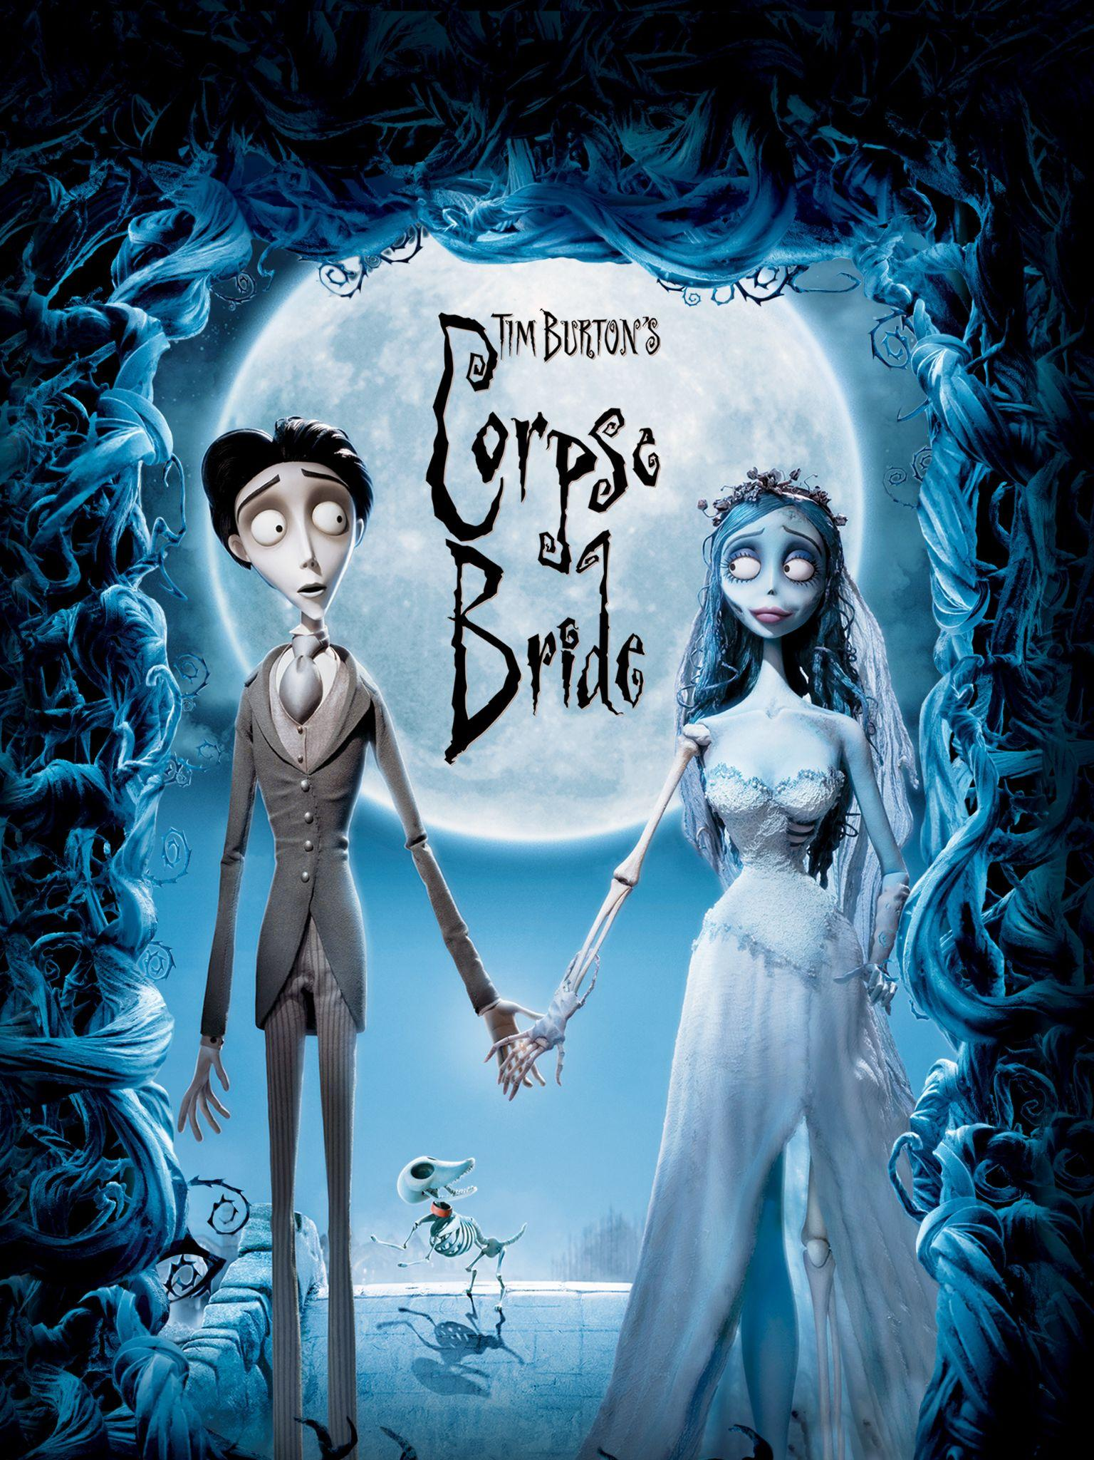
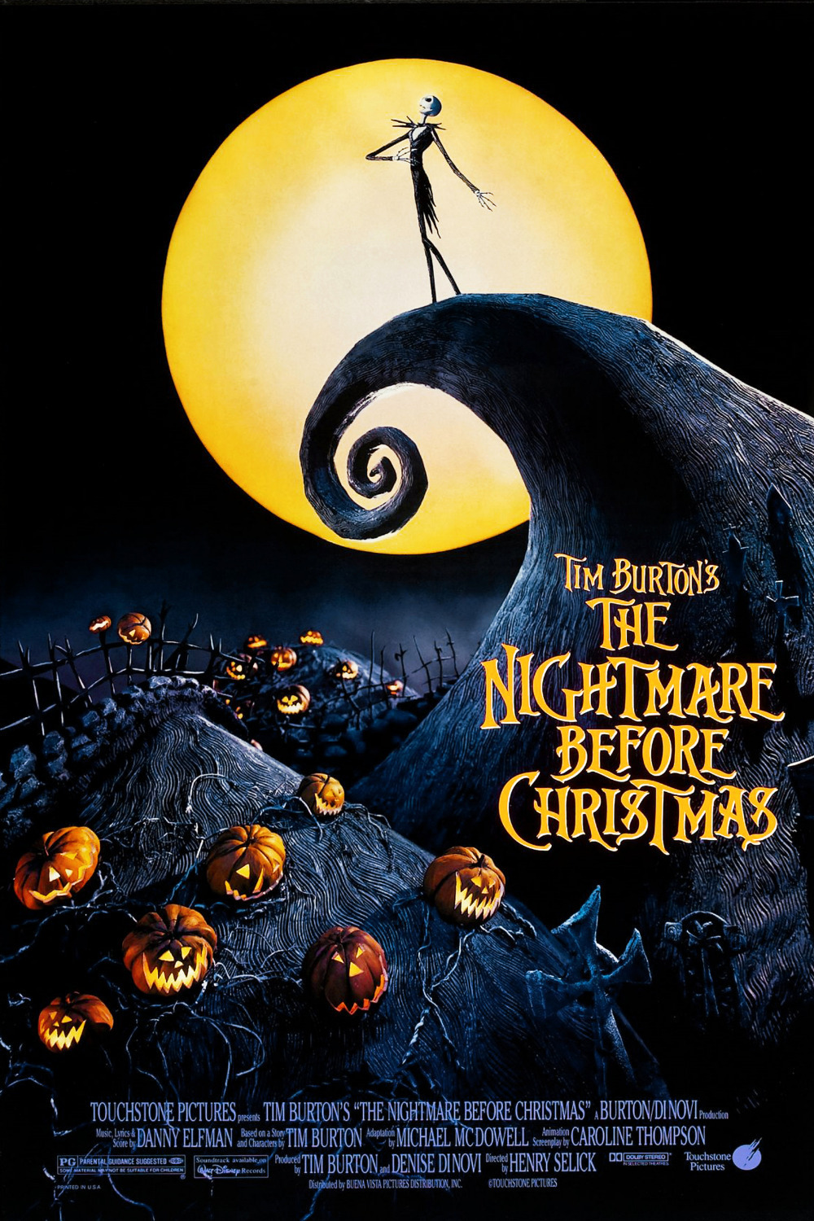
Tim Burton

Slide 7
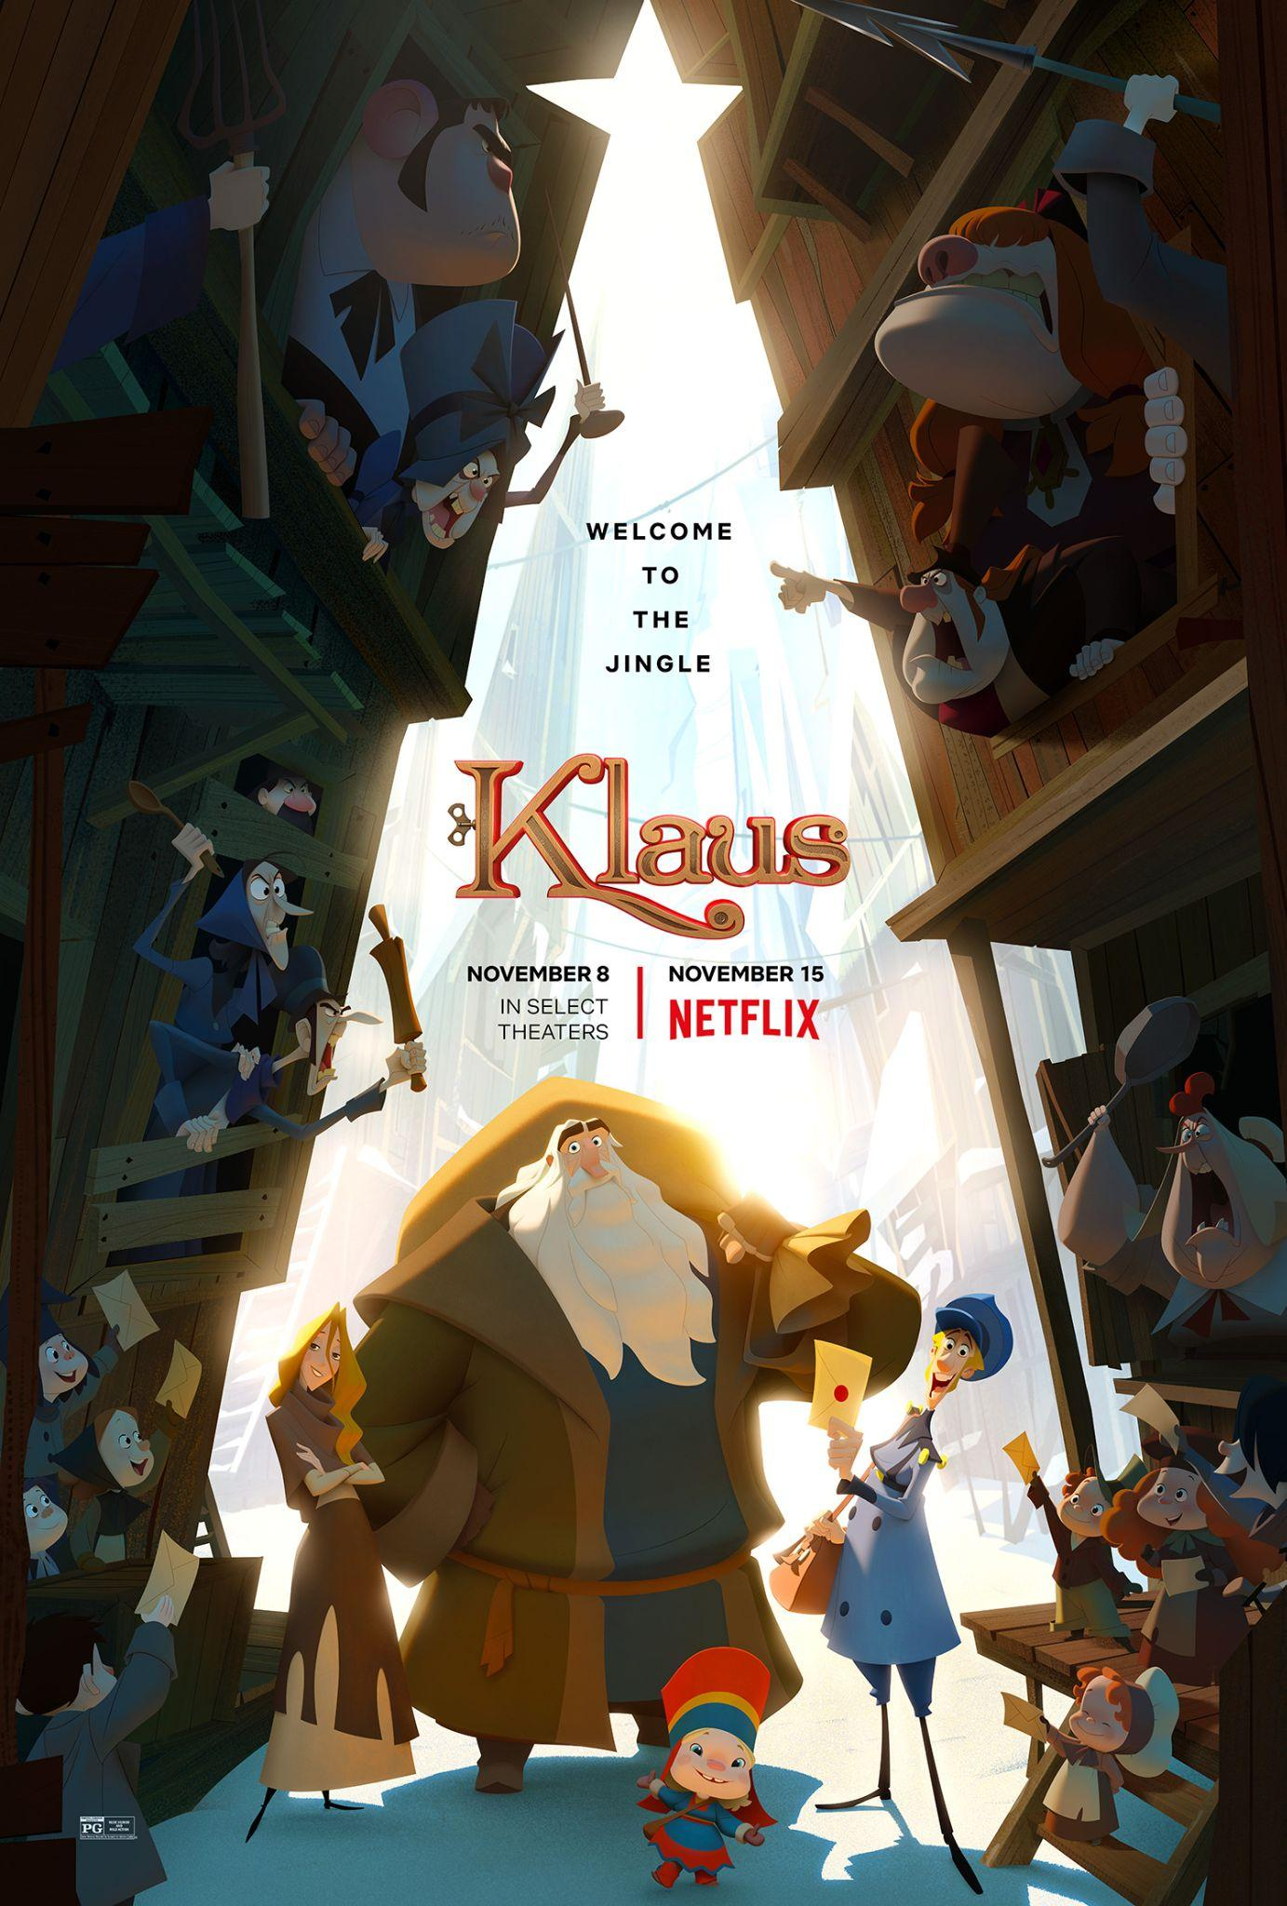
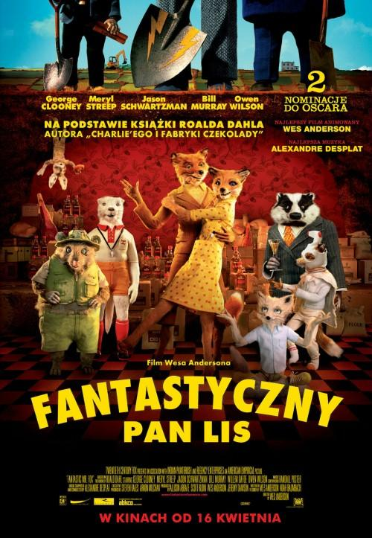
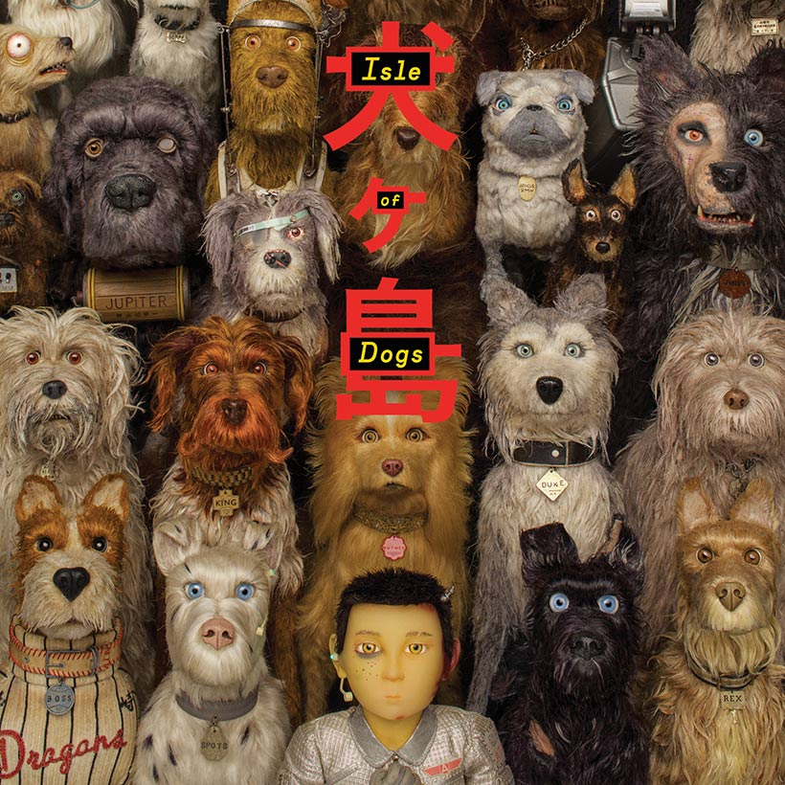
Wes Anderson
Klaus
Klaus
https://www.youtube.com/watch?v=BlU49dJhfcw&t=189s

Slide 8

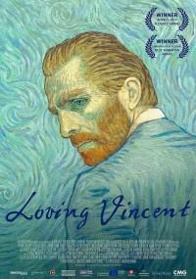

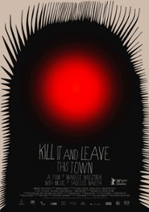
Art animation / mix media
https://www.youtube.com/watch?v=52Gg9CqhbP8

Slide 9
Bibliography
https://pogotowie-komputerowe.org.pl/z-jakiego-oprogramowania-animacyjnego-korzysta
https://www.filmweb.pl/film/Gnij%C4%85ca+panna+m%C5%82oda-2005-118497/trivia
https://www.wroclaw.pl/kultura/obrazy-z-filmu-twoj-vincent-na-wystawie-w-wiedniu
https://narrasoft.com/rendering-in-video-editing/
https://en.wikipedia.org/wiki/Computer-generated_imagery
https://www.cprogramming.com/tutorial/animation/frames_and_layers.html
Photos:
https://i1.wp.com/thedisinsider.com/wp-content/uploads/2021/02/image0-26.jpeg?fit=1280%2C720
https://scadanimation.blog/2021/02/12/disney-closes-up-bluesky-studio/
https://www.filmy-animowane.pl/artykuly/illumination/
https://kultura.onet.pl/film/wiadomosci/disney-nowa-animacja-studia-akcja-ma-rozgrywac-sie-w-polsce/7m3174n
https://naekranie.pl/aktualnosci/comcast-kupil-dreamworks-animation-852272
https://www.publicitarioscriativos.com/pixar-oferece-curso-gratuito-de-animacao/
https://twitter.com/mjhtv23/status/1276918256524070913?lang=zh-Hant
https://www.filmweb.pl/film/ParaNorman-2012-599050
https://www.filmaffinity.com/us/movieimage.php?imageId=693377106
https://www.imdb.com/title/tt4302938/

Slide 10
Bibliography
https://www.imdb.com/title/tt0432283/
https://www.udiscovermusic.com/news/wes-anderson-isle-dogs-soundtrack/
https://www.primevideo.com/gp/video/detail/Tim-Burton-s-Corpse-Bride/0TZVI6N1BU03TZ2U392YDZ9HV6/ref=atv_nb_lcl_ko_KR?persistLanguage=1&language=pl_PL&token=gyiMnIY2JB0u7lxBNfX6cYMKgbf7i6wpLo0Xxt9cbSvbAAAADAAAAABegYwucmF3AAAAABVX8CwXqz4nuL9RKX%2F%2F%2Fw%3D%3D&ie=https://typography.guru/forums/topic/1434-9-movie-poster-font/UTF8
https://www.imdb.com/title/tt0107688/
https://www.filmweb.pl/film/Frankenweenie-2012-465816
https://netflix.fandom.com/wiki/Klaus
https://www.filmweb.pl/film/Zabij+to+i+wyjed%C5%BA+z+tego+miasta-2019-658043/posters
https://www.filmweb.pl/film/P%C5%82%C3%B3tno-2020-865994/posters
https://www.filmweb.pl/serial/Mi%C5%82o%C5%9B%C4%87%2C+%C5%9Bmier%C4%87+i+roboty-2019-824633/posters
https://www.filmweb.pl/film/Tw%C3%B3j+Vincent-2017-698207/posters

