Slide 1
SLAVE STATUS IN ROMAN LAW
Marcin Guzy
Kierunek: Prawo
Wydział Prawa i Administracji
III ROK

Slide 2
Roman Law
Personal Right in Rem
Law
Family Law Inheritance Law

Slide 3
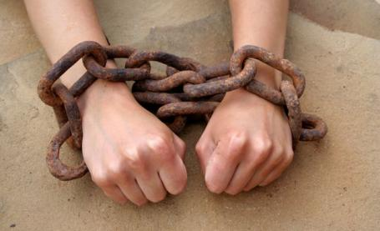
Inception of Slavery
“Slavery is a human invention and not found in nature. Indeed, it was that other human invention, war, which provided the bulk of slaves, but they were also the bounty of piracy ... or the product of breeding” -Gaius

Slide 4
Statuses of Roman Citizen
Status libertatis - status of freedom, slavery or liberation
Status civitatis - citizenship status
Status familiae - status qualifying position in roman family

Slide 5
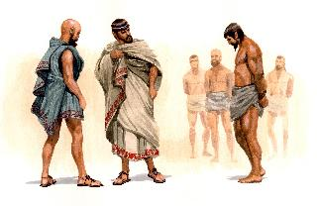
Limitations in slaves life
They couldn’t:
-conclude marriages
-have own estates
-be party in litigation
-aquire anything for themselves

Slide 6

How could you become slave in ancient Rome?
Captured Born from Turned foreigner Sold abroad Death Penalty
during war slave-mother into slave for debts exchanged
for slavery

Slide 7
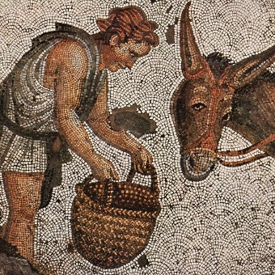
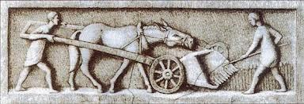
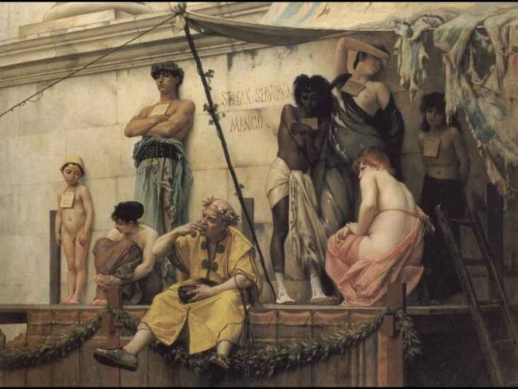
Slaves everyday struggle
Commonly slaves were used to do physical work. Usually, treated inhumanly, working in tragic conditions they were dying and nobody cared about it. Any action that slave did, was considered like it was his or her master action.
Tending animals
Working on farm
Helping masters in buisness trade

Slide 8
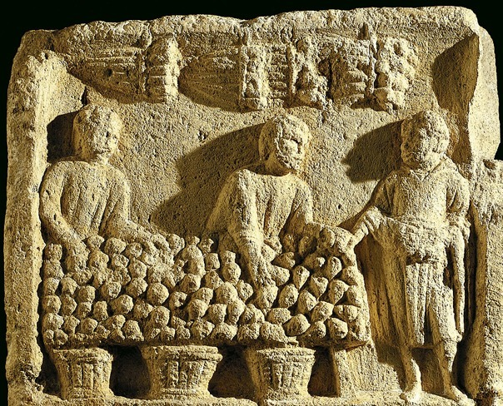
Slave function in commercial exchange
Pecculium- part of master’s estate which was given to slave for his own management.

Slide 9
How could you end your slavery in ancient Rome?
Freed by master’s Inscribed Freed Notation
words in censorial list in Roman church in master’s will

Slide 10
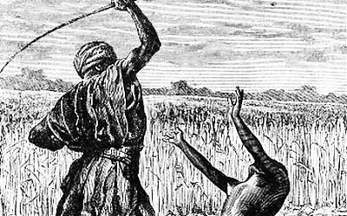
Regulations agaist master’s abuses
Lex Petronia- act, which banned sending slaves to fight with wild animals in circus
Emperor Antonius Pius rescript- law dictating that if master’s treated slave with extraordinary cruelty he should sell him
Activity of Emperors Claudius and Hadrian- their operations carried to total prohibition of killing own slaves

Slide 11

Many years of improving issue of human rights wiped out slavery from law of any country. Nowadays taking somebody’s freedom is considered as crime. Today there are punishements for those take one’s freedom, not those who are deprived of it. We must hope that the times when people were treated as things have past and will never come back

Slide 12
Glossary
Plea -skarga
Personal law - prawo osobowe
Perceive - postrzegac
Nothing further from the truth- nic bardziej mylnego
Being - byt, istnienie
Deprive -pozbawiać
Burden - obciązyc
Severe -ciężki
Bulk - duży rozmiar
Invention - wynalazek
Breeding - rozmnażanie
Twelve Tables- 12 tablic
Long standing- długo trwać, o długiej tradycji
Legal capacity- zdolność prawna
Appearance- zjawisko
Draft Animals- zwierze pociągowe
Affair- sprawa
Accordingly – konsekwentnie
Enumerate- wyliczyc
Form- utworzyć
Battle- bitwa
Foreigner- cudzoziemiec
Quirit law- prawo kwirytow
Desertion- dezercja
Creditor- wierzyciel
Debtor- dłużnik
In flagrante- na gorącym uczynku
Death penalty- kara śmierci
In the course of time- z biegiem czasu
Inhumanly- nieludzko
Acquire- nabywać
Devoid- pozbawiać
Business trade- obrót handlowy
Mental skills- zdolności umysłowe
Enterprise- przedsiębiorstwo
Management- zarządzanie
Stall-zgasnąć
Appropriate- zawłaszczyć
Censorial list- spis cenzorski
Congregation- wierni
Abuse- nadużycie
Act-ustawa
Right in Rem- prawo rzeczowe
Commercial Exchange- wymiana handlowa

Slide 13
Bibliography
-„Rzymskie Prawo Prywatne” Marek Kuryłowicz, Adam Wiliński, Warszawa 2008
-www.imperiumromanum.pl
-www.wikipedia.pl

Slide 14
Thank you for your attention !

