Slide 1
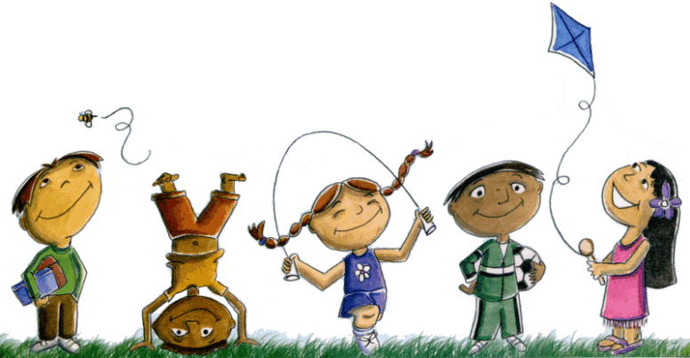
Rights of the Child
PATRYCJA ŻOŃCA Prawo III rok 2015/2016

Slide 2
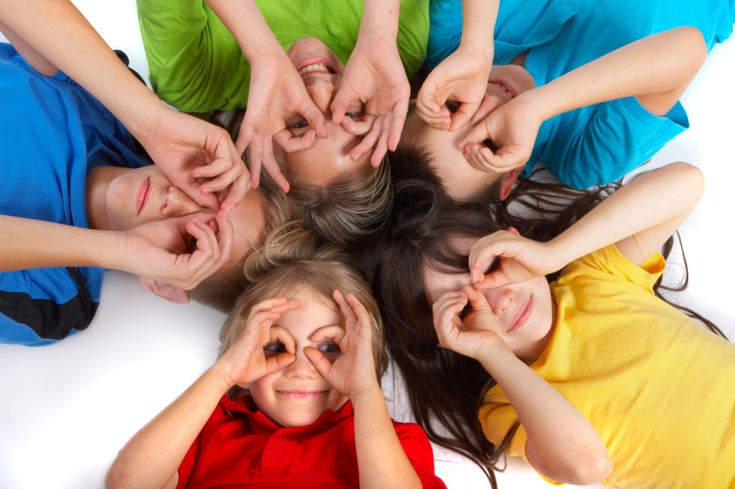
Definition of the Child

Slide 3
,, a child”
,, the one who does not speak ‘’
,, a child is any human being below the age of eighteen years, unless under the law applicable to the child, majority is attained earlier’’

Slide 4
History
Declaration of Geneva
Declaration of Children Rights
International Convention on the Rights of the Child

Slide 5

The UN Convention consists of 54 articles, each of which details a different type of right.
A common approach is to group these articles together under the following themes:
Survival rights
Development rights
Protection rights
Participation rights

Slide 6
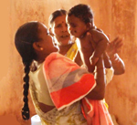
Right to Life
The right to life means that each child must be able to live his or her own life. Children have the right not to be killed. They have the right to survive and to grow up in proper conditions.

Slide 7
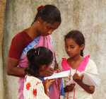
Right to Education
The right to education allows each child to receive instruction, to enjoy a social life, and to build his or her own future. This right is essential for economic, social and cultural development.

Slide 8
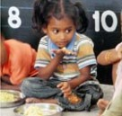
Right to Food
The right to food is the right of each child to eat. It is the right to not die of hunger and to not suffer from malnutrition. Every five seconds, a child dies of hunger somewhere in the world.

Slide 9
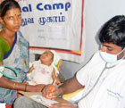
Right to Health
The right to health means that children must be protected against illness. They must be allowed to grow and become healthy adults. This contributes to developing an active society.

Slide 10
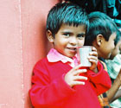
Right to Water
The right to water means children have the right to safe
drinking water and proper sanitary conditions. The right to water is essential for good health, survival and proper growth.

Slide 11
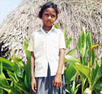
Right to Identity
Each child has the right to have a surname, a first name, a nationality, and to know who his or her relatives are. The right to identity also means that each child’s existence and rights must be officially recognised.

Slide 12
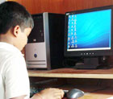
Right to Freedom
The right to liberty is the child’s right to express him or herself, to have opinions, to have access to information, and to participate in decisions which affect his or her life. Children also have the right to religious freedom.

Slide 13
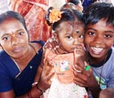
Right to Protection
The right to protection is the right to live in a secure and protective environment which preserves the child’s well-being. Each child has the right to be protected from all forms of mistreatment, discrimination, and exploitation.

Slide 14


Slide 15
KNOWLEDGE- wiedza
FREEDOM- wolność
DISCRIMINATION- dyskryminacja
CITIZENSHIP- obywatelstwo
LIBERTY- wolność
HUNGER- głód
DEATH PENALTY- kara śmierci
CONDITIONS- warunki
ENSURE- zapewnić
RIGHTS- prawa
CIRCUMSTANCES- okoliczności
PROTECTION- ochrona
RESPONSIBILITY- odpowiedzialność
CONVENTION- konwencja
OVERSIGHT- przeoczenie
PARENTAL- rodzicielski
ENCOMPASS- objąć
SECURITY- bezpieczeństwo
MISTREATMENT- znęcanie
FRAGILE- kruchy

Slide 16
Sources:
http://www.childrensrights.ie/childrens-rights-ireland/un-convention-rights-child
http://www.humanium.org/en/
http://www.unicef.org/
https://www.unicef.pl/Co-robimy/Prawa-dziecka/Geneza-praw-dziecka
https://pl.wikipedia.org/wiki/Konwencja_o_prawach_dziecka

