Slide 1
10 most interesting prisons in the world
Bartosz Krzeszowski Prawo III stacjonarne Wydział Prawa i Administracji Uniwersytet Rzeszowski Rok akademicki 2014/15

Slide 2
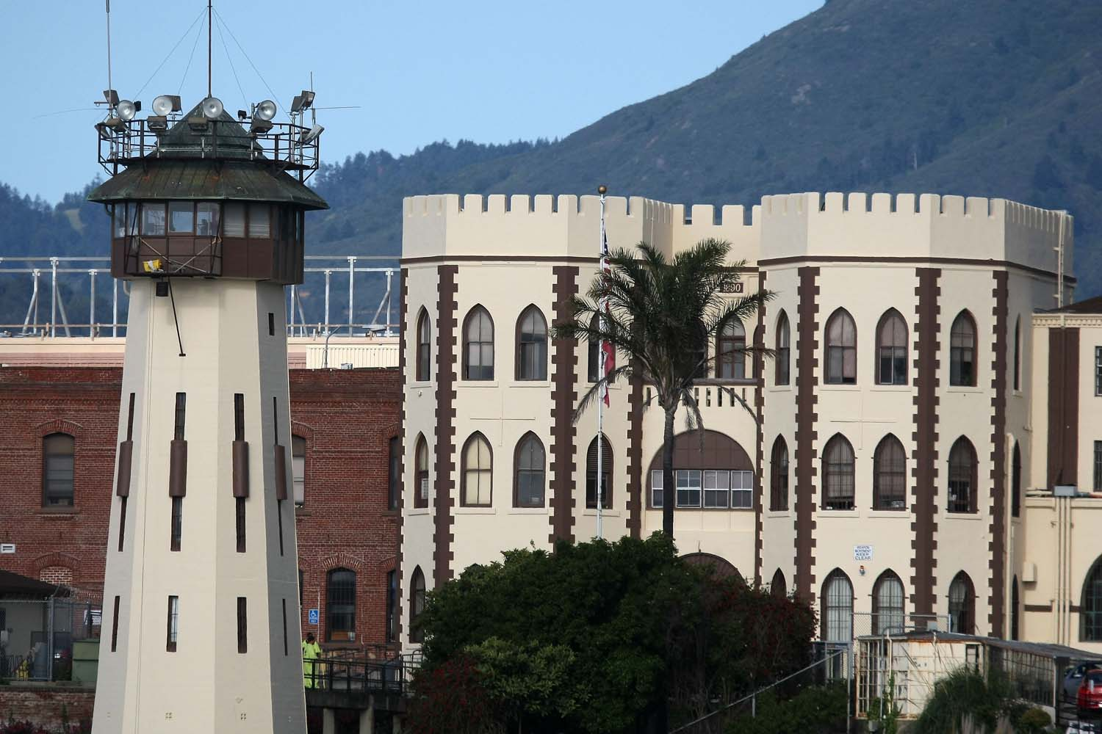
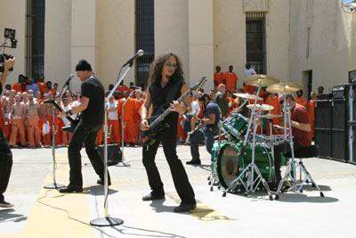
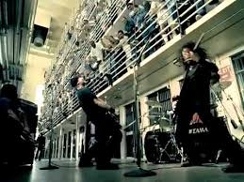
1. San Quentin state prison Metal music in jail
2003 – Metallica made a music video for song ‘’St Anger” at San Quentin and performed a free concert for prisoners.

Slide 3
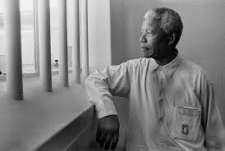
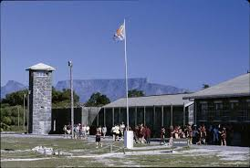
2. Robben Island Former Apartheid machine
Nobel laurate and former president of South Africa Nelson Mandela was imprisoned on ‘’seal island’’ for 18 years of 27 he served before the fell of Apartheid.

Slide 4
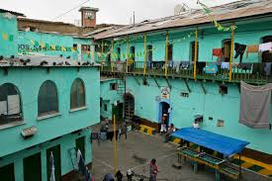
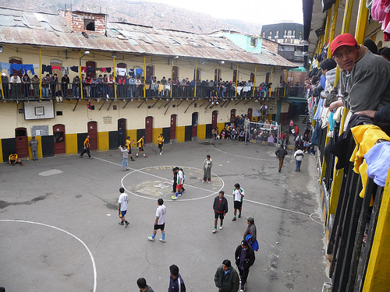
3. San Pedro prison Jail or poor district of La Paz?
Once you pass security gates, any resemblance to a normal jails disappears. There are children playing, market stalls, restaurants, hairdressers and even a hotel. Inside San Pedro the inmates have developed their own laws and rules. Although tourism to San Pedro is illegal if you give the guards little bribe, about 60$, you can visit this special place but you have to follow the rules like no taking pictures and leaving before 6 p.m.

Slide 5
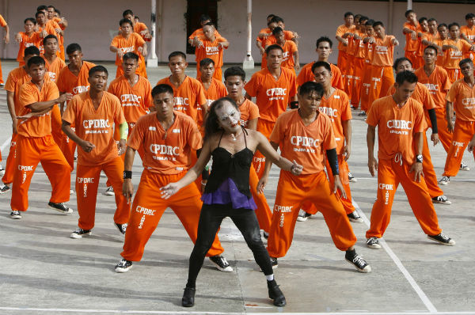
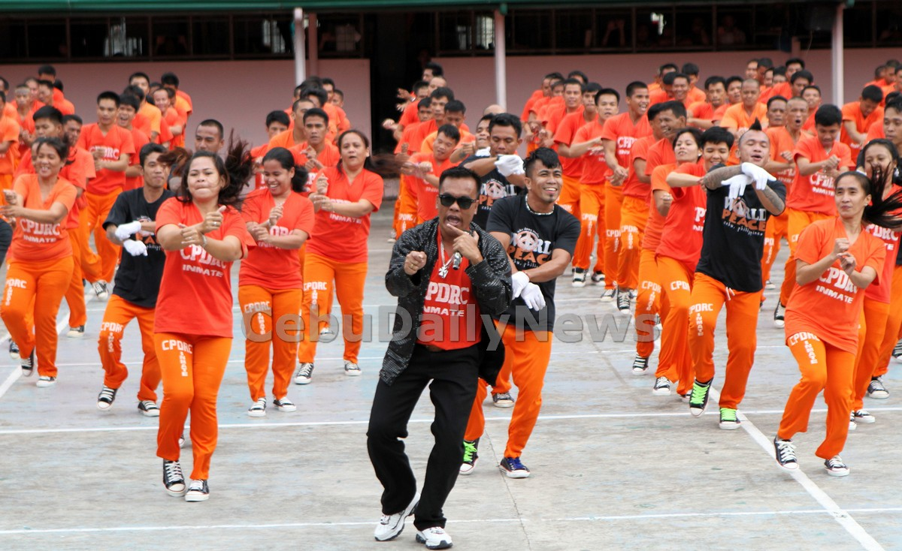
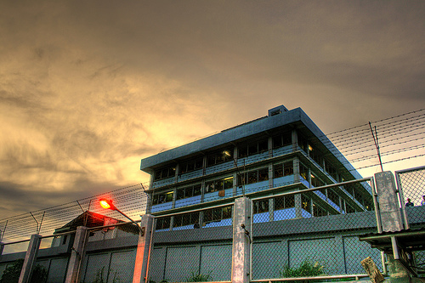
4. Cebu prison Dancing criminals!
‘’Thriller’’
‘’Gangnam Style’’

Slide 6
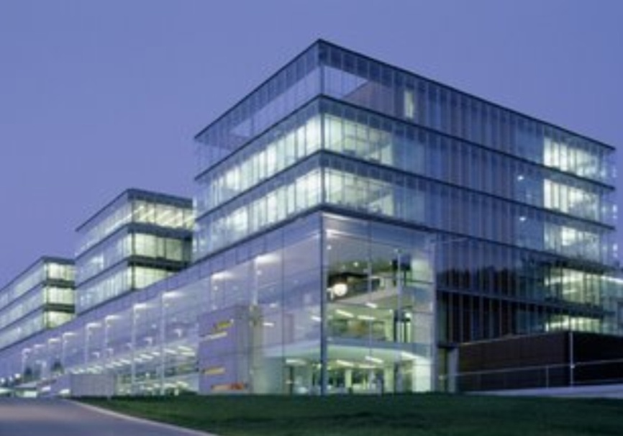
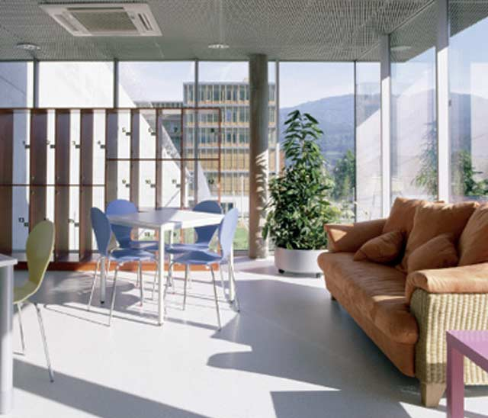
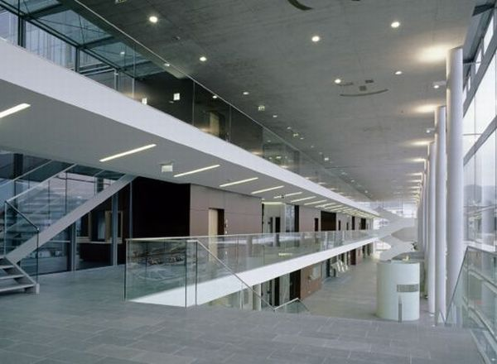
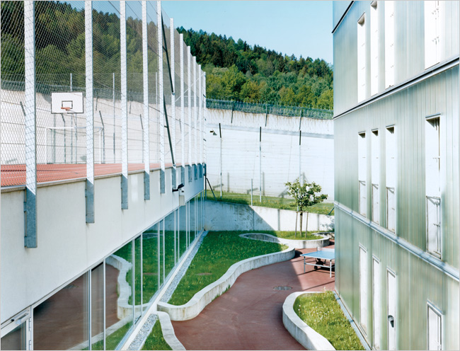
5. Justizzentrum Leoben 5-star prison

Slide 7
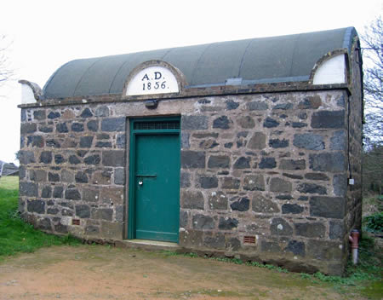
6. Sark Prison in Guernsey Smallest prison in the world
Built in 1856. Functioning to this day but rarely used. It can house 2 prisoners.

Slide 8
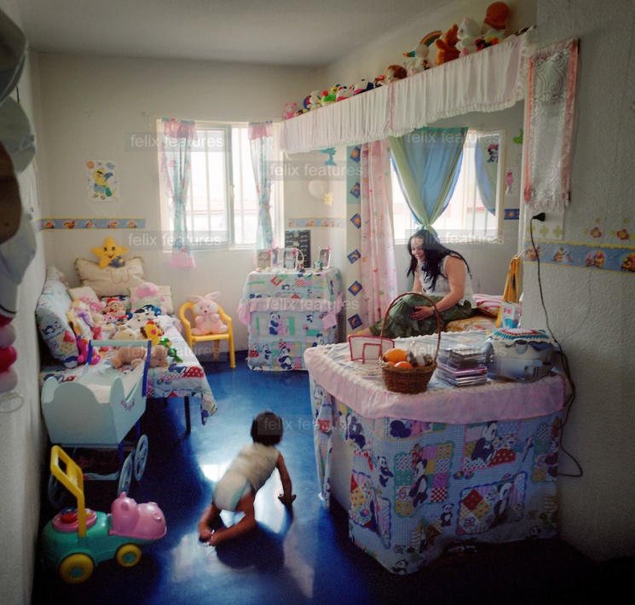

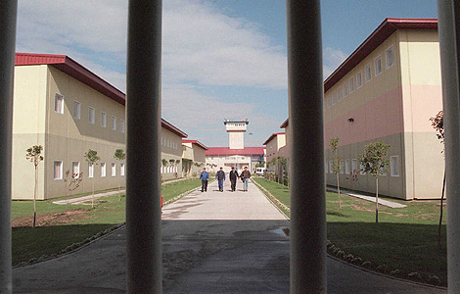
7.Aranjuez prison Cells for families
Children imprisoned with their parents until they are 3 years old. Beating the pain of separation.

Slide 9
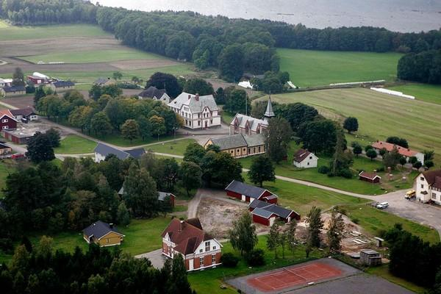
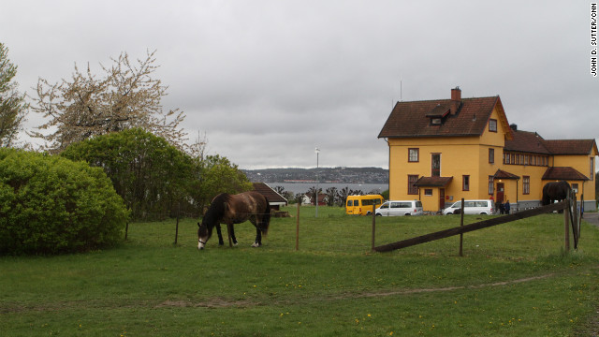
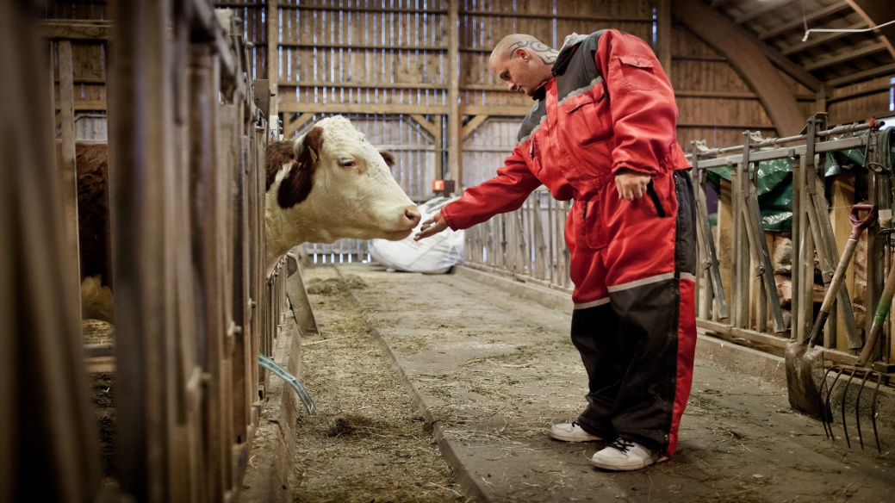
8. Bastoey Island low security prison Norway ecological prison
Bastoey Island low security prison uses solar panels for energy, produces most of its own food, recycles everything it can and tries to reduce its carbon footprint.

Slide 10
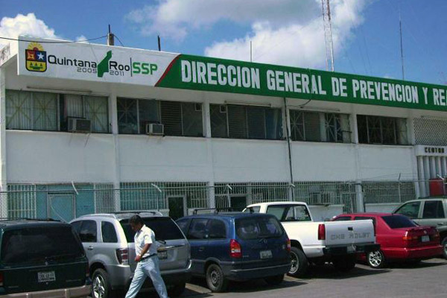
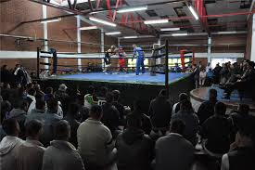
9. Cereso chetumal You talkin’ to me?! Let’s go to the boxing ring
Cereso chetumal has not seen violence in many years. When there is a disagreement, inmates put the gloves and get into boxing ring to solve the problem. After two-three rounds, dispute is over.

Slide 11
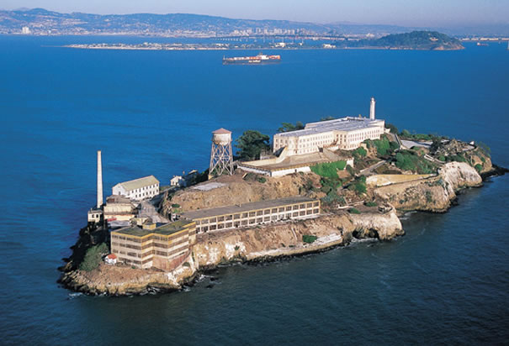
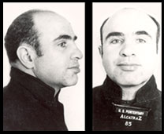
10. Alcatraz Most famous prison?
Federal prison from 1934 to 1963. The prison operators believed Alcatraz to be escape-proof and America’s strongest prison. A total of 36 prisoners made 14 escape attempts during 29 years of the prison’s existence. The penitentiary claimed that no prisoner successfully escaped.
Al Capone

Slide 12
Key vocabulary
facility – budynek
inmate – więzień
to confine – zamknąć
penitentiary – zakład karny
department of corrections – departament ds. systemu penitencjarnego
rehabilitation – resocjalizacja
death row – część więzienia z celami śmierci
gas chamber – komora gazowa
lethal injection – zastrzyk trucizny
to feature – przedstawić
World Heritage Site – lista światowego dziedzictwa UNESCO
resemblance – podobieństwo
market stall – stoisko handlowe
to come at price – mieć swoją cenę
to supervise – nadzorować
to render – czynić
to provide – przewidywać
to deprive – pozbawić
inherent – nieodłączny
odd - dziwaczny

Slide 13
aggravated assault – napad kwalifikowany (z intencją w celu zadania poważnych obrażeń)
delinquent – przestępca
dependency – teren zależny
Bailiwick – baliwat
detention – areszt
toddler – maluch
to bond – wiązać się
to grasp – zrozumieć
carbon footprint – ślad węglowy (suma emisji gazów cieplarnianych)
porridge – owsianka
grant – dotacja
arts and crafts – rękodzieło artystyczne
wooden shop work – dzieła z obróbki drewna
bead work – korale, paciorki
crochet – szydełkowanie
leave – przepustka
escape-proof – zabezpieczone przed ucieczką
maintenance – utrzymanie
to cite – cytować, uznawać
to dismiss – odprawiać

Slide 14
Bibliography
http://en.wikipedia.org/wiki/San_Quentin_State_Prison
http://whc.unesco.org/en/list/916
http://news.bbc.co.uk/2/shared/spl/hi/picture_gallery/06/americas_inside_a_bolivian_jail/html/1.stm
http://en.wikipedia.org/wiki/CPDRC_Dancing_Inmates
http://www.atlasobscura.com/places/justizzentrum-leoben
http://smalleststuff.com/smallest-prison-in-the-world/
http://www.taipeitimes.com/News/editorials/archives/2007/02/11/2003348580
http://www.enn.com/green_building/article/22379
https://suite.io/john-lamkin/1q9f2fm#ixzz0RnFN30Oc
http://en.wikipedia.org/wiki/Alcatraz_Island
All images taken from google.com

