Slide 1
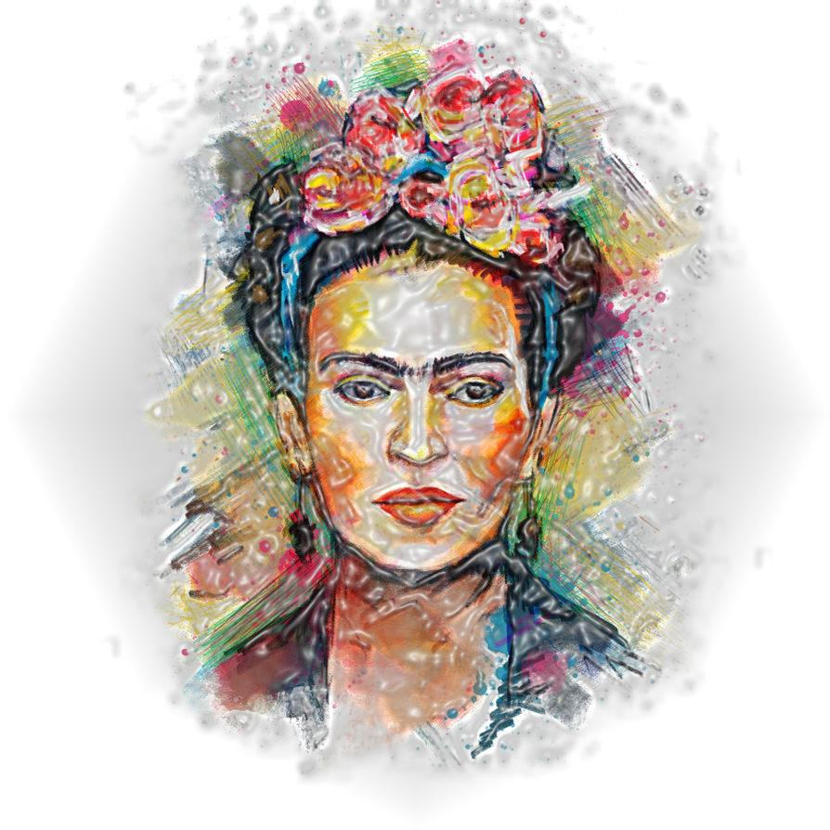
Frida Kahlo
/A ribbon
around
a bomb/
Paulina Podolska

Slide 2
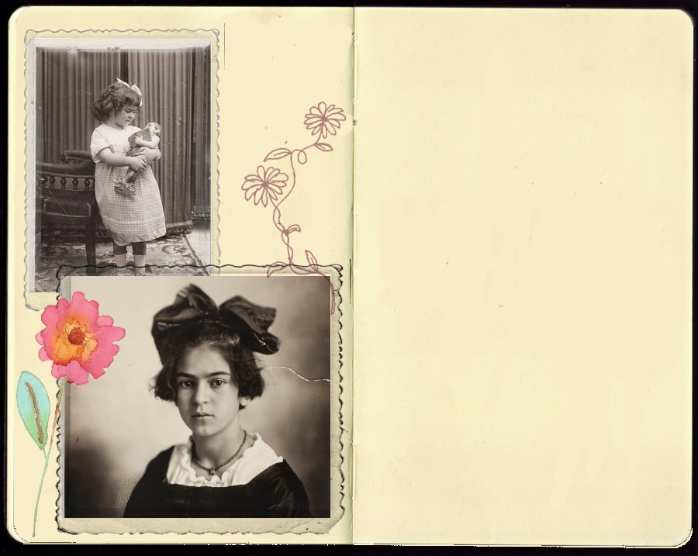
Early years
    The daughter of the Mexican
    Revolution? Frida’s true (1907) and
    „official” (1910) date of birth.
    The girl in a man’s world –
    education in the Preparatoria
    and dreams of being a doctor.
    Friendship with The Cachuchas
    and the first love to Alejandro Arias.

Slide 3
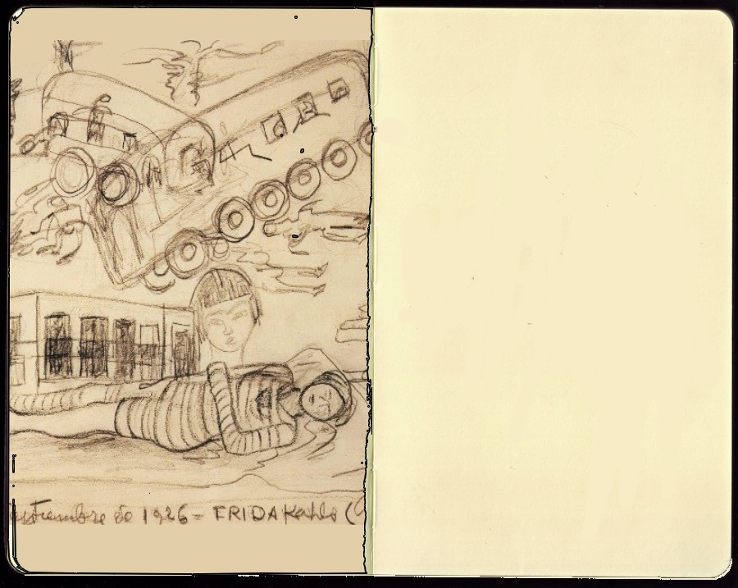
The accident
17th September 1925 – collision of the trolley car and the bus, which Frida was a passenger.
Results: serious injury, broken spinal column, collarbone, ribs, dislocated foot and shoulder.
Three months in a full body cast.
Painting as a reaction to the new situation.

Slide 4
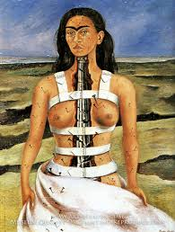

Slide 5
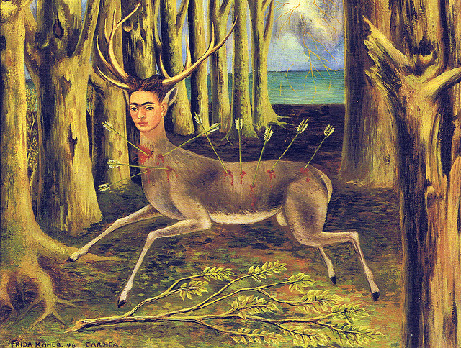

Slide 6
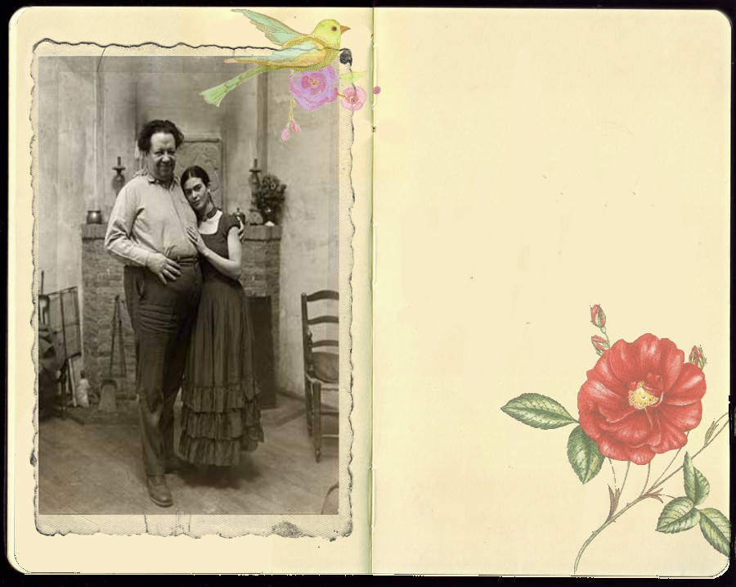
„The second accident”
– marriage with Diego
Their first meeting in Preparatoria
during Diego’s work on the mural
at the lecture hall.
Diego’s artistic supervision over
her painting and their political activity
in the Communist Party of Mexico
Diego’s divorce with his second
wife – Lupe Marin and marriage with
20 years younger Frida.
Three Frida’s pregnancies ended in
medically necessary
abortion.

Slide 7
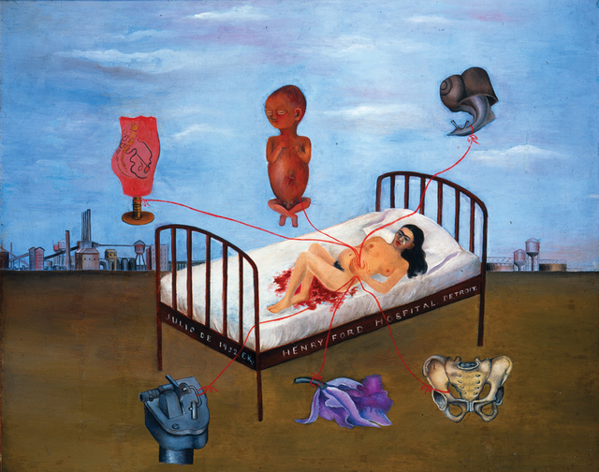

Slide 8
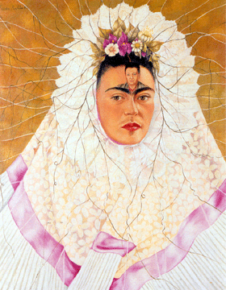

Slide 9
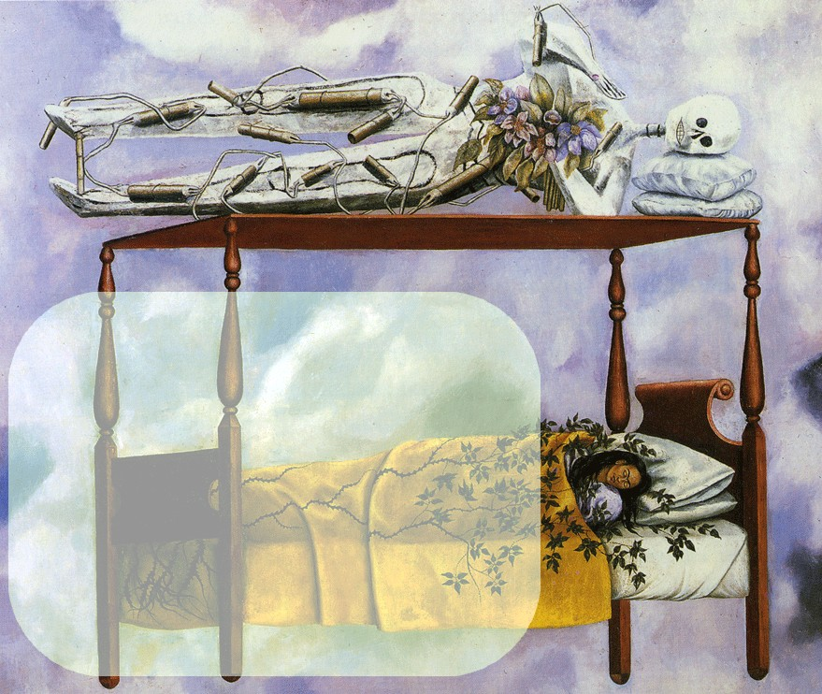
Later years and death
Seven spine surgeries in 1950.
Gangrene and right leg amputation.
Four years of lying in bed with horrible pain and taking narcotic painkillers.
13th July 1954 – death at the age of 47, probably caused by overdosing .

Slide 10
Controversial
lifestyle
Smoking cigarettes and
drinking with labourers in
cheap bars.
Non-feminine, dirty
sense of humour.
An open marriage and
declared bisexuality.
Friendship with
Diego’s ex-women.

Slide 11
Political color
One year in the Communist
Party.
Fascination for Józef Stalin
and unfulfilled dream of
meeting him.
Helping Lew Trocki and
a love affair with him.
Confession of having Jewish
roots and protests against
antisemitism.

Slide 12
The other side of Frida
An icon of female fashion
Strong maternal instinct and big love for
her sister’s childreen
An animal – especially monkeys – fan.

Slide 13
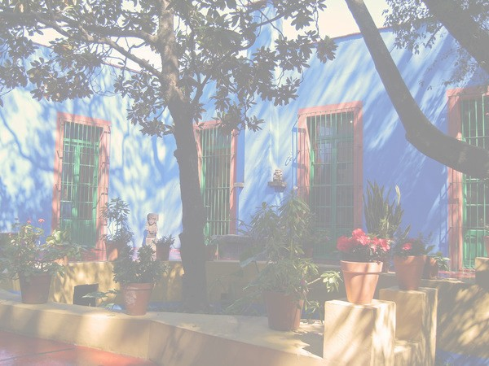
Do you remember….:
why did Frida give her birth date as July
1910, not – 1907?
who was Lew Trocki?
how does the specialists try to characterize Frida’s
art?

Slide 14
BONUS QUESTION !
Why did Frida call Diego her second accident ? Tell us your opinion about their marriage.

Slide 15
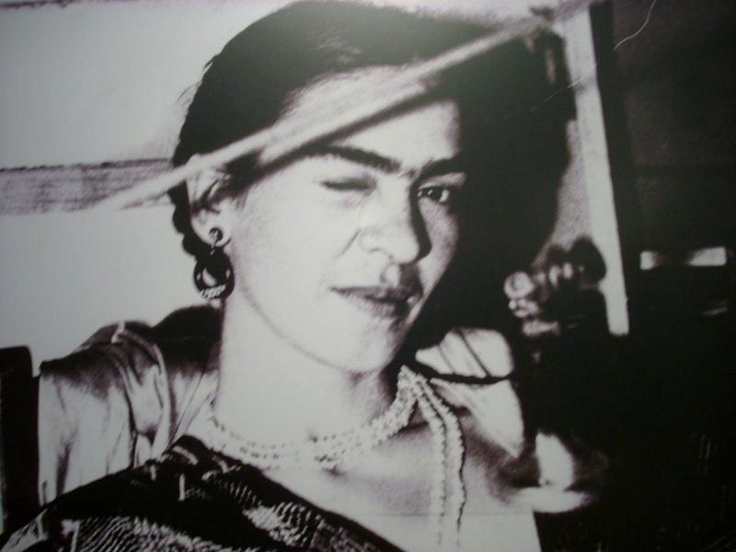
Thank you for your attention

