Slide 1
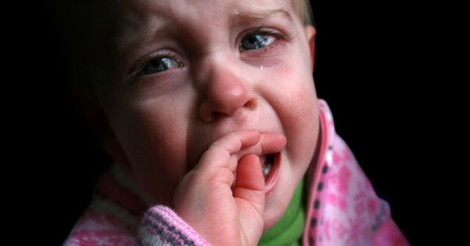
How harmful is the slate?

Slide 2
What is slate?
Slate is hitting his hand on the flat, generally in the buttocks. Usually - buttocks defenseless child. The definition does not specify, however, how hard is to be meted slate, how much pain has a cause, why, what and in what position is to be given, by clothing or not.
No matter what, how much, how many times and for which we beat a child. Hitting a beating. We can not treat the slaps as "something else" if we want this for generations stretching band of violence against children has finally been broken.

Slide 3
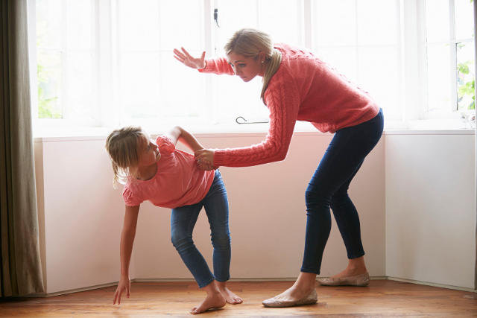
Is slate is violence?
What is the seemingly innocent slate? For us - an act of helplessness, a sign that we can not explain to your child what it got wrong. The proof is that we no longer have arguments and patience, even though in the confrontation with other people can endure much more.

Slide 4
Slate does not bring up a child!
Slate for a child to humiliation, a demonstration of strength and parental authority. After a while, only anger awakens and strengthens the aversion to the parent. Violence gives the child a false message and interferes with unwavering certainty of being loved. This is because it is experiencing physical and psychological violence from a person at which it should feel safe and loved. This dissonance causes him to lack of faith in their own strength, nervousness, distrust, which translates into a variety of fears and problems.

Slide 5
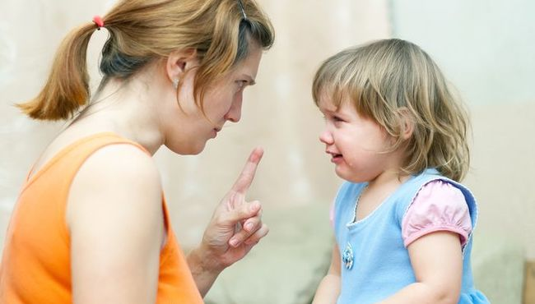
Explaining the young person why he did wrong, we give him a chance to understand the situation, and declare slap the child is that he has to be afraid. Hitting is not educational method is only to discharge the emotions a parent. Slate does not bring up a child.

Slide 6
Can a plain slate is violence?
Using corporal punishment, parents often do not realize that apply physical violence. Do not have done that, so as not allowed to beat your spouse. Allowing violence is pernicious consequence of the innocent slap. Toddler treats beating as a normal reflex discharge of emotion and transfer such behavior to other people - treating it as a natural way of solving problems. In this way, a spiral of violence that can lead to fatal consequences.

Slide 7
The consequences of corporal punishment is for each child other, some children into adulthood will remember spanking with a laugh, others will always be to have a distance to the parent and deeply concealed grief. Everything depends on the sensitivity and strength of character and the intensity of penalties. We must remember that a lot of risk, using corporal punishment - in the future, our grown-up child may feel resentment us and many other negative feelings. And here it is the near the road to loosen contacts.

Slide 8
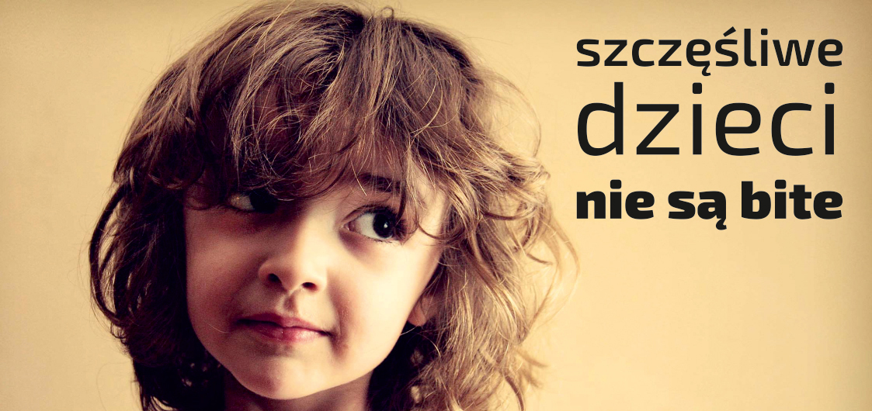
HAPPY CHILDREN AREN'T BEATEN

Slide 9
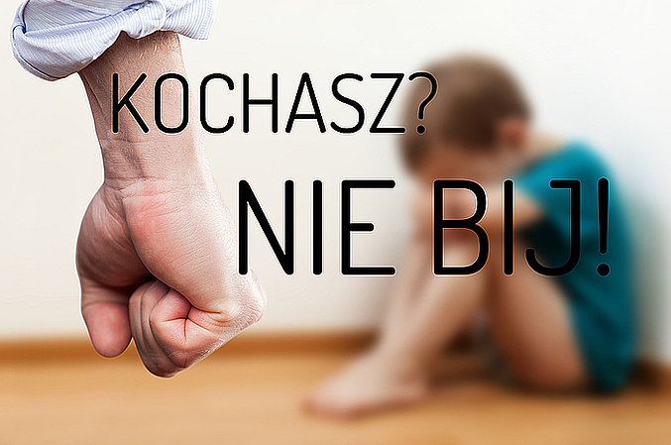
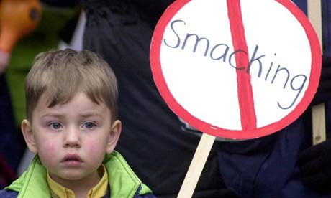
Slate is a weakness parents
What blame the child, we had a stressful day, that we can not deal with your own emotions? That's our problem that can not overwhelm us. If you quickly get nervous and we have somewhere to unload, let it be a gym, aerobics, and even washing the floor at home.

Slide 10

Thirty-April - Global Day Of Opposition
To Beating Children

Slide 11

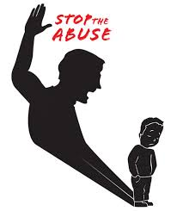
Stop smacking!
From 1 August 2010, the use of corporal punishment of children is prohibited, but still 60% of Poles believe that sometimes you have to give a child a slap.
The campaign „I love. I do not give smacking” it aims to raise awareness that no form of violence against children - even (not) guilty slate - can not be underestimated.
If you want to centuries-old history of beating children ever come to an end, we have to say smacking STOP!
Because slate is also the beating.

Slide 12

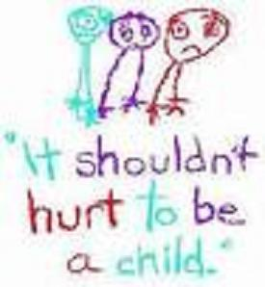
What to do, when after a stressful day your toddler throws himself on the floor, screams and kicks? You have to turn the program maximum patience and wisdom - to explain rebuke and show love. It is a difficult task, but bringing much parental satisfaction. All this in order to develop appropriate, healthy relationships with their children and raise a happy man. Thanks to our child learn to resolve disputes in a peaceful manner and will not in the future use of violence.

Slide 13
STOP thoughtless actions!

Slide 14
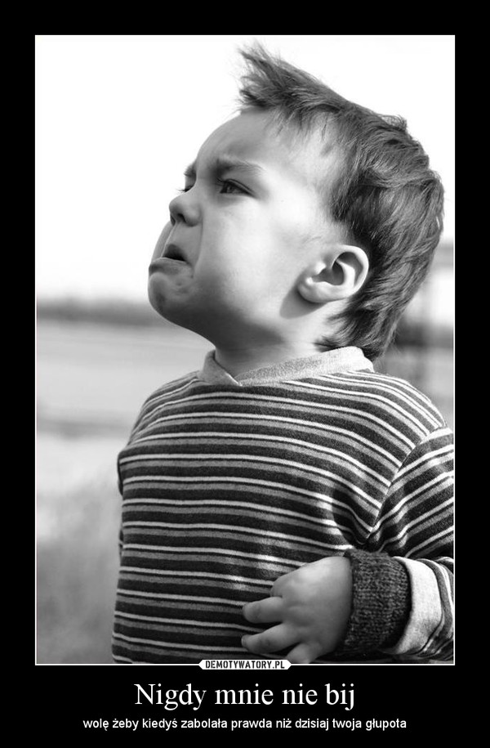
„Violence is not always the right answer.”
Becca Fitzpatrick
„Beating the human can't withstand long. Even heartbeat ends in death.”
Stanisław Jerzy Lec
„There are two kinds of fools - those are easily intimidated and cease to act, and those who think that they could do something when intimidate others.”
Paulo Coelho
I was never hit. I prefer to ever hurt truth than it is today your stupidity.

Slide 15
The presentation prepared by Agnieszka Pietras and Angelika Słota

