Slide 1
CONTRACEPTION
Made by: Sylwia Świerad Diana Wisz Kornelia Wanat

Slide 2
Methods of contraception
Birth control is how you prevent pregnancy before it begins. There are lots of different methods that work really well and are easy to use, including:
long-acting reversible contraception, such as the implant or intra uterine device (IUD)
hormonal contraception, such as the pill or the Depo Provera injection
barrier methods, such as condoms
fertility awareness
permanent contraception, such as vasectomy and tubal ligation.

Slide 3
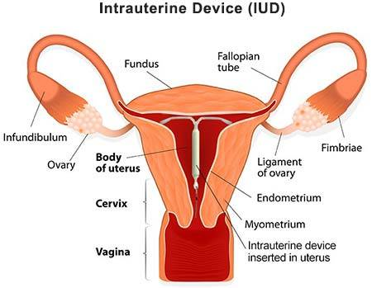
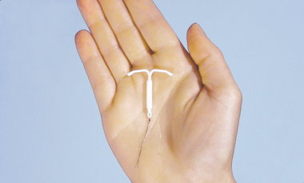
Long-acting reversible contraception
INTRA UTERINE DEVICE (IUD) that lasts for five to ten years

Slide 4
Intra uterine device (iud)
You shouldn't get any kind of IUD if you:
have or might have an STD or other pelvic infection
think you might be pregnant
have cervical cancer that hasn't been treated
have cancer of the uterus
have vaginal bleeding that’s not your period
have had a pelvic infection after either childbirth or an abortion in the past 3 months.
Possible side effects:
the IUD can sometimes slip out of the uterus
it is possible to get pregnant
It is possible to get an infection
when the IUD is put in, it could push through the wall of the uterus
mild pain when the IUD is put in
cramping or backaches for a few days after insertion
spotting between periods
irregular periods
heavier periods and worse menstrual cramps
IUDs don’t protect against STDs.

Slide 5
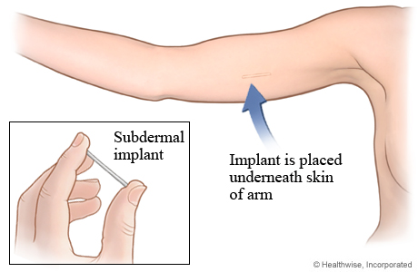
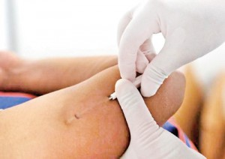
Long-acting reversible contraception
IMPLANT that lasts for three or five years

Slide 6
The birth control implants
Possible side effects:
Irregular bleeding
Headaches
Breast pain
Nausea
Weight gain
Ovarian cysts
Pain or bruising where the implant was inserted
An infection where the implant was inserted
Birth control implants don’t protect against STDs

Slide 7
Long-acting reversible contraception
The benefits of LARCs:
VERY effective
REALLY convenient and private
You can get pregnant after taking out an IUD or an implant
IUDs and implants can make your periods better
The copper IUD doesn’t have hormones
The implants have only one hormone
The copper IUD can be used as emergency contraception.

Slide 8
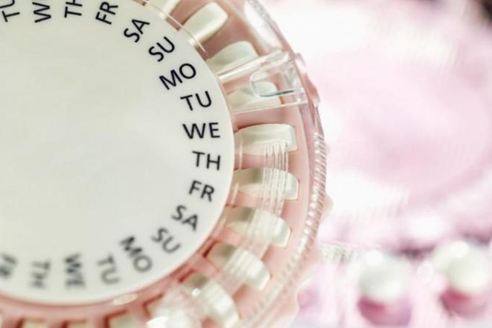
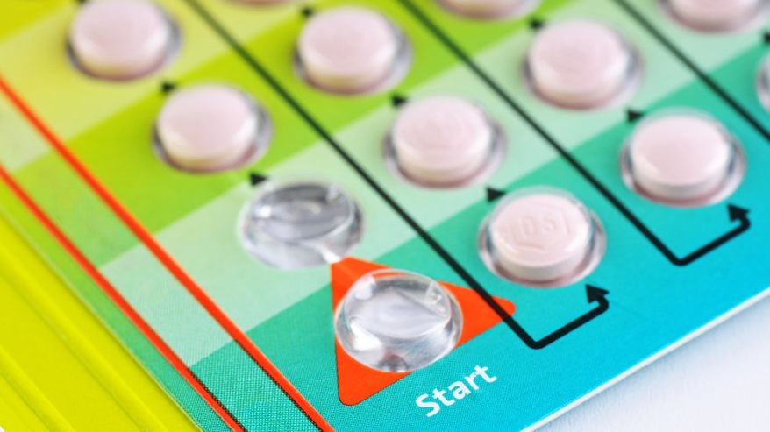
HORMONAL CONTRACEPTION
Birth control pills are a kind of medicine with hormones that you take every day to prevent pregnancy. There are many different brands of pills. The pill is safe, affordable, and effective if you always take it on time. Besides preventing pregnancy, the pill has lots of other health benefits, too.
BIRTH CONTROL PILL

Slide 9
Birth control pill – the benefits
The combination pill can reduce or help prevent:
acne
bone thinning
cysts in the breasts and ovaries
endometrial and ovarian cancers
serious infections in the ovaries, fallopian tubes, and uterus
iron deficiency (anaemia)
PMS (premenstrual syndrome).
The other benefits:
the pill makes your period regular and easy to predict
the pill is convenient
you can get pregnant right away when you stop taking the pill.

Slide 10
Birth control pill
The disadvantages and possible side effects of the birth control pills:
you have to take the pill every day
the pill can change your level of sexual desire
bleeding beetwen periods
sore breasts
nausea
headaches
the pill doesn’t protect you against STDs
there’s still a very slight chance that you can get pregnant.

Slide 11
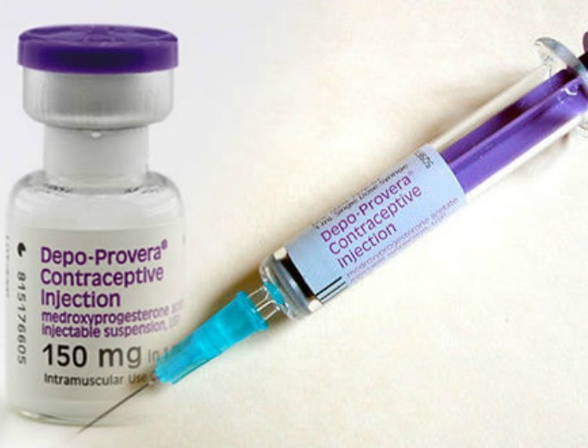
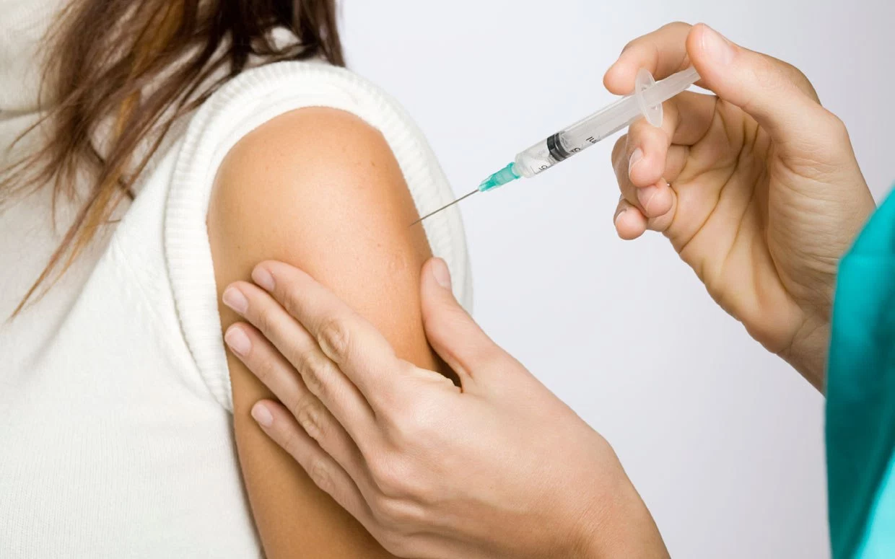
HORMONAL CONTRACEPTION
Birth Control Shot – Depo Provera Injection
The birth control shot is an injection you get from a nurse or doctor once every 3 months. It’s a safe, convenient, and private birth control method that works really well if you always get it on time. The birth control shot contains the hormone progestin. Progestin stops you from getting pregnant by preventing ovulation.

Slide 12
Birth control shot
Possible side effects:
temporary bone thinning
changes in the period (spotting between periods or no periods)
nausea
weight gain
headaches
breast tenderness
hair loss or more hair on the face or body
depression
slight bruising where the shot was given
very rarely, a small, permanent dent in the skin where the shot was given.
The other disadvantages:
you have to go to a doctor or nurse to get the injection every three months
it may take up to 10 months after stopping the birth control shot to get pregnant.

Slide 13
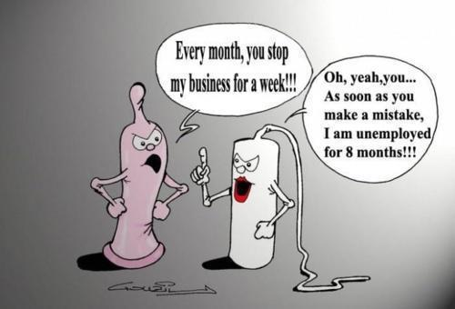
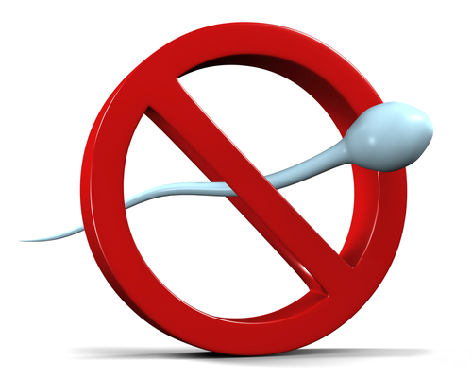
Barrier methods
THE MALE CONDOM
Condoms are thin, stretchy pouches, made of latex, plastic or lambskin, that the man wears on his penis during the sex. Condoms provide great protection from both pregnancy and STDs. They are 85% effective.

Slide 14
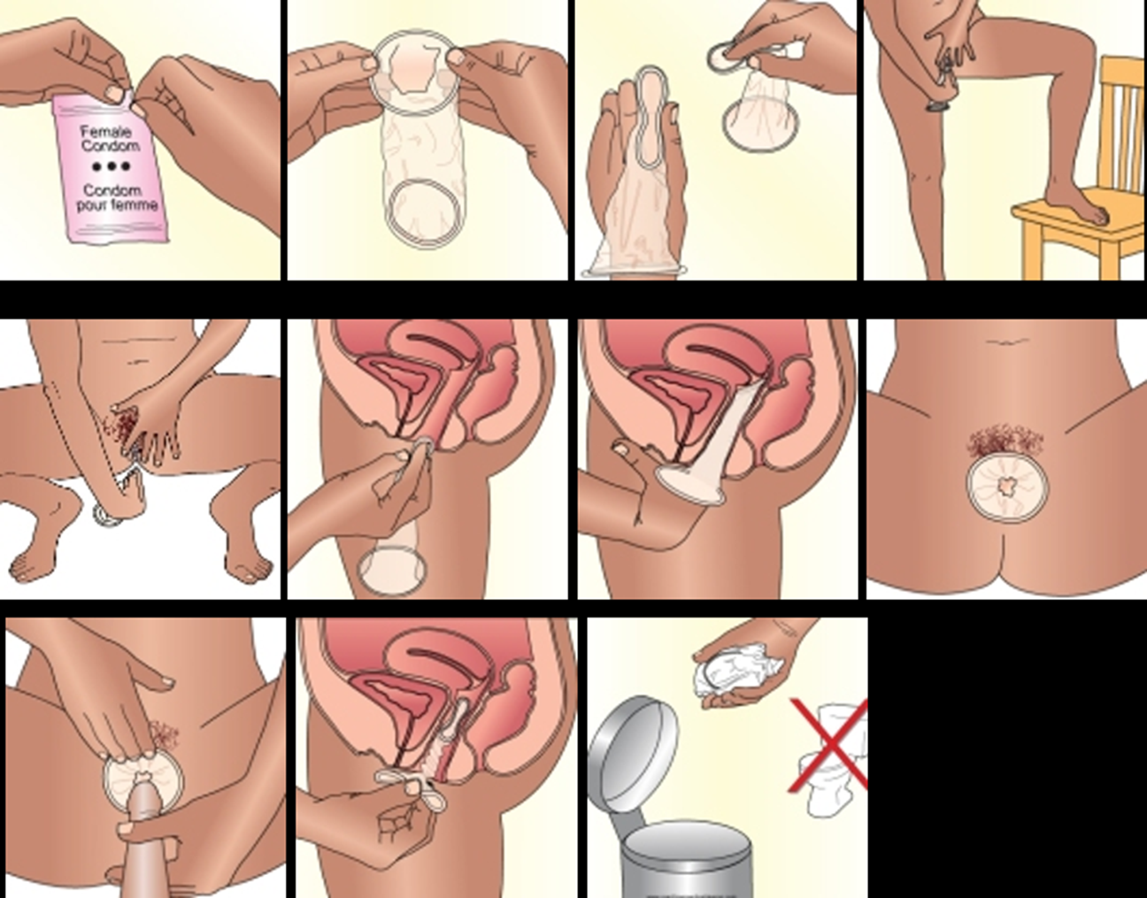
Barrier methods
THE FEMALE CONDOM

Slide 15
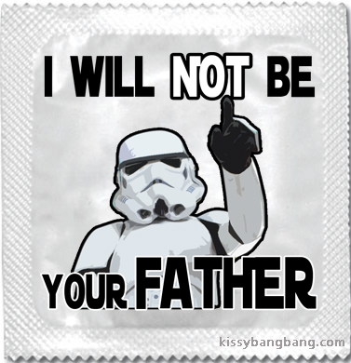
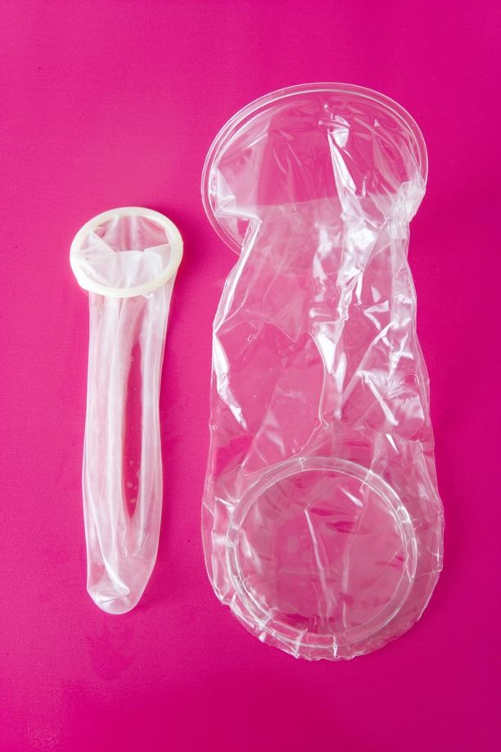
Barrier methods
The benefits of using male and female condoms:
effective against STDs
help other methods of birth control work even better
male condoms don’t cost much and are convenient
have no side effects (rarely allergic to latex – male condoms)
female condoms are latex – free.
The disadvantage is that you have to use a condom every time you have sex.

Slide 16
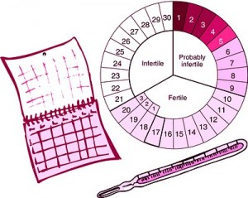
Fertility awareness methods (fams)
Fertility awareness methods are ways to track your ovulation so you can prevent pregnancy. FAMs are also called "natural family planning” and “the rhythm method.” The days near ovulation are your fertile days — when you’re most likely to get pregnant. So people use FAMs to prevent pregnancy by avoiding sex or using another birth control method (like condoms) on those “unsafe,” fertile days. FAMs are 76% effective.

Slide 17
Fertility awareness methods (fams)
There are few different FAMs:
The Temperature Method: you take your temperature in the morning every day before you get out of the bed.
The Cervical Mucus Method: you check your cervical mucus (vaginal discharge) every day.
The Calendar Method: you chart your menstrual cycle on a calendar. These methods help you to predict:
when you’re going to ovulate by tracking the changes in your body temperature and cervical mucus during your menstrual cycle
your fertile days by tracking the length of your menstrual cycles over several months.

Slide 18
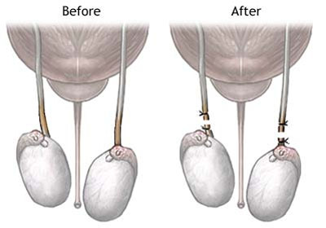
Permanent contraception
VASECTOMY
A vasectomy is a simple surgery done by a doctor in an office, hospital, or clinic. The small tubes in your scrotum that carry sperm are cut or blocked off, so sperm can’t leave your body and cause pregnancy. The procedure is very quick, and you can go home the same day. And it’s extremely effective at preventing pregnancy —100%.

Slide 19
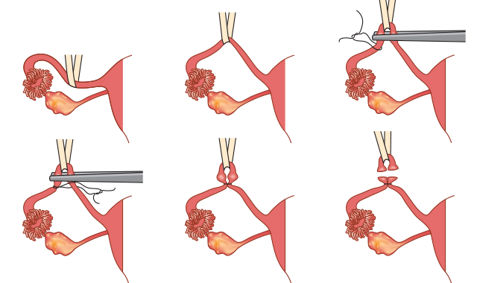
PERMANENT CONTARCEPTION
TUBAL LIGATION
Tubal ligation is a surgical procedure that permanently closes or blocks your fallopian tubes. When the fallopian tubes are blocked, sperm can't get to an egg and cause pregnancy. You still get your period after tubal ligation — you just can’t get pregnant. This method is 100% effective.

Slide 20
Permanent contraception
The benefits of vasectomy and tubal ligation:
VERY effective
Convenient
Permanent (for some people it can be a big disadvantage)
Tubal ligation doesn’t change your hormones.
The disadvantages:
Permanent (it can be an advantage)
It can have some risks
Doesn’t prevent STDs.

Slide 21
Vocabulary:
Contraception – antykoncepcja
LARCs (long-acting reversible contraception) – długoterminowa odwracalna antykoncepcja
IUD (intra uterine device) – wkładka domaciczna
STDs (sexually transmitted diseases) – choroby przenoszone drogą płciową
Bruising – siniaki
Acne – trądzik
Bone thinning – rozrzedzenie kości
Fallopian tubes – jajowody
Nausea - nudności
Shot/injection – zastrzyk
Progestin – progestagen
Breast tenderness – tkliwość piersi
Pouch – kieszonka
FAMs (fertility awareness methods) – metody oparte na świadomości płodności
Fertile – płodny
Cervical mucus – śluz szyjki macicy
Vasectomy - wazektomia
Scrotum – worek mosznowy
Tubal ligation – podwiązanie jajowodów

Slide 22
Bibliography:
Kleinman R. L. Hormonal Contraception International Planned Parenthood Federation 1990
”Contraception” – Issues in Adolescent Health and Development
https://www.plannedparenthood.org/learn/birth-control
http://www.familyplanning.org.nz/advice/contraception/contraception-methods
https://www.obgynecologistnyc.com/procedures/iud-birth-control-insertion-nyc/
http://www.cleveland.com/healthfit/index.ssf/2011/08/new_iud_poses_fewer_risks_and.html
https://www.webmd.com/sex/birth-control/subdermal-implant-for-birth-control
http://www.sundaytimes.lk/140316/mediscene/birth-control-make-a-smart-choice-88593.html
https://www.papilot.pl/ginekolog/tabletki-antykoncepcyjne-jednak-nam-szkodza-podobno-wywoluja-jaskre,24254,1
http://www.medonet.pl/ciaza-i-dziecko/co-musisz-wiedziec,tabletki-antykoncepcyjne---skutki-uboczne-i-rodzaje-pigulek,artykul,1707861.html
https://followtheoutbreak.wordpress.com/2014/10/29/lethal-virus-more-threatening-to-public-health-than-ebola-influenza/
http://www.ncregister.com/daily-news/usaid-and-clinton-and-gates-foundations-involved-in-depo-provera-deception
http://www.newhealthadvisor.com/how-to-use-female-condom-picture.html
http://www.sandiegohomebirth.com/resources/natural-birth-control
http://holistichormonalhealth.com/what-is-the-sympto-thermal-method-of-fertility-awareness/
http://www.dailysun.co.za/Success/Health/mzansi-women-are-sex-smarter-20170828
https://jeffreysterlingmd.com/2013/12/29/straight-no-chaser-straight-talk-about-vasectomies/
http://contemporaryobgyn.modernmedicine.com/contemporary-obgyn/news/legally-speaking-tubal-ligation-failure-results-wrongful-pregnancy-claim?page=full
https://www.seedoc.co/disease/sexual-health/contraception/

