Slide 1

Personal
Data Protection
Łukasz Wołoszyn

Slide 2

Presentation Plan
What are personal data?
GDPR
DPA
Penalties

Slide 3

Personal Data
Personal data includes all information about an identified or identifiable living individual.
Specific information that, when combined, can lead to identifying a person also constitutes personal data.

Slide 4

Data Division
Ordinary data
Name
Surname
Address
PESEL Number
Phone Number
Sensitive data
Racial or ethnic origin
Political views
Health status
Genetic code
Fines, Judgments issued by court or authority

Slide 5

Consent to Personal Data Processing
According to GDPR, a company/organization must demonstrate that consent for processing has been given. Consent must be:
voluntary,
specific,
informed (thus transparency is required),
withdrawing it should be easy.

Slide 6
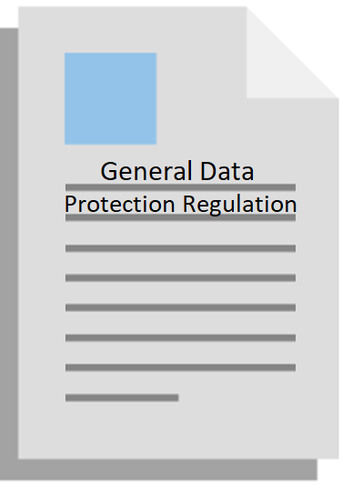
GDPR
Regulation of the European Parliament and of the Council (EU) from 2016
It contains provisions on the protection of individuals concerning the processing of personal data and on the free movement of such data.
In Poland, it applies to all those who process personal data in connection with economic activities (since May 25, 2018).

Slide 7

DPA
DPA, or the Personal Data Protection Authority, is the competent body responsible for personal data protection. Specifically, it is the President of the DPA, who replaced the General Inspector for Personal Data Protection (GIODO) after May 25, 2018.

Slide 8
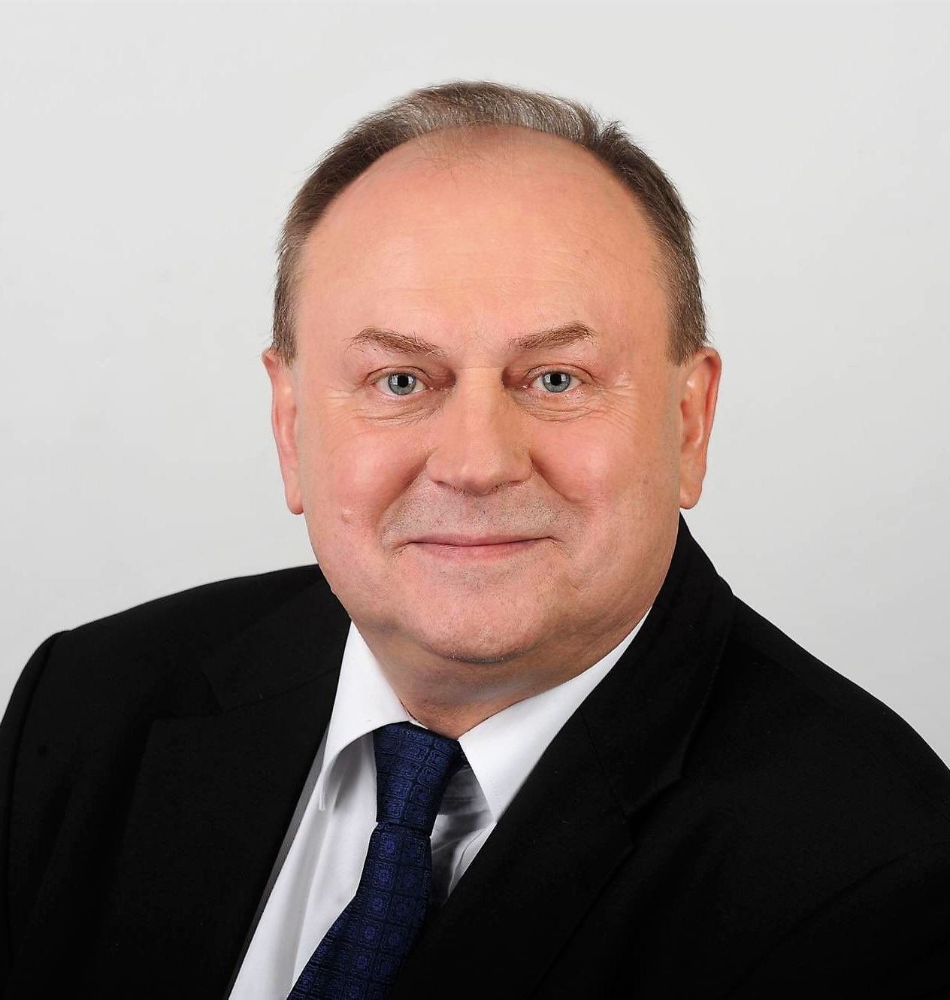
President of the DPA
Jan Nowak - a Polish official and local government representative. Councillor of the Warsaw Wola District [municipal borough of Warsaw], since 2008, director of the Office of the General Inspector for Personal Data Protection (later the Personal Data Protection Office), since 2019, president of the Personal Data Protection Office.

Slide 9

Administrative Penalties
The regulation sets out general conditions for imposing administrative fines and distinguishes two ranges of fines for Data Administrators:
Up to 10 million euros
This penalty applies to, among other things:
Lack of default data protection
Improper securing of IT systems
Incorrectly maintained register of processing activities or its absence
Up to 20 million euros
This penalty applies to, among other things:
Violation by Data Administrator of basic principles of data processing
Violation of personal rights
Improper transfer of personal data to recipients in third countries

Slide 10
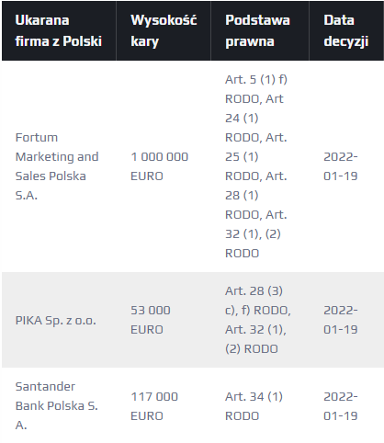
Since the entry into force of GDPR regulations in Poland, 35 fines have been imposed on Polish companies, totaling 2.2 million euros.

Slide 11
Thank you for your attention

Slide 12
o https://pl.wikipedia.org/wiki/Ogólne_rozporządze nie_o_ochronie_danych o https://pl.wikipedia.org/wiki/Jan_Nowak_(urzędnik) o https://pl.wikipedia.org/wiki/Prezes_Urzędu_Ochrony_
Danych_Osobowych o https://resilia.pl/blog/rejestr-kar-rodo-polskie-firmy/ o https://pl.freepik.com
Bibliography

