Slide 1
The influence of gaming industry on pc peripherals
Done by: Mateusz Mikołajuk

Slide 2
What exactly is gaming industry?
Console market (Xbox, PlayStation, Nintendo)
Mobile market (mostly android and iOS)
PC market
  Steam and other platforms
  Indie scene (Steam greenlight; humblebundle and similar)
  E-sports

Slide 3
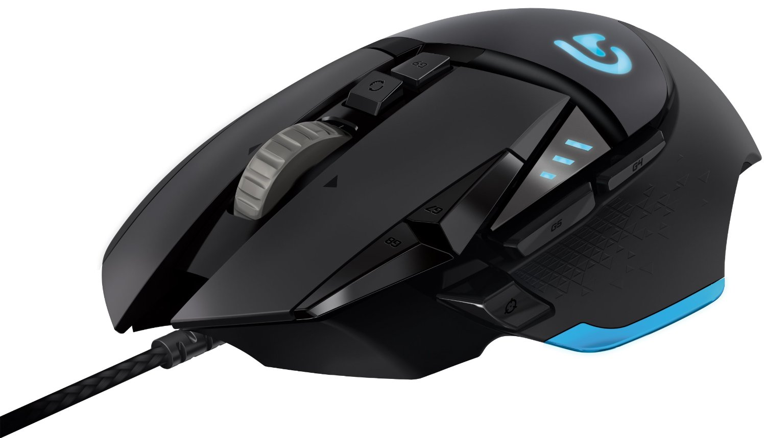
What competitive gamer wants?
Choice
Looks
Technical properties
  Precision
  Fast response
  High quality

Slide 4
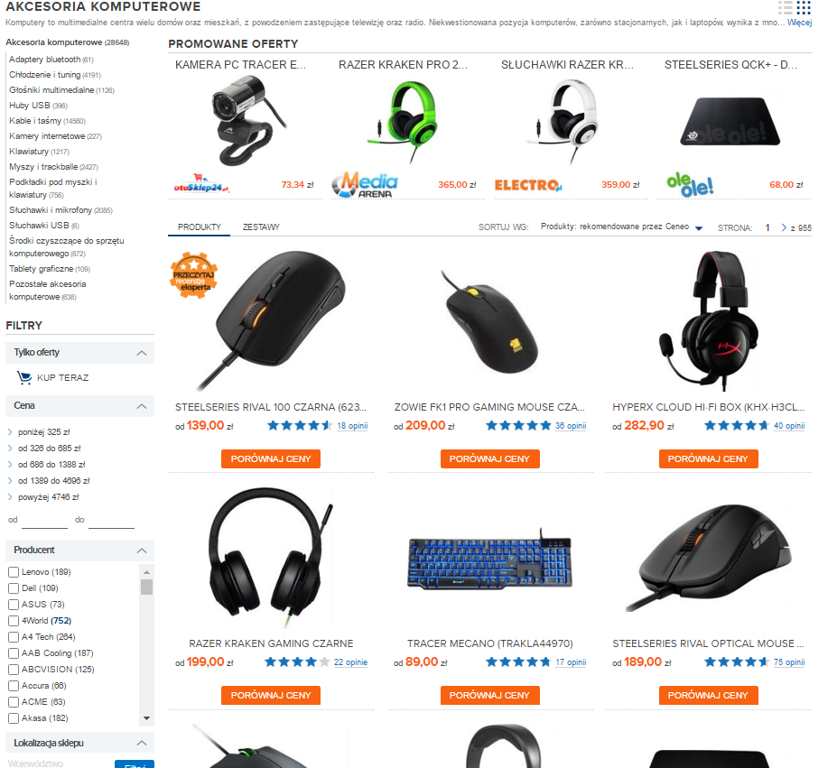
But does it actually happen?

Slide 5
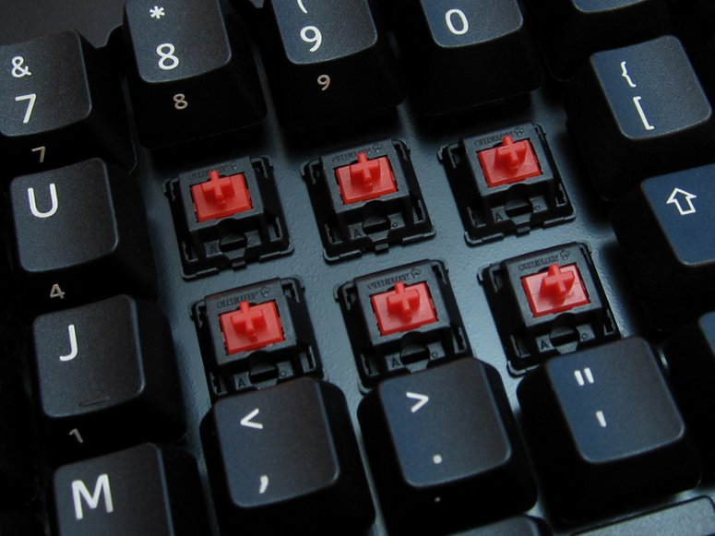
The rise of mechanical keyboards
Industrial grade background
Cherry MX switches
Fast and responsible
Unbreakable – tested up to 50 million clicks
Modding capabilities

Slide 6
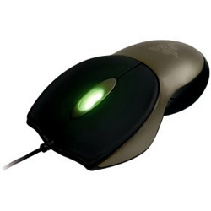
How gaming peripherals changed
The first gaming mouse: Razer Boomslang (1999)
  High dpi sensor – 1800
  High pulling rate 1000 Hz
  Better clicking mechanisms
  Scroll wheel glow

Slide 7
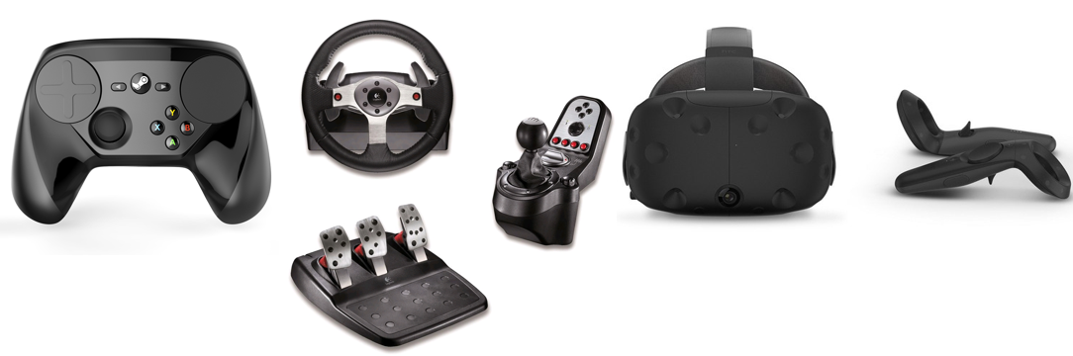
The freedom of choice

Slide 8
Sources
https://en.wikipedia.org/
https://www.google.pl/trends/
https://www.google.pl/imghp
https://www.reddit.com/r/MechanicalKeyboards/
Thanks for listening!

