Slide 1

Robert Bielecki

Slide 2

What Google Inc. is?

Slide 3
Milestones in Google Inc. history
1. 1997 – domain registration
2. 1998 – obtaining 25 000 000 $ of fundation
3. 2001 – Google Images
4. 2002 – Google News
5. 2004 – Google Mail, entering stock with 1,67 billion $ worth
6. 2006 – Youtube as part of Google Inc.
7. 2007 – Google street view, Android System
8. 2008 – Google Chrome
9. 2010 – Nexus One
10. 2015 – Alphabet Company

Slide 4
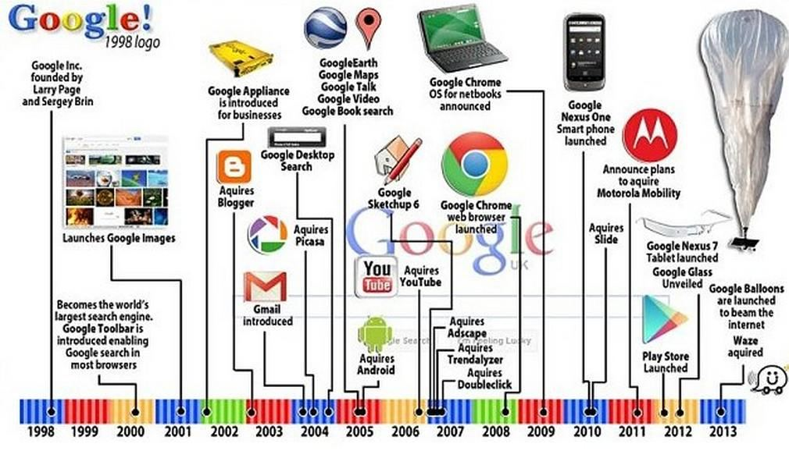
Milestones in Google Inc. history

Slide 5





Google Inc. Products

Slide 6
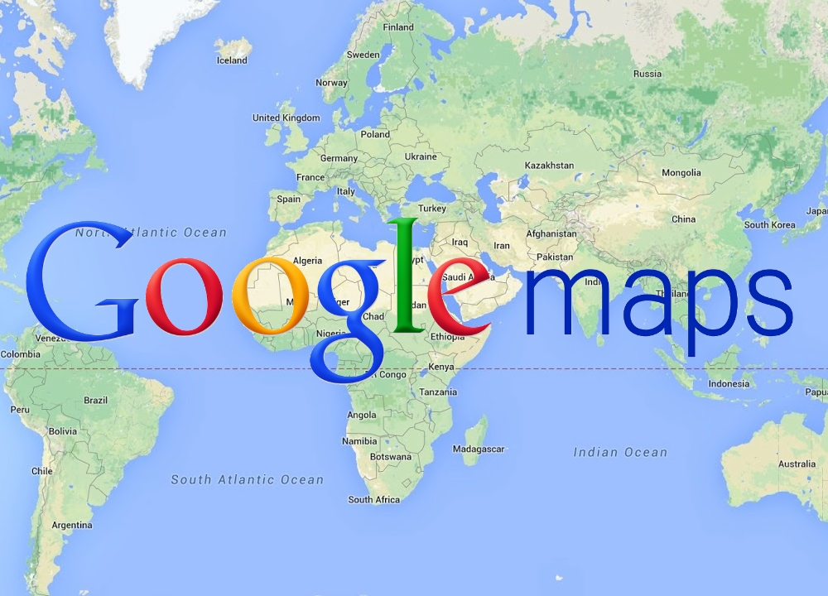

Slide 7


Slide 8


Slide 9








Google in numbers

Slide 10
Greatest Failures of Google Inc.
Google Answers (2003)
Google Voice Search (2004)
Google Video (2005)
Google Wave/Buzz (2009/10)
Google + (2011)

Slide 11
Thank you for your attention !

