Slide 1
Digital painting
Karolina Madej

Slide 2
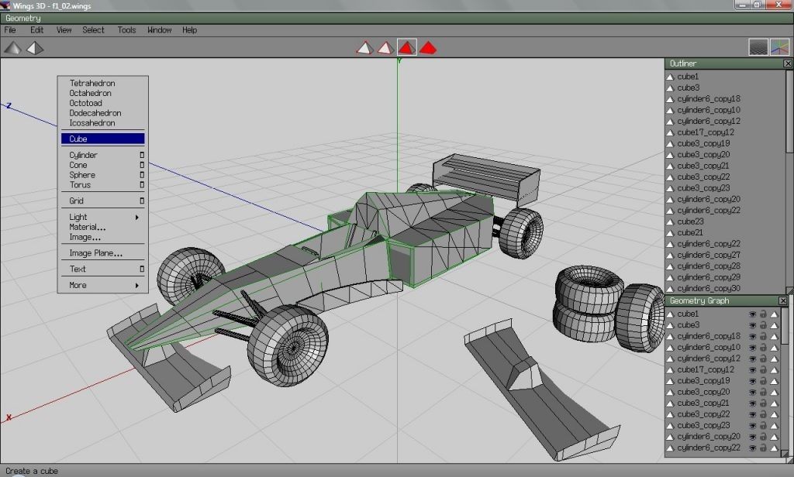
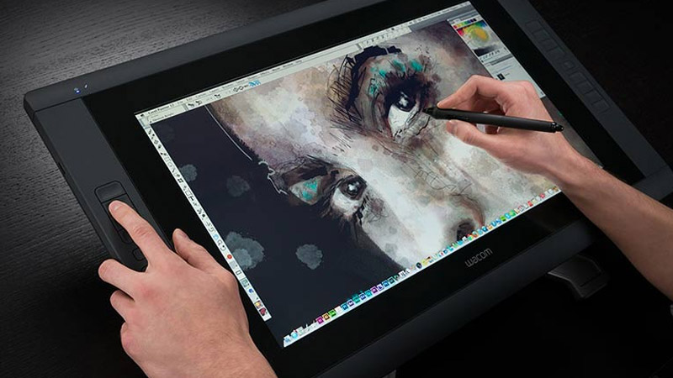
What is digital art?
Digital art is artistic work that uses computer technologies in its creation process. It covers a lot of subjects, such as digital painting, 3D modelling, CGI, AI generated images and more. The type of digital art I will be covering in detail is digital painting.

Slide 3
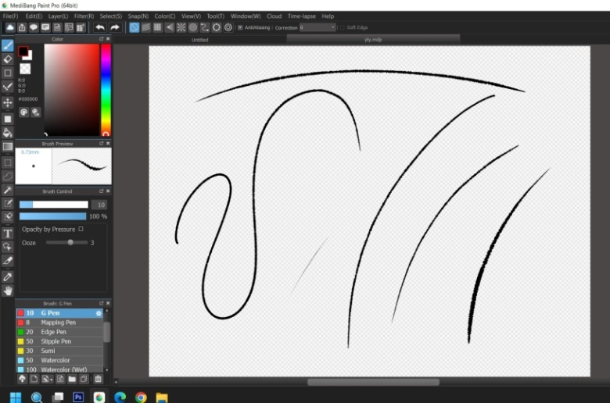
Digital painting
Digital painting is a form of art made using computer software. It employs pixels, which are assigned a certain color in order to create an image (raster graphics).
A digital artist can create a virtual canvas and draw on it using digital brushes, which can simulate traditional painting tools. The work can then be saved on the device as PNG, JPEG and other formats.

Slide 4




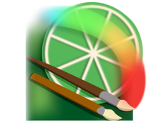


Popular art programs
Adobe Photoshop
Clip Studio Paint
Paint Tool SAI
MediBang Paint
Krita
Procreate
Fire Alpaca

Slide 5
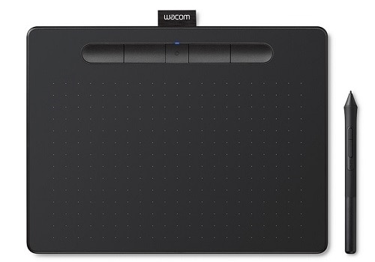
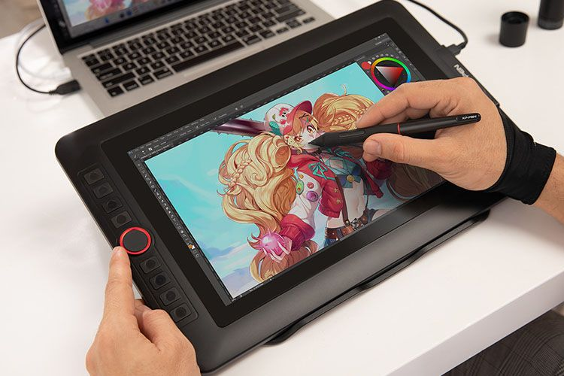
Tools that help digital artists with their work:
Graphics tablets, are screenless pads that you plug into your computer. They include a digital pen, which is used to simulate mouse movements and clicks.
Screen tablets come with a digital pen as well, but they also include a screen display. They tend to be more expensive than regular graphics tablets.

Slide 6
Pros of digital painting:
Digital painting comes with a lot of advantages that traditional artists don’t have. Some of them are:
Unlimited access to painting tools
Customizable brushes
Texture brushes
A layer system that lets you split your drawing into individual parts
Color filters
Colordrop tool

Slide 7
Pros of digital painting:
You can easily correct your mistakes without leaving a trace.
Select tool lets you select an element in your artwork and operate on it separately from the rest of the piece.
You can move elements on your canvas, rotate them, flip them and scale them up or down.
You can change the size of your canvas any time you want.

Slide 8
Cons of digital painting
Some art programs can charge you a lot of money (although there are free and inexpensive software available as well)
It’s difficult to sell digital artwork that wasn’t specifically commissioned for someone. A traditional artist can make an original painting and sell it to others. But it’s not as easy to do it with digital art, because anyone can save or screenshot it and it’s virtually no different from the original.

Slide 9
Cons of digital painting
Art theft is a very prevelant problem, there are a lot of people who take others’ work and claim it as their own or even sell it online.
Forgetting to save your file will result in loss of progress
Computer files can be corrupted
Looking at the screen for a long time can cause eyestrain
Starting out can be difficult

Slide 10
Sources:
https://en.wikipedia.org/wiki/Digital_painting
https://en.wikipedia.org/wiki/Digital_art

Slide 11
Thank you for your attention!

