Slide 1
Legal Profession in England and Wales
Anita Ostafińska
Uniwersytet Rzeszowski
Kierunek: Prawo, rok III
Prowadzący: mgr Krzysztof Tucholski

Slide 2
Branches
Legal professions in England and Wales are divided between two distinct branches under the legal system, those of solicitors and barristers.
Each is governed by its own professional body
Solicitors are represented by the Law Society barristers by the Bar Council

Slide 3
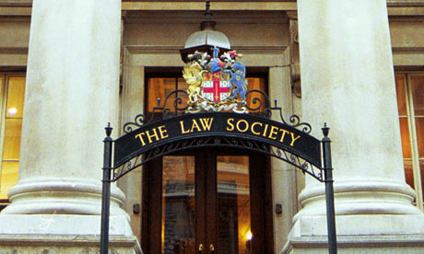
The Law Society
The governing body of solicitors
A regulatory body that can set rules and discipline for solicitors
The representative of the interests of solicitors

Slide 4
The Bar Council
The governing body of barristers
Regulated by a Code of Conduct
Regulatory and representative functions
Main purpose: to maintain and enhance professional standards
Complaints against barristers are handled by the Bar Standards Board

Slide 5
Definitions :
Solicitor - is a lawyer that restricts his or her practice to giving legal advice and prepares formal legal documents, and does not normally litigate. A solicitor is a member of the legal profession qualified to deal with conveyancing, drawing up of wills, and other legal matters.
Barristers - a lawyer that restricts his or her practice to the court room; a litigation specialist.

Slide 6
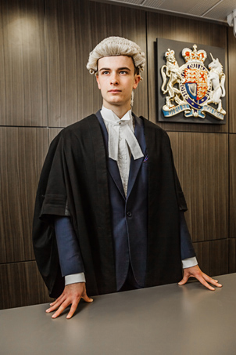
The basic difference between: Solicitors and Barristers
The basic difference between barristers and solicitors is that a barrister mainly defends people in court and a solicitor mainly performs legal work outside court. However, there are exceptions in both cases.

Slide 7
,

Slide 8
Salary £ £ £ :
Solicitor:
Barrister:
£25,000 to £75,000 a year (139 000zł - 416 000zł)
Qualified barristers can earn anything from £25,000 to £300,000
(139tys zł – 1,5mln zł )
Salaries for those with over ten years' experience can rise to £1,000,000
(5,5mlm zł)

Slide 9
Bar Statistics
According to the General Council of the Bar, there are more than 15,000 barristers in independent practice in England and Wales
more than 60% are men
10% of all barristers from ethnic minorities

Slide 10
Glossary:
to act for a client - reprezentować klienta
to admit to the bar - zostać przyjętym do palestry
apparel - strój
to appear in court - pojawić się w sądzie
apprenticeship - aplikacja
The Bar - palestra
barrister - adwokat, obrońca
case files - akta sprawy
to conduct litigation - prowadzić sprawę w sądzie
to draft pleadings - przygotować pisma procesowe
to exercise the right - korzystać z prawa

Slide 11
hearing - rozprawa sądowa
judge - sędzia
The Law Society - Izba Radców Prawnych (Solicitors)
Legal Practice Course - staż w kancelarii prawniczej
to plead cases - reprezentowanie strony w postępowaniu sądowym
right of audience - prawo do wystąpień w sądzie
solicitor – radca prawny
case preparation - przygotowanie sprawy sądowej
training contract – staż
gown - toga

Slide 12
Bibliography
https://www.lawsociety.org.uk
http://www.barcouncil.org.uk
http://www.wikipedia.org
http://dictionary.law.com/

Slide 13
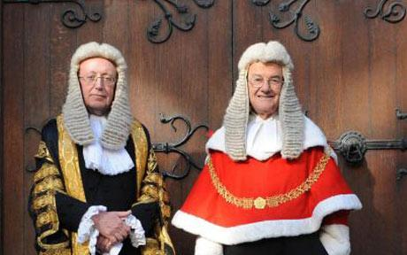
Thank you for attention !!

