Slide 1

THE
INTERNATIONAL
CRIMINAL COURT
Alicja Borowiec
Prawo, III rok, studia stacjonarne
Rok akademicki 2015/2016
Prowadzący mgr Krzysztof Tucholski

Slide 2
What is the International Criminal Court?
The International Criminal Court ( ICC)
is a permanent international court established to investigate, prosecute and try individuals accused of committing the most serious crimes of concern to the international community as a whole, namely the crime of genocide, crimes against humanity, war crimes and the crime of aggression.

Slide 3
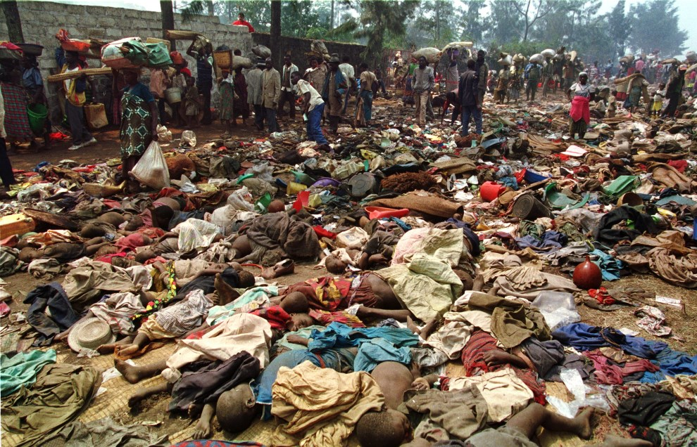
1.What is genocide?
For example: killing members of the group,causing serious bodily or mental harm to members of the group, imposing measures intended to prevent births within the group,
forcibly transferring children of the group to another group.
.
2. What are crimes against humanity?
For example: imprisonment, torture, murder, extermination, enslavement.

Slide 4
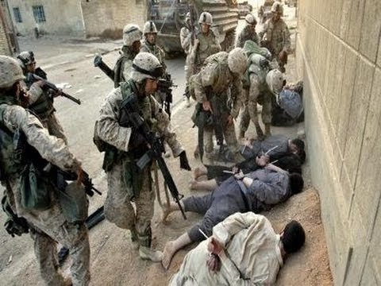
3. What are war crimes?
For example: mutilation, cruel treatment and torture, taking of hostages, intentionally directing attacks against the civilian population, pillaging,
rape and sexual slavery.
4. What is a crime of aggression?
The act of aggression includes, among other things, invasion, military occupation, and annexation by the use of force, blockade of the ports or coasts.

Slide 5
A few words about history
On 17 July 1998, the international community reached a historic milestone when 120 States adopted the Rome Statute, the legal basis for establishing the permanent International Criminal Court.
The Rome Statute entered into force on 1 July 2002 after ratification by 60 countries.

Slide 6
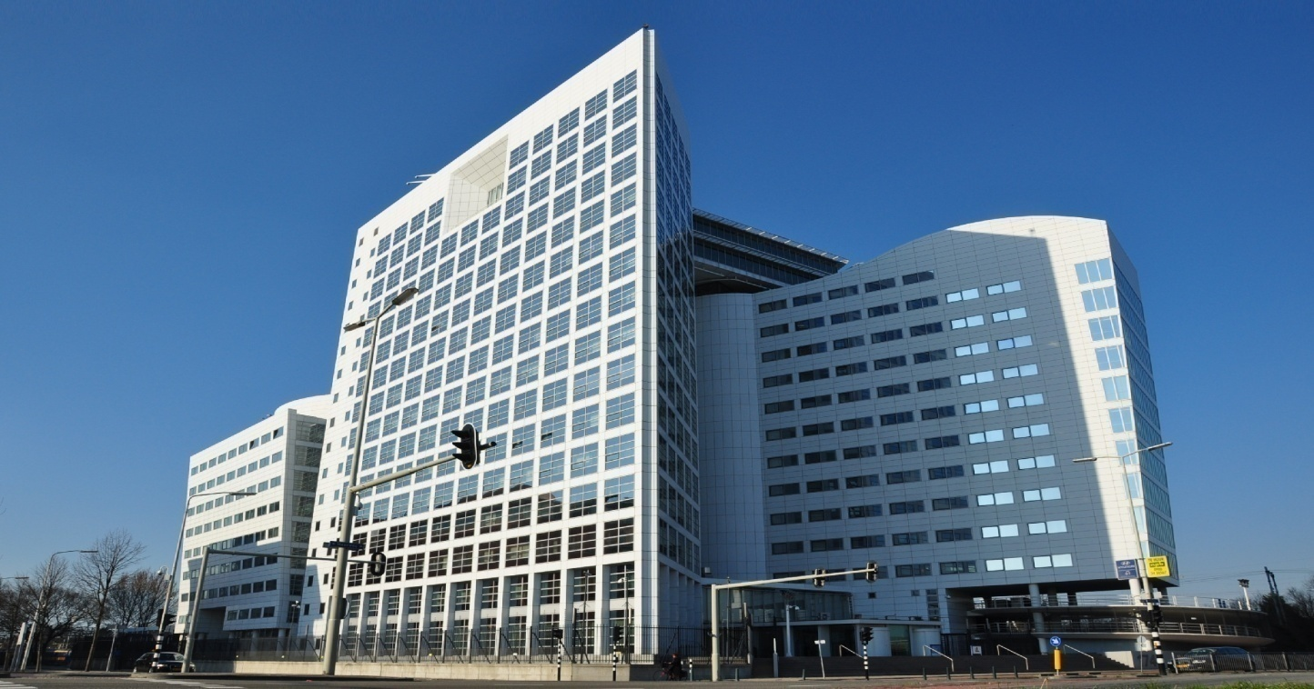
Where is the seat of the Court?
The seat of the Court is in The Hague in the Netherlands. The Rome Statute provides that the Court may sit elsewhere whenever the judges consider it desirable. The Court has also set up offices in the areas where it is conducting investigations.

Slide 7
Structure of the Court
The Court is composed of four organs. These are the Presidency, the Judicial Divisions, the Office of the Prosecutor and the Registry.

Slide 8
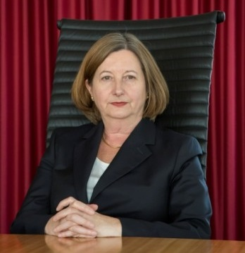
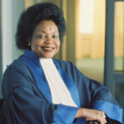
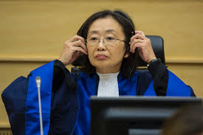
Presidency
The Presidency is responsible for the overall administration of the Court, with the exception of the Office of the Prosecutor, and for specific functions assigned to the Presidency in accordance with the Statute. The Presidency is composed of three judges of the Court, elected to the Presidency by their fellow judges, for a term of three years.
President of the Court
Judge Silvia First Vice-President Second Vice-President
Alejandra Fernandez Judge Joyce Aluoch Judge Kuniko OZAKI
de Gurmendi

Slide 9
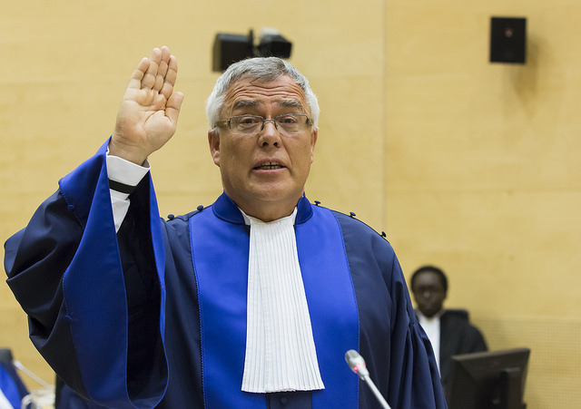
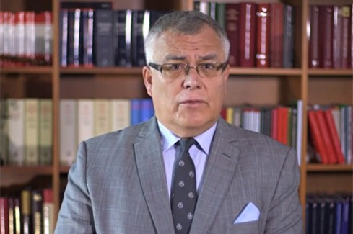
Judicial Divisions
The Judicial Divisions consist of eighteen judges organized into the Pre-Trial Division, the Trial Division and the Appeals Division. The judges of each Division sit in Chambers which are responsible for conducting the proceedings of the Court at different stages.
Judge Piotr Hofmański- the first Pole in the history of the Court

Slide 10
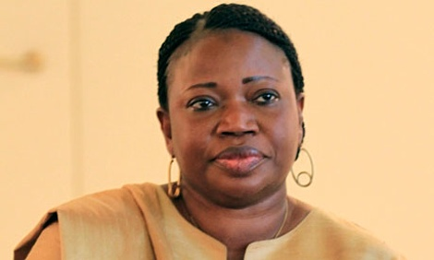
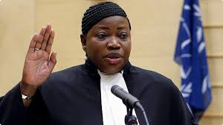
Office of the Prosecutor
The Office of the Prosecutor is responsible for receiving referrals and any substantiated information on crimes within the jurisdiction of the Court, for examining them and for conducting investigations and prosecutions before the Court. The Office is headed by the Prosecutor, Mrs. Fatou Bensouda (The Gambia), who was elected by the States Parties for a term of nine years.
She is assisted by Deputy Prosecutor James Stewart who is in charge of the Prosecutions Division of the Office of the Prosecutor.

Slide 11
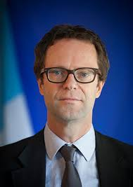
Registry
The Registry is responsible for the non-judicial aspects of the administration and servicing of the Court. The Registry is headed by the Registrar who is the principal administrative officer of the Court. The Registrar exercises his or her functions under the authority of the President of the Court. The current Registrar, elected by the judges for a term of five years, is Mr Herman von Hebel (The Netherlands).

Slide 12
Other Offices
The Court also includes a number of semi-autonomous offices such as the
*Office of Public Counsel for Victims and the
*Office of Public Counsel for Defence.
These Offices fall under the Registry for administrative purposes but otherwise function as wholly independent offices. The Assembly of States Parties has also established a Trust Fund for the benefit of victims of crimes within the jurisdiction of the Court and the families of these victims.

Slide 13
Situations and cases
23 cases in 10 situations have been brought before the International Criminal Court. Pursuant to the Rome Statute, the Prosecutor can initiate an investigation on the basis of a referral from any State Party or from the United Nations Security Council.
1) Situation in Uganda, 2) Situation in the Democratic Republic of the Congo, 3) Situation in Darfur, Sudan, 4) Situation in the Central African Republic, 5) Situation in the Republic of Kenya, 6) Situation in Libya, 7) Situation in Ivory Coast, 8) Situation in Mali,
9) Situation in the Central African Republic II,
10) Situation in Georgia

Slide 14
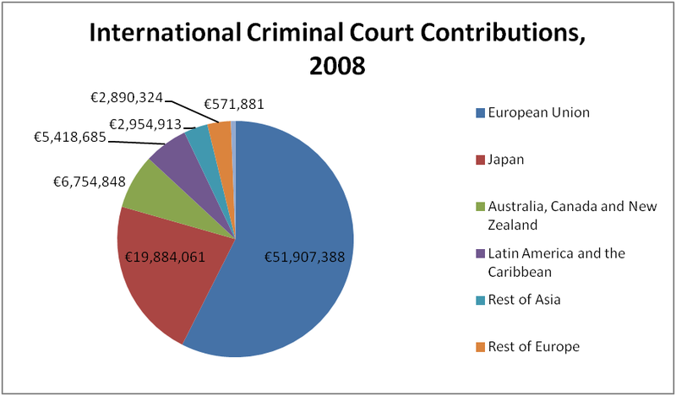
How is the Court funded?
The Court is funded by contributions from the States Parties and by voluntary contributions from governments, international organisations, individuals, corporations and other entities.
.

Slide 15
Glossary
annexation- aneksja
Appeals Division - Wydział Odwoławczy
civilian population - ludność cywilna
crimes against humanity- zbrodnie przeciwko ludzkości
crime of aggression- zbrodnia agresji
cruel treatment - okrutne traktowanie
Deputy Prosecutor- zastępca prokuratora
enslavement - zniewolenie
extermination - eksterminacja
genocide- ludobójstwo
imprisonment- uwięzienie
interntational community- społeczność mędzynarodowa
Internatonal Criminal Court- Międzynarodowy Trybunał Karny
invasion- inwazja

Slide 16
mutilation- okaleczenie
occupation- okupacja
Pre- Trial Division- Wydział Przygotowawczy
Presidency- Prezydium
rape- gwałt
Registry- Sekretariat
Rome Statute- Statut Rzymski
sexual slavery- seksualne niewolnictwo
taking of hostages- branie zakładników
to investigate- badać
to pillage- grabić, grabież
to prosecute- ścigać sądownie
Trial Division- Wydział Orzekający
Trust Fund- Fundusz Powierniczy
war crimes- zbrodnie wojenne

Slide 17
Bibliography
1. Grabowski R., Międzynarodowy Trybunał Karny, w: Organy i korporacje ochrony prawa, red. S. Sagan, Warszawa 2001.
2. Izydorczyk J., Wiliński P., Międzynarodowy Trybunał Karny (International Criminal Court), Kraków 2004.
3. www.icc-cpi.int

Slide 18
Thank you for your attention!

