Slide 1
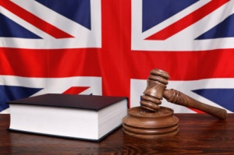
Sylwia kuras
III Prawo
Prowadzący: mgr Krzysztof Tucholski
LEGAL PROFESSIONALS IN ENGLAND AND WALES

Slide 2

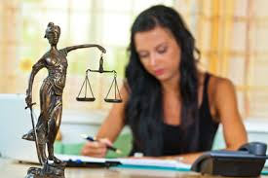
What you need to do to become qualified lawyer?
You need to:
get the Bachelor's degree in Law or the Bachelor’s degree in any other field
take the Legal training , which consists of two stages:
1) a one-year vocational course
2) a one-year or two-year practice

Slide 3
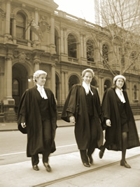
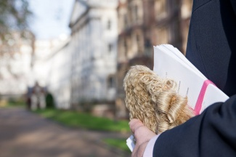
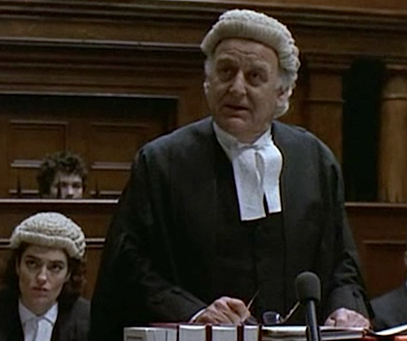
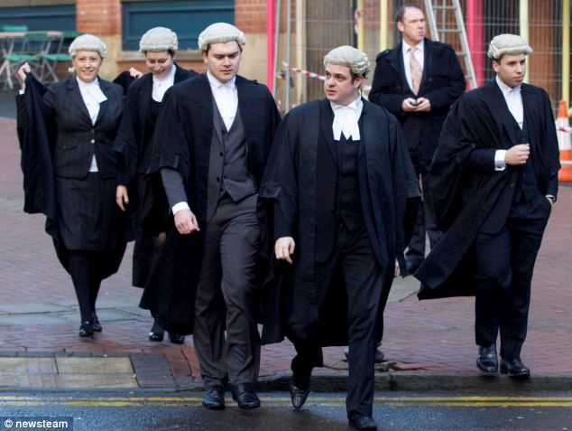
Barristers
They are individual specialist legal advisers and courtroom advocates.
Barristers are trained mainly in advocacy.

Slide 4


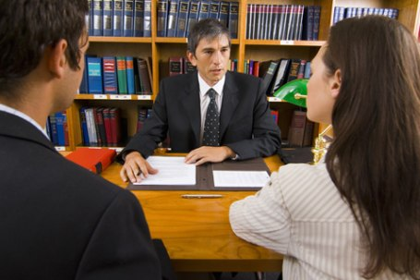




Solicitors
A solicitor's job is to provide clients (members of the public, businesses, voluntary bodies, charities, etc.) with skilled legal advice and representation, including representing them in court.

Slide 5
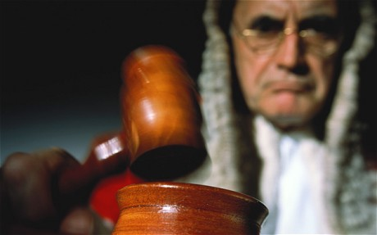
JUDGES
Who aspire to be judges :
- have first to be qualified lawyer, either solicitors or barristers;
- must be citizens of the United Kingdom, the Republic of Ireland or a Commonwealth country
- have practised as a lawyer for a minimum period of time as specified by law for each type of judicial post.
Judges are characterized by
independence.

Slide 6
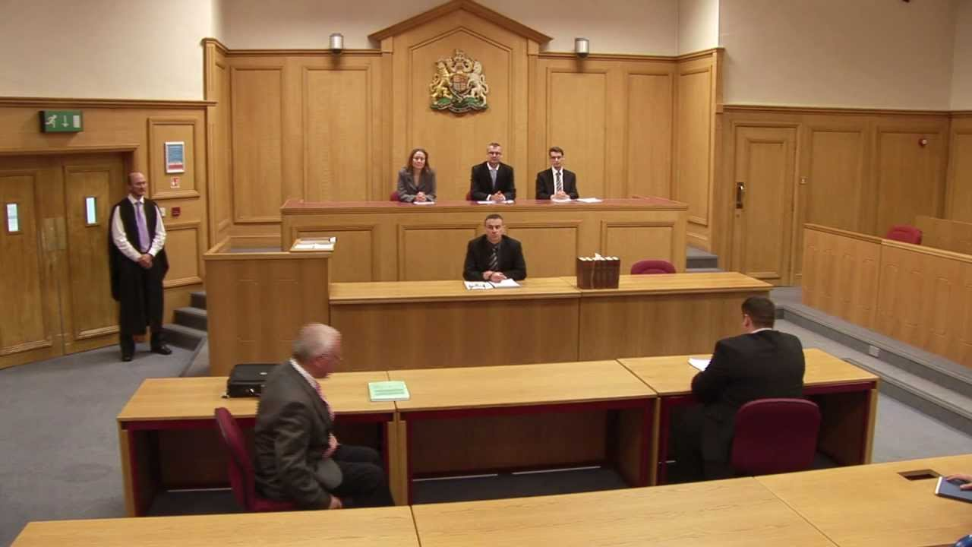
Justice of the Peace
They do not have to be legally qualified.
They deal with the relatively less serious criminal cases such as minor theft.

Slide 7
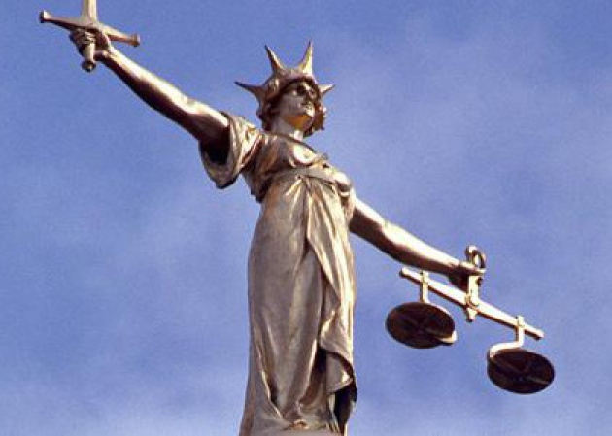

Crown Prosecution Service
A state institution operating in England and Wales, serves as a public prosecutor in criminal cases.

Slide 8

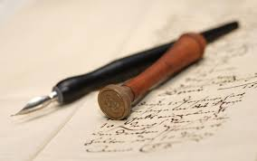
Notaries Public
Candidates must normally be a solicitor before being allowed to become a notary.
They are not a separate legal profession in their own right.

Slide 9

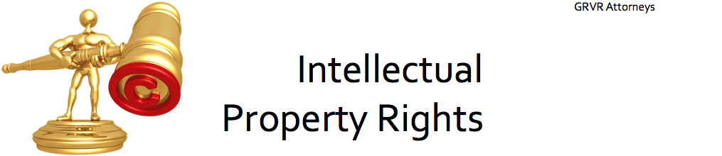
Patent and trade mark attorneys
Patent and trade mark attorneys are specialist advisers in the field of intellectual property.
They provide legal advice to clients in this field, particularly in relation to patents, trade marks, designs and copyright.

Slide 10
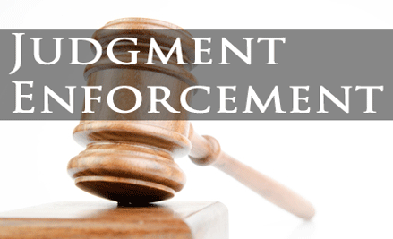
High court enforcement officers
County court bailiffs
Certificated bailiffs

Slide 11
Glossary
Legal professions – zawody prawnicze
Bachelor of Laws- licencjat nauk prawniczych
Barrister- adwokat
Solicitor- radca prawny
Lawyer - jest to ogólne określenie oznaczające prawnika
Indepandence- niezawisłość
Justice of the Peace- sędziowie pokoju
Public prosecutor – oskarżyciel publiczny
Crown Prosecution Service- Koronna Służba Prokuratorska, CPS
Notaries Public- Notariusze
Patent and trade mark attorneys- Rzecznicy patentowi i rzecznicy ds. znaków towarowych
Litigators- uprawnienia procesowe
Enforcement of judgments-egzekucja wyroków
Trade marks- znaki towarowe
Designs- wzory
Copyright- prawa autorskie
Hallmark – znak rozpoznawczy

Slide 12
Bibliografia
http://ec.europa.eu/civiljustice/legal_prof/legal_prof_uni_pl.htm
Richard L. Abel, The Making of the English Legal Profession: 1800-1988 (1998)

Slide 13
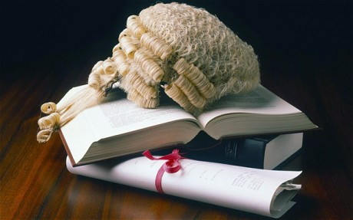
Thank you for your attention!

