Slide 1
Death Penalty in Poland
Katarzyna Kuźnar
Uniwersytet Rzeszowski
Wydział Prawa i Administracji Prawo III stacjonarne
Rok akademicki 2014/2015 Prowadzący: mgr Krzysztof Tucholski

Slide 2
The Middle Ages and the period until 1918
The death penalty existed in society since it’s very beginning and was a major tool in the fight against crime.
Death was punishment for: murders, raper, robberies, arsons,
high treasons and falsification of coins.
Death was carried out in a number of ways: breaking by wheel, decapitation, crucifixion, stoning, quartering, burning at the stake, impalement, starvation, drowning in a swamp or hanging.
The way of death often depended on social origin of perpetrator.

Slide 3
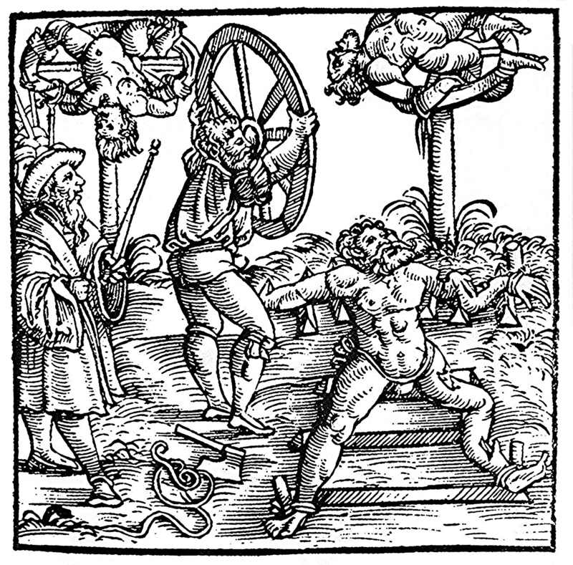
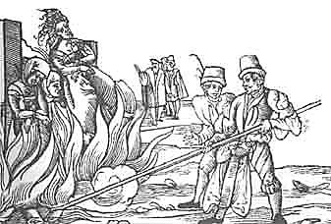
Burning at the stake
Breaking by wheel

Slide 4
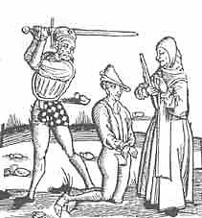
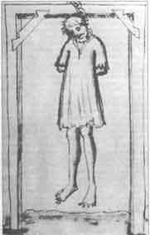
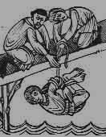
Decapitation
Hanging
Drowning

Slide 5
Death penalty in Polish criminal law until 1945
After Poland regained independence, the problem of unification of criminal law was treated as something extremely urgent.
During legislation work both supporters and opponents of death penalty emerged. ~~~~~~
1922 – Draft of criminal code developed by J. Makarewicz
Separate bill was reported by Makowski also in 1922
(suggested use death penalty in time of war or state of emergency)

Slide 6
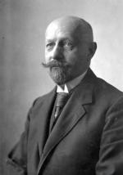
As a result of the discussions, by a majority of one vote, it was decided to include the death penalty among the substantial penalties.
The Penal Code was issued by a decree of the President of Poland on 11 July 1932.
Juliusz Makarewicz
Polish lawyer, creator of ’’Code of Makarewicz”

Slide 7
5 CAPITAL OFFENCES According to the code of makarewicz
The attack on the independent existence of the state
The attempt on the life or health of the President of Poland
Aggravated act of war treason
Diversionary action during
the war
5. Murder

Slide 8
The Polish People’s Republic (PRL)
In the Stalin period from 1944 until 1956 the death penalty was used on a massive scale. A hundred prisons executed nearly 3,500 people,
most of whom fought for freedom (as political opponents and members of Polish independence organizations) or committed murder.
In Polish People’s Republic capital punishment was sentenced for: treason, espionage, terrorism, brutal murder, but also for economic scandals.
The most notorious case of it was conviction to death in 1965 of Stanisław Wawrzecki, who was deemed guilty of ’’meat scandal”.

Slide 9
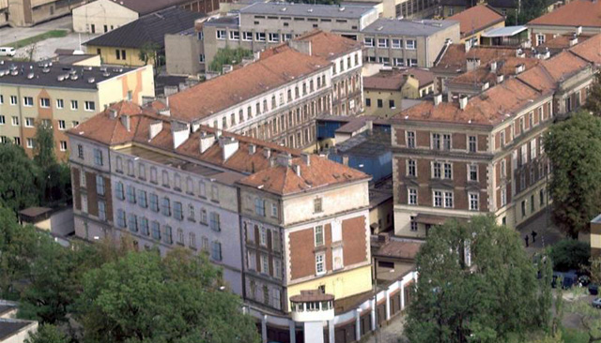
The Last execution
The last execution in Poland has been performed on Andrzej Czabański, who was convicted of murder and rape and also tried to kill two of his victim’s daughters.
The man was executed on April 21st 1988 in Cracow’s prison on
the Montelupich street. In accordance with the established procedure, the sentence was performed by hanging.

Slide 10
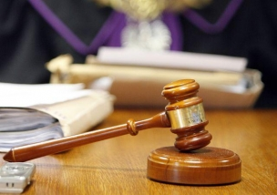
The moratorium and the amnesty
A few months later, the government of Mieczyslaw Rakowski announced a moratorium on the death penalty.
On December 7th 1989 the parliament adopted an amnesty law, which changed penalty of all prisoners that were sentenced to death to the highest penalty of 25 years imprisonment.
Between 1988 and 1996 the courts ruled the death penalty against about 10 people, including for example Mariusz Trynkiewicz.

Slide 11
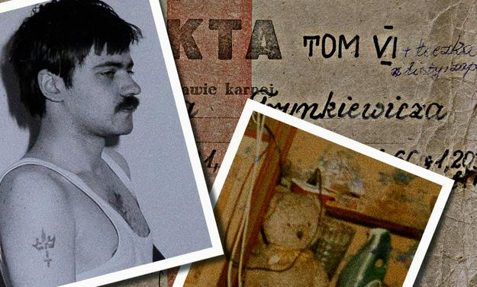
Mariusz trynkiewicz (So-called "Satan from piotrkow")
A serial killer and a sex offender who, on September 29th 1989, by the sentence of the court, was sentenced to death four times - for each murder individually. As a result of the 1989 amnesty his sentence was changed to a penalty of 25 years imprisonment. He ended his incarceration on February 11th 2014. Currently he resides in a closed resort in Gostynin. He was placed there under the recently introduced law about isolation of dangerous criminals.

Slide 12
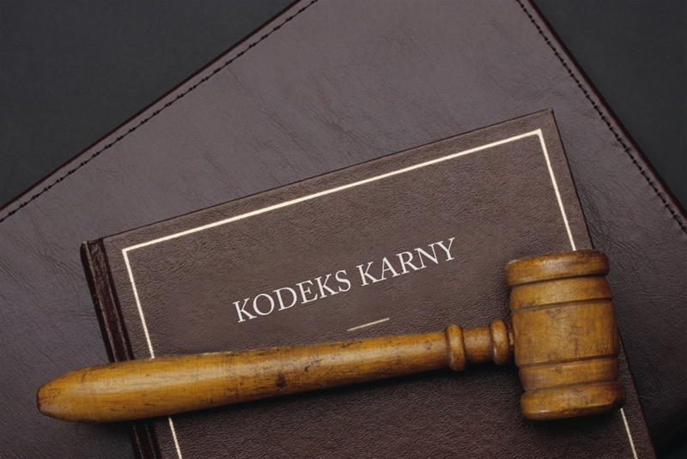
The capital punishment was formally elimineted from penal code in 1997, and was replaced by a punishment of imprisonment for life.

Slide 13
Glossary
Social origin – pochodzenie społ.
To perpetrated – popełniać
Breaking wheel – łamanie kołem
Criminal law – prawo karne
Bill – projekt ustawy
Decree – rozporządzenie
Offence – przestępstwo
Aggravated – kwalifikowany (tryb)
Treason - zdrada
Deem guilty – uznać za winnego
Polish People’s Republic – PRL
Notorious – znany
Established procedure – obowiązująca procedura
Amnesty – amnestia, ułaskawienie
Imprisonment – pozbawienie wolności
Sentence – wyrok
Incarceration – więzienie
So-called – tak zwany
Meat scandal – afera mięsna
Drowning in swamp – topienie w bagnie
Impalement – nabicie na pal

Slide 14
Bibliography
http://pl.wikipedia.org/wiki/Kara_śmierci_w_Polsce
http://pl.wikipedia.org/wiki/Lista_osób_skazanych_na_karę_śmierci_w_Polsce_po_roku_1945
http://karasmierci.manifo.com/
http://www.infor.pl/prawo/prawo-karne/wyrok-i-kara/296287,Kara-smierci-w-Polsce.html
http://rp.pl

Slide 15
Thank you for
your
attention !

