Slide 1
Author : Damian Chanek University of Rzeszów Faculty Law and Administration 3rd year law Supervisor : mgr Krzysztof Tucholski
CRIMINAL PROFILING

Slide 2
General information
Criminal profiling - (offender profiling) - investigative tool used by law enforcement agencies to identify likely suspects.
Predictive offender profiling - analyzes patterns that may predict future offenses and/or victims.
Dates back to 1888 – case of Jack the Ripper.
First offender’s profile – dr Thomas Bond on Jack the Ripper.
BAU – Behavioral Analysis Unit ( department of FBI)

Slide 3
Goals of criminal profiling
providing law enforcement with a social and psychological assessment of the offender,
providing a psychological evaluation of belongings found in the possession of the offender,
offering suggestions and strategies for the interrogation process

Slide 4
Criminal profiling aims to identify the most likely type of person that could have committed a crime, not a specific person who committed a crime,
Criminal’s personality is being determined by his choices before, during and after the a crime
Physical evidence also has a major role in describing criminal’s personality.

Slide 5
Important terms
Behavior consistency – the use of linkage analysis in order to find similar cases that have little evidence and link them to one offender because of the similarities.
Homology - is the idea that similar crimes are committed by similar offenders that possess similar characteristics.
Linkage analysis - form of behavioral analysis that is used to determine the possibility of a series of crimes as having been committed by one offender.

Slide 6
Criminal profiling methodology employed by the FBI
Contains 5 stages :
Profiling Inputs
Decision Processing
Crime Assessment
Criminal Profile
Investigative Use

Slide 7
Stage 1 : Profiling inputs
Collecting crime related informations such as :
Autopsy reports,
Photographs of crime scene,
Information about victim,
and obviously as much physical evidence as possible .
Questions to answer : what happened, why it happened and how it happened.

Slide 8
Stage 2: Decision Processing
Involves determining whether the crime in question can be located within a number of behavioral classifications.
FBI has developed a checklist of symptoms and signs, based on which they are classyfying offenders to certain types such as : power assertive serial rapist, organized mass murderer, ritual killer and many, many others.
Classyfying the primary motive of offender for e.g. financial, sexual, emotional.

Slide 9
Stage 3 : Crime Assessment
In this stage profiler is piecing together the chain of events that occured before, during and after a crime.
Reconstructing the crime from perspective of both the victim and the offender.

Slide 10
Stage 4 : The criminal profile
Creating a hypothesis about the type of person that could have committed the crime.
Usual desription contains information about suspect’s : age, sex, race, occupation, IQ, mental health, family status

Slide 11
Stage 5 : Investigative use
In this stage profiler’s report is being made avalaible to the investigating team.
Main purpose of the profile – minimizing information overload – team investigating the crime can focus their efforts on suspects that match profile delivered to them.
Some famous cases had more than 200,000 (!) possible suspects. In situations like this, description made by a profiler is crucial.
Profile is also a valuable tool in determining an interrogation strategy.

Slide 12
Criminal profiling in Poland
Relatively new and barely used
Questioned by experts because of it’s potential to derail whole investigations by pointing on a wrong type of suspect.
Profilers are being looked down on.

Slide 13
,, Inkasent z Małopolski”
Famous case that occured in 1997 – suspect Wojciech B was accused of being a serial killer.
Prof. Gierowski created an opinion about a type of person that could commit those crimes.
Profile matched a psychological evaluation done by psychiatrists.
Wojciech B. was found not guilty because of the lack of physical evidence.

Slide 14
Interesting criminal profiling cases :
Jack the Ripper – 1888
Jeffrey Dahmer – killer and rapist of 17 young boys in 1978-1991
Richard Chase called : ,, The Vampire of Sacramento”
Edmund Kemper in 1950’s
,, Mad Bomber” New York in 1960s

Slide 15
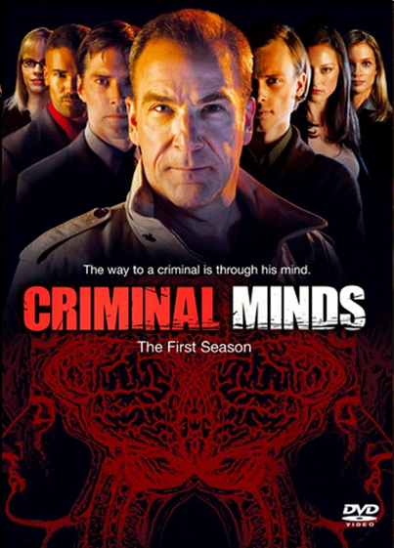
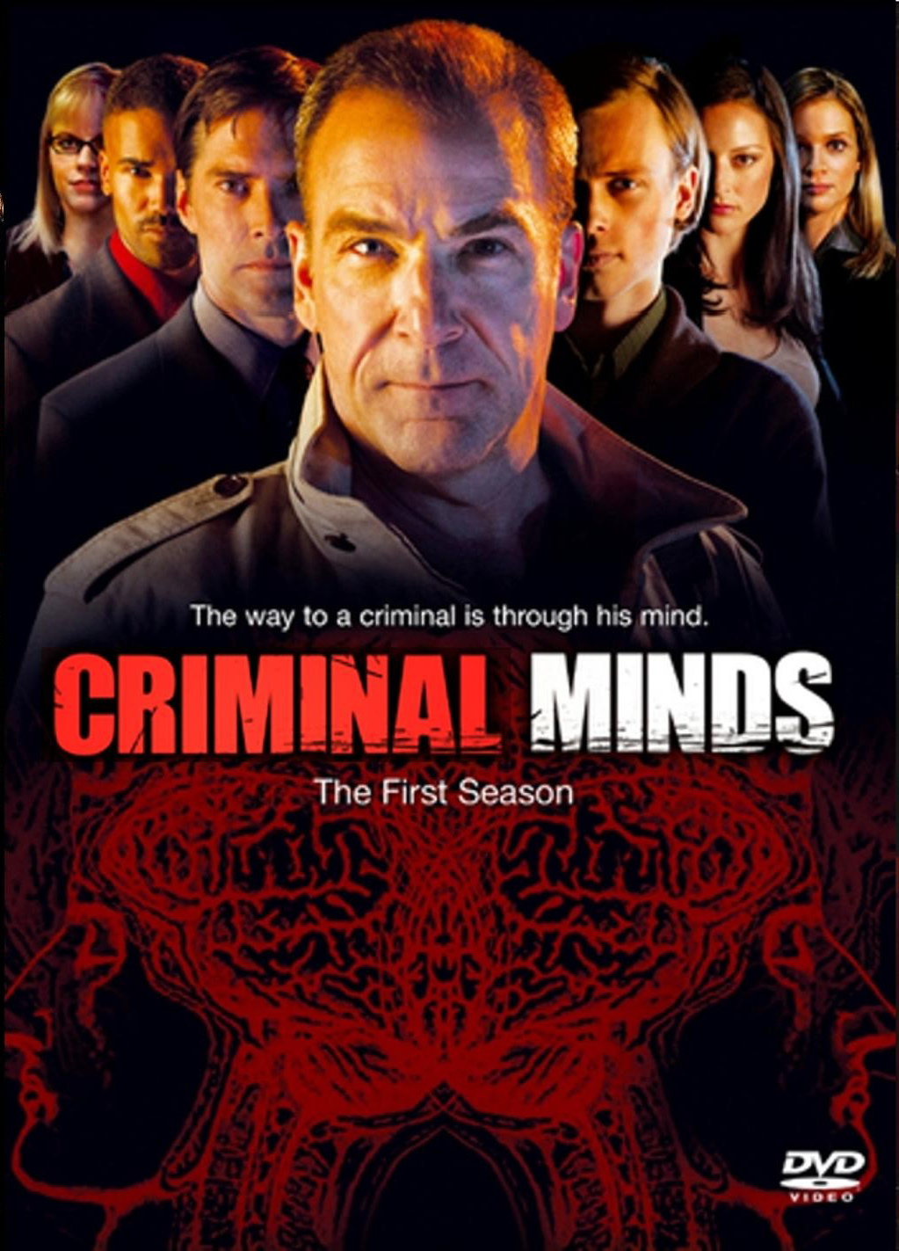
For people interested in criminal profiling I strongly reccomend a TV show called Criminal Minds.

Slide 16

Glossary
law enforcement agencies - organy ścigania
interrogation – przesłuchanie
specific – konkretny
behavioral - behawioralne
overload – przeładowanie
minimizing – minimalizacja
questioned – kwestionowane
looking down on sth – pogardzać czymś
derail – dosłw. wykoleić, zakłócić przebieg, zdestabilizować
evaluation – ocena, ewaluacja
mutilation – okaleczenie
linkage – połączenie
perpetrator - przestępca
inquiry - dochodzenie

Slide 17
Bibliography
Jerzy Konieczny, Maciej Szostak - ,, Profilowanie kryminalne”,wyd. Lex, Warszawa 2011
Lea Winerwman - ,,Criminal profiling – reality behind the myth”, 2004.
https://en.wikipedia.org/wiki/Offender_profiling
http://www.all-about-forensic-psychology.com/psychological-profiling.html

