Slide 1
ASSASSINATION OF JOHN F. KENNEDY
University of Rzeszów
Faculty of Law and Administration
Sabina Dolasińska 3rd year of law
Supervisor: Krzysztof Tucholski

Slide 2
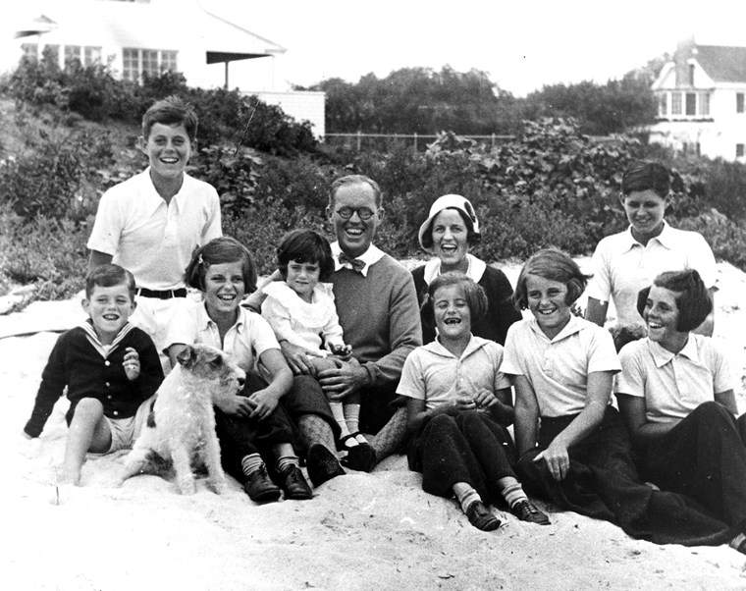
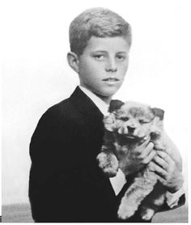
EARLY LIFE AND EDUCATION
John Kennedy was born on May 29, 1917
Joseph Kennedy (father), Rose Kennedy (mather)
Prinston University, Harvard University (study)

Slide 3
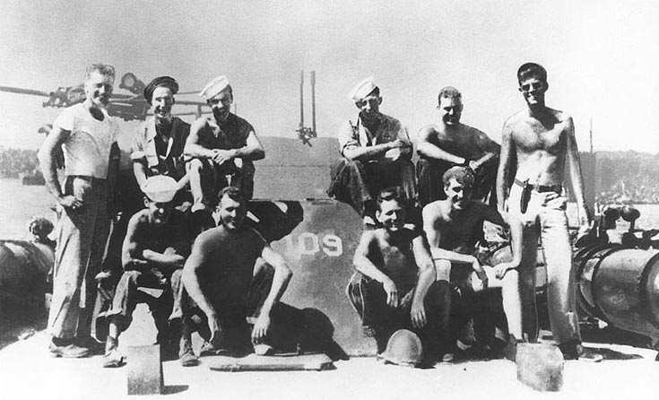
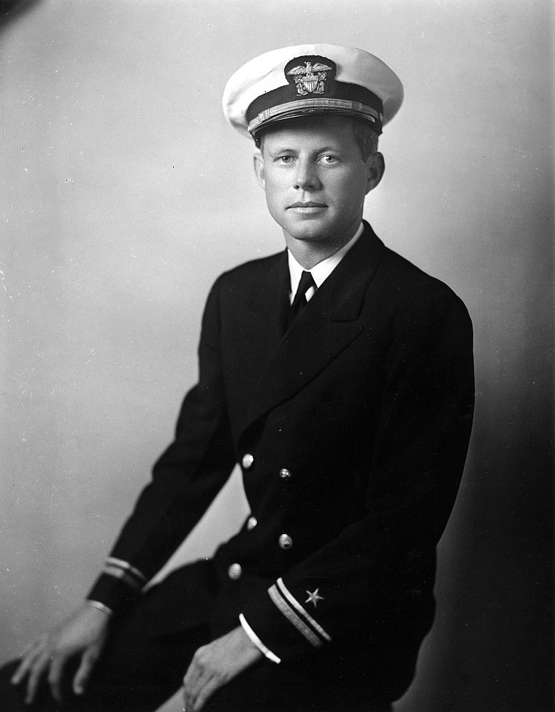
U.S. NAVY RESERVE
On September 24, 1941, John Kennedy joined the United States Naval Reserve.
On September 2, 1943, PT-109 was rammed at an angle and cut in half by destroyer Amagiri.
Navy and Marine Corps Medal, Purple Heart Medal

Slide 4
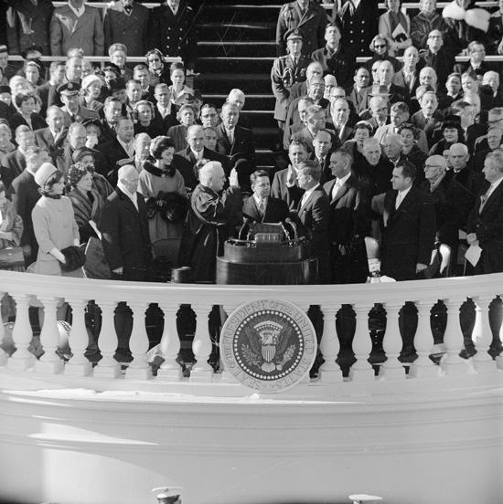
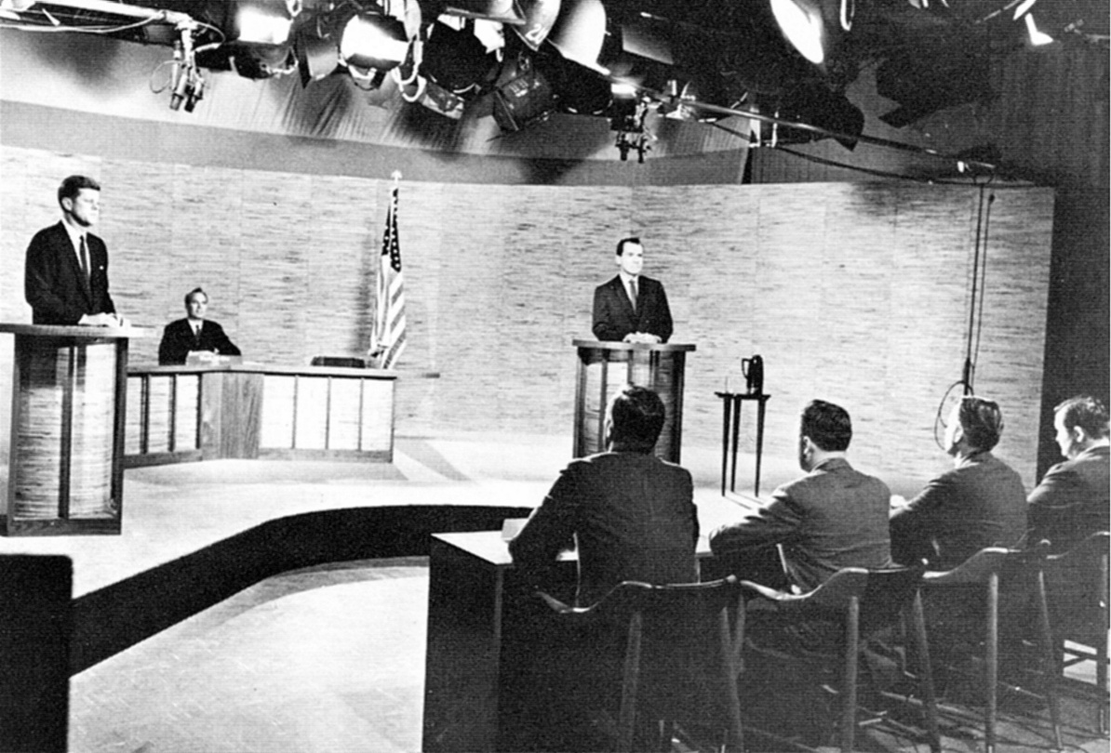
PRESIDENTIAL ELECTION
Richard Nixon from Republican Party
On October 26, 1960 -> first televised U.S. presidential debates
John Kennedy was sworn in as 35th president on January 20, 1961.

Slide 5
ASSASSINATION
President Kennedy was assassinated in Dallas, Texas on November 22, 1963.
Parkland Hospital
Lee Harvey Oswald was killed by Jack Ruby on November 24.
Warren Commision
A 2004 Fox News poll found that 66% of Americans thought there had been a conspiracy to kill President Kennedy, while 74% thought there had been a cover-up. A Gallup Poll in mid-November 2013, showed 61% believed in a conspiracy, and only 30% thought Oswald did it alone.

Slide 6
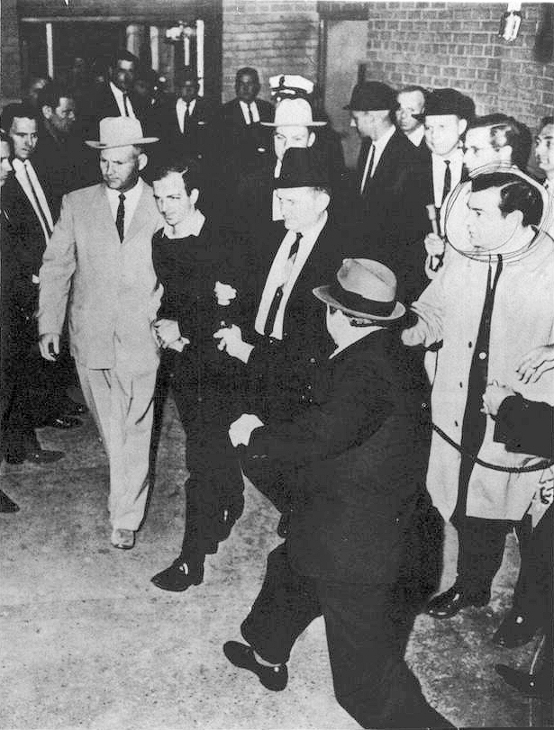
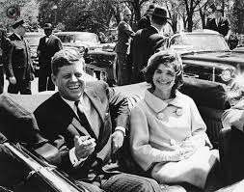
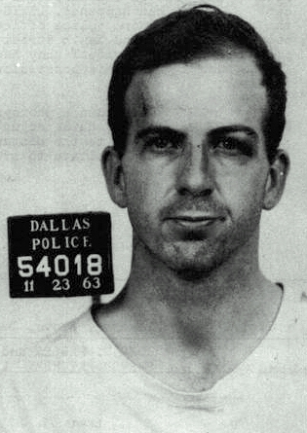
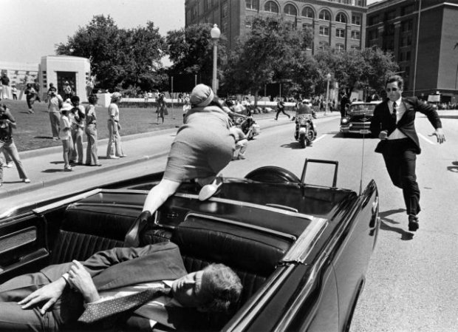
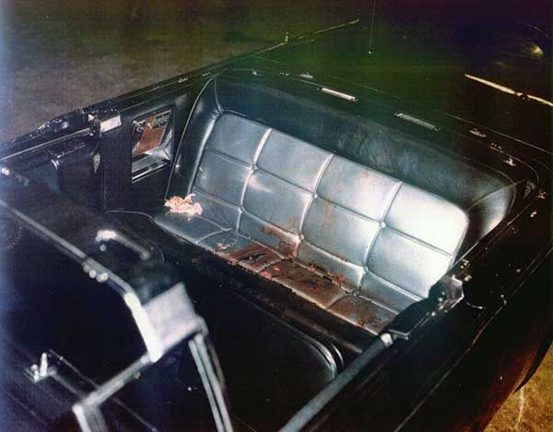

Slide 7
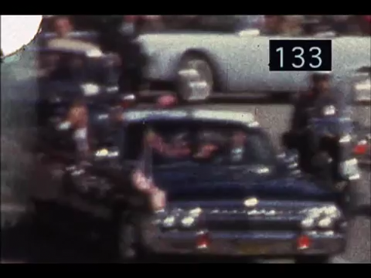

Slide 8
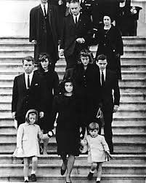
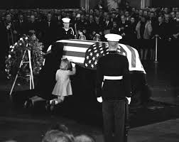
FUNERAL
A Requiem Mass was held for Kennedy at the Cathedral of St. Matthew the Apostle on November 25, 1963. Afterwards, Kennedy was interred in a small plot, in Arlington National Cemetery.

Slide 9
GLOSSARY
wealthy - zamożny
assigned – przydzielony
commander – dowódzca
patrol boat – łódz tropiąca
presidential debetes – debata prezydencka
sworn - zaprzysiężony
assassination – zamach
prosecute - zaskarżyć
Mass – msza

Slide 10
BIBLIOGRAPHY
https://en.wikipedia.org/wiki/John_F._Kennedy
https://en.wikipedia.org/wiki/Assassination_of_John_F._Kennedy

Slide 11
THANK YOU FOR YOUR ATTENTION !

