Slide 1
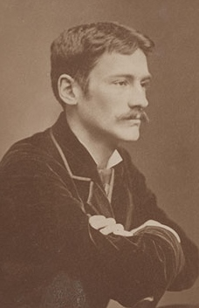
Thomas Wilmer Dewing
Anna Szukała
II Sztuki Wizualne
Rzeszów 2015

Slide 2
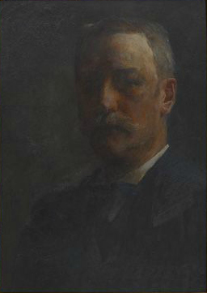
Life
Dewing’s Art
Inspirations
Explanation of my choice

Slide 3
Biography
Born on May 4th, 1851, Boston, Massachusetts
1876 – 1879, studies in Paris at the Académie Julian
1880, moved to New York, met Maria Oakey and married her
1897, joined the Ten American Painters
Death on November 5th, 1938, New York

Slide 4
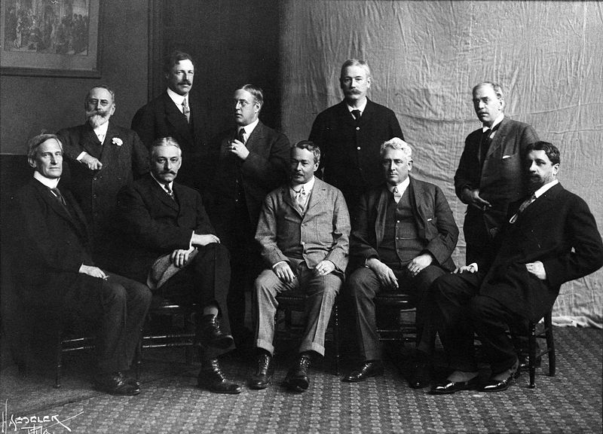
„The Ten”, 1908

Slide 5
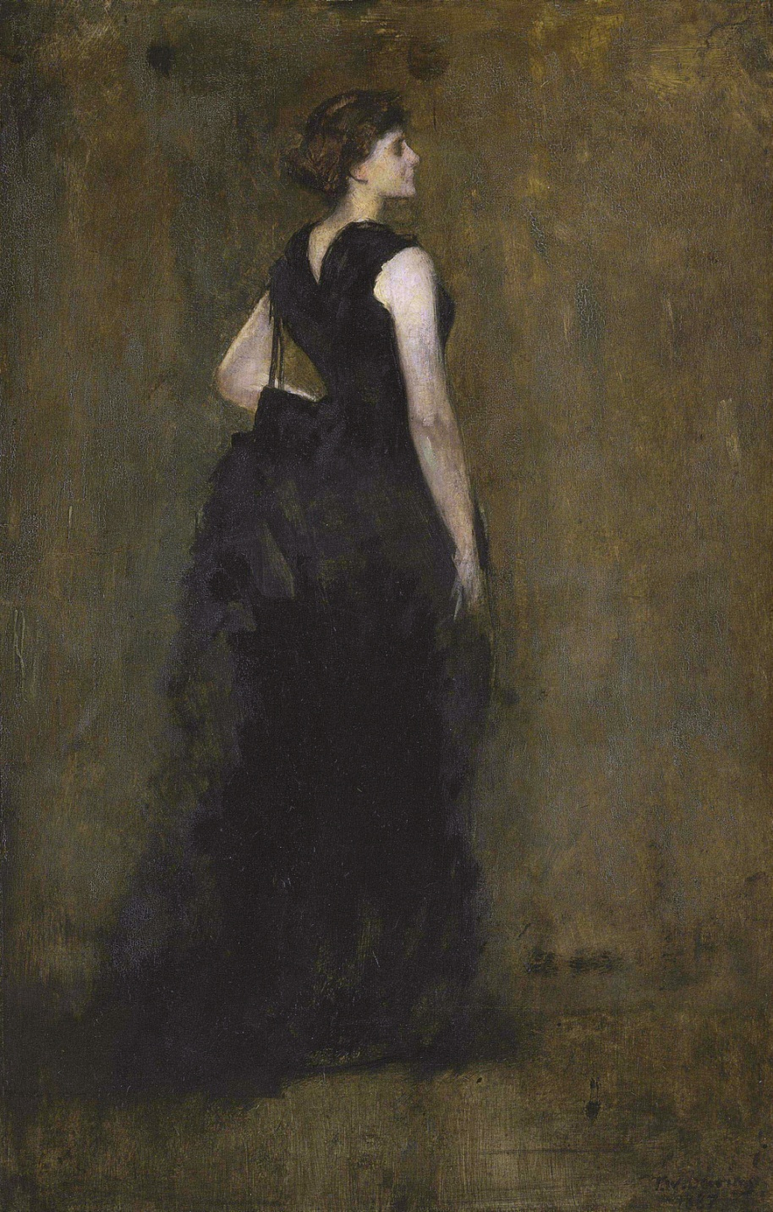
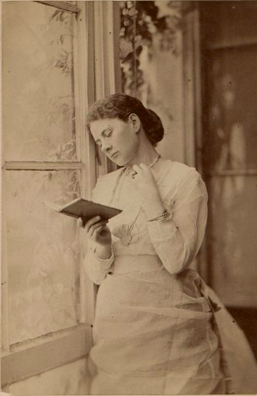
„Maria Oakey by Thomas Wilmer Dewing”

Slide 6
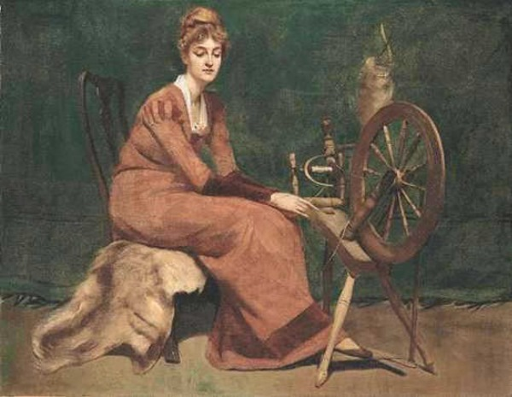
Artworks
„The Spinner”, 1880

Slide 7
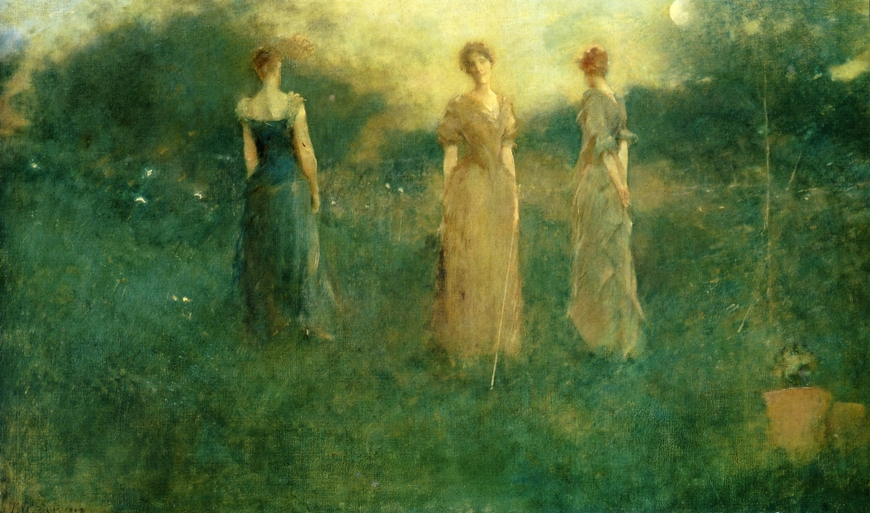
„In the Garden”, 1892-1894

Slide 8
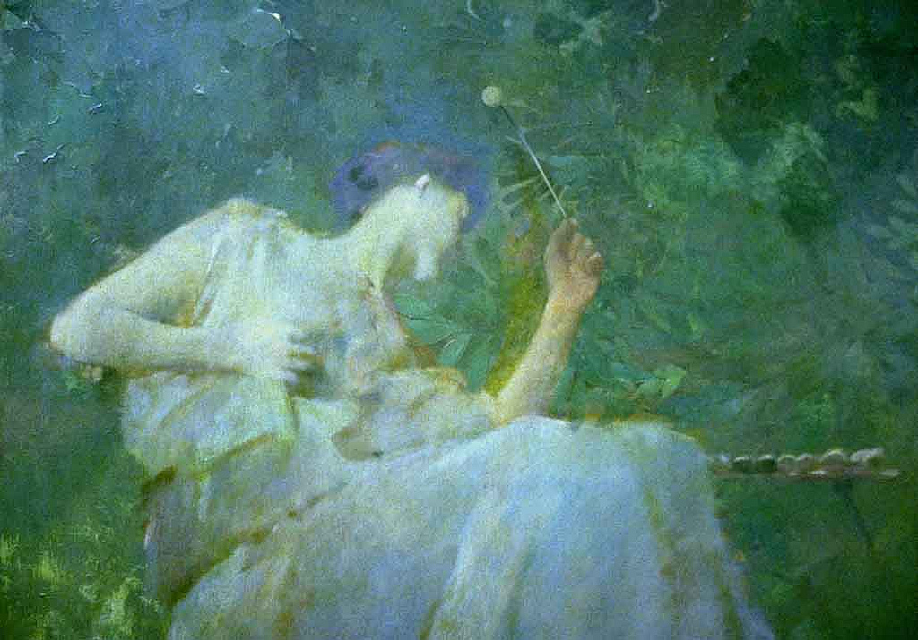
„The four sylvan sounds”, 1886-1887

Slide 9
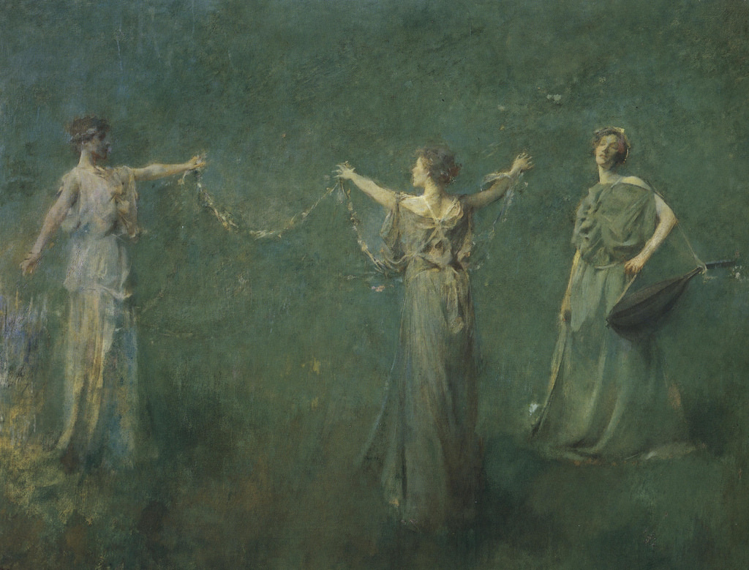
„La Pêche”, 1901-1904

Slide 10
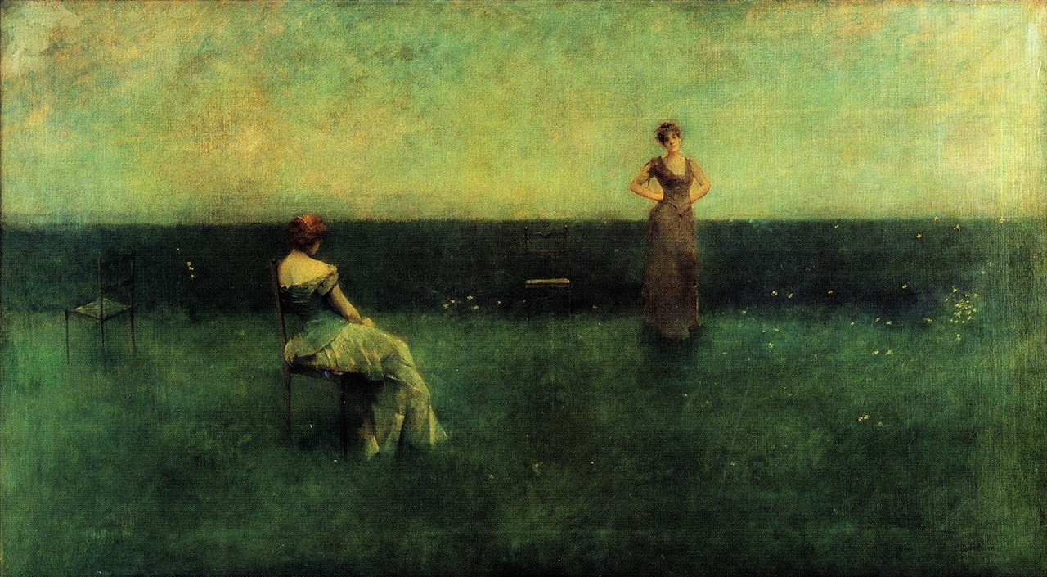
„ The Recitation”, 1891

Slide 11
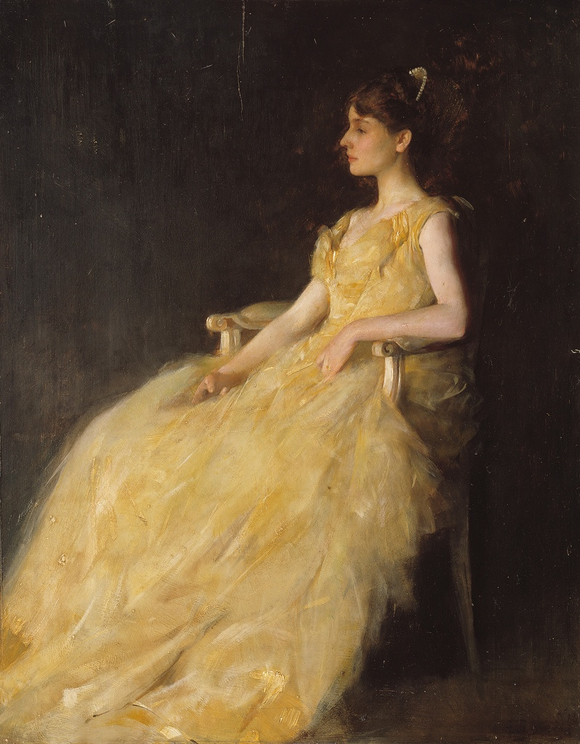
„Lady in Yellow”, 1888

Slide 12
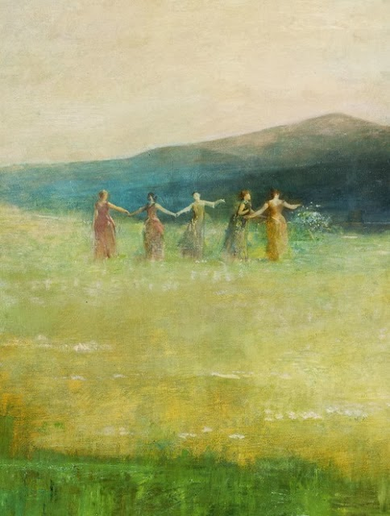
„Spring”, 1890

Slide 13
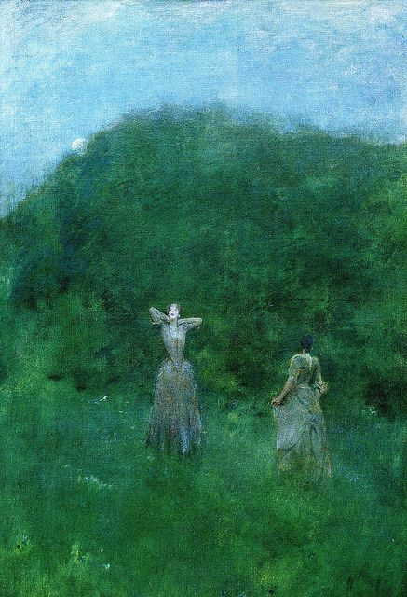
„Moonrise”, 1893

Slide 14
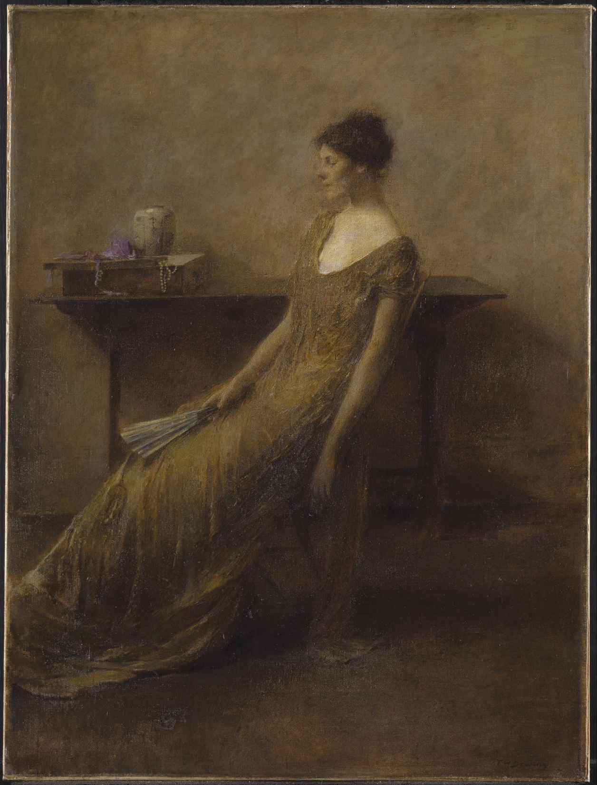
„Lady in Gold”, 1910

Slide 15
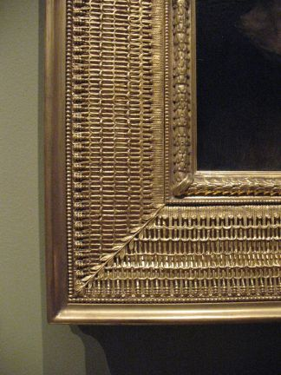
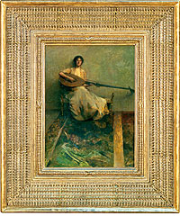
Frames made by Stanford White

Slide 16
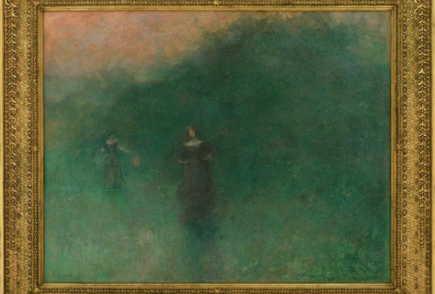
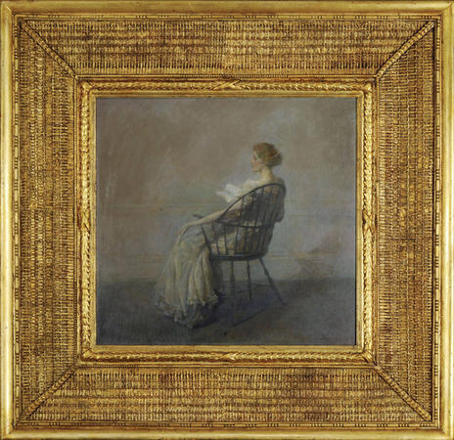

Slide 17
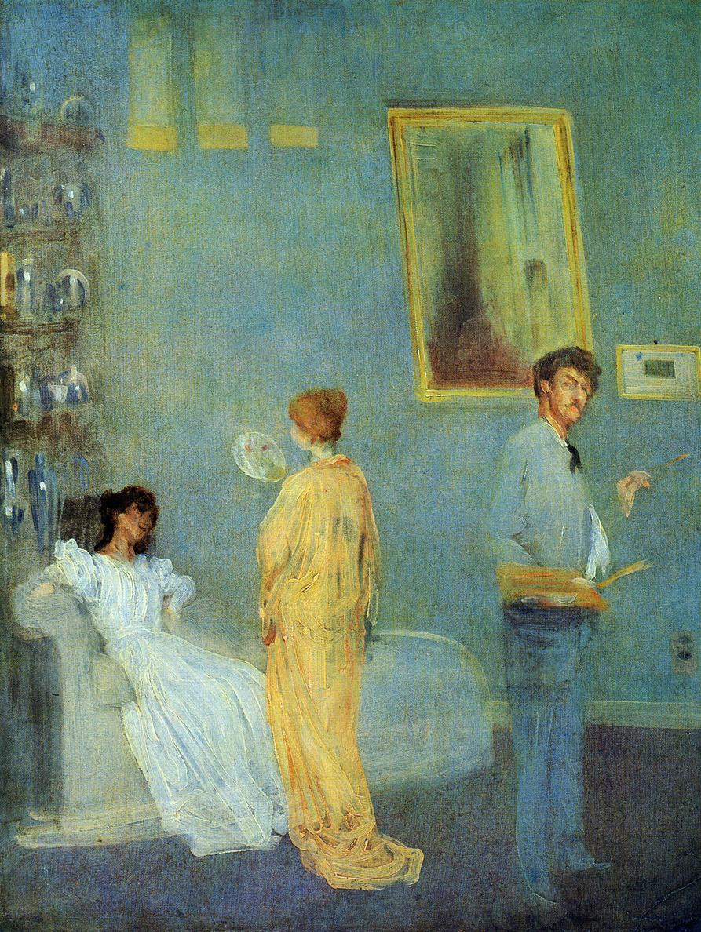
Inspirations
James McNeill Whistler
„Whistler in his studio”, 1865

Slide 18
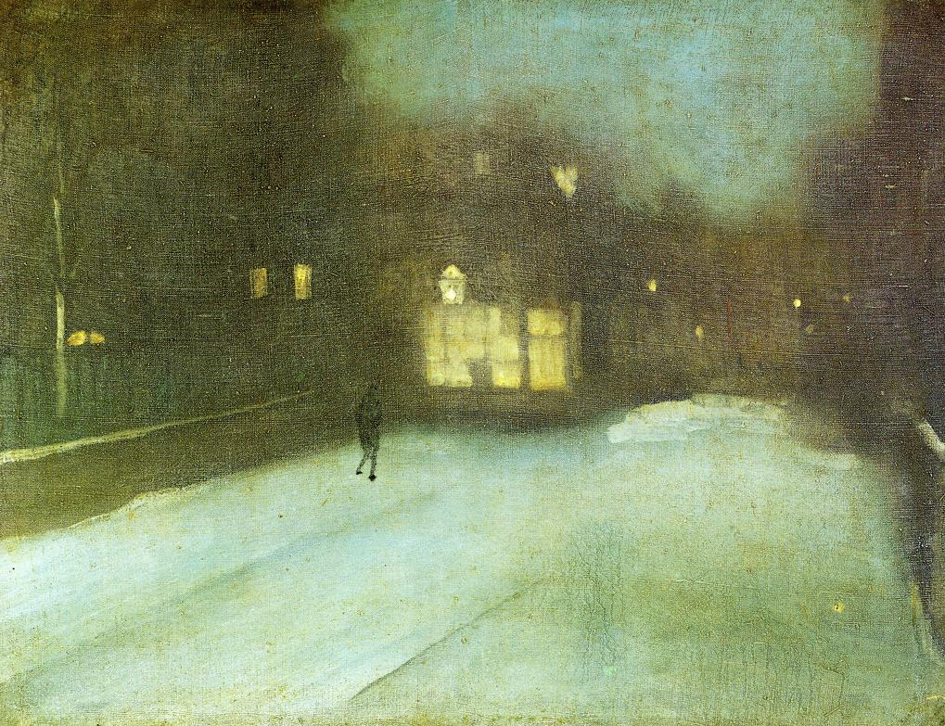
„Nocturne in Grey and Gold: Chelsea Snow”, 1876

Slide 19
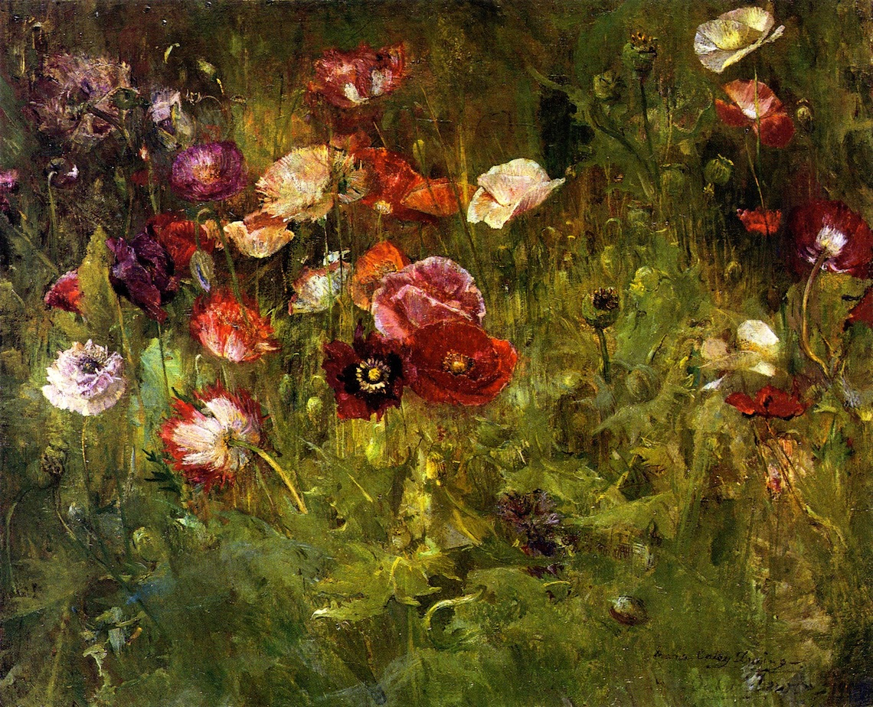
Maria Oakey
„ A Bed of Poppies”, 1909

Slide 20
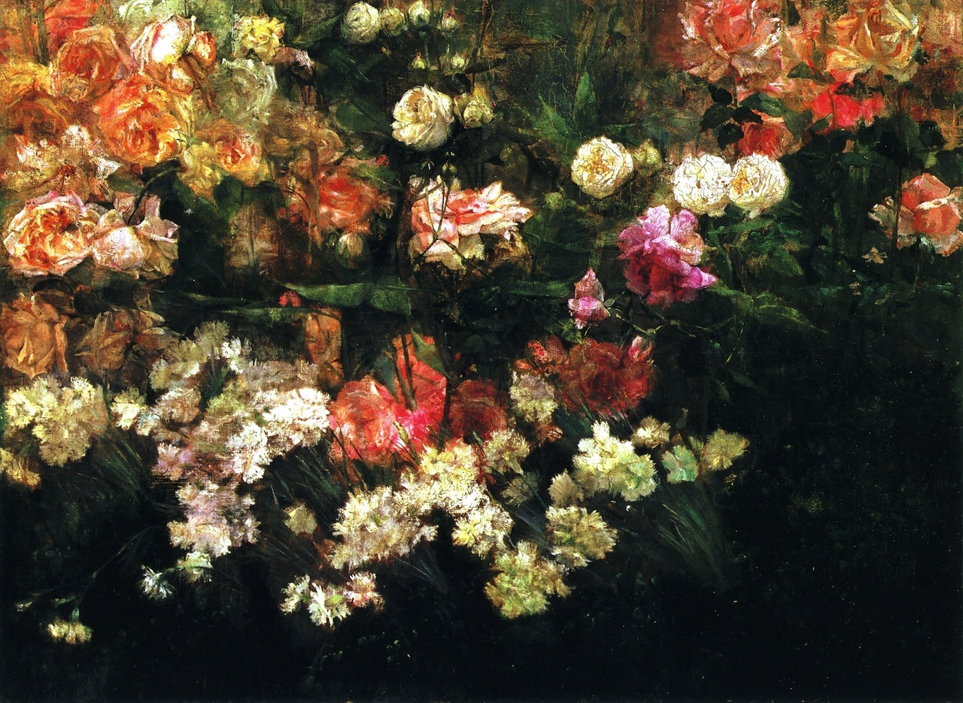
„Garden in May”, 1895

Slide 21
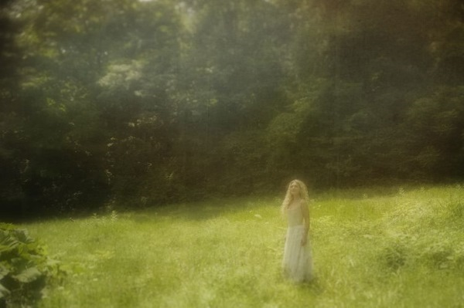
Explanation of my choice
Photoshoot inspired by Dewing’s painting

Slide 22
Bibliography
https://www.asia.si.edu/collections/zoomObject.cfm?ObjectId=48294
http://crystalbridges.org/blog/maria-oakey-dewing/
http://en.wikipedia.org/wiki/Maria_Oakey_Dewing#/media/File:Maria_Oakey_Dewing_by_Thomas_Wilmer_Dewing_(1851-1938).jpg
http://floralls.tumblr.com/post/108714278716/labellefilleart-garden-in-may-maria-oakey
https://www.tumblr.com/tagged/acad%C3%A9mie-julian
http://pl.wikipedia.org/wiki/Plik:Ten_American_Painters_(The_Ten).jpg
https://www.pinterest.com/pin/54324739231276968/
https://www.pinterest.com/pin/54324739231276968/
http://www.the-athenaeum.org/art/full.php?ID=45718
https://www.flickr.com/photos/hauksven/7897762700
https://www.flickr.com/photos/97048587@N04/12109742835
http://www.the-athenaeum.org/art/full.php?ID=45779
http://en.wikipedia.org/wiki/Maria_Oakey_Dewing#/media/File:A_Bed_of_Poppies-Maria_Oakey_Dewing.jpg
http://www.wikiart.org/en/james-mcneill-whistler/nocturne-in-grey-and-gold-chelsea-snow-1876
http://massimogienda.blogspot.com/2013/11/thomas-wilmer-dewing.html
http://www.bertc.com/g4/dewing30.htm

Slide 23
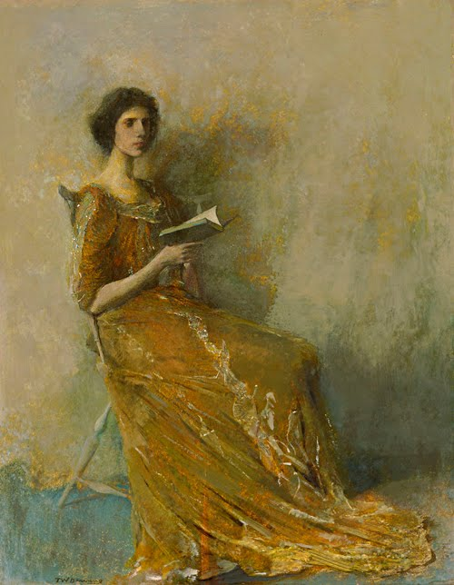
Thank you for you attention
„Portrait in a Brown Dress”, 1908

