Slide 1
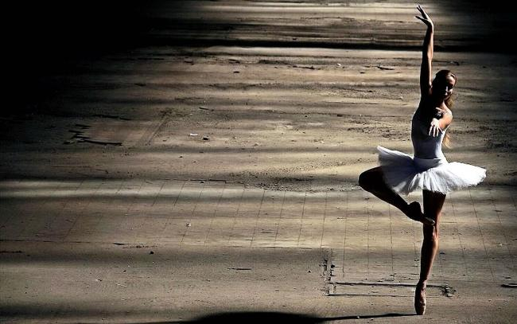
Contemporary dance
Katarzyna panek
1 Wf sum

Slide 2
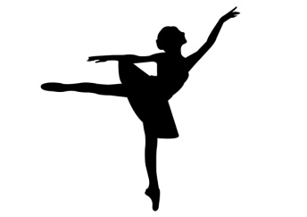
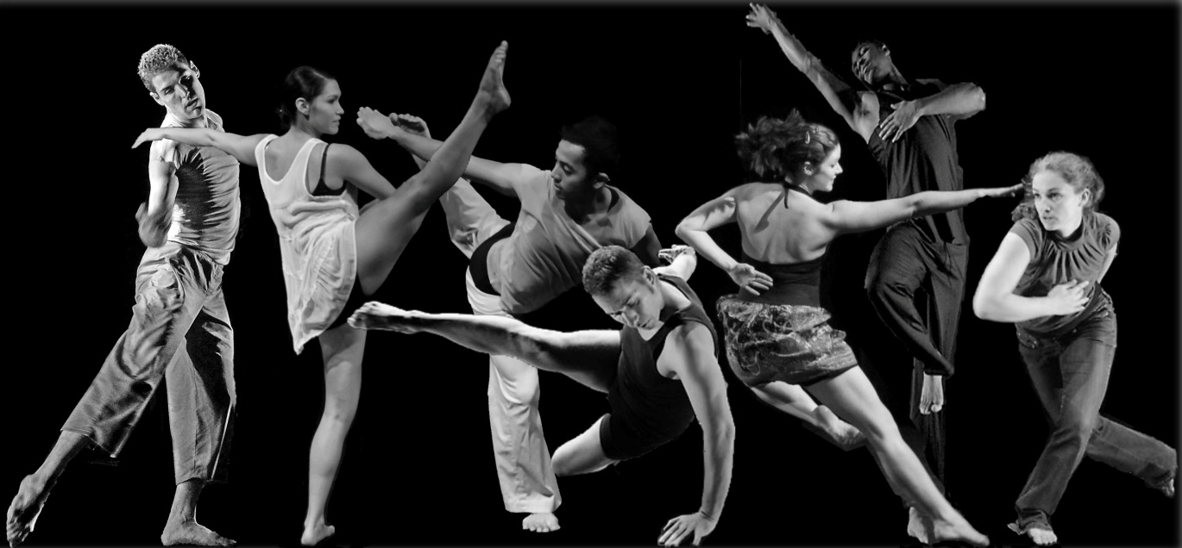
What is contemporary dance?
Contemporary dance is a style of expressive dance that combines elements of several dance genres including modern, jazz, lyrical and classical ballet. Contemporary dancers strive to connect the mind and the body through fluid dance movements.

Slide 3
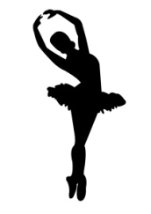
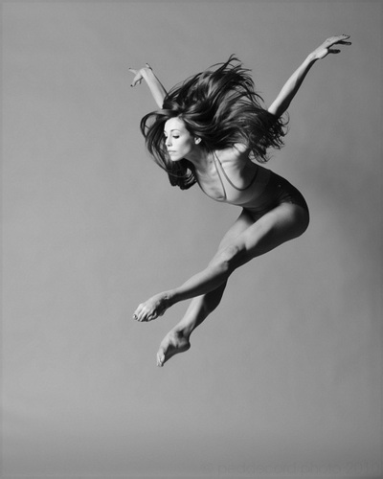
Contemporary dance
Contemporary dance stresses versatility and improvisation, unlike the strict, structured nature of ballet.
Contemporary dancers focus on floorwork, using gravity to pull them down to the floor.
This dance genre is often done in bare feet.
Contemporary dance can be performed to many different styles of music.

Slide 4

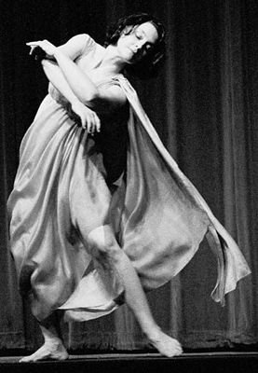
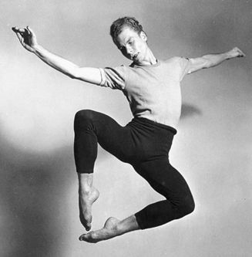
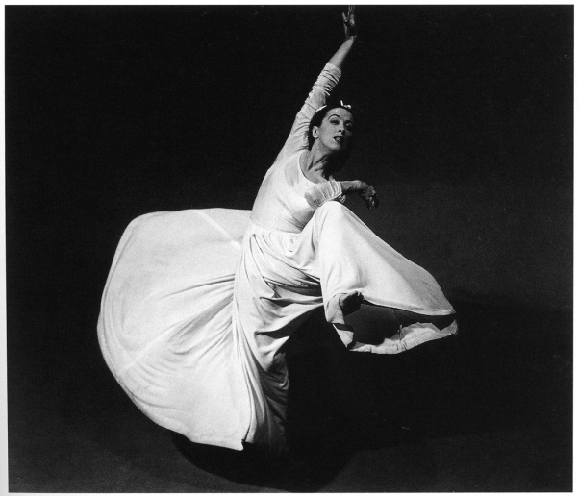
Pioneers of contemporary dance
Pioneers of contemporary dance include Isadora Duncan, Martha Graham and Merce Cunningham. These contemporary dancers all believed that dancers should have freedom of movement, allowing their bodies to freely express their innermost feelings.

Slide 5
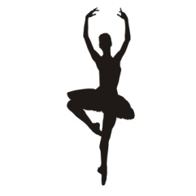
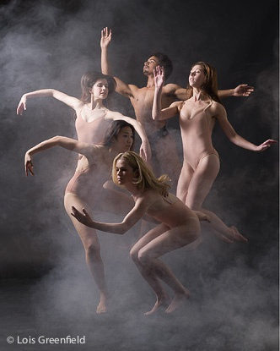
Key ideas
Contemporary dance does refuse the classical ballet's leg technique in favor of modern dance's stress on the torso
Contemporary dance is not necessarily narrative form of art
Choreography that appears disordered, but nevertheless relies on technique
Unpredictable changes in rhythm, speed, and direction
Multiple and simultaneous actions
Suspension of perspective and symmetry in ballet scenic frame perspective such as front, center, and hierarchies
Creative freedom
"Independence between dance and music"
Dance to be danced, not analyzed!!

Slide 6
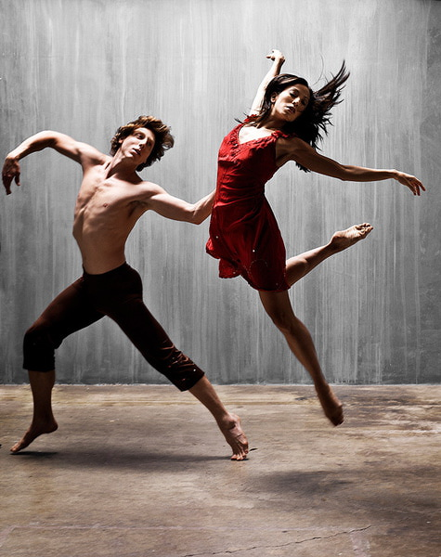
Choreographer's role
There is usually a choreographer who makes the creative decisions. He/she chooses whether the piece is an abstract or a narrative one.
Dancers are selected based on their skill and training.
The choreography is determined based on its relation to the music or sounds that is danced to.
The role of music in contemporary dance is different from in other genres because it can serve as a backdrop to the piece.
The choreographer has control over the costumes and their aesthetic value for the overall composition of the performance and also in regards to how they influence dancers’ movements.

Slide 7

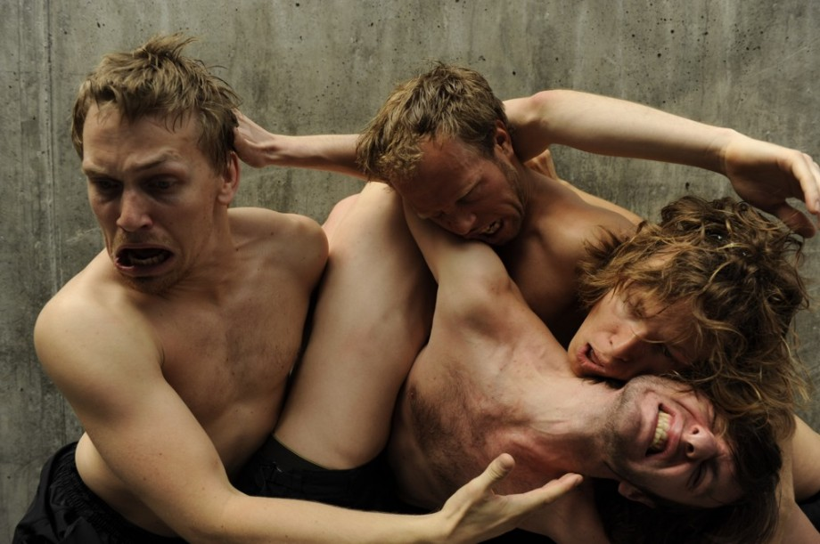
Thank you for your attention
https://www.youtube.com/watch?v=dc8ExNgj4Uw&feature=share

