Slide 1
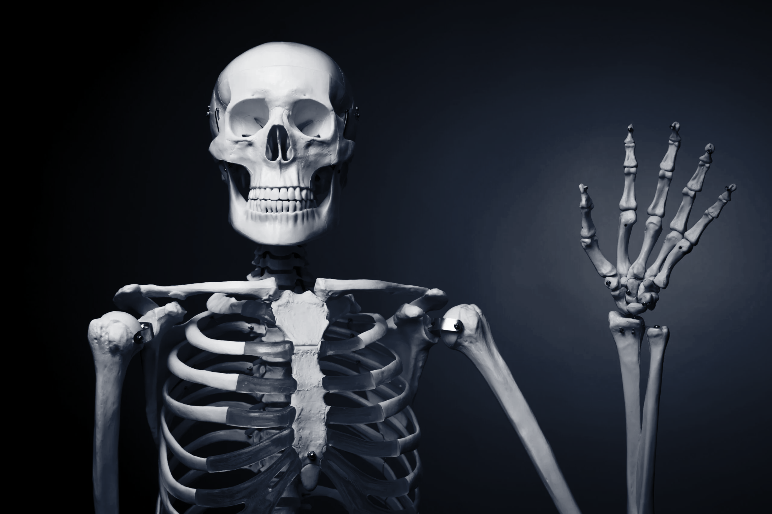

Kamila Dubiel
Faculty of Medicine,Rzeszów University
Physiotherapy, Year 3
2022/2023
Hello
The joint

Slide 2
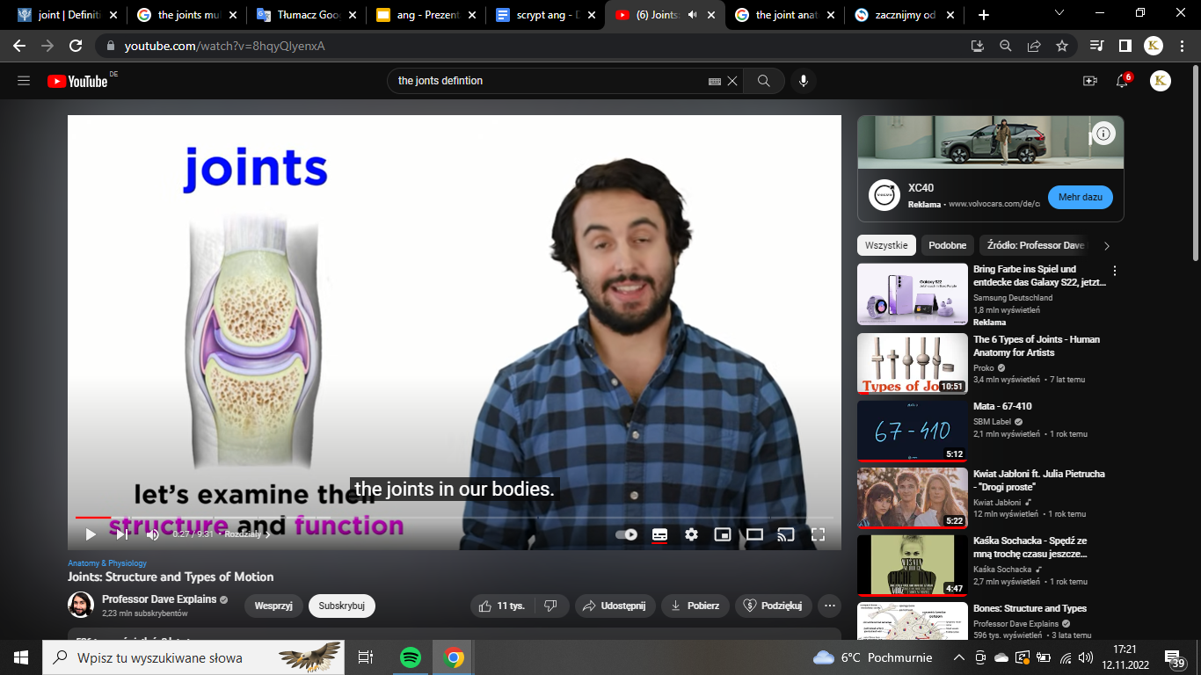
Joint in anatomy, a structure that separates two or more adjacent elements of the skeletal system. Depending on the type of joint, such separated elements may or may not move on one another.
https://encrypted-tbn0.gstatic.com/images?q=tbn:ANd9GcTjc6IX6TTi3u4DkzgoiImg8PXvKrOJGMhcHVtJbEZcYm8eEKSfE0tyH7Q6OoeWdGwo2Aw&usqp=CAU
These are found where bones meet

Slide 3
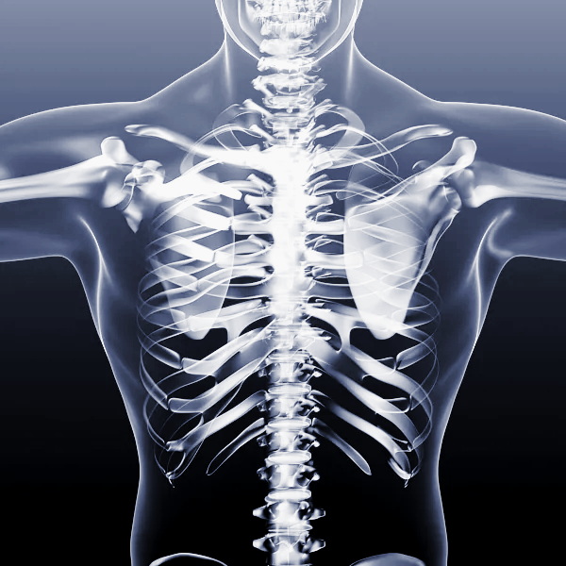
Joints can be classified by:
STRUCTURE
(composition)
or
FUNCTION
(extendt of mobility)

Slide 4
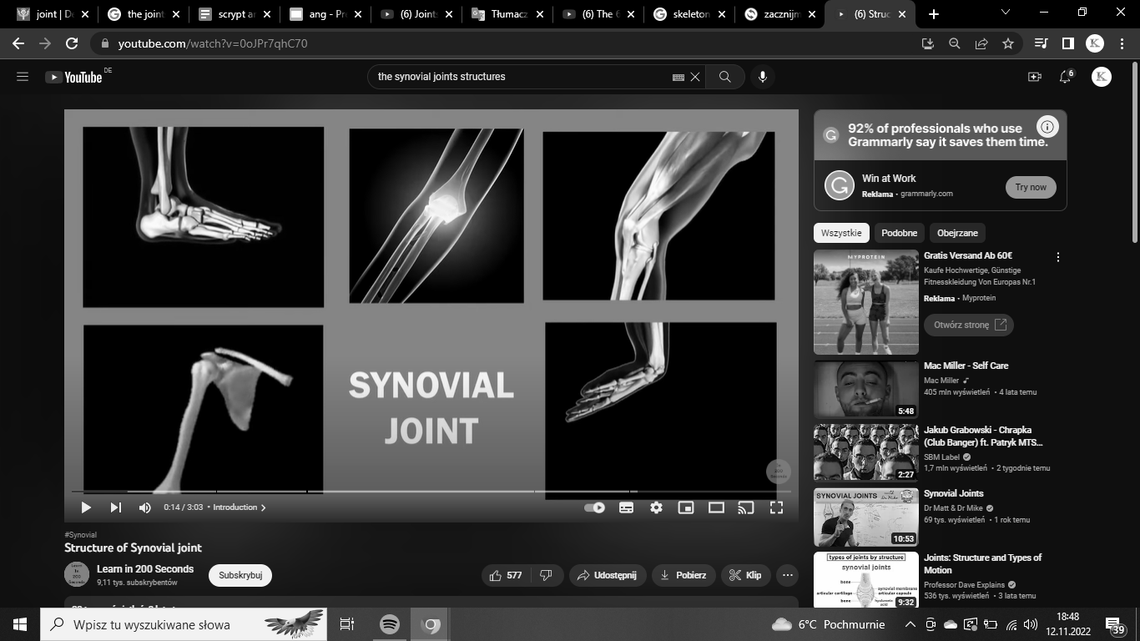
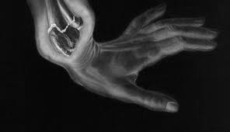
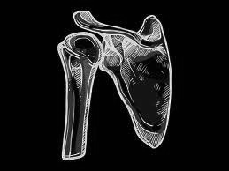
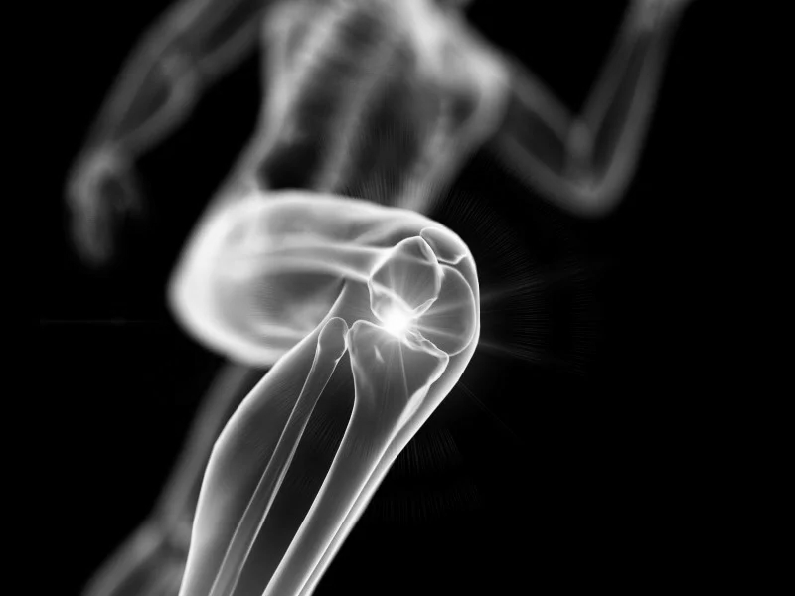
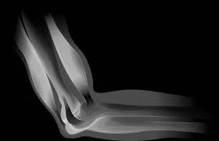
Synovial joints
are the most common type of joint in the body

Slide 5
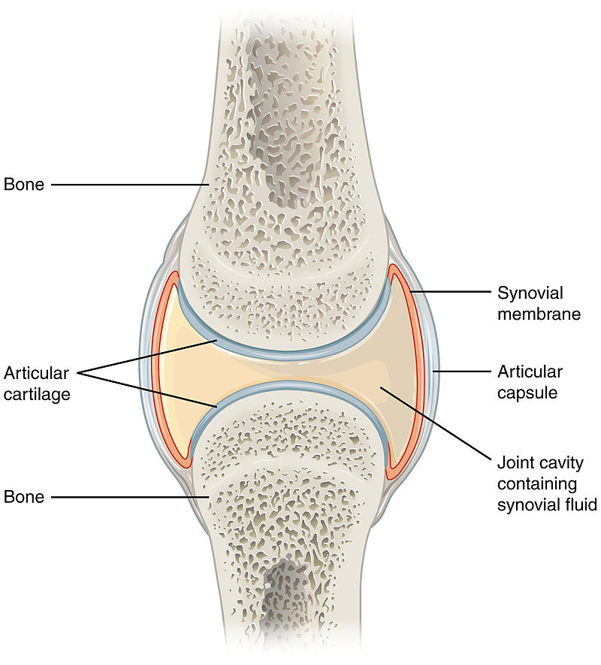
Synovial joint structure
https://upload.wikimedia.org/wikipedia/commons/8/8b/907_Synovial_Joints.jpg

Slide 6
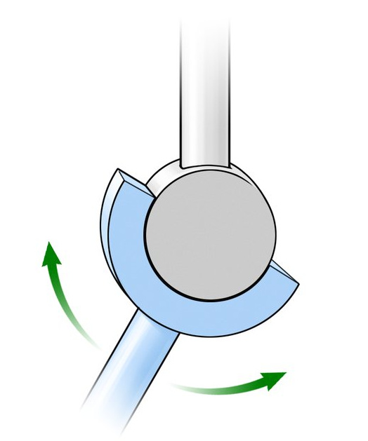
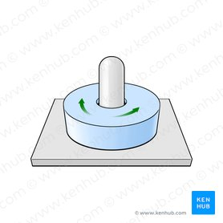
6 types of synovial joints
Hinge Joint eg. Elbow
Pivot Joint eg. median atlantoaxial joint
Flexion
Rotation
Extension
https://www.kenhub.com/thumbor/i6aDdd4lPrWHaK31ivdRTsqMtAo=/fit-in/800x1600/filters:watermark(/images/logo_url.png,-10,-10,0):background_color
https://www.kenhub.com/thumbor/Vy2LFo8dHEar9r6qLwuUn6UgJFQ=/fit-in/278x278/filters:fill(FFFFFF,true):watermark(/images/watermark_only_sm.png,0,0,0)

Slide 7
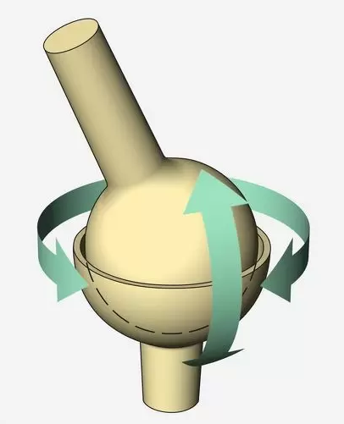
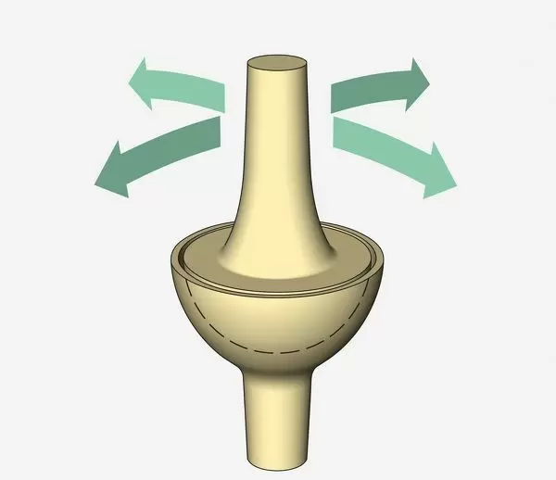
Ellipsoid Joint eg. wrist
Ball & Socket Joint
eg. hip
movement in all three planes
Flexion
Extension
Abduction
Adduction
Circumduction
https://media.gettyimages.com/illustrations/illustration-ball-and-socket-joint-arrows-indicating-possible-of-illustration-id73016739
https://www.fineartstorehouse.com/p/629/illustration-ellipsoidal-joint-13559515.jpg.webp

Slide 8
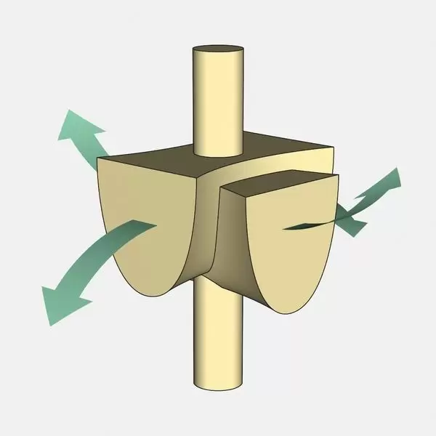
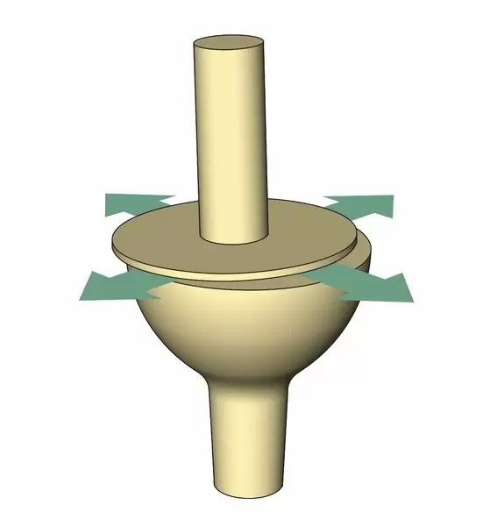
Saddle Joint eg. joint of thumb
Plane Joint eg. Intercarpal
Joints
Flex
Extend
Circumduct
Abduct
Adduct
Glide
Rotate
https://www.fineartstorehouse.com/p/629/illustration-saddle-joint-arrows-indicating-13559507.jpg.webp
https://www.fineartstorehouse.com/p/629/illustration-plane-joint-arrows-indicating-13559509.jpg.webp

Slide 9
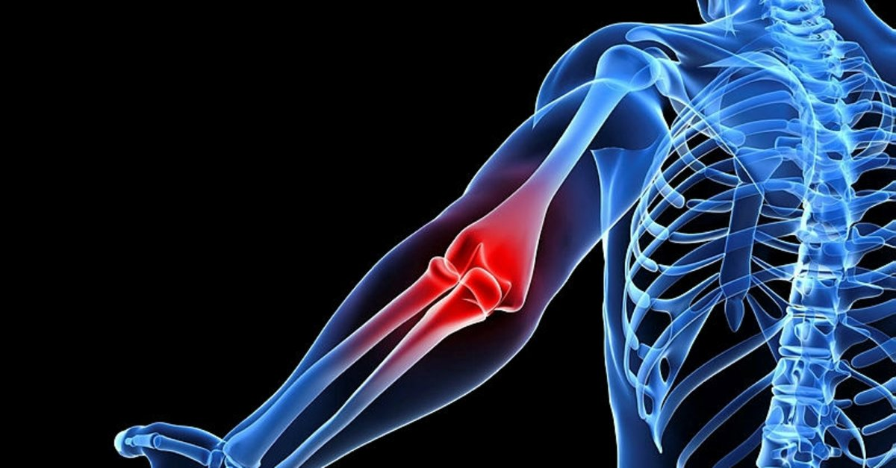
Osteoarthritis is the common form of joint degeneration
Patients’ complaints?
Pain or aching
Stiffness
Decreased range of motion (or flexibility)
Swelling
https://iasbh.tmgrup.com.tr/32bd09/1200/627/0/30/800/448?u=https://isbh.tmgrup.com.tr/sbh/2019/11/28/kireclenme-belirtileri-nelerdir-neden-olur-kireclenme-tedavisi-nasil-yapilir-1574950416405.jpg

Slide 10
What are the risk factors for Osteoarthritis?
Age
Joint injury
Genetics
Gender
Obesity
Race

Slide 11
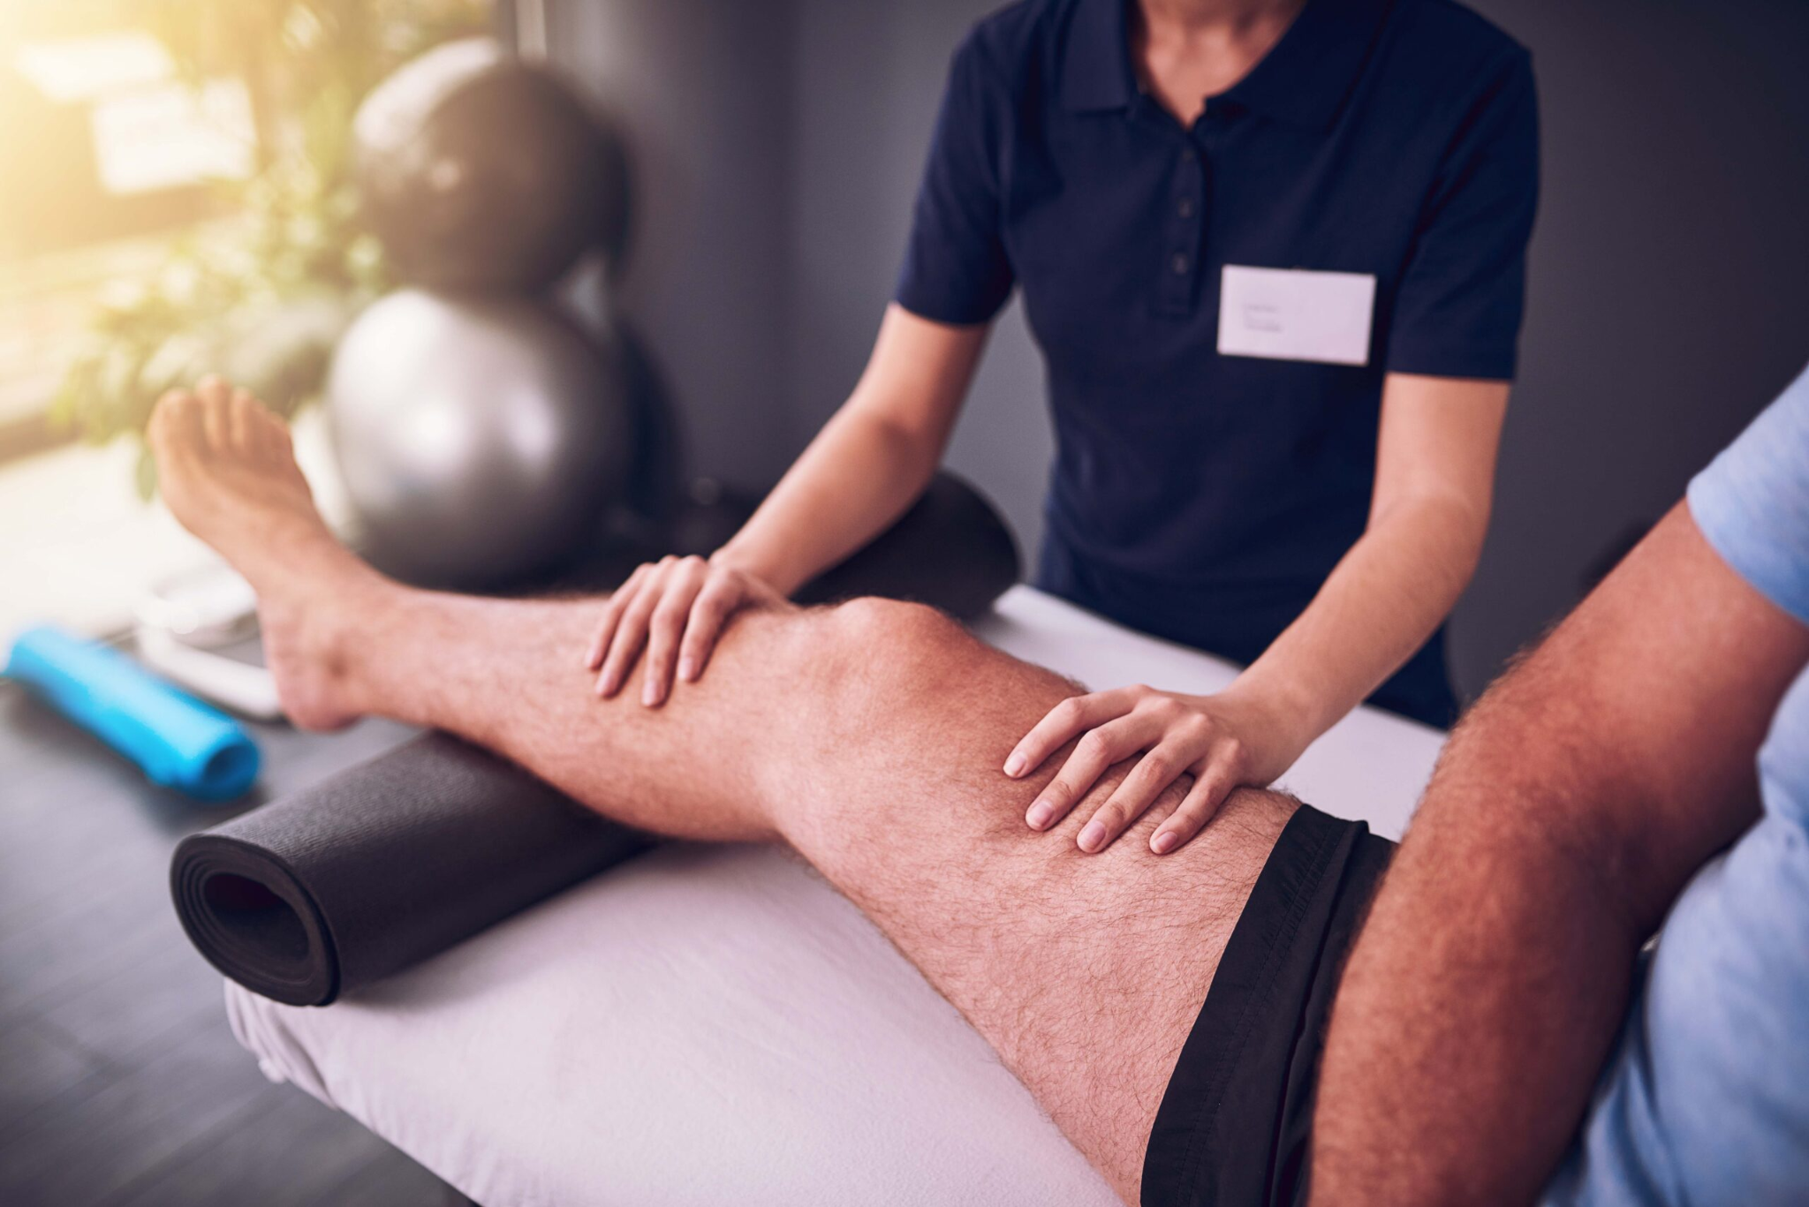
How is Osteoarthritis treated?
Increasing physical activity
Physical therapy
Weight lose
Medications
Supportive devices
Surgery
https://e3physio.com.au/wp-content/uploads/2022/04/kneeosteoarthritis-scaled.jpg

Slide 12
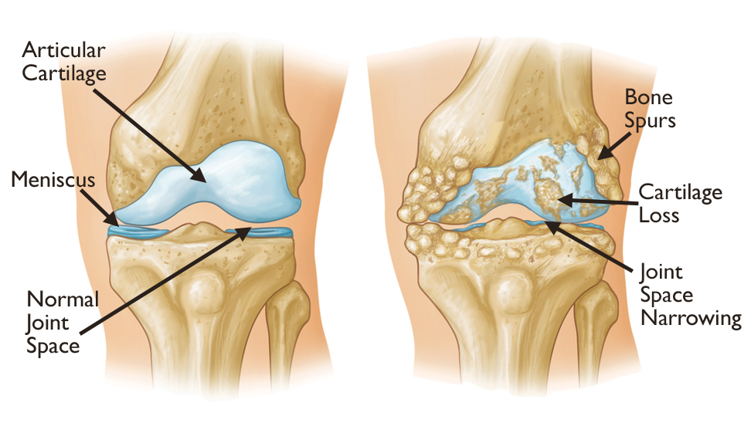
Healthy joint
Osteoarthritis
https://orthoinfo.aaos.org/link/91c49ea6dd424a59b177fb0e2bf84f18.aspx

Slide 13
Vocabulary
Bibliography
synovial joint - staw z błoną maziową
ball and socket - staw panewkowy
hinge joint - staw zawiasowy
ellipsoidal joint - staw eliptyczny
saddle joint - staw siodełkowy
plane joint - staw płaski
pivot joint - staw obrotowy
articular cartilage - chrząstka stawowa
joint capsule - torebka stawowa
synovial fluid - płyn maziowy
synovial membrane - błona maziowa
joint cavity - jama stawowa
crepitus - trzeszczenie
bony spurs - wyrośle kostne
stiffness - sztywność
lubricate - stanowć substancję poślizgową
lining - wyściółka
degeneration - zwyrodnienie
http://anationary.pl/slownik-anatomiczny
I.M. KhanS.N. Redman R. Williams G.P Dowthwaite S.F.OldfieldC.W.Archer; Volume 79, 2007, Pages 1-36; The Development of Synovial Joints. Elsevier Health Sciences
https://www.cdc.gov/arthritis/basics/osteoarthritis.htm
Elise F. Morgan, Ginu U. Unnikrishnan, and Amira I. Hussein. Bone Mechanical Properties in Healthy and Diseased States

Slide 14
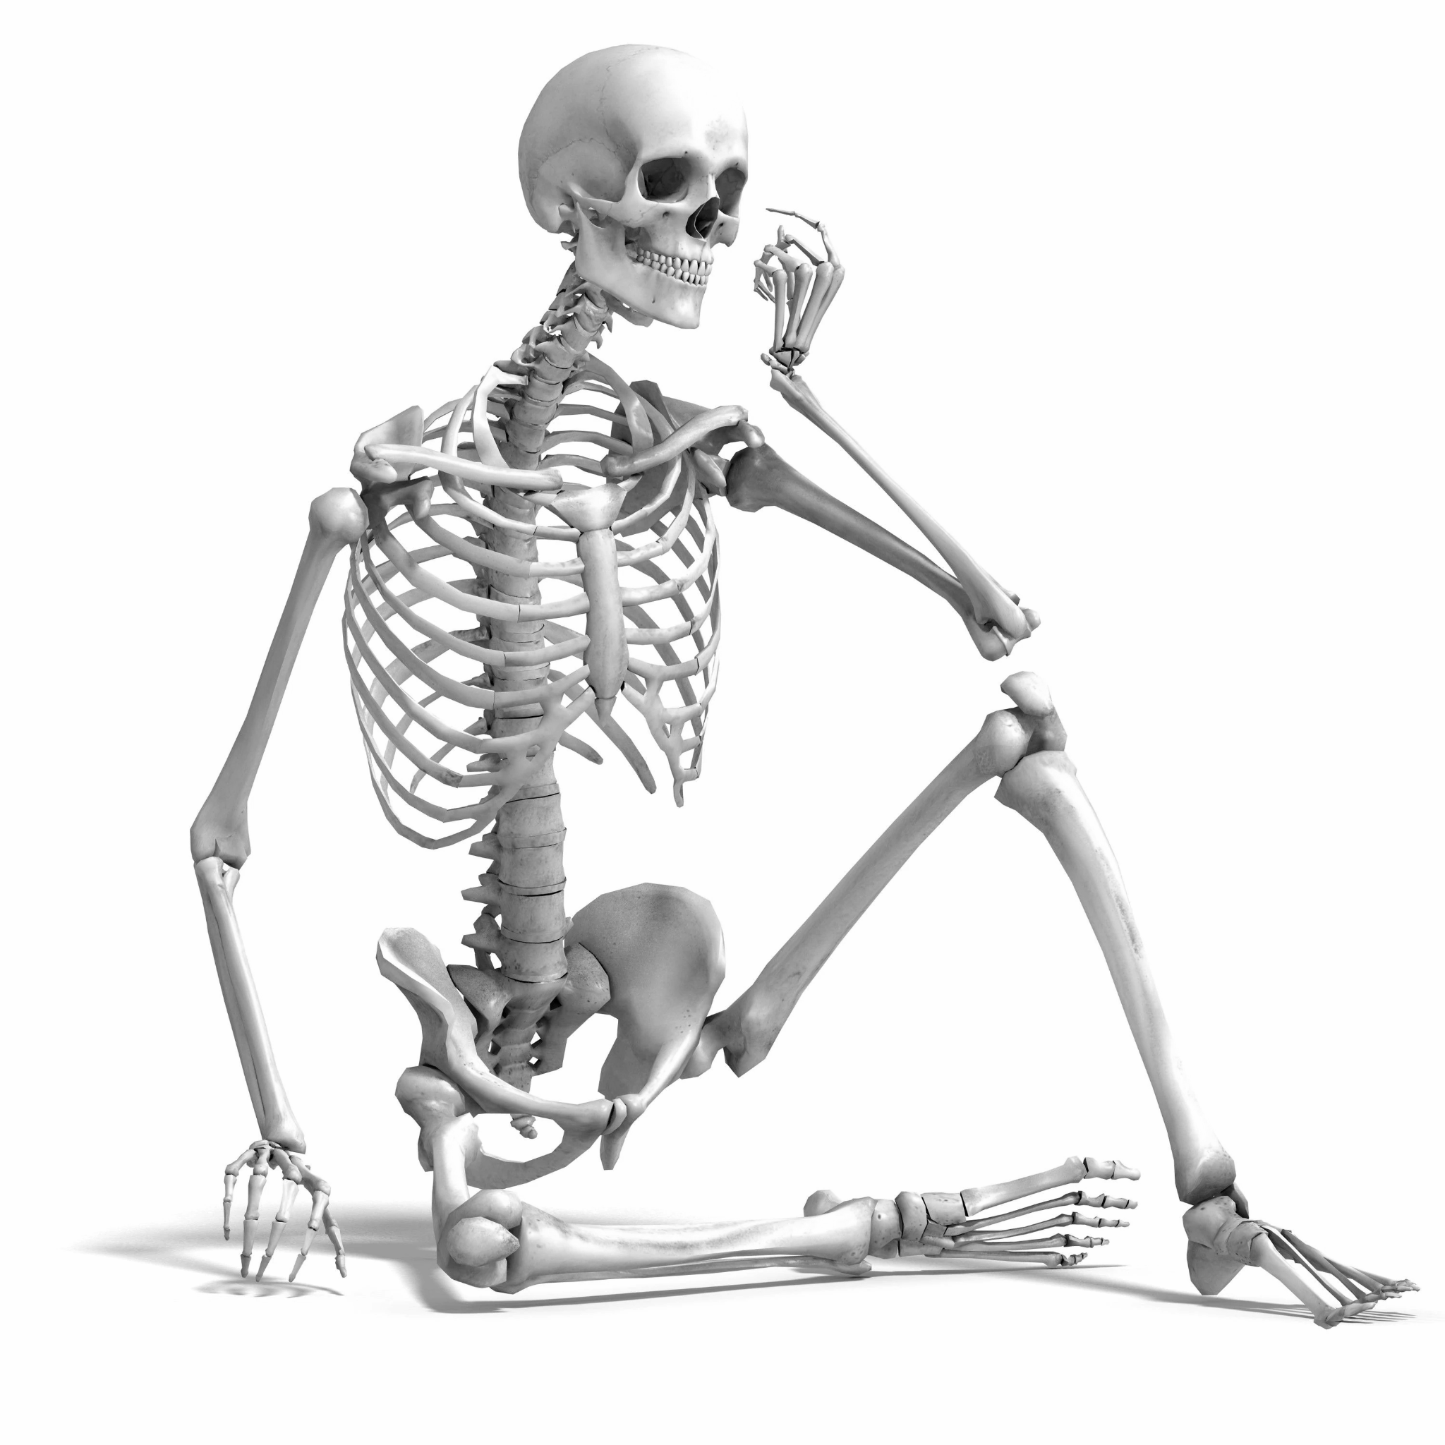
Thank you for your attention!

