Slide 1
The NERVOUS SYSTEM
16 May 2016
Areta Kłak
Faculty of Medicine
Rzeszów University
Bachelor degree studies in Physiotherapy
Year 2
Structure and main functions

Slide 2
VOCABULARY:
spinal cord – rdzeń kręgowy
spinal nerves – nerwy rdzeniowe
cranial nerves – nerwy czaszkowe
presynaptic membrane – błona presynaptyczna
postsynaptic membrane – błona postsynaptyczna
synaptic cleft – szczelina synaptyczna
medulla oblongata – rdzeń przedłużony
grey matter – istota szara
white matter – istota biała
cerebral hemispheres – półkule mózgowe
frontal lobe – płat czołowy
parietal lobe – płat ciemieniowy
temporal lobe – płat skroniowy
occipital lobe – płat potyliczny

Slide 3
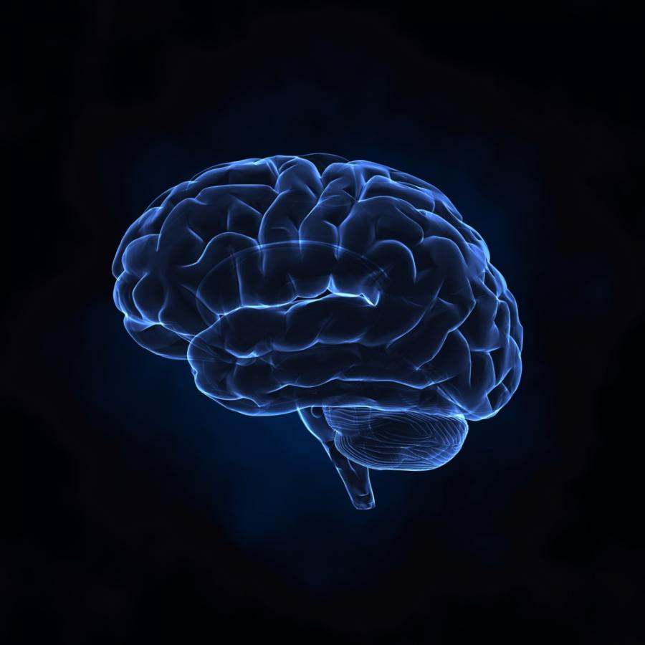
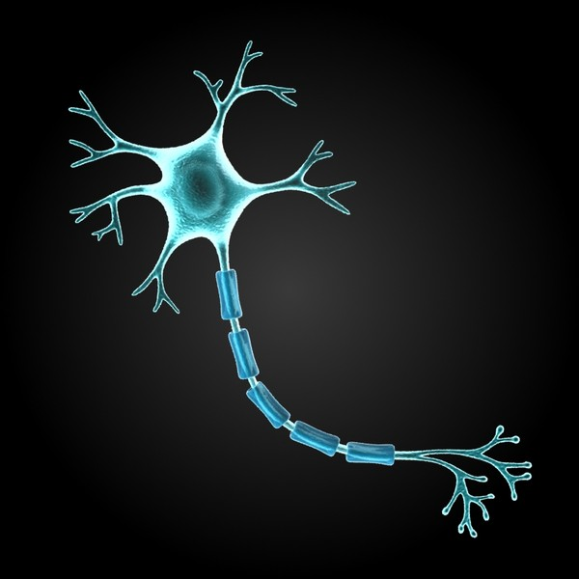
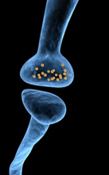
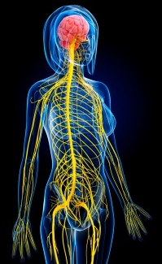
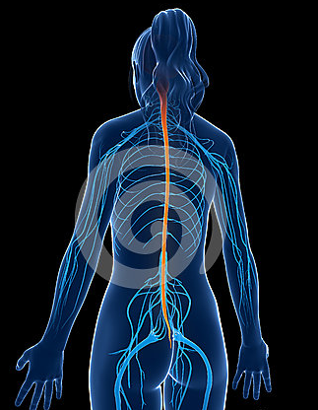
3.BRAIN
1.NEURON
5.CRANIAL AND SPINAL NERVES
2.SYNAPSE
4.SPINAL CORD
1.http://www.mnd.pl/?start_from=275&ucat=&archive=&subaction=showful&id=&\
2.https://mein.sanofi.de/Themen/Mensch-und-Gesundheit/Nerven/Nervenzellen
3.http://www.openspace.net.pl/kofeina-spowalnia-rozwoj-mozgu/
4.http://www.dreamstime.com/stock-image-highlighted-spinal-cord-d-rendered-medical-illustration-image30727811
5.http://www.gettyimages.com/detail/illustration/female-central-nervous-system-artwork-royalty-free-illustration/168835622

Slide 4
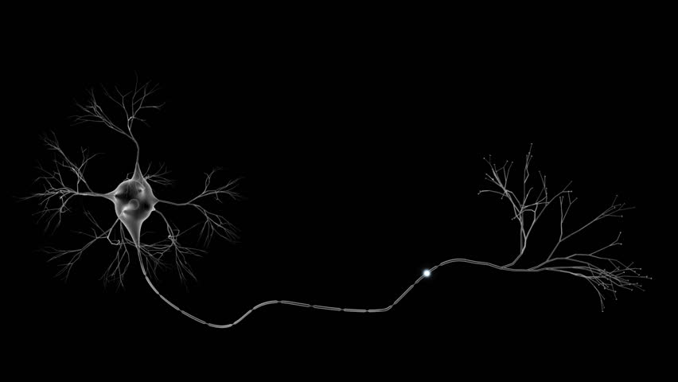
Neuron
(nerve cell)
Soma
(cell body)
Axon terminal
Nucleus
Dendrites
(receives messages)
Schwann cells
Myelin sheath
Axon
(sends messages)
https://www.shutterstock.com/es/video/search/axon/

Slide 5
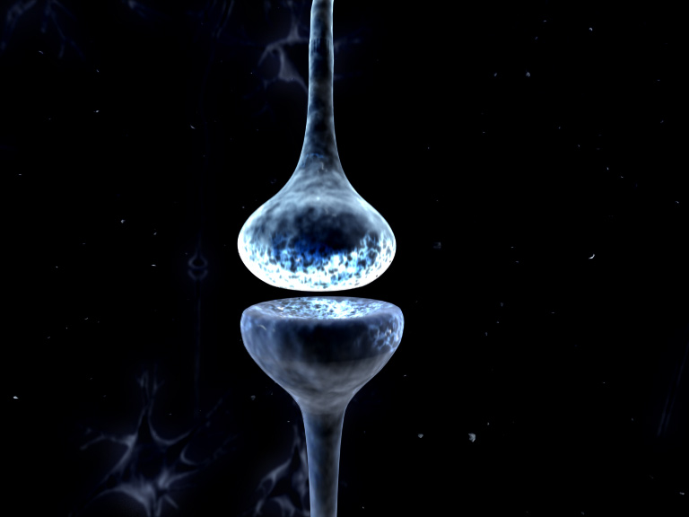
Synapse
Presynaptic membrane
Neurotransmitters
Synaptic cleft
Receptors
Postsynaptic membrane
http://www.doctordisruption.com/brain-science/chips-for-brains/

Slide 6
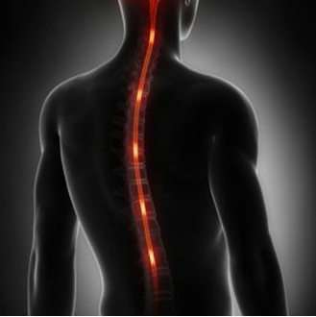
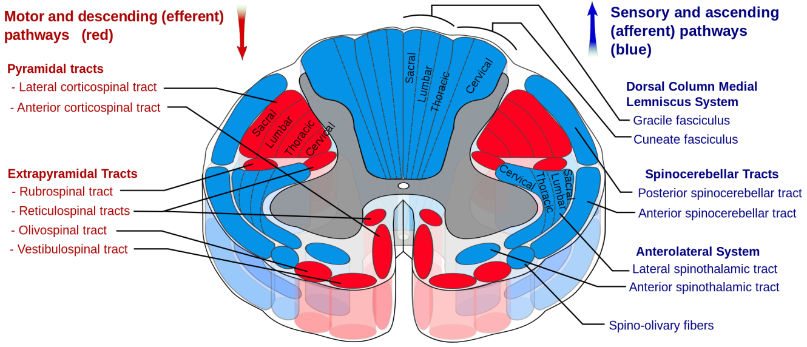
Spinal cord
H-shaped
Grey matter
White matter
http://info.wyborcza.pl/temat/wyborcza/rdzeń+kręgowy?utm_nooverride=1&back=http%3A%2F%2Finfo.wyborcza.pl%2Ftemat%2Fwyborcza%2Frdze%25C5%2584%2Bkr%25C4%2599gowy
https://en.wikipedia.org/wiki/Spinal_cord

Slide 7
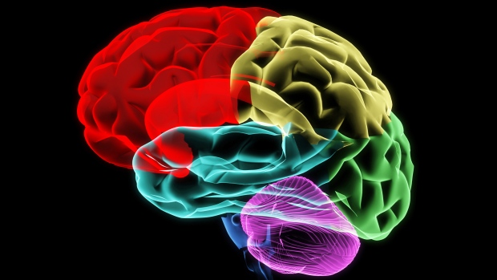
Brain
Frontal lobe
Parietal lobe
Occipital lobe
Temporal lobe
Brain stem
Cerebellum
http://www.ctvnews.ca/health/scientists-grow-human-brain-tissue-from-stem-cells-1.1431844

Slide 8
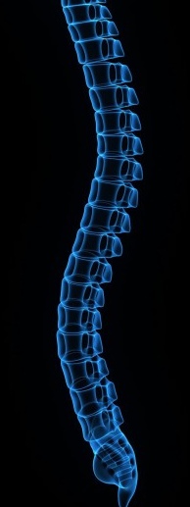
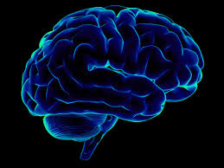
CNS
Central Nervous System
http://sinicropispine.com/myelomalacia-spinal-cord-softening/
http://www.yaabot.com/tag/brain/

Slide 9
Conclusions:
The basic structure of the nervous system is a neuron.
In the human body is about 30 million neurons.
Neurons do not touch each other – the space in between is called synapse.
Spinal cord is about 45 cm lenght.
Spinal cord consist of grey matter and white matter.
The most important organ of the nervous system is the brain.
The brain has about 1300 grams.
The brain and the spinal cord together make up the central nervous system (CNS).

Slide 10
Questions:
How many neurons are in the human body?
How much does the human brain weigh ?
What does CNS mean?
Which does CNS consist of?
Fill gaps:
Neurons do not touch each other – the space in between is called …………..
Spinal cord consist of ………… matter and ………… matter.

Slide 11
BIBLIOGRAPHY:
Ch.R. Noback, N.L. Strominger, R.J. Demarest, D.A. Rugierro The Human Nervous System Structure and Function, Sixth Edition, Humana Press, Totowa, New Jersey
L. Bender, D. Harding, T. Jackson, D. Kennedy, G. Lee, J. Stokes, The Facts On File illustrated Guide to the Human Body. Brain and Nervous System, Facts On File, Inc. 132 West 31st Street New York NY 10001
http://www.innerbody.com/image/nervov.html
http://www.bbc.co.uk/education/guides/zkdnb9q/revision

Slide 12
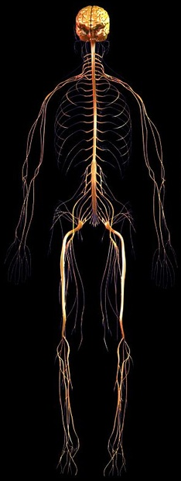
Thank you for your attention !
http://ourbodypartsystem.weebly.com

