Slide 1

UNIVERSITY OF RZESZÓW
FACULTY OF MEDICINE
SKELETAL SYSTEM
Oliwia Magdziarz
3rd year of Physiotherapy
2022/2023

Slide 2
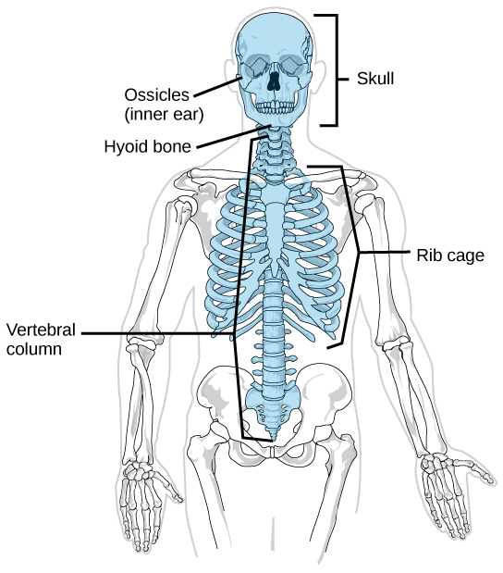
AXIAL SKELETON
Structures:
Skull
Rib cage
Vertebral column
Functions:
Protect
The attachment of muscles
https://en.wikipedia.org/wiki/Axial_skeleton#/media/File:Axial_skeleton_diagram.svg

Slide 3
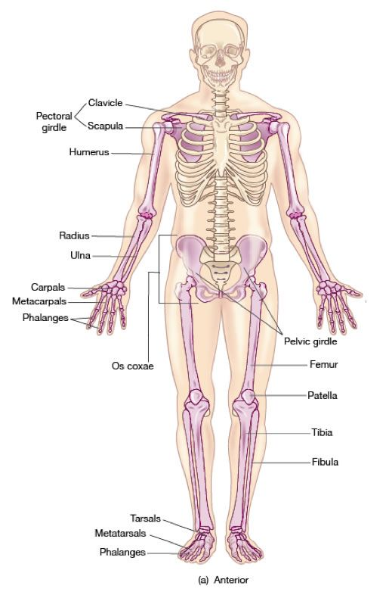
APPENDICULAR SKELETON
Structures:
Shoulder Girdle
Upper Extremity
Pelvic Girdle
Lower Extremity
Functions:
Movement
https://pl.pinterest.com/pin/19492210860318423/

Slide 4
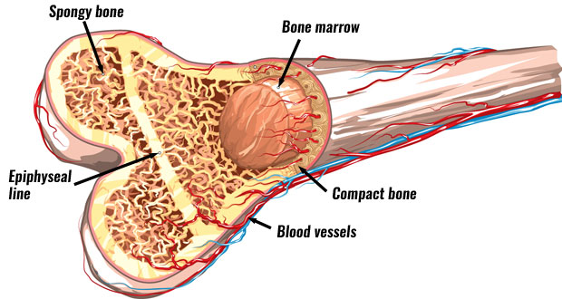
BONE STRUCTURE
Periosteum
Compact bone
Spongy bone
Bone marrow
https://www.teachpe.com/anatomy-physiology/structure-of-bones

Slide 5
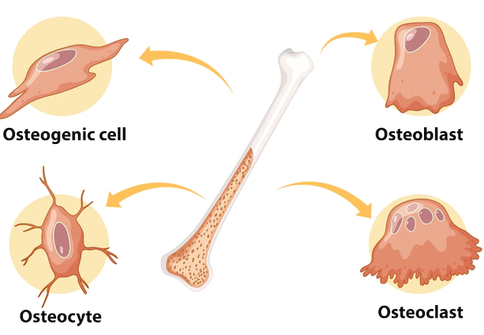
BONE CELLS
Osteoblasts - generating and repairing
Osteocytes - support metabolic
Osteoclasts - remodeling injured bones
https://www.freepik.com/free-vector/human-bone-cells-anatomy_10125903.htm

Slide 6
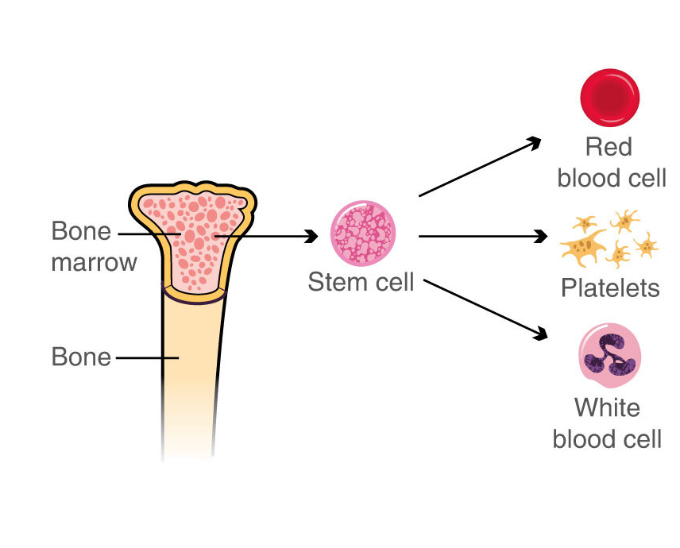
BONE MARROW
Oxygen
Clotting
Immunity
https://www.macmillan.org.uk/cancer-information-and-support/treatment/types-of-treatment/stem-cell-and-bone-marrow-transplants

Slide 7
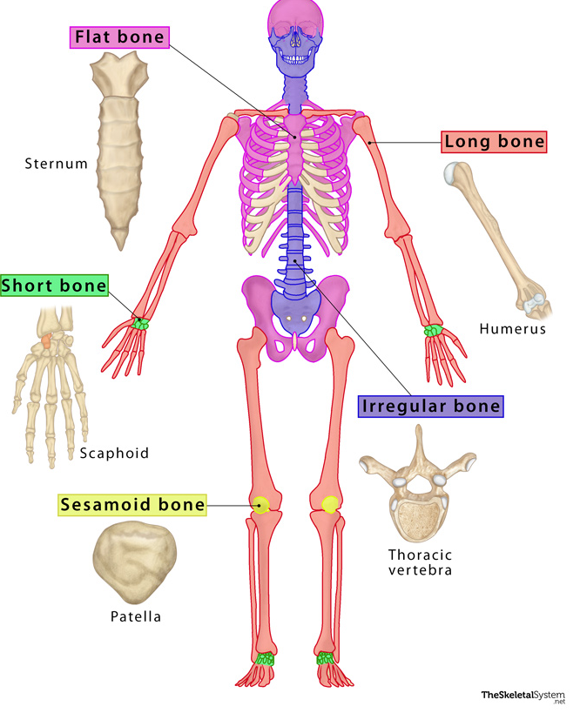
TYPES OF BONES
Long bone - long, thin shape
Irregular bone - various shapes
Sesamoid bone - elements of the tendons
Short bone - squat, cubed shape
Flat bone - flattened, broad surface
https://www.theskeletalsystem.net/types-of-bones

Slide 8
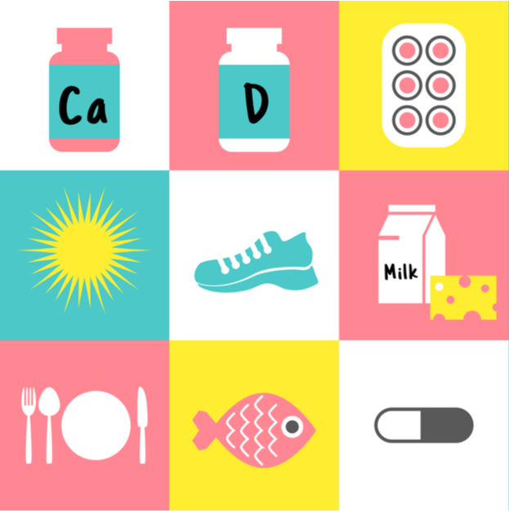
BONE DENSITY
Calcium
Vitamin D
Sunshine exposure
Healthy diet
Physical activity
Hormone control
https://redhotmamas.org/are-you-playing-your-part-in-prevention-of-osteoporosis/

Slide 9
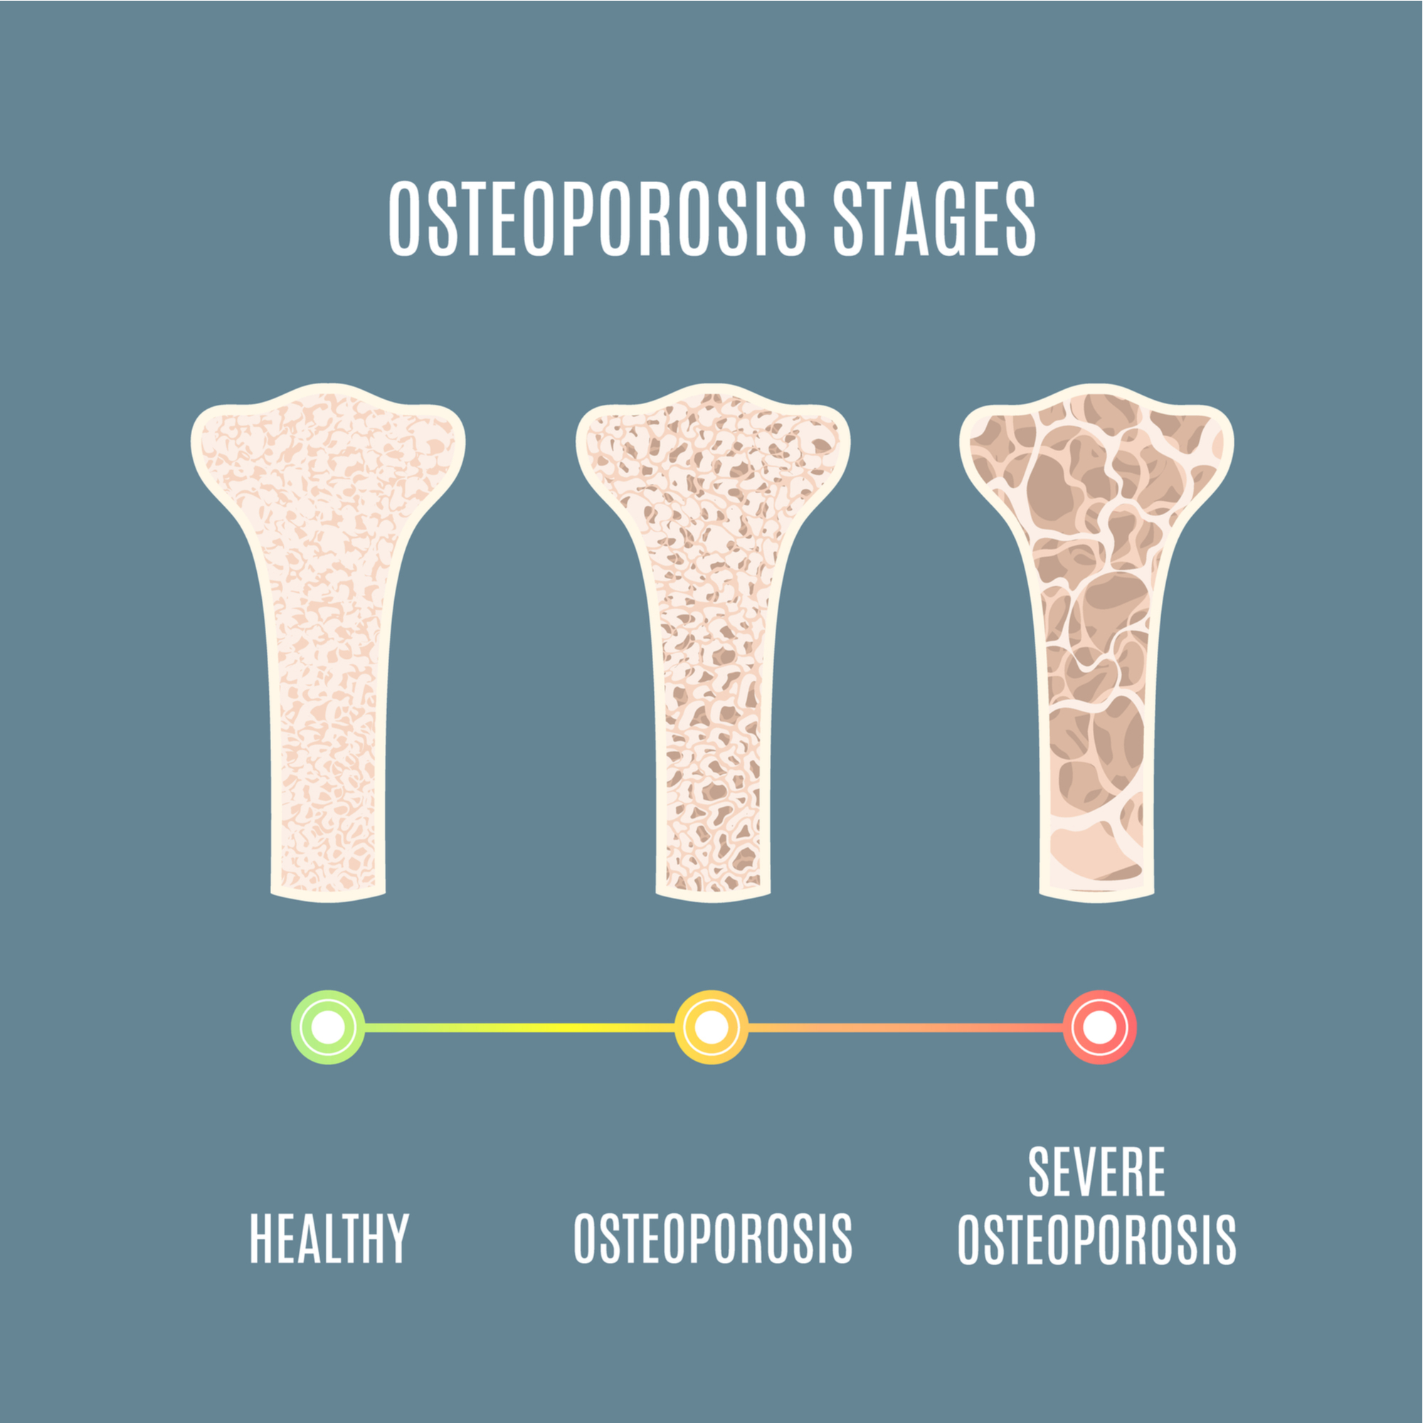
OSTEOPOROSIS
Reduction in bone density
Removal and resorption impaired
Risk factors:
low calcium
vitamin D deficiency
diet
physical activity
smoking, drinking alcohol
https://www.adjustablebedspecialists.ie/blog/natural-ways-to-cope-with-osteoporosis/

Slide 10
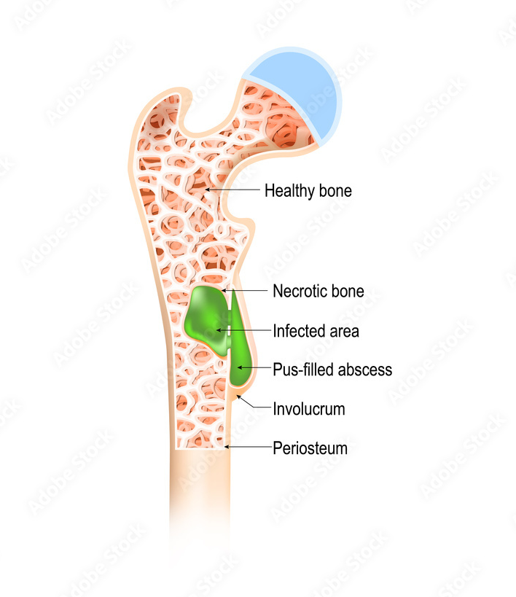
OSTEOMYELITIS
Bone infection
Types of osteomyelitis:
acute
chronic
vertebral
https://stock.adobe.com/de/images/osteomyelitis-is-infection-in-the-bone/180048106

Slide 11
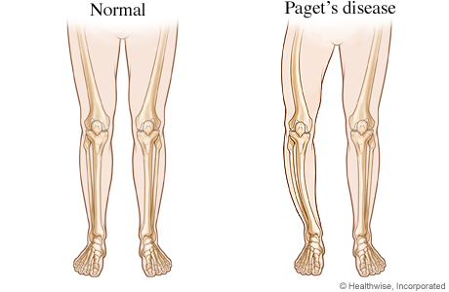
PAGET’S DISEASE
Rare chronic disease
Resorption and formation disorder
Symptoms:
Pain
Tingling and weakness
Bone deformities
Hearing loss
https://www.cigna.com/knowledge-center/hw/bowed-legs-from-pagets-disease-zm2733

Slide 12
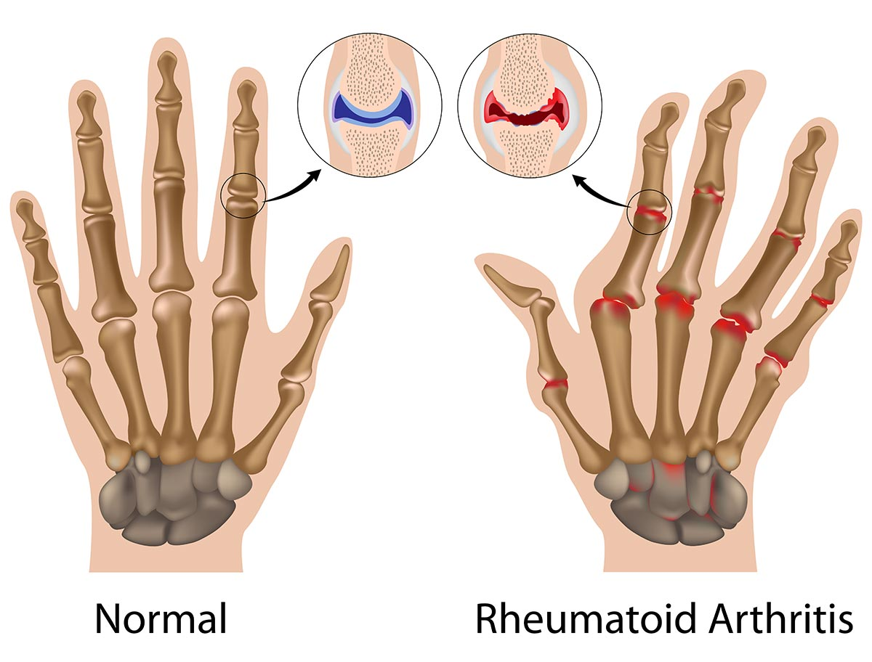
ARTHRITIS
Worse with the age
Joints of hands, spine, knees, hips
Symptoms:
Pain
Stiffness
Swelling
Redness
Decreased range of motion
https://www.vejthani.com/diseases-conditions/rheumatoid-arthritis/

Slide 13
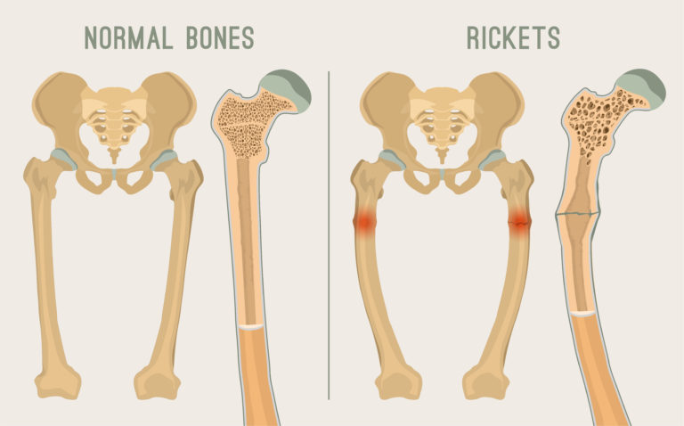
RICKETS
Childhood’s disease
Soft bones
Easily breaks
Different form of osteomalacia

Slide 14
Vocabulary:
skull - czaszka
cushioning - amortyzacja
framework - struktura
layers - warstwy
periosteum – okostna
compact - zbita
spongy - gąbczasta
marrow - szpik
resorption - resorpcja
platelets - płytki krwi
clotting - krzepnięcie
immunity - odporność
cubed shape - kształt kostki
flattened - spłaszczony
broad - szeroki
surface - powierzchnia
density - gęstość
osteomyelitis - zapalenie szpiku
fungi - grzyby
tingling - mrowienie
swelling - obrzęk

Slide 15
Bibliography:
A. Huysseune, Skeletal System, The Laboratory Fish, Handbook of Experimental Animals 2000, Pages 307-317.
Zhang M, Chen P, Li B, Du J, Pan T, Chen J. Approach to the patient with pregnancy and lactation-associated osteoporosis: A case report and a review of the literature. Medicine (Baltimore). 2017
Wojciech Pluskiewicz, Osteoporoza choroba współczesnej cywilizacji, Śląski Uniwersytet Medyczny w Katowicach.
M. Janiszewska,T. Kulik, M. Dziedzic, D. Żołnierczuk-Kieliszek, A. Barańska, Osteoporosis as a social problem – pathogenesis, symptoms and risk factors of postmenopausal osteoporosis, Probl Hig Epidemiol 2015, 96(1): 106-114.
https://pl.bab.la/slownik/polski-angielski/
Elders MJ. The increasing impact of arthritis on public health. The Journal of rheumatology. Supplement. 2000 Oct;60:6-8. PMID: 11032095.
Daniel P. Lew, M.Dand Francis A. Waldvogel, M.D., Osteomyelitis, Volume 364, Issue 9431, 24–30 July 2004, Pages 369-379.
Charlotte Jane Elder, , Nicholas Bishop, Rickets, Volume 383, Issue 9929, 10–16 May 2014, Pages 1665-1676.

