Slide 1
CARDIOVASCULAR SYSTEM KUPCZYK Mateusz Faculty of Medicine, Rzeszów University Bachelor degree studies in Physiotherapy, Year 2
21.04.2015

Slide 2
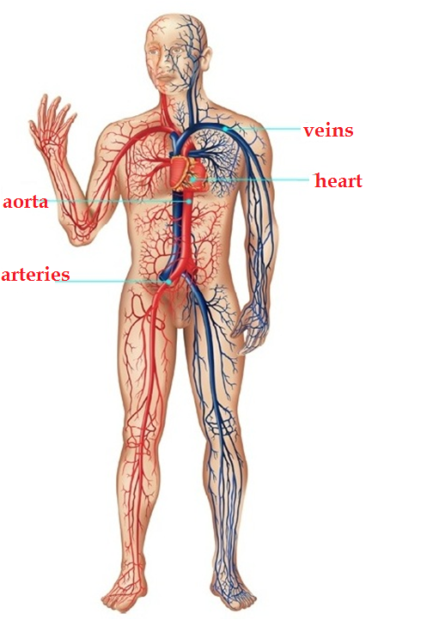
STRUCTURE
Heart- muscle pump
Blood vessels- closed system of channels with blood inside.
Blood vessels are divided into:
a) veins (blood flows to the heart)
b) arteries (blood flows from the heart)
c) capillaries (the smallest blood vessels)
[1] http://linemed.pl/nhealth_guide/details/cId,2,id,194

Slide 3
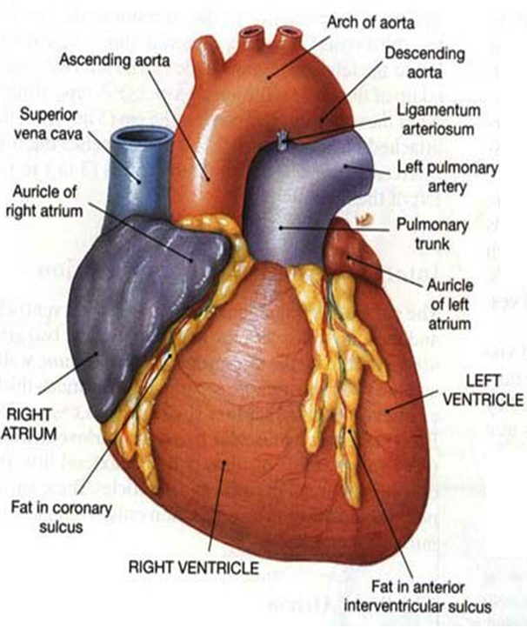
HEART
2 ventricles (left, right)
2 atriums (left, right)
2 compartments:
-interventricular
-interatrial
3 heart valves:
-tricuspid valve
-bipartite valve
-2 semilunar valves
3 heart layers:
-endocardial
-intracardial
-epicardial
[2].http://kitchenoverlord.files.wordpress.com/2013/02/human-heart-diagram.jpg?w=860

Slide 4
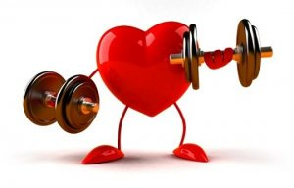
HEART- EXCELLENT PUMP !
Heart beats about 72 times/min
and pumps about 5 liters of blood/min
During life heart beats 2.5 billion times and pumps more than 173 million liters of blood
During exercise the amount
of blood which flows through the heart grows four times
[3] http://fitnessprestige.pl/

Slide 5
BLOOD VESSELS
Arteries are the blood vessels that carry blood away from the heart to all the organs.
Veins are the large return vessels of the body and act as the blood return counterparts of arteries.
Capillaries are the smallest and thinnest of the blood vessels in the body and also the most common.

Slide 6
ARTERIES AND VEINS
3 main differences between veins and arteries:
valves in veins
thicker layer of
muscle in arteries
higher lumen in veins

Slide 7
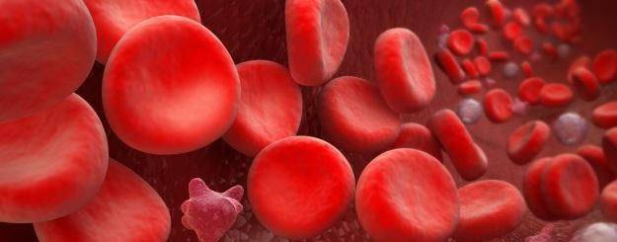
BLOODSTREAM
Small bloodstream
Large bloodstream
http://zdrowie.gazeta.pl/Zdrowie/1,101459,7026367,Krew.html

Slide 8
SMALL BLOODSTREAM
pulmonary arteries
right ventricle
lung capillaries
left atrium
pulmonary veins

Slide 9
LARGE BLOODSTREAM
aorta
arteries
left ventricle
tissues capillaries
right atrium
veins

Slide 10
CARDIOVASCULAR SYSTEM-FUNCTIONS
Transportation (respiratory gases, vitamins, hormones, waste products of metabolism, nutrients, etc.)
Maintain a constant body temperature (36,6’C)
Maintain a constant pH (7,35-7,45)
Protection against foreign objects (bacteria, viruses)
Protection against bleeding (blood clotting)
Regulation of the osmotic pressure

Slide 11
CONCLUSIONS
The cardiovascular system is necessary for the proper functioning of the body
Heart is the most important part of the cardiovascular system – it is an excellent muscle pump
Blood vessels are responsible for the transport of blood in the body
There are two bloodstreams: smaller and larger
The cardiovascular system has many important functions in our body

Slide 12
Answer the questions
1. What are the two components of the cardiovascular system?
2. How many times does your heart beat in one minute?
3. Give two functions of the cardiovascular system.
Fill in the gaps with the correct word
1. ………. are the smallest blood vessels in the human body.
2. The ………. is the end of large bloodstream.
3. ………. prevents the backflow of blood.

Slide 13
Vocabulary:
Bibliography:
Blood vessels- naczynia krwionośne
Veins- żyły
Arteries- tętnice
Capillaries- naczynia włosowate
Ventricle- komora serca
Atrium- przedsionek serca
Compartment- przegroda serca
Valve- zastawka:
tricuspid- trójdzielna
bipartite- dwudzielna
semilunar- półksiężycowa
Heart layer- warstwa serca
Lumen- światło naczynia
Bloodstream- krwioobieg
Tissues- tkanki
Maintain- utrzymywać
Foreign objects- ciała obce
Osmotic pressure- ciśnienie osmotyczne
Nutrients- składniki odżywcze
Blood clotting- krzepnięcie krwi
Ziółko Ewa, Podstawy fizjologii człowieka, Państwowa Wyższa Szkoła Zawodowa W Nysie Skrypt Nr 10, C by Oficyna Wydawnicza PWSZ w Nysie, Nysa 2006, ISBN 83-60081-05-0, pages: 29-40
Zimmermann Kim Ann, Circulatory System: Facts, Function & Diseases [dostęp: 17.04.2015], Dostępny w Internecie: http://www.livescience.com/22486-circulatory-system.html
Podręczny słownik Angielsko-Polski, Polsko-Angielski, compilation: Mariusz Idzikowski, Leszek Jakubowski, Wyd. 1, Warszawa, Biuro Wydawnicze Faktor, 2003, ISBN 83-85670-07-6

Slide 14
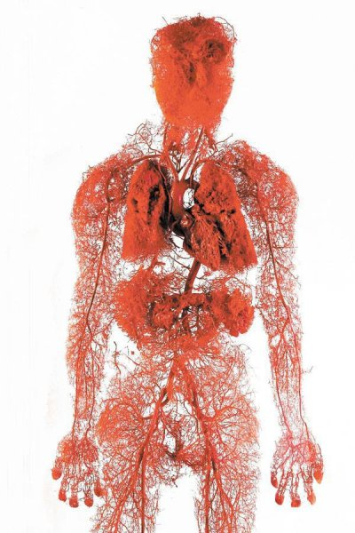
Thank you for your attention !
[6]. http://www.techpedia.pl/zagadka/2505

