Slide 1
Dealing with sports injuries
Anita Turbak Faculty of Medicine, Rzeszów University Bachelor degree studies in Physiotherapy, Year 2

Slide 2
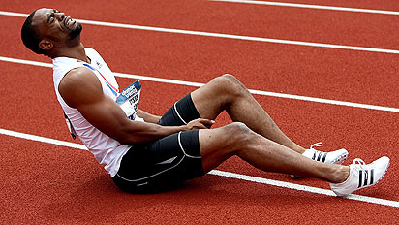
Aims of physiotherapy after sport injury
treat and fully rehabilitate the person post-injury, post-operatively
to prevent further injury
to return the athlete to sport in the shortest possible time

Slide 3
Ways to classify sports injuries
Cause: direct injury indirect injury overuse injury
Type of body tissue: hard tissue soft tissue

Slide 4
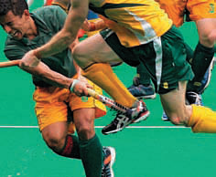
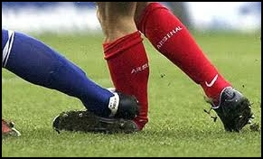
Direct injuries
a collision with another
being struck with an object (ball, hockey stick etc.)
Examples

Slide 5
Indirect injuries
An indirect injury can occur in two ways:
In some distance from the impact site.
Internal forces

Slide 6
Overuse injury
Overuse injuries occur when excessive and repetitive force is placed on the bones and other connective tissues of the body
Pain in this type of injury

Slide 7
Soft-tissue injuries
Tears, sprains and contusions
A tear is a disruption of the fibres of a muscle or tendon.
A sprain is a tear of ligament fibres, muscles or tendons supporting a joint.
A contusion or bruise is bleeding into the soft tissue.

Slide 8
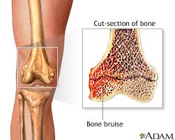
Hard-tissue injury
Hard-tissue injuries are those involving damage to the bones of the skeleton

Slide 9
The aims of immediate treatment are:
To prevent further tissue damage
To minimise swelling
To reduce pain
To reduce the formation of scar tissue
To reduce the time needed for rehabilitation

Slide 10
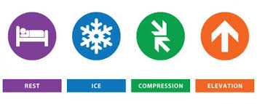
Dealing with soft tissue injuries

Slide 11
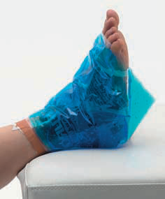
RICER (Acute phase)
R for Rest
I for Ice
C for Compression
E for Elevation
R for Referral.

Slide 12
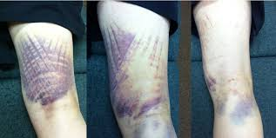
After acute phase
Light exercises
Cryotherapy
Laser
Kinesio taping

Slide 13
Vocabulary:
The aim – cel
Direct - bezpośredni
Cause – przyczyna, powód
Tissue – tkanka
Occur – pojawić się
Internal forces – siły wewnętrzne
Overuse – zużycie
Connective tissues – tkanki otaczające
Tear – rozdarcie
Sprain – skręcenie
Contusion – stłuczenie
Severe – ciężki
Scar tissue – tkanka bliznowata
Acute - ostry
Cryotherapy – krioterapia
Referral – skierowanie

Slide 14
Bibliography
https://www.pdhpe.net/sports-medicine/how-are-sports-injuries-classified-and-managed/
Ortopedia i traumatologia : podręcznik dla studentów medycyny - Tadeusz Szymon Gaździk
Rehabilitacja w sporcie - Rafał Gnat
Urazy i uszkodzenia w sporcie - Artur Dziak
http://twoj-angielski.pl/slownictwo/angielski/Angielski_w_fizjoterapii
Pictures:
http://www.spritely-osteopathy.com/assets/images/conditions/sports-injury-2.jpg
http://drmilanhari.co.za/?page_id=424
https://physioneeds.biz/physio-blog/rice-blog/

Slide 15
Thank you for your attention!

