Slide 1

Fractures - bone healing process
Sebastian Oleszko
III R Fizjoterapia JMGR stacjonarne
21.10.2022/rok akademicki 2022/23 sem. zimowy

Slide 2
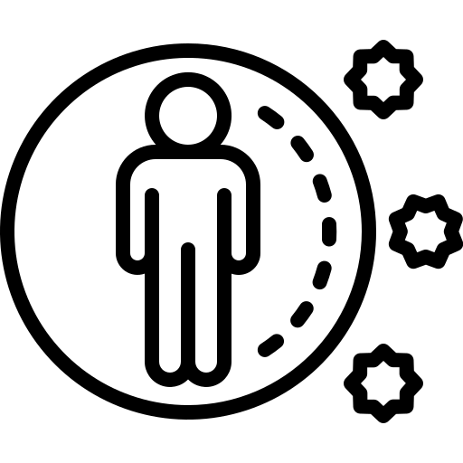
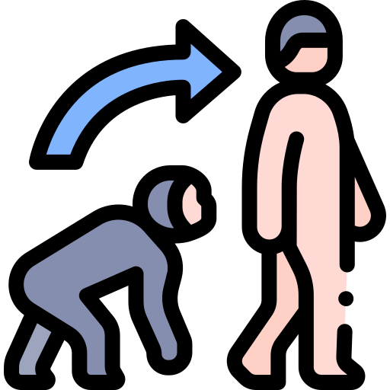


1. Bone Union
Evolution has equipped each person with universal reparatory mechanisms which are activated by the immune system

Slide 3



2. Phases of Fracture Regeneration Process
1.‭ ‬Reactive phase - 3/7 days
2. Reparative phase - 4 weeks
3. Remodelling phase - 2+ years

Slide 4
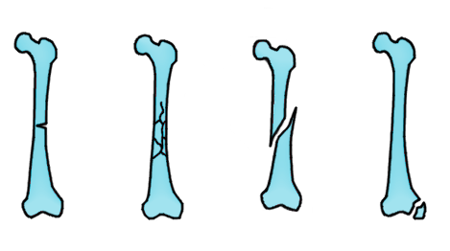
3. Types of fractures
Closed Fracture
Open Fracture
Displaced Fracture
Comminuted Fracture
Avulsion Fracture
Greenstick Fracture
Compression Fracture

Slide 5
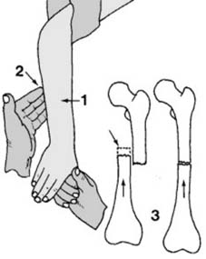
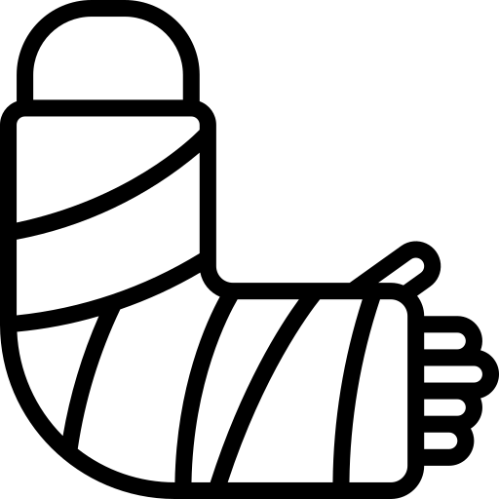
4a. Methods of treatment
Splinting/ Casting 2. Closed Reduction
photo nr 2 from:https://musculoskeletalkey.com/closed-reduction-and-casting-techniques-in-fracture-management/

Slide 6
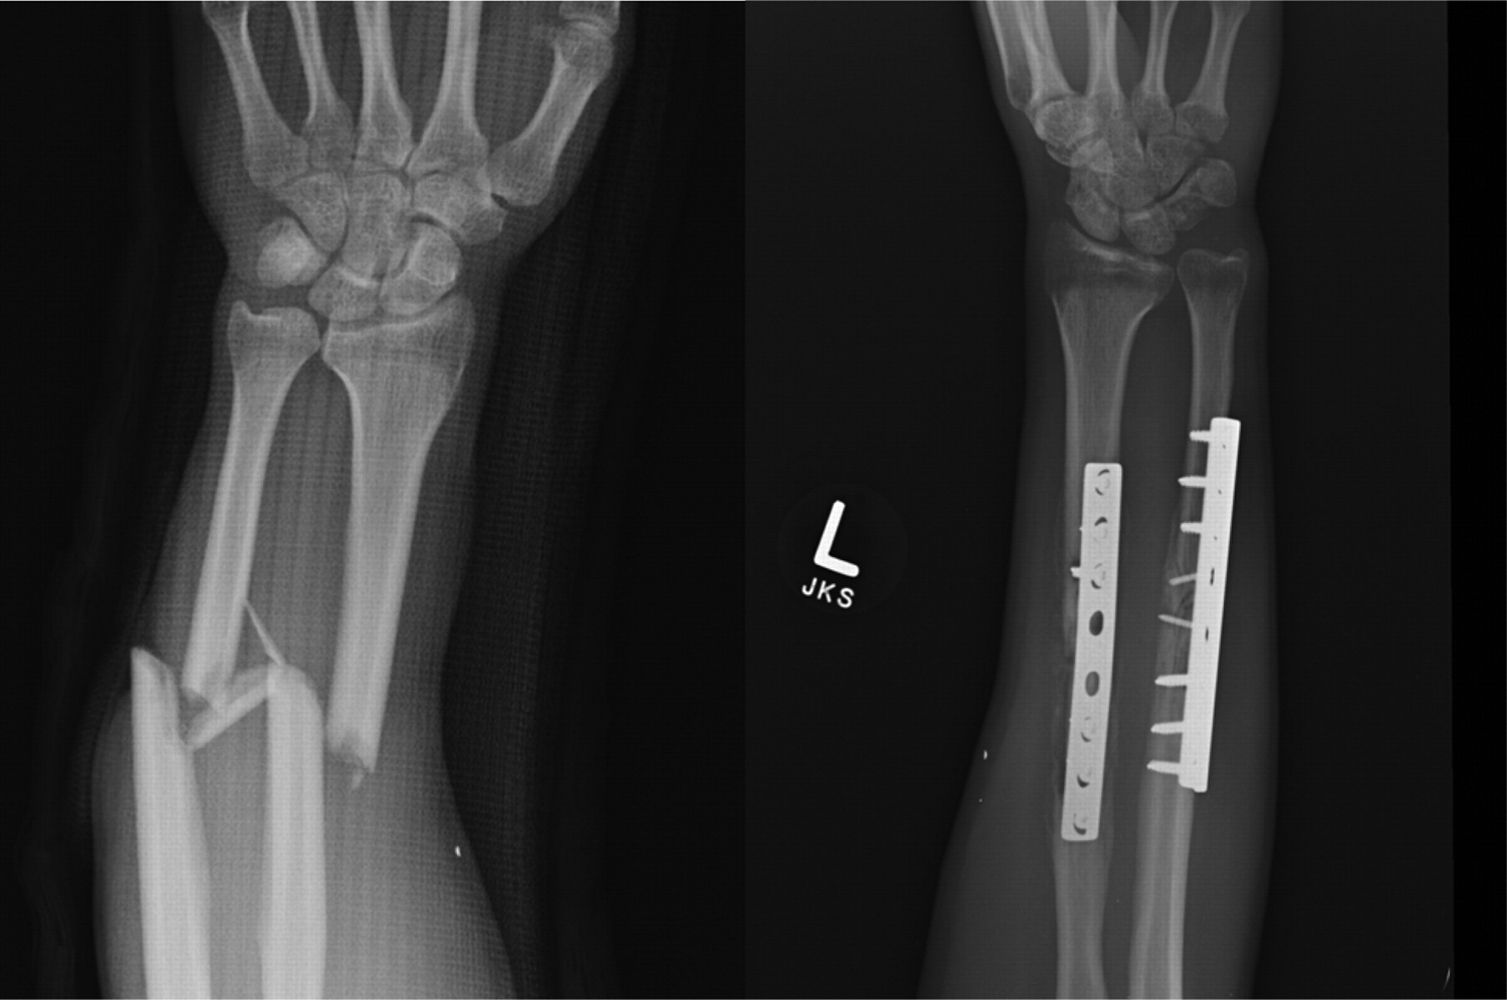
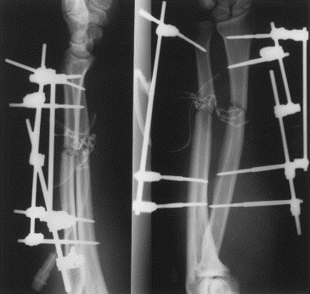
4b. Methods of treatment
3. Internal fixation 4. External fixation
photo nr 3 from: https://journals.asm.org/doi/10.1128/JCM.01258-09
photo nr 4 from: https://www.injuryjournal.com/article/S0020-1383(99)00262-4/fulltext

Slide 7
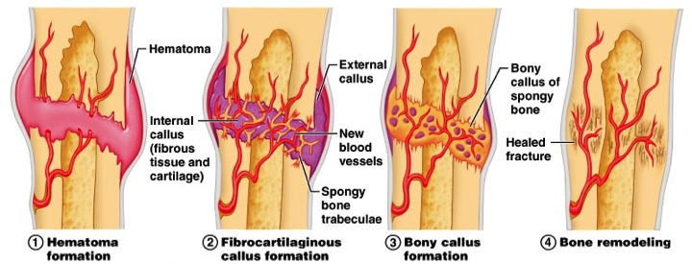
5. Pseudoarthrosis
photo from: https://www.orthobullets.com/basic-science/9009/fracture-healing

Slide 8
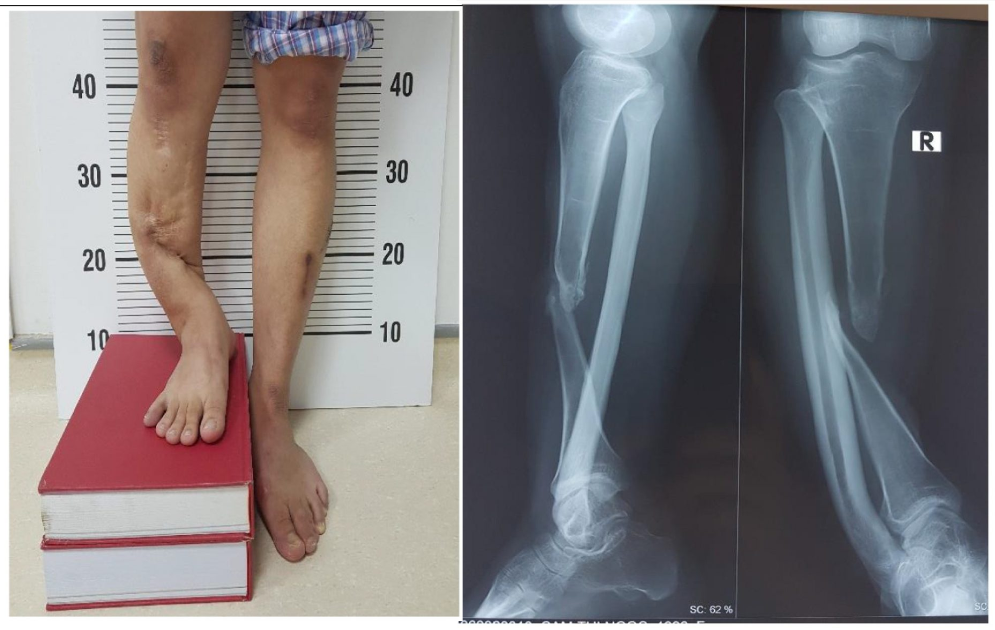
photo from: https://drdoan.vn/en/fibula-lengthening-then-centralization-for-the-treatment-of-pseudoarthrosis-at-the-middle-third-of-tibia-with-large-leg-length-discrepancy-a-case-report/

Slide 9
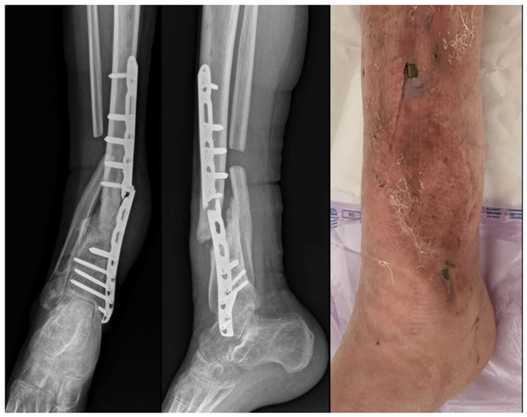
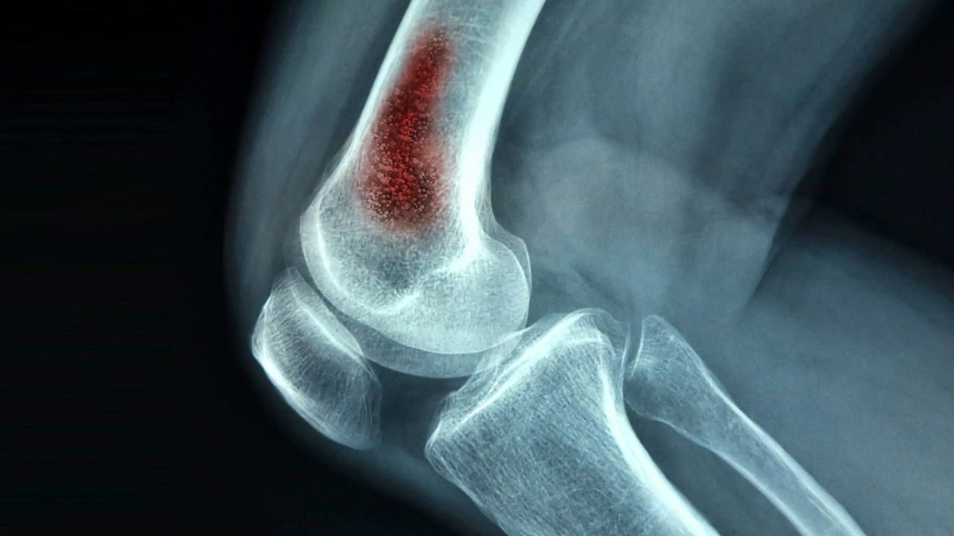
6a. Bone Healing Problems - Infection
2.
1.
photo nr 1 from: https://www.hopkinsmedicine.org/health/conditions-and-diseases/osteomyelitis
photo nr 2 from: https://jbji.copernicus.org/articles/6/321/2021/

Slide 10
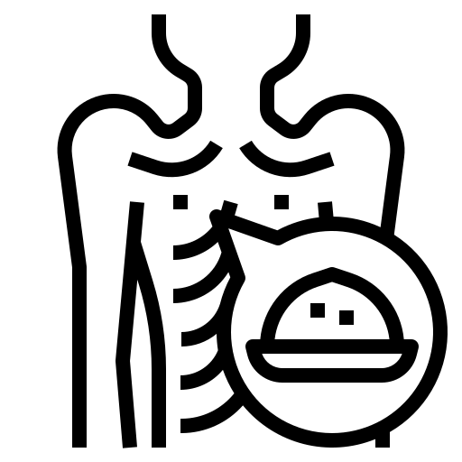

6b. Bone Healing Problems - Malnutrition
Causes reduced activity and proliferation of osteochondral cells
Decreases callus formation
Diabetes mellitus is associated with collagen defects including decreased collagen content

Slide 11


7a. Diseases That Causes Bone Union Problems - Diabetes
Diabetes disturbs distribution of glucose and decreases tissue immunity to infections!

Slide 12
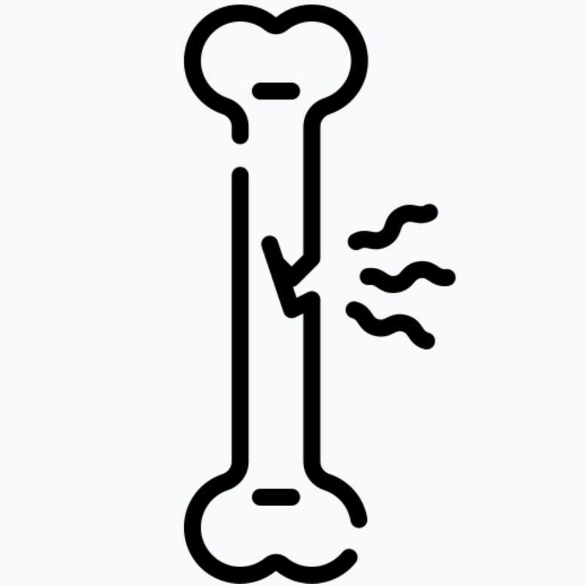

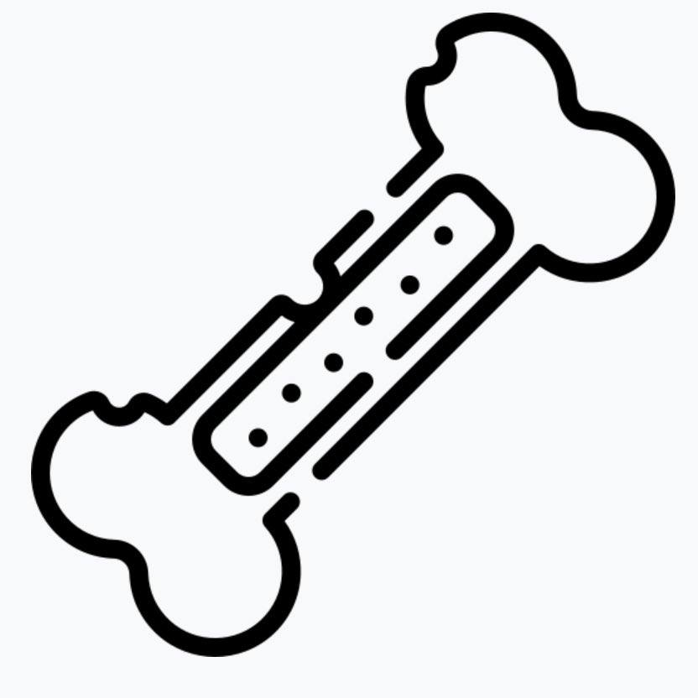
7b. Diseases That Causes Bone Union Problems - Osteoporosis
Osteoporosis is a disease characterized by low bone mass and increased fracture risk. As a result of lower physical activity and the osteoporosis fractures these patients could have muscle dystrophy.

Slide 13
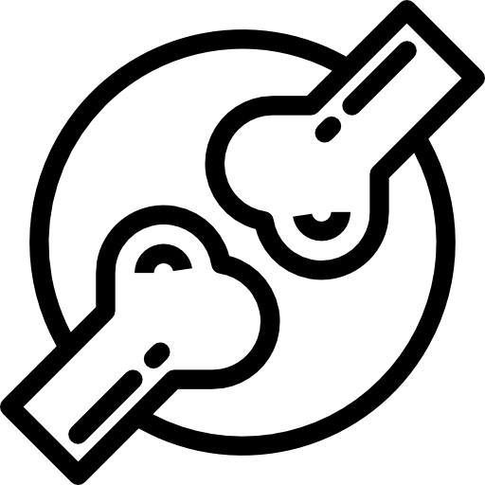
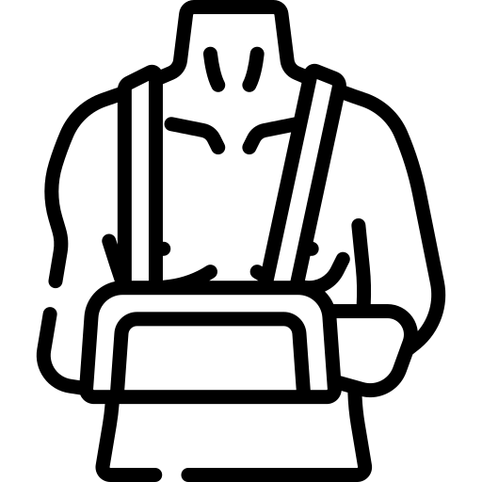

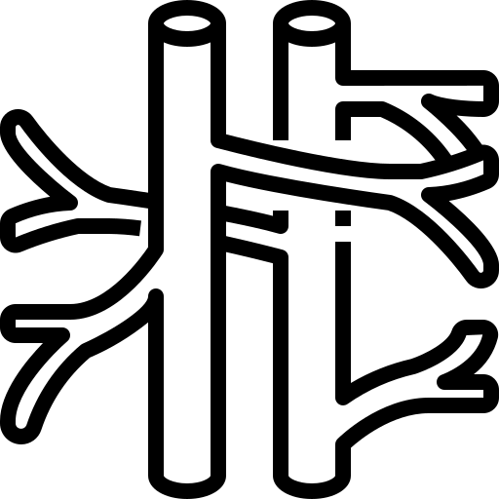
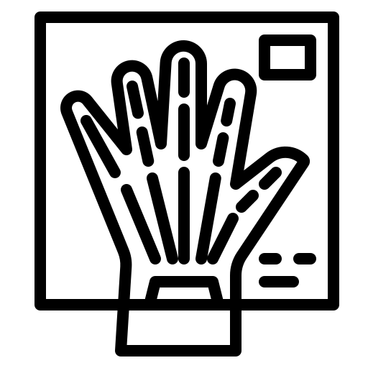

To Sum Up
Fracture treatment includes maintaining contact between the fragments, appropriate immobilization, good nutrition status, appropriate blood supply, avoid irrational use of diagnostic methods such as too frequent X-ray-based imaging.

Slide 14

THANKS FOR YOUR ATTENTION!
photo from: http://clipart-library.com/clipart/8iEj7XX8T.htm

Slide 15
Bibliography:
Grzegorz Szczęsny (2015). Fracture Healing and its Disturbances. A literature Review. Ortopedia Traumatologia Rehabilitacja © MEDSPORTPRESS, 2015; 5(6); from https://www.researchgate.net/profile/Grzegorz-Szczesny/publication/290157191_Fracture_Healing_and_its_Disturbances_A_Literature_Review/links/56b0c05c08ae9f0ff7b76ea3/Fracture-Healing-and-its-Disturbances-A-Literature-Review.pdf
A. Oryan , S. Monazzah , A. Bigham-Sadegh (2015). Bone Injury and Fracture Healing Biology. Biomed Environ Sci, 2015; 28(1): 57-71 from https://reader.elsevier.com/reader/sd/pii/S089539881560006X?token=C745AFD45137F778BC75D4C470833A627A6156ABF317A9CE6CCF0E9A20842CDF82967F913B22CA45C5A58CFC54561262&originRegion=eu-west-1&originCreation=20221021065825
G. S. Baht, L. Vi4, B. A. Alman (5 March, 2018). The Role of the Immune Cells in Fracture Healing. Current Osteoporosis Reports (2018) 16:138–145, from https://link.springer.com/content/pdf/10.1007/s11914-018-0423-2.pdf
M. WEBER-RAJEK, K. CIECHANOWSKA (20 March, 2015). Physical treatment in postmenopausal osteoporosis – a review of research; GinPolMedProject 1 (35) 2015, from: https://www.researchgate.net/profile/Magdalena-Weber-Rajek/publication/282173673_Physical_treatment_in_postmenopausal_osteoporosis_-_A_review_of_research/links/5609957108ae4d86bb11e328/Physical-treatment-in-postmenopausal-osteoporosis-A-review-of-research.pdf
Dictionary: Merriam-webster.com
All icons used in this presentation are from https://www.flaticon.com/free-icon

