Slide 1
Nervous System
Structure, Functions
and Dysfunctions
Karolina Niezgoda
III R Fizjoterapia JMS
rok akademicki 2022/2023 sem. zimowy

Slide 2
What is the nervous system responsible for?
The nervous system uses specialized cells called neurons to send signals or messages all over the body. These electrical signals travel between the brain, skin, organs, glands and muscles.

Slide 3
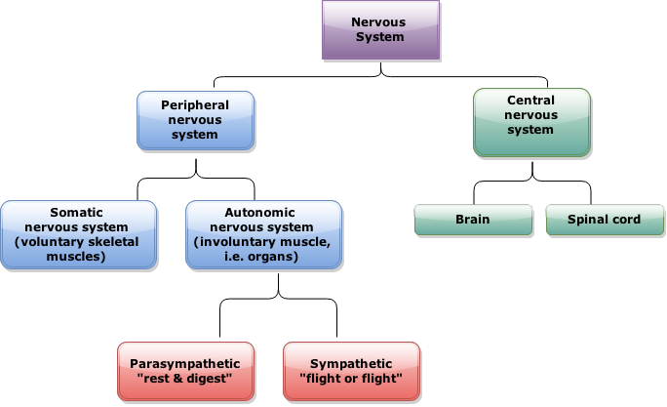
https://quizlet.com/231057567/the-nervous-system-components-unit-3-diagram/

Slide 4
Nervous system disorders
Nerve damage can happen in several ways. Some of the most common causes of nerve impairment include:
Disease
Stroke
Accidental injury
Pressure
Toxic substances
Aging process
Nerve damage can happen in several ways. Some of the most common causes of nerve impairment include:

Slide 5
Alzheimer's Disease
Nervous system diseases
Alzheimer's disease is a progressive neurologic disease that results in the irreversible loss of neurons, particularly in the cortex and hippocampus.The clinical hallmarks are progressive impairment in memory, judgment, decision making, orientation to physical surroundings, and language.
https://aptekacentrum.lublin.pl/blog/magazyn/2020/09/Obraz1.jpg

Slide 6
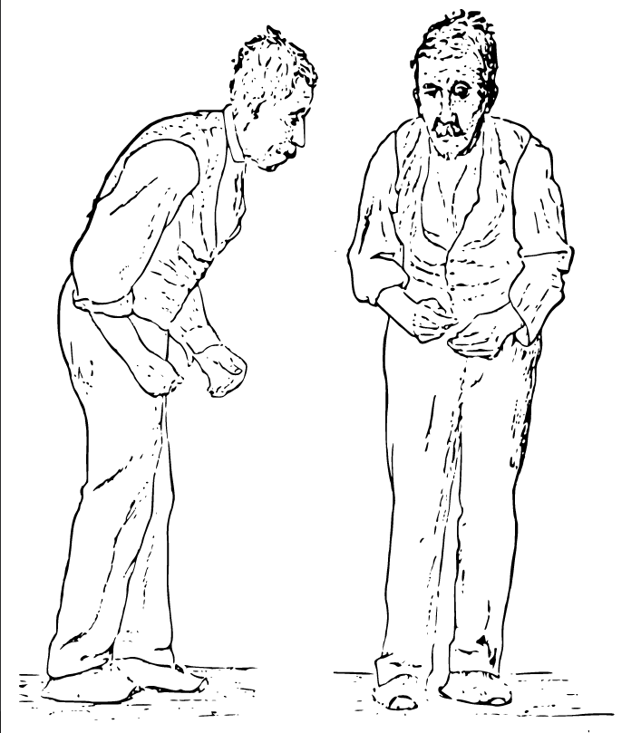
Parkinson's Disease
Nervous system diseases
Parkinson's disease is characterized clinically by parkinsonism and pathologically by the loss of neurons in the substantia nigra.
Parkinson’s disease has four main symptoms: - Tremor in hands, arms, legs or head - Stiffness of the limbs and trunk - Slowness of movement - Impaired balance and coordination
https://upload.wikimedia.org/wikipedia/commons/4/44/Sir_William_Richard_Gowers_Parkinson_Disease_sketch_1886.svg

Slide 7
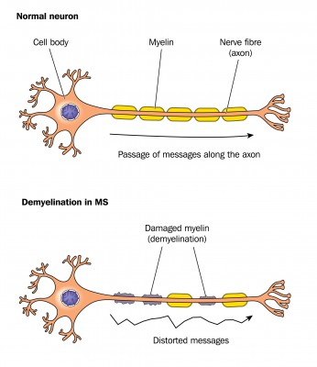
Multiple sclerosis
Nervous system diseases
Multiple sclerosis (MS) is an inflammatory disease that affects the central nervous . Your immune system destroys myelin, the protective covering that surrounds nerve fibers . MS can also result in long-term scar tissue, making it difficult for your brain to send messages to the rest of your body. It leads to significant disability through deficits of sensation and motor, autonomic, and neurocognitive function.
https://www.drogapozdrowie.pl/wp-content/uploads/2019/07/stwardnienie_rozsiane.jpg

Slide 8
Multiple Sclerosis Symptoms
-Fatigue
-Difficulty walking
-Vision problems
-Speech issues

Slide 9
Multiple sclerosis - Risk factors
Age
Race
Climate
Vitamin D
Gender
Family history

Slide 10
Multiple Sclerosis Complications
Many people with multiple sclerosis are at a higher risk of developing muscle stiffness or spasms, paralysis- typically in the legs, bladder or bowel dysfunctions, mood swings, depression, and epilepsy.

Slide 11
How do I keep my nervous system healthy?
We must remember that this system is the command center for your entire body. It needs care to keep working correctly.
See your doctor regularly, eat a healthy diet, avoid drugs, and only drink alcohol in moderation.

Slide 12
Thank you for your attention
https://img.freepik.com/premium-photo/computer-keyboard-workplace-cup-isolated-background_488220-38896.jpg

Slide 13
Vocabulary
peripheral nervous system - obwodowy układ nerwowy
spinal cord - rdzeń kręgowy
ganglia - zwoje mózgowe
diabetes- cukrzyca
multiple sclerosis - stwardnienie rozsiane
cortex - kora mózgowa
tremor - drżenie
stiffness - sztywność
inflammatory disease - choroba zapalna
myelin - mielina
fatigue - zmęczenie
brainstem - pień mózgu
glands - gruczoły
substantia nigra - istota czarna
optic neuritis - zapalenie nerwu wzrokowego
diplopia - podwójne widzenie

Slide 14
Reference
Anatomy and physiology of the nervous system (January 2020) , from https://cancer.ca/en/cancer-information/cancer-types/neuroblastoma/what-is-neuroblastoma/the-nervous-system
Nervous System, from https://my.clevelandclinic.org/health/articles/21202-nervous-system
Charles R. Noback, David A. Ruggiero, Robert J. Demarest, Norman L. Strominger (2005). The Human Nervous System: Structure and Function. 6th ed.
Robert L. Nussbaum, M.D., and Christopher E. Ellis, Ph.D. (April 3, 2003) Alzheimer's Disease and Parkinson's Disease. N Engl J Med 2003; 348:1356-1364
Sospedra M and Martin R. ( 2005). Immunology of Multiple Sclerosis. Annual Reviews, 23:683–747
McAlpine D, Compston A. (2006). Multiple Sclerosis. Elsevier Health Sciences
Gibson-Horn C,(2008). Balance-Based Torso-Weighting in a Patient with Ataxia and Multiple Sclerosis: A Case Report. JNPT;32: 139–146
English-Polish dictionary

