Slide 1
MUSCULAR SYSTEM
Kacper Kolasa
III R Fizjoterapia JMGR stacjonarne
2022/2023 sem. zimowy
https://candent.ca/products/the-muscular-system.html

Slide 2
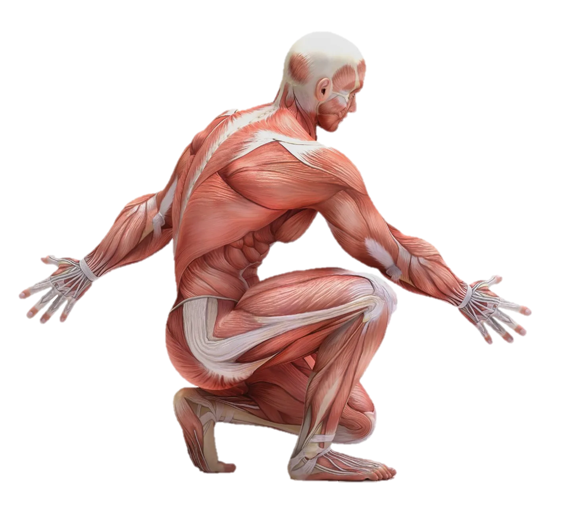
WHAT IS THE MUSCULAR SYSTEM?
https://knowledge.carolina.com/life-science/anatomy-and-physiology/muscular-system/

Slide 3
FUNCTION OF MUSCULAR SYSTEM
-responsible for movement (locomotion, transport of body fluids);
-maintaining body posture;
-heat generation.

Slide 4
MUSCLE TISSUE
The body has 3 main types of muscle tissue:
1) Skeletal
2) Smooth
3) Cardiac
Types of Muscle Tissue:
Skeletal Muscle
Smooth Muscle
Cardiac Muscle
https://bio.libretexts.org/Bookshelves/Introductory_and_General_Biology/Book%3A_Introductory_Biology_(CK-12)/13%3A_Human_Biology/13.15%3A_Smooth_Skeletal_and_Cardiac_Muscles

Slide 5
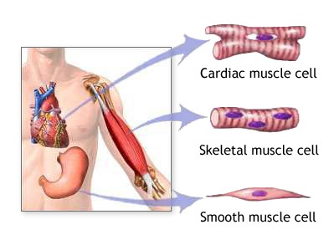
https://medlineplus.gov/ency/imagepages/19841.htm

Slide 6
DIVISION OF HUMAN MUSCLES
The following muscle divisions are distinguished:
Due to their location in the body;
Due to their function;
Due to the structure.

Slide 7
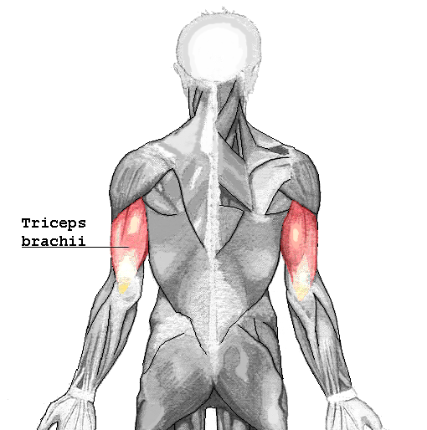
TRICEPS BRACHII
Origin of the muscle: humerus and scapula
Insertion of the muscle: ulna
Function: extensor of the elbow joint
https://en.wikipedia.org/wiki/Triceps

Slide 8
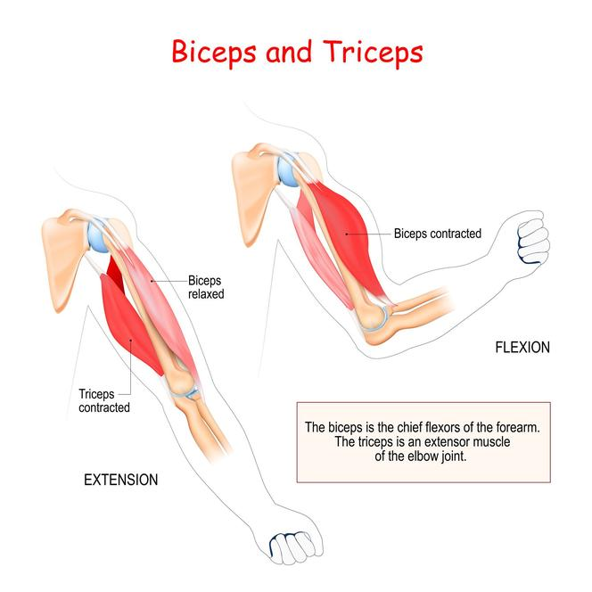
ANTAGONIST IN OUR BODY
https://www.vectorstock.com/royalty-free-vector/anatomy-biceps-and-triceps-vector-31601487

Slide 9
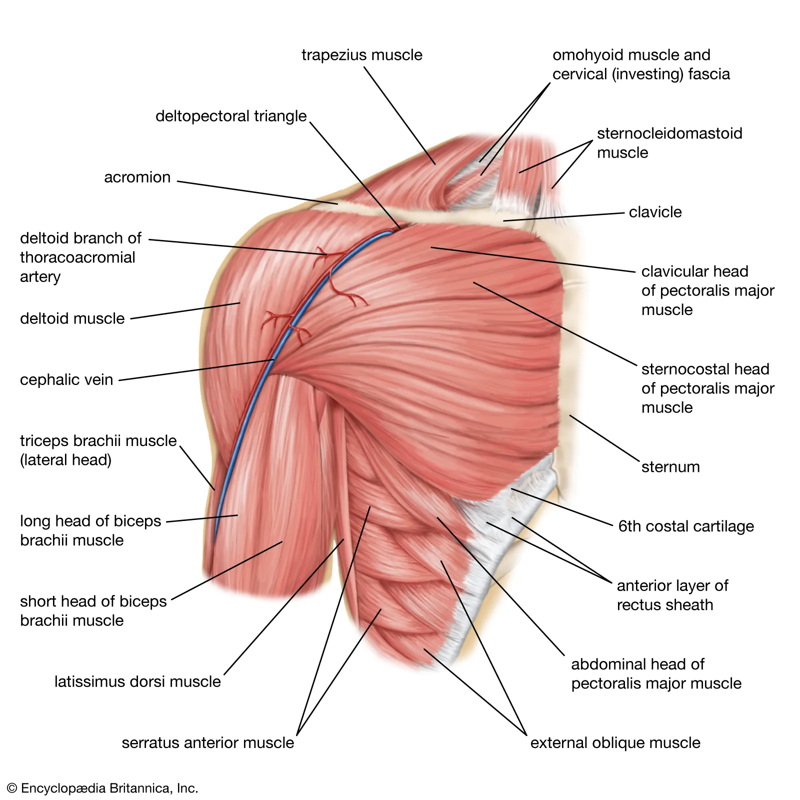
SYNERGISTIC MUSCLES
Some muscles are arranged in pairs or groups to work more efficiently. By performing the same movement together, they create synergistic muscles: for example, the shoulder muscles or the extensor muscles.
https://www.britannica.com/science/human-muscle-system/The-shoulder

Slide 10
TYPES OF MOVEMENTS
Adduction moving a body part toward the mid line of the body,
Abduction moving a body part away from the body,
Flexion bending the joint,
Extention straightening and extending of the joint,
Rotation involves moving a body part around an axis.

Slide 11
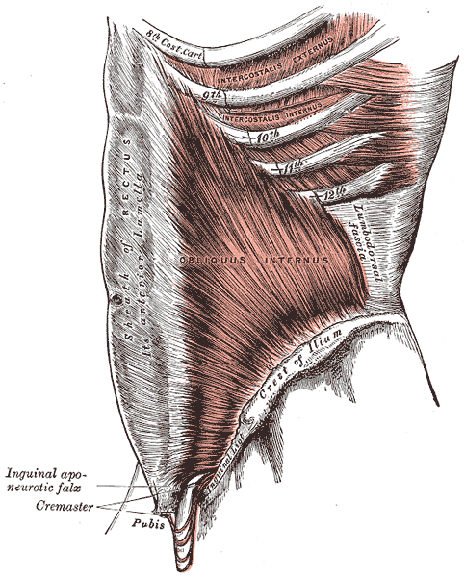
SUPPORTIVE STRUCTURES
Tendons- attach a muscle to a bone.
Fascia- attach muscle to muscle.
Tendons and fascia work together with the muscles which create the Muscular system necessary for movement.
https://pl.wikipedia.org/wiki/Powi%C4%99%C5%BA

Slide 12
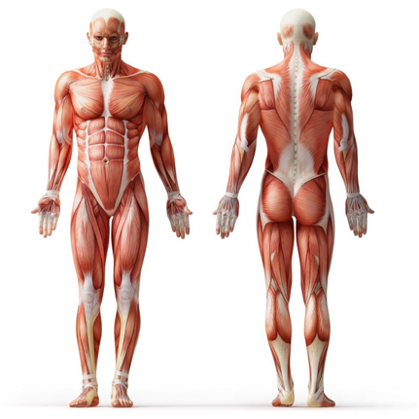
INTERESTING FACTS ABOUT THE MUSCULAR SYSTEM
The longest and the shortest muscle in our body,
The smallest and the biggest muscle,
How many muscles we must use to smile?
https://www.builtlean.com/muscles-grow/

Slide 13
QUIZ
1. How many muscles we have in our body?
200
160
640
450
Where the triceps brachii muscle has the insertion?
On the Radius
On the Breastbone
On the Ulna
On the Tibia
3. What is the biggest muscle in our body?
Stapedius
B) Biceps
C) Sartorius
D) Gluteus maximous

Slide 14
SŁOWNIK/DICTIONARY
Fascia- powięź
Tendons- ścięgna
Distinguished- wyróżnić
Fiber- włókno
blood vessels- naczynia krwionośne
tissue- tkanka
Attachments- przymocowany
Origin- przyczep początkowy
Insertion- przyczep końcowy
Consists- składa się
Account for- stanowić część
Approximately- około
Appearance- wygląd zewnętrzny
Shape of cells- kształt komórek
Voluntary/involuntary- zależny/ niezależny

Slide 15
BIBLIOGRAPHY
https://www.innerbody.com/image/musfov.html
http://www.theratape.com/education-center/wp-content/uploads/2012/11/Kinesio-Study-Myofascial-Shoulder-Pain.pdf Treatment of myofascial pain in the shoulder with Kinesio Taping. A case report
https://www.medicalnewstoday.com/articles/249192
https://www.diki.pl

Slide 16
THANKS FOR ATTENTION

