Slide 1
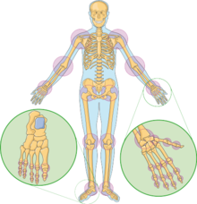
Joints - connection between parts of skeleton
Łukasz Hadała
Fizjoterapia 3 rok JMGR stacjonarne
2022/2023 sem. zimowy

Slide 2
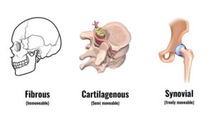
Joints - classification
1.Fibrous:
immovable joint
held together by tough tissue
example: cranium
2.Cartilaginous:
slightly moveable joint
example: vertebral column https://d1whtlypfis84e.cloudfront.net/guides/wp-content/uploads/2018/02/08085444/types-of-joint-300x160.jpg
3.Synovial:
freely movable joint
allows movement

Slide 3
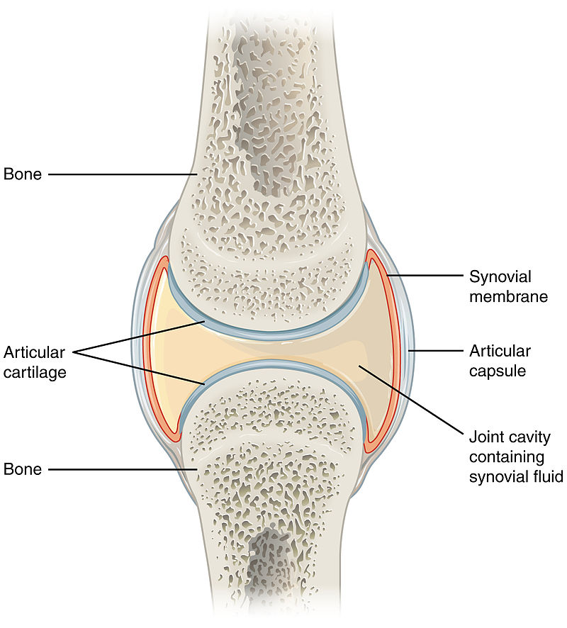
Synovial joints
synovial fluid
joint capsule
synovial membrane
articular cartilage
https://upload.wikimedia.org/wikipedia/commons/8/8b/907_Synovial_Joints.jpg

Slide 4
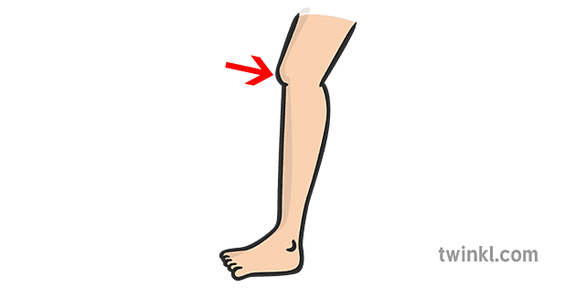
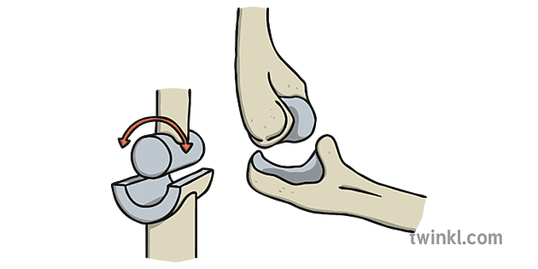
Types of joints - Hinge joint
allows movement in one axis
Hinge joint allows to flexion and extension
example: Elbow or Knee joint
https://images.twinkl.co.uk/tr/image/upload/t_illustration/illustation/hinge-joint.png

Slide 5
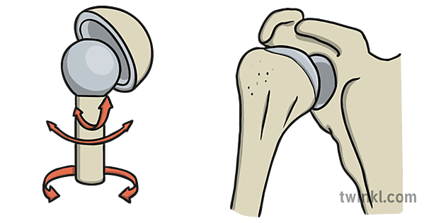
Types of joints - Ball & Socket joint
allows greatest movement in all axes
Ball & Socket joint allows to flexion, extension, abduction, adduction, rotation and circumduction
example: Shoulders
https://encrypted-tbn0.gstatic.com/images?q=tbn:ANd9GcQYWqJVdZATh4OoMCEGpENQy9qGhV2uSPdDHw&usqp=CAU https://images.twinkl.co.uk/tr/image/upload/t_illustration/illustation/ball-and-socket-joint.png

Slide 6
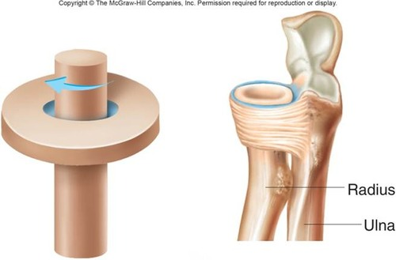
Types of joints: Pivot joint
allows movement in one axis
Pivot joint allows rotation called supination and pronation
example: proximal and distal radio-ulnar joint
https://dwes9vv9u0550.cloudfront.net/images/10993919/4b08865c-5eef-45a5-9407-158e2ab148b2.jpg

Slide 7
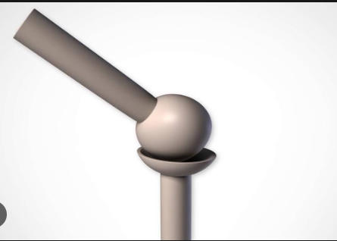
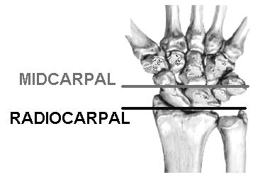
Types of joints - Ellipsoid/Condyloid joint
allows similar movement to Ball & Socket joint in two axis
Ellipsoid joint allows to flexion, extension, abduction, adduction and circumduction
example: radiocarpal joint
https://i.ytimg.com/vi/D6cIFG5wXF8/maxresdefault.jpg https://ouhsc.edu/bserdac/dthompso/web/namics/gifiles/wristap.gif

Slide 8
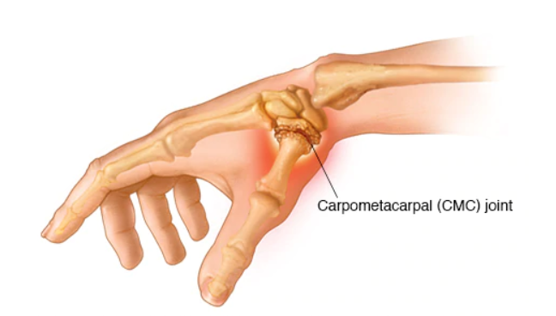
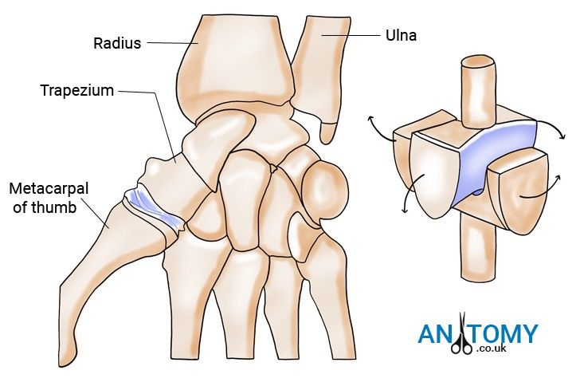
Types of joints - Saddle joint
allows similar movement to Ellipsoid joint in two axis
Saddle joint allows to flexion, extension, abduction ,adduction and circumduction
example: carpometacarpal joint
https://i.pinimg.com/736x/4a/b8/6f/4ab86f60ba0c4d8175f6b97f85f362f2.jpg

Slide 9
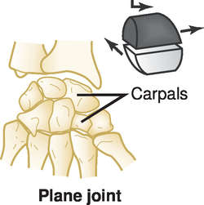
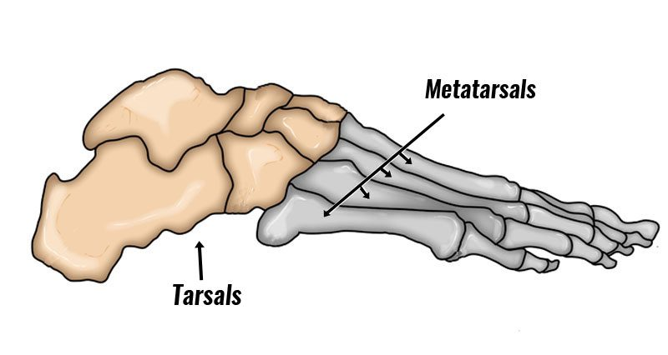
Types of joints - Plane joint
allows glide and rotation between flat surfaces
Plane joint allows slipping movement on the another bone
example: carpals or tarsals
https://img.tfd.com/medical/Davis/Tabers/th/j03d.jpg https://www.sportsinjuryclinic.net/wp-content/uploads/2016/10/tarsal-coalition800.jpg

Slide 10
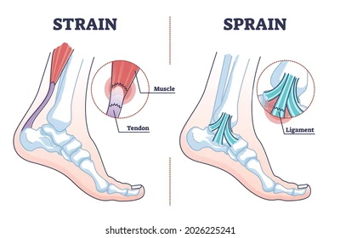
Joint injuries and damage
strain:
refers to overstretching tendons of muscles surrounding joints
mainly affects the ankle joint
sprain:
A sprain is a stretching or tearing of ligaments
The most common location for a sprain is in ankle

Slide 11
Quiz
How many types of synovial joints we have?
a)3 b)6 c)4
Which joint has a greatest movement?
a)pivot joint b)hinge joint c)ball & socket joint
Which connection is most moveable?
a)fibrous b)synovial c)cartilaginous
Elbow is an example of?
a)hinge joint b)ellipsoid joint c)saddle joint

Slide 12
Dictionary
articulation - staw
surfaces - powierzchnie
surrouding - otaczać
circumduction - obwodzenie
slightly - nieznacznie
tissue- tkanka
sprain - zwichnięcie
strain - naderwanie
slipping - ślizganie
hinge joint - staw zawiasowy
ball & socket joint - staw kulisty
pivot joint - staw obrotowy
saddle joint - staw siodełkowy
elipsoid joint - staw elipsoidalny
plane joint - staw płaski
supination - odwracanie
pronation - nawracanie
cartilage - chrząstka

Slide 13
Bibliography
“Mechanisms of synovial joint and articular cartilage development” Ryota Chijimatsu, Taku Saito Cellular and Molecular Life Sciences 2019
https://www.physio-pedia.com/Synovial_Joints
“Preinjury to Postinjury Disablement and Recovery After a Lateral Ankle Sprain: A Case Report “ J Athl Train (2018) 53 (8) John J. Fraser, bJay Hertel
https://www.diki.pl
https://www.youtube.com/watch?v=0cYal_hitz4&t=463s

Slide 14
Thanks for attention

