Slide 1

Accessories and methods used during rehabilitation process
Jan Wójcik
Fizjoterapia 2 rok, 2016/2017
Studia stacjonarne
Numer indeksu: 091699

Slide 2
Individual approach
Rehabilitation process
Mile stones
Potential
Weight adjusting
Progress supervision
Accessories and methods:
Dumbbells
Kettlebells
Weight bar
Thera band
Exercise ball
Medicine ball
Step
Bosu
Exercises in water

Slide 3
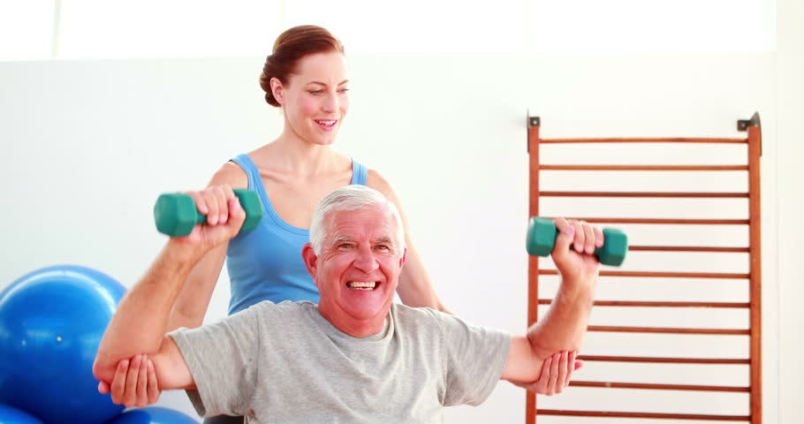
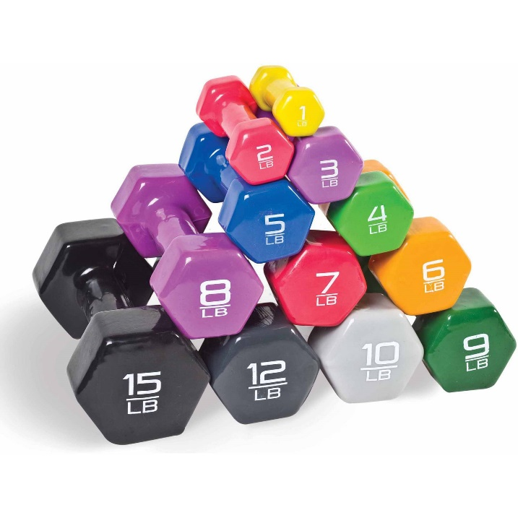
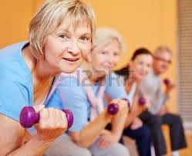
Dumbbells
Weight up to 50 kg
Portable (easy to carry)
One or many muscle groups involved at a time
Very easy to use
Comfortable grip
Exercises:
Press
Row
Hammer curl
https://www.shutterstock.com/video/clip-5653094-stock-footage-pretty-physiotherapist-helping-elderly-patient-lift-hand-weights-at-the-rehabilitation-center.html
https://www.walmart.com/browse/sports-outdoors/dumbbells/4125_4134_1026285_1078284_1078285
https://www.123rf.com/stock-photo/rehabilitation_elderly.html

Slide 4
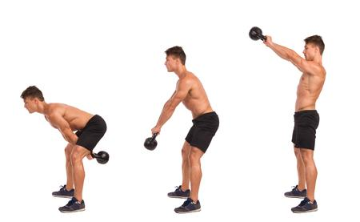
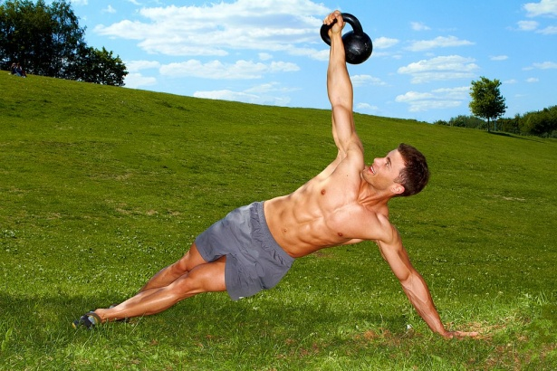
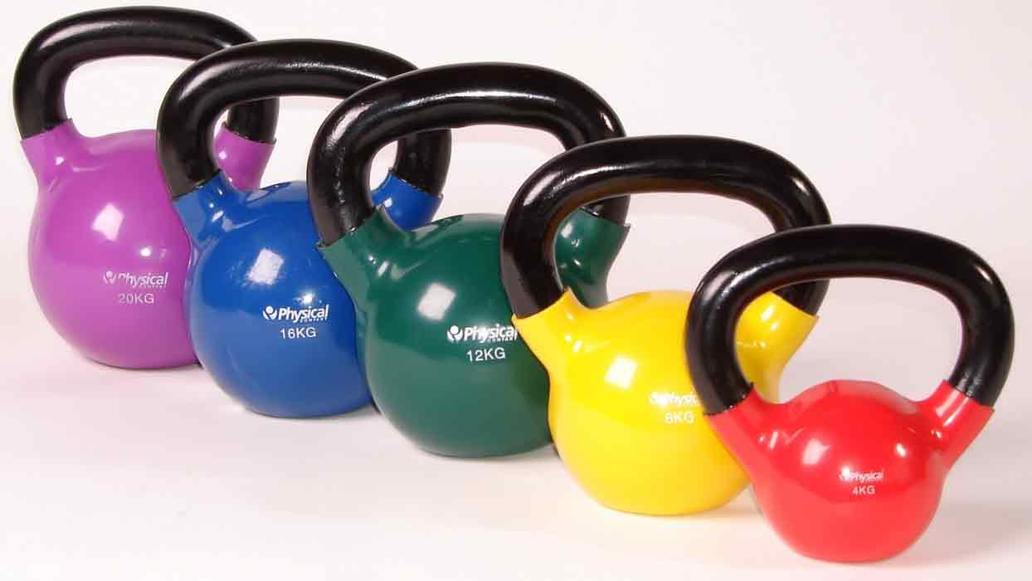
Kettlebells
https://ortic.pl/pl/n/6
Weight up to 50 kg
Different grip
Swing option
Exercises:
Swing
Press
Squat
http://www.trener-personalny.pl/trening-z-kettlebells-hkc/61/
http://www.over60health.info/health-articles/exercise-fitness/kettlebell-and-kettlebell-workouts/

Slide 5
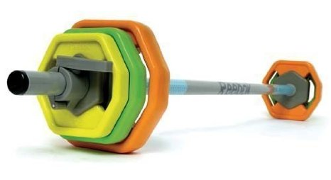
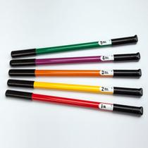
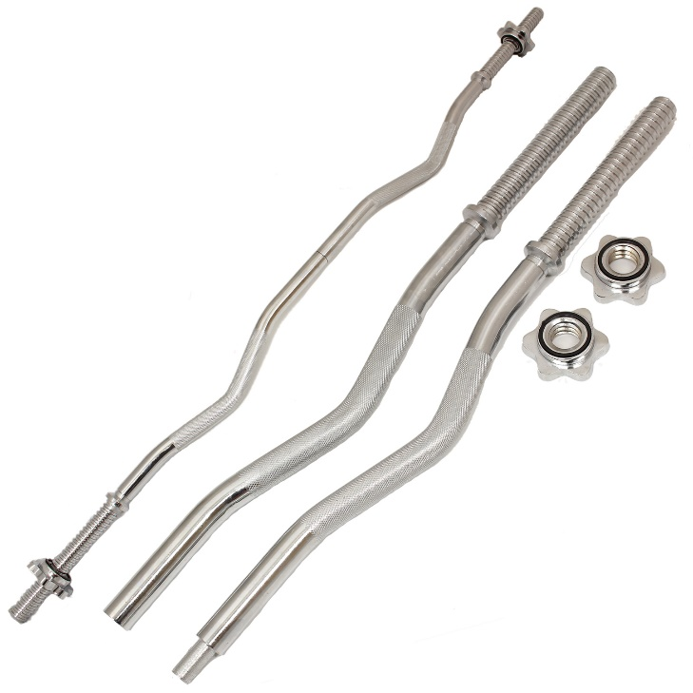
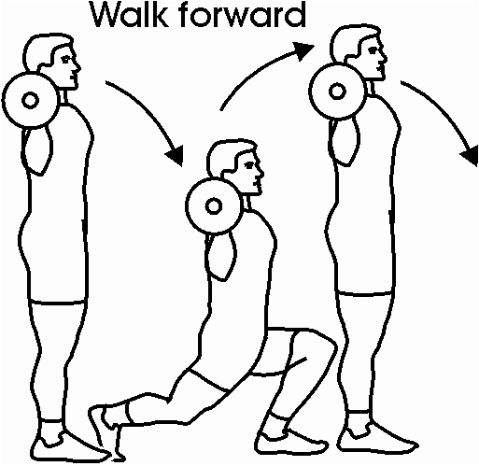
Weight bar
Weight 1-20 kg
Two handed
Exercises:
Squat
Walking lunge
Press
Row
https://guide.alibaba.com/shop/new-reebok-polyurethane-rep-set-home-gym-exercise-and-fitness-weight-bar-and-collars_3801829.html
http://www.clinton-ind.com/products/physical-therapy-equipment/exercise-weights/pt-weight-bars
http://www.ebay.co.uk/itm/MAX-FITNESS-2PC-CURL-BAR-WEIGHT-BAR-LIFTING-ARM-EZ-EASY-CURLBAR-BARBELL-SPINLOCK-/400548340824
https://pl.pinterest.com/pin/312859505342653543/

Slide 6
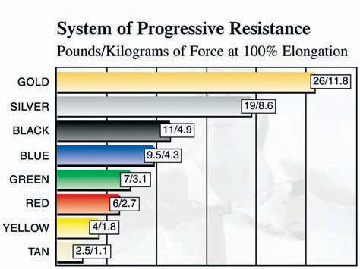
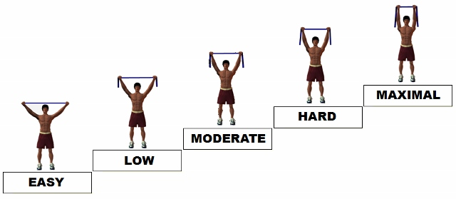
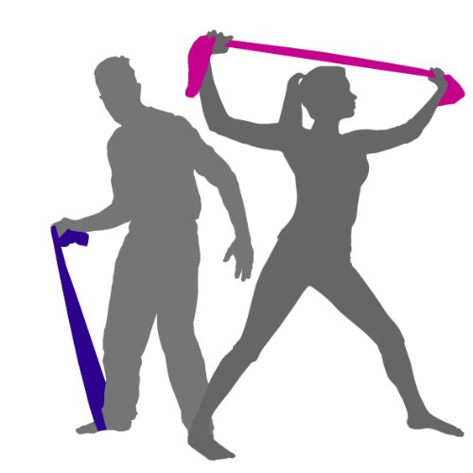
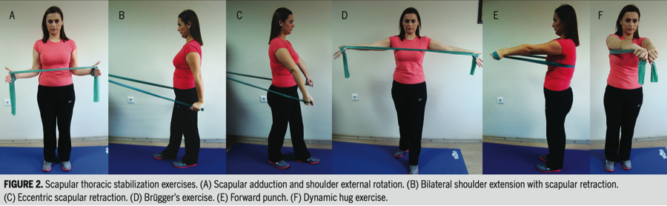
Thera band
Flexible
Alternative to conventional training accessories
Resistance depends on the colour
Easy and safe to use
http://www.ebay.com/itm/1-Gold-Thera-Band-Theraband-Resistance-Band-5-Feet-Free-Shipping-Theraband-/251214250463
http://www.performancehealthacademy.com/announcing-the-new-thera-band-c2-ae-resistance-intensity-scale-for-exercise-rise.html
http://ukfitnessdirectory.com/shop/resistance-bands-best-fitness-bands-exercise-equipment-a-home-gym-multi-gym-for-strength-training-workouts-travel-physio-rehab-recuperation-theraband-pilates-yoga-mat-exercises-seated-ex/
http://blog.performancehealthacademy.com/2016/04/14/how-to-improve-neck-stabilization-exercise/

Slide 7
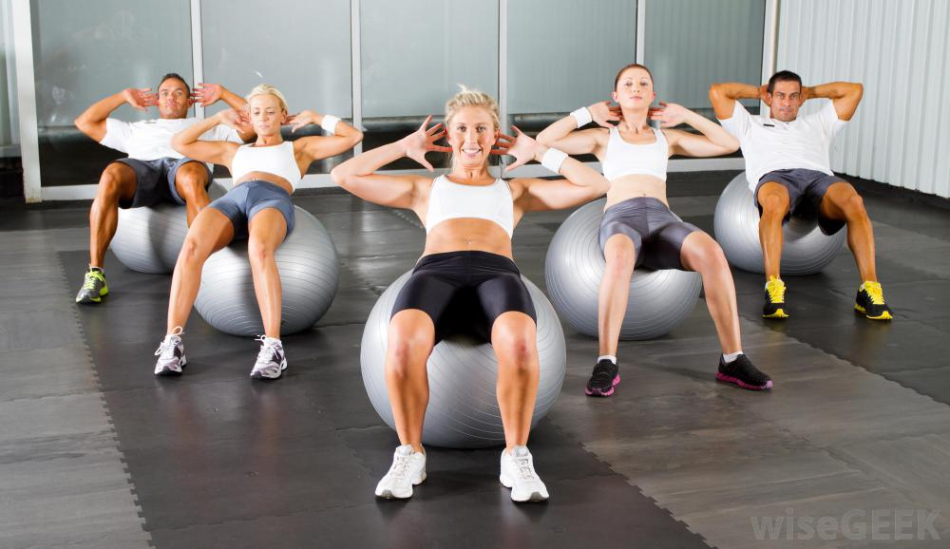
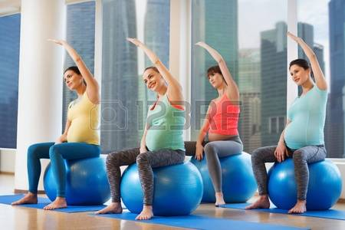
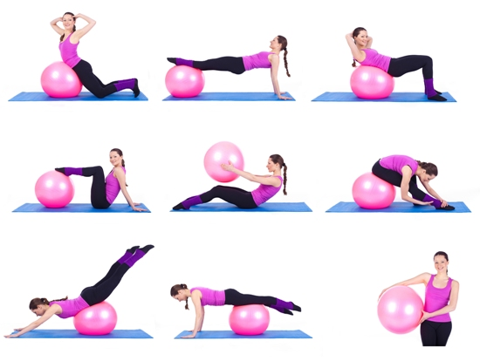
Exercise ball
Comfortable sit
Supporting Correct body posture
Recommended for pregnant women
Balance
Soft
http://www.wisegeek.com/what-is-a-swiss-ball.htm
https://www.123rf.com/stock-photo/pregnant_with_fitness_ball.html
http://stylesatlife.com/articles/swiss-ball-exercises/

Slide 8
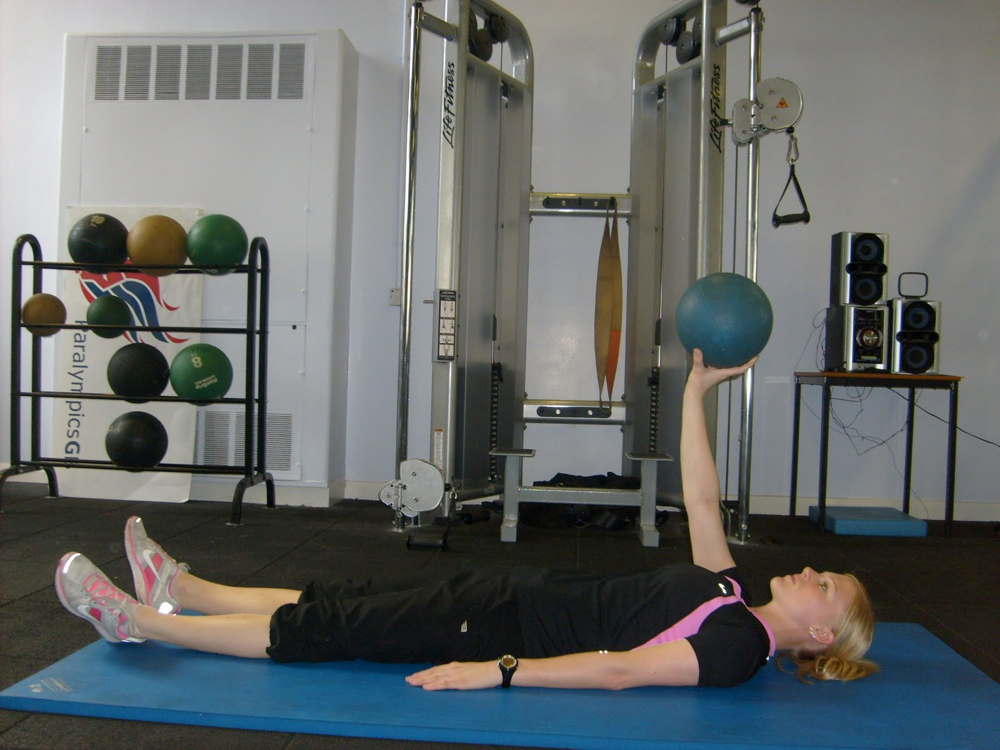
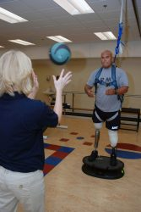
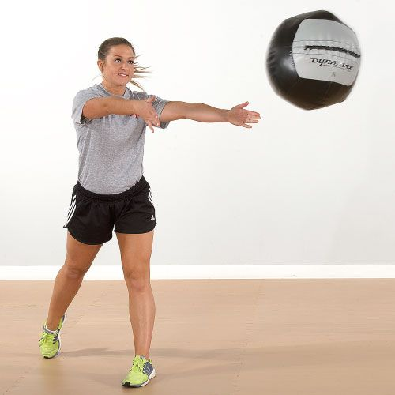
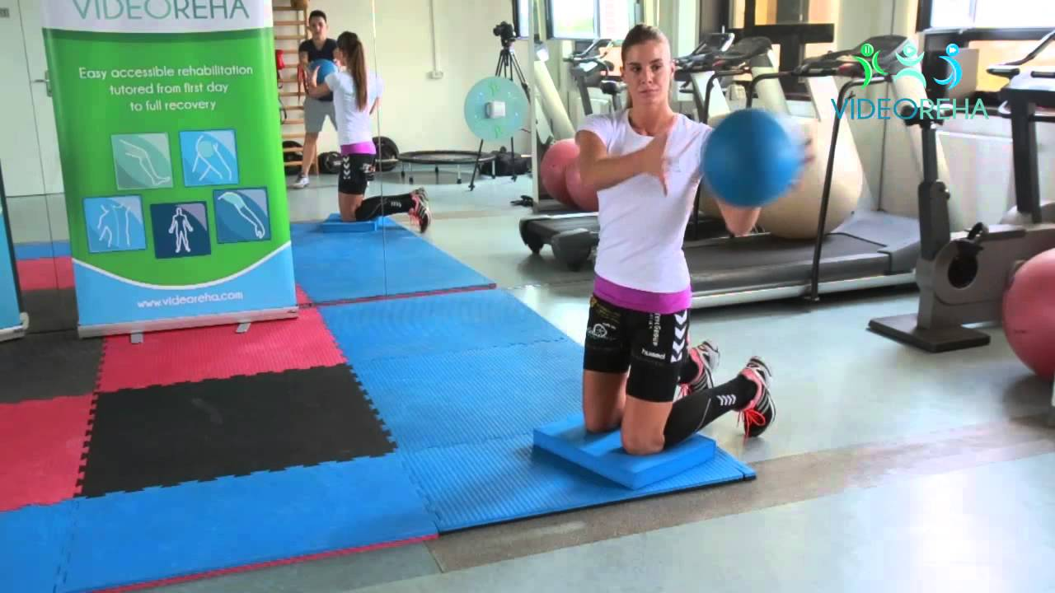
Medicine ball
Weight up to 10 kg
Easy to catch
Strength, agility and endurance
Exercises:
„Wallball”
Ball catching
Lifting
http://strengthandrehab.blogspot.com/2010/09/tennis-injury-prerehabilitation.html
http://wiselygreen.com/fitness-benefits-of-medicine-ball-exercises-for-everyone/
https://www.youtube.com/watch?v=o9ccn-OVCoo
https://pl.pinterest.com/leemaggio/perform-better-latest-equipment-ideas-about-full-b/

Slide 9
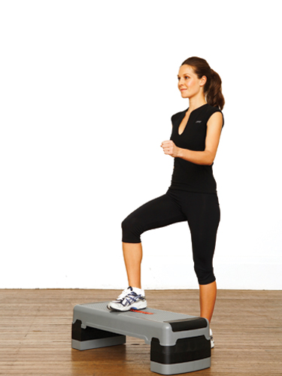
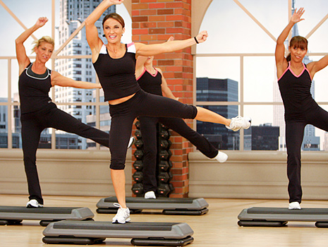
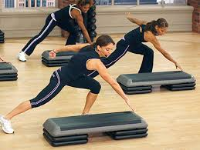
Step
Whole body training
Coordination
Condition training
Cardiovascular and muscular endurance
https://2ptc1.wordpress.com/what-is-queens-college-step-test/
http://cathe.com/aerobic-step/
http://cathe.com/aerobic-step/

Slide 10
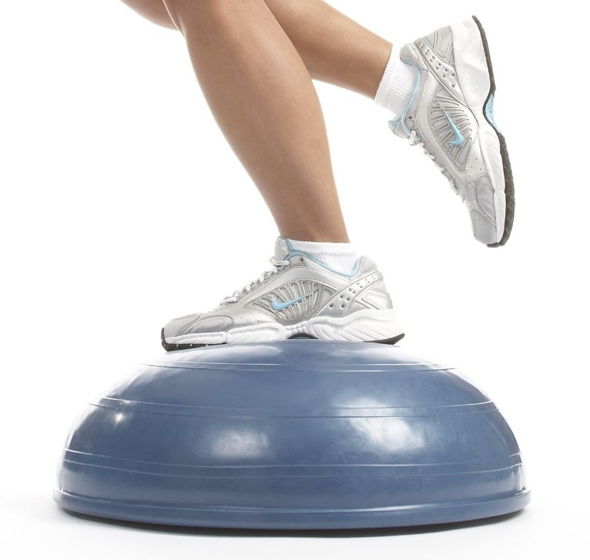
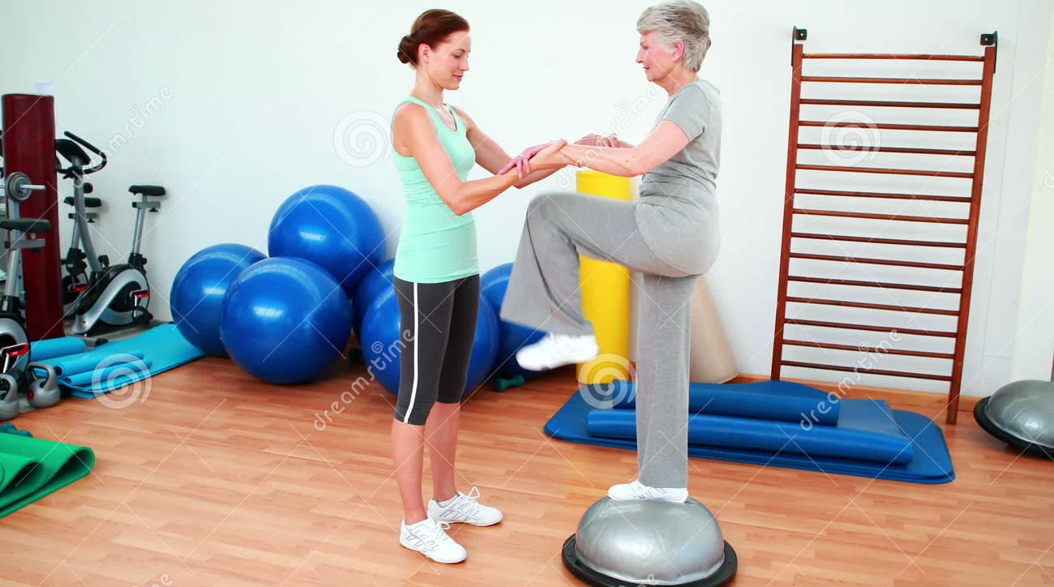
Bosu
Coordination
Balance
Whole body training
Challenging
Core strength
http://www.physioprescription.com/2013/09/30/sprained-ankle-treatment-rehab-exercises/
https://www.dreamstime.com/stock-video-footage-trainer-helping-elderly-client-to-use-bosu-ball-rehabilitation-center-video40129256

Slide 11
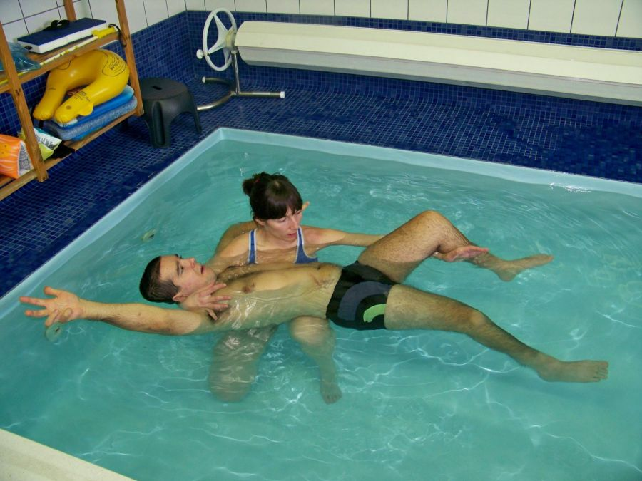
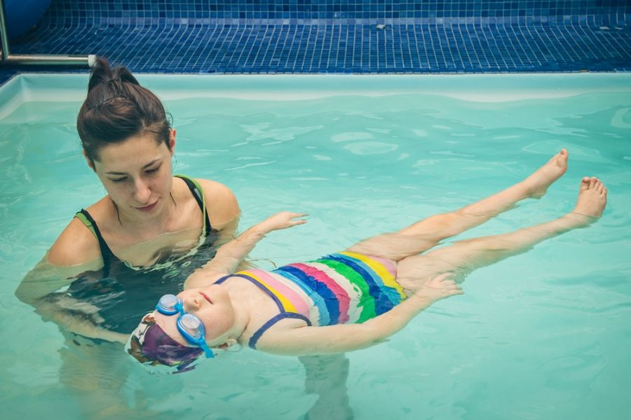
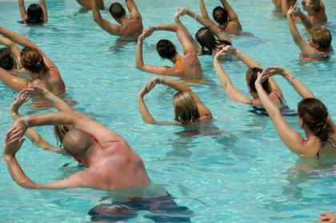
Exercises in water
Unweighting
Faster moves = higher resistance
Perfect for everybody
Natural environment
http://www.zabajka.home.pl/?pl_cwiczenia-w-wodzie,90
http://www.zabajka.home.pl/?pl_cwiczenia-w-wodzie,90
http://www.leksykonmasazu.pl/slowko/cwiczenia-w-wodzie/931

Slide 12
Test your knowledge!
A. Bosu | 1. You can get wet
B. Medicine Ball | 2. Flexible, different colours
c. Exercises in water | 3. It weights up to 10 kg
D. Thera band | 4. It looks like a ball cut in half
E. Exercise ball | 5. Soft and comfortable sitting place

Slide 13

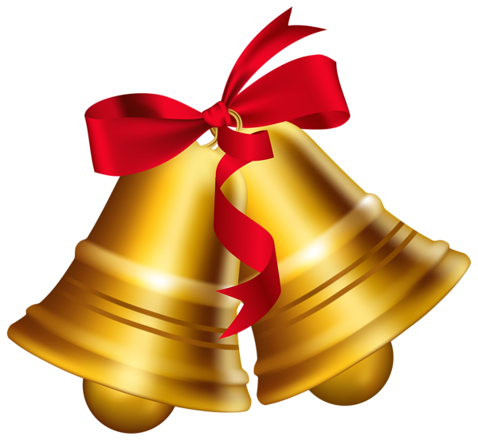
Rebus
+
=
?

Slide 14
Vocabulary
Accessories – akcesoria
Mile stone – kamień milowy
Potential – możliwości
Supervision – nadzór
Dumbbells – hantle
Portable – przenośny
Comfortable – wygodny
Press – wyciskanie
row – wiosłowanie
Swing – machać (tam i z powrotem)
Squat – przysiad
Grip – chwyt
Walking lunge – wykrok
Flexible – elastyczny
Correct body posture – prawidłowa postawa ciała
Pregnant women – kobiety w ciąży
Agility – zręczność
Endurance – wytrzymałość
Unweighting – odciążenie
Natural environment – naturalne środowisko
Whole body training – trening całego ciała
Resistance – opór
Catch – łapać, chwytać
Soft - miękki

Slide 15
Bibliography
http://www.over60health.info/health-articles/exercise-fitness/kettlebell-and-kettlebell-workouts/
https://www.bodybuilding.com/exercises/finder/lookup/filter/equipment/id/1/equipment/dumbbell
http://www.livestrong.com/article/480682-advantages-and-disadvantages-of-dumbbells/
http://www.livestrong.com/article/513433-bosu-ball-exercises-for-runners/

