Slide 1
UNIWERSYTET RZESZOWSKI
KOLEGIUM NAUK MEDYCZNYCH
INSTYTUT NAUK O ZDROWIU
Patrycja Ficek
Fizjoterapia JMN 3 rok, VI sem.
2021/2022

Slide 2
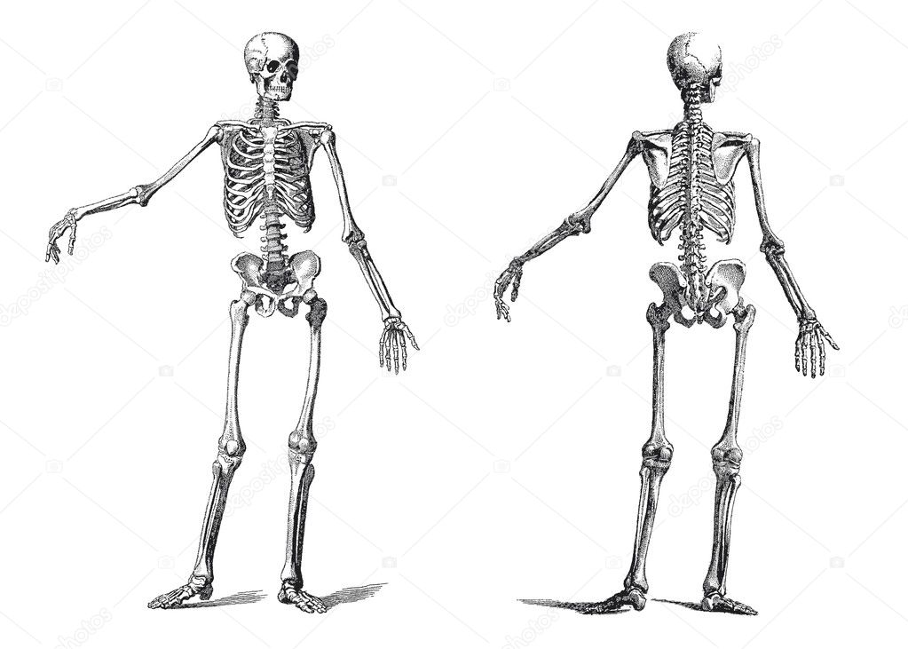
The Skeletal System
https://pl.depositphotos.com/5872085/stock-illustration-human-skeleton-vintage-nineteenth-century.html

Slide 3
The Axial skeleton
206 bones
Skull; spine; rib cage
Protecting the brain, spinal cord, heart and lungs
https://en.wikipedia.org/wiki/Axial_skeleton

Slide 4
The Appendicular skeleton
the arms, legs, shoulder girdle and pelvic girdle
protects
https://bio.libretexts.org/Courses/West_Hills_College_-_Lemoore/Human_Anatomy_Laboratory_Manual_(Hartline)/07%3A_Introduction_to_the _Skeletal_System/7.03%3A_Axial_Skeleton_and_Appendicular_Skeleton

Slide 5
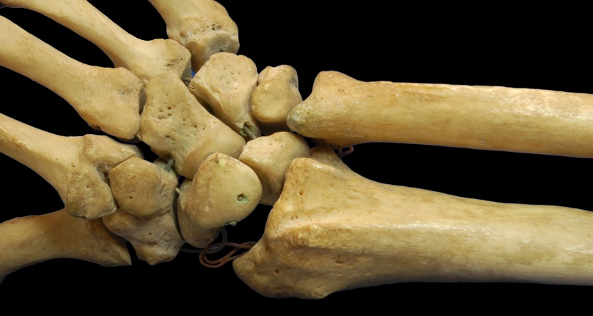
Classification of bones
Long bone
Places for the attachment
https://nrpt.co.uk/training/body/skeletal/long.htm
Short bone
https://en.wikipedia.org/wiki/Short_bone

Slide 6
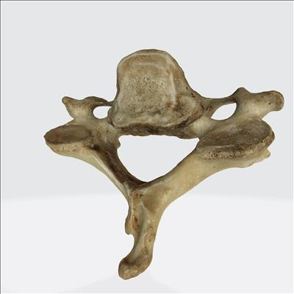
Classification of bones
Irregular bone
Flat bone
Skinny
Protect internal organs
https://www.google.com/search?q=ko%C5%9B%C4%87+p%C5%82aska+&tbm=isch&ved=2ahUKEwjfxpiR0Mj2AhXkolwKHfMNDrgQ2-cCegQIABAA&oq=ko%C5%9B%C4%87+p%C5%82aska+&gs_lcp=CgNpbWcQAzIECAAQHlCAEFiAEGCkFGgAcAB4AIABUIgBkQGSAQEymAEAoAEBqgELZ3dzLXdpei1pbWfAAQE&sclient=img&ei=x8owYp_HDOTF8gLzm7jACw&bih=558&biw=784&rlz=1C1CHBD_enPL885PL885#imgrc=5aU5wbTGrxrGuM
https://medicum.umed.lodz.pl/MediaObject/Details/545

Slide 7
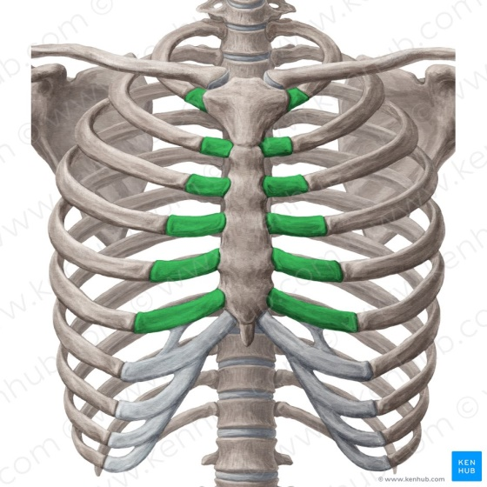
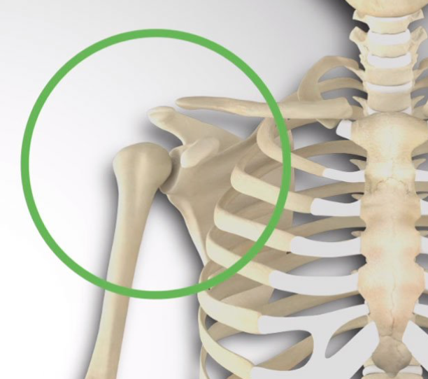
Types of Joints
Fibrous
Cartilaginous
Synovial
https://rehab-gdansk.pl/zamrozony-bark-co-to-jest-i-jak-go-leczyc-objawy-i-cwiczenia/
https://www.kenhub.com/en/library/anatomy/the-ribs
https://www.zoology.ubc.ca/~biomania/tutorial/bonejt/jt01aa02.htm

Slide 8
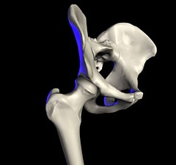
Types of Synovial Joints
Ball and Socket Joints
the greatest range of movement
https://rehab-gdansk.pl/zamrozony-bark-co-to-jest-i-jak-go-leczyc-objawy-i-cwiczenia/
https://pl.wikipedia.org/wiki/Staw_biodrowy

Slide 9
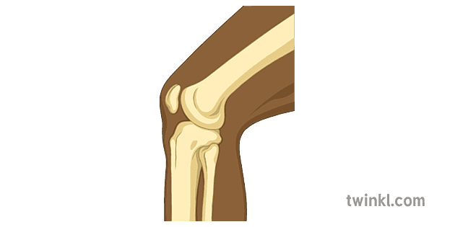
Types of Synovial Joints
Hinge joint
flexion and extension
https://www.twinkl.pl/illustration/hinge-joint
https://www.twinkl.pl/illustration/hinge-joint-1

Slide 10
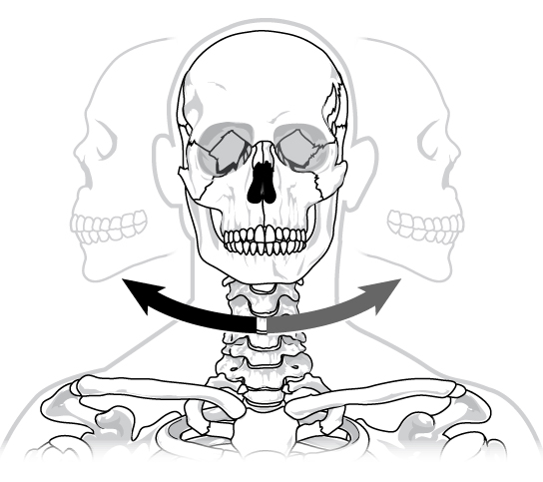
Types of Synovial Joints
Pivot Joint
only rotation
https://study.com/learn/lesson/pivot-joint-examples-movement.html
https://courses.lumenlearning.com/wm-biology2/chapter/types-of-synovial-joints/

Slide 11
Types of Synovial Joints
Gliding Joint
small and limited
https://www.twinkl.it/teaching-wiki/joints-in-the-human-body

Slide 12
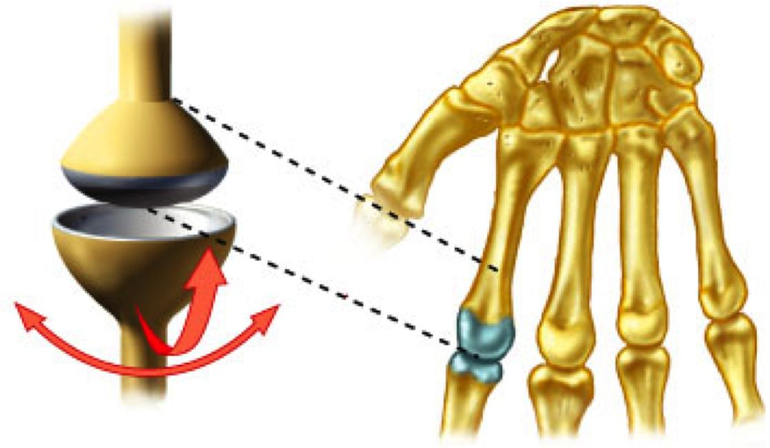
Types of Synovial Joints
Saddle Joint
Ellipsoidal Joints
https://pl.pinterest.com/pin/485403666064307387/
https://radiopaedia.org/articles/saddle-joint

Slide 13
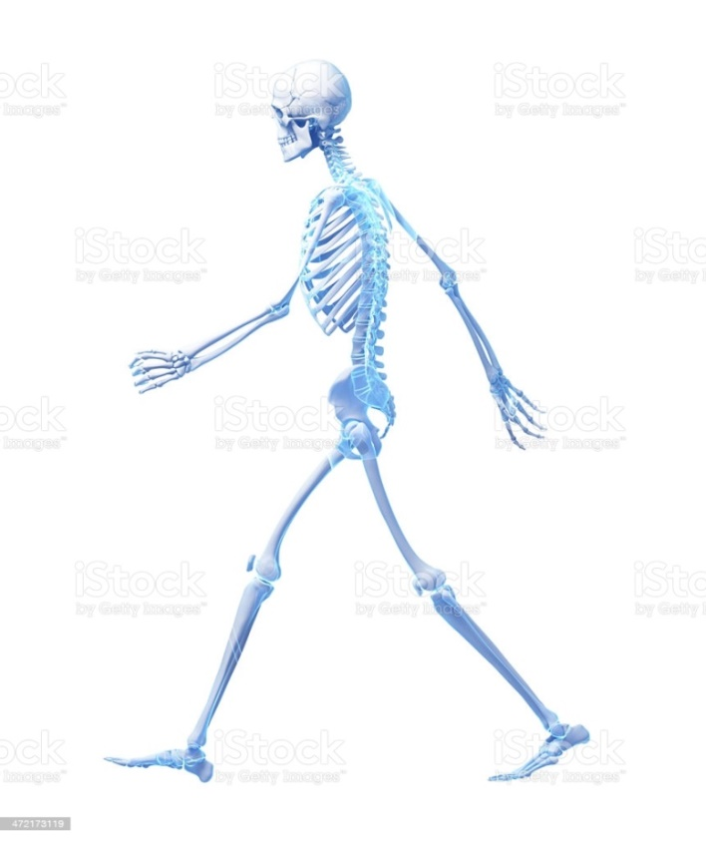
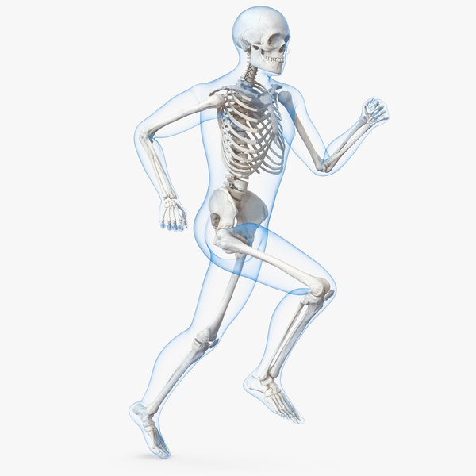
FUNCTINS OF THE SKELETON
Shape
Movement
https://www.istockphoto.com/pl/zdj%C4%99cie/chodzi%C4%87-szkielet-gm472173119-35265262
https://www.turbosquid.com/pl/3d-models/male-body-skeleton-running-3d-model-1229826

Slide 14
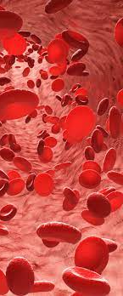
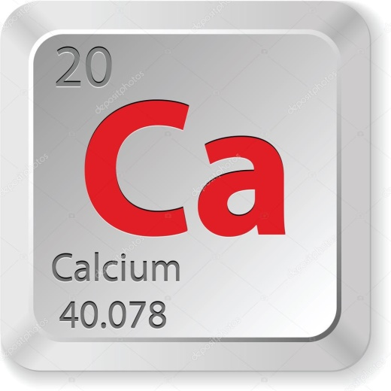
FUNCTINS OF THE SKELETON
Blood Cell Production
Protection
Store Minerals
https://zdrowie.radiozet.pl/Medycyna/Diagnostyka-medyczna/Erytrocyty-czerwone-krwinki-niskie-wysokie.-Jakie-sa-przyczyny
https://www.pngegg.com/pl/png-pdggj
https://pl.depositphotos.com/vector-images/calcium.html?qview=15395649

Slide 15
References
Elise F. Morgan, Ginu U. Unnikrisnan, and Amira I. Hussein. Bone Mechanical Properties in Healthy and Diseased States. Rev Biomed Eng. 2018 Jun 4; 20: 119–143.
Bart Clarke. Normal Bone Anatomy and Physiology. Clin J Am Soc Nephrol. 2008 Nov
Bradley W. Anderson; John Ekblad; Bruno Bordoni. Anatomy, Appendicular Skeleton. StatPearls Publishing; 202

