Slide 1


Cardiac rehabilitation
Kacper Józefczyk
University of Rzeszów
Faculty of Medicine
3rd year of Physiotherapy
2022/2023

Slide 2

Risk factors of cardiovascular diseases
Smoking
Lack of physical activity
Unhealthy diets
Hypertension
Increased blood sugar/lipid levels
Overweight or obesity
https://www.luxmed-diagnostyka.pl/phavi/ph/r,750,0/upl/2021/0804/0828-bol-klatka-piersiowa.jpg?token=92f21134

Slide 3
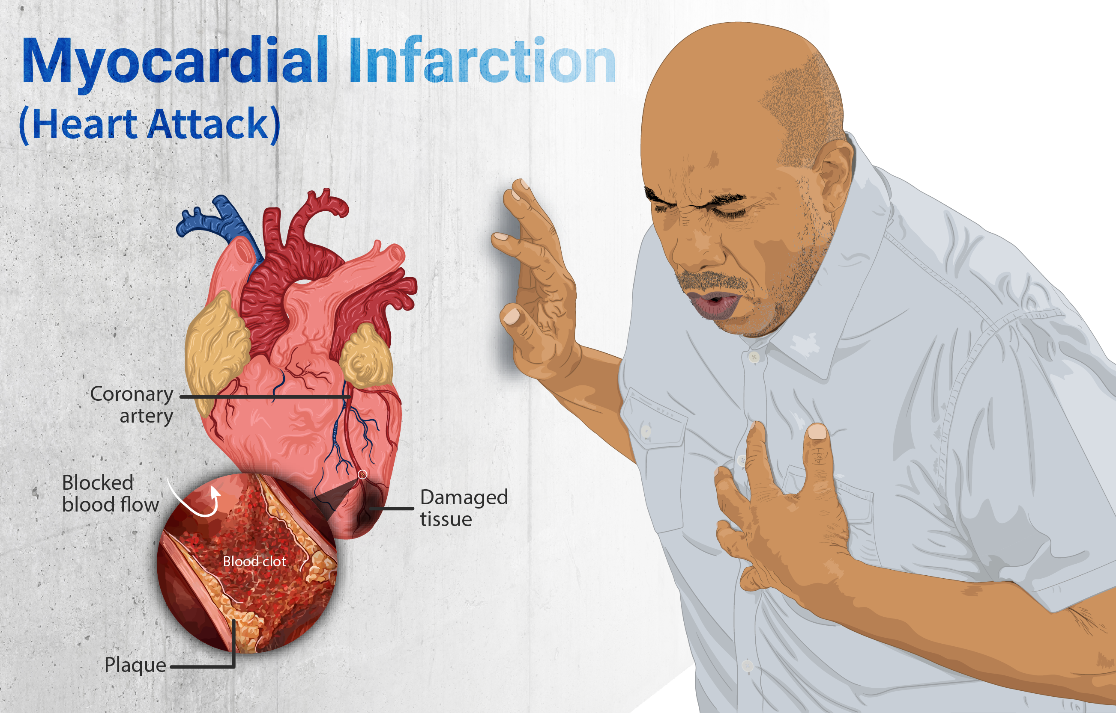
Symptoms:
Chest pain or discomfort which may travel into the shoulder, arm, back, neck or jaw. Often it occurs in the center or left side of the chest and lasts for more than a few minutes.The discomfort may occasionally feel like heartburn
Shortness of breath
Nausea
Feeling faint
Cold sweat
Feeling tired
https://upperhillcardiovascularcentre.com/wp-content/uploads/2021/09/myocardial-infarction-heder-image.png

Slide 4
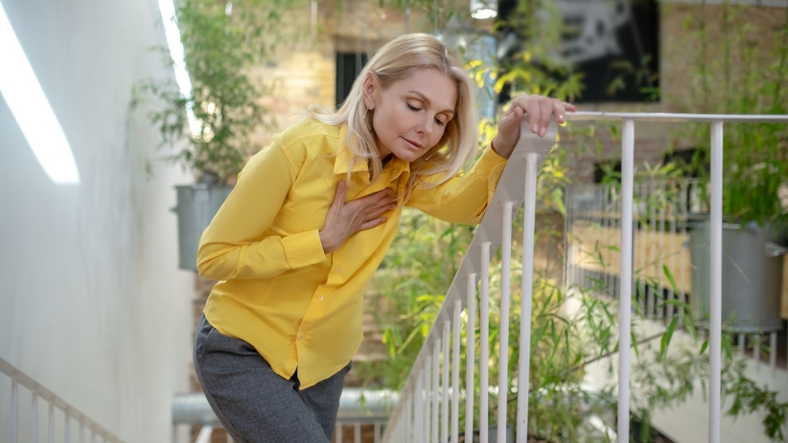
Cardiac insufficiency
Symptoms:
Shortness of breath with activity or when lying down
Fatigue and weakness
Swelling in the legs, ankles and feet
Rapid or irregular heartbeat
Reduced ability to exercise
Persistent cough or wheezing
Rapid weight gain
https://gfx.zdrowie.radiozet.pl/var/radiozetzdrowie/storage/images/medycyna/diagnostyka-medyczna/zadyszka-przy-wchodzeniu-po-schodach-jakie-sa-tego-przyczyny/2263100-2-pol-PL/Zadyszka-przy-wchodzeniu-po-schodach-jakie-sa-tego-przyczyny_article.jpg

Slide 5
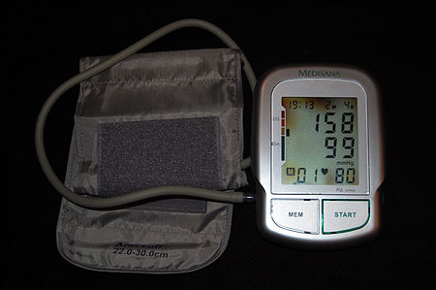
Hypertension
Major risk factor for stroke, coronary artery disease, heart failure, atrial fibrillation, peripheral arterial disease, vision loss, chronic kidney disease, and dementia.
Hypertension is a major cause of premature death worldwide.
https://upload.wikimedia.org/wikipedia/commons/thumb/4/47/Grade_1_hypertension.jpg/450px-Grade_1_hypertension.jpg

Slide 6
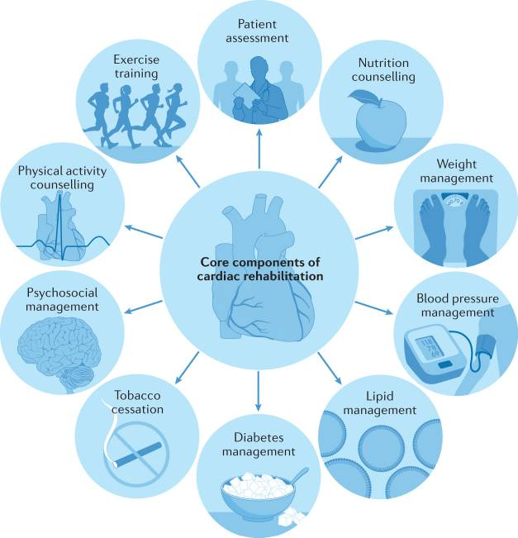
Complex intervention of cardiac rehabilitation

Slide 7
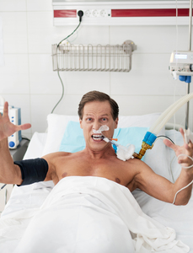
First stage of rehabilitation
First period:
Breath exercises
Dynamic exercises for small muscle groups
Relaxation exercises
Lying and sitting position
Turning sideways
Time 5-10min
https://us.123rf.com/450wm/iakovenko/iakovenko1810/iakovenko181000091/109767782-portret-rozw%C5%9Bcieczonego-pacjenta-na-wentylator-mechaniczny-le%C5%BC%C4%85cy-w-%C5%82%C3%B3%C5%BCku-i-patrz%C4%85cy-na-kamer%C4%99-z-gry.jpg?ver=6

Slide 8
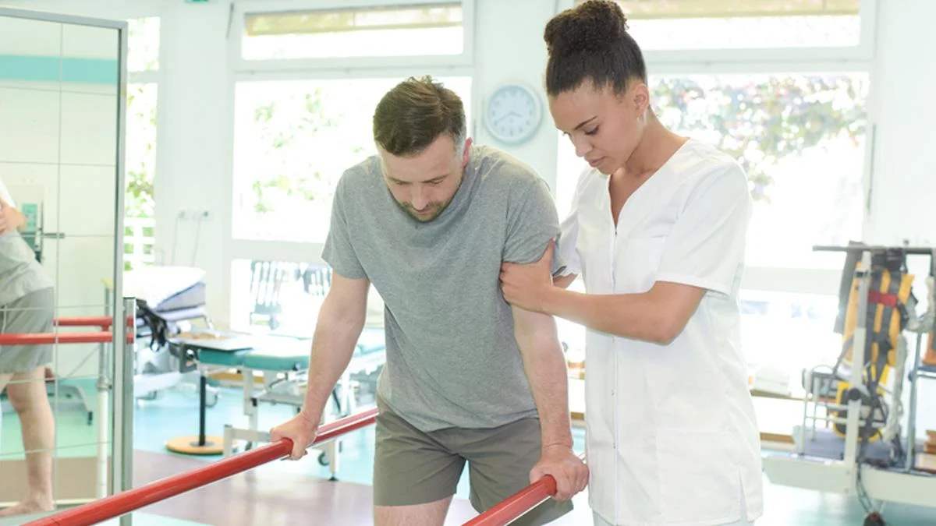
First stage of rehabilitation
Second period:
Standing up and moving around the room
Exercises from period 1 in the supine and sitting position
Dynamic exercises for lower and upper limbs
Dynamic coordination exercises
Time 10-15min
https://www.csp.org.uk/sites/default/files/styles/full_width/public/media-image/2020-10/physical-rehab.jpg?itok=C2fQb5Bn

Slide 9
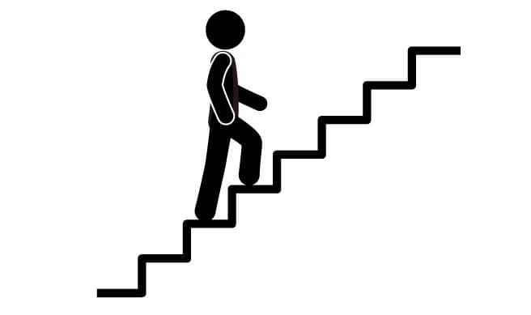
First stage of rehabilitation
Third period:
Full self service
Longer walks(up to 200meters)
Walking up the stairs to the 1st floor
Exercises from period 1 and 2
Time 15-20min
https://krokdozdrowia.com/wp-content/uploads/2015/03/wchodzenie-po-schodach.jpg

Slide 10
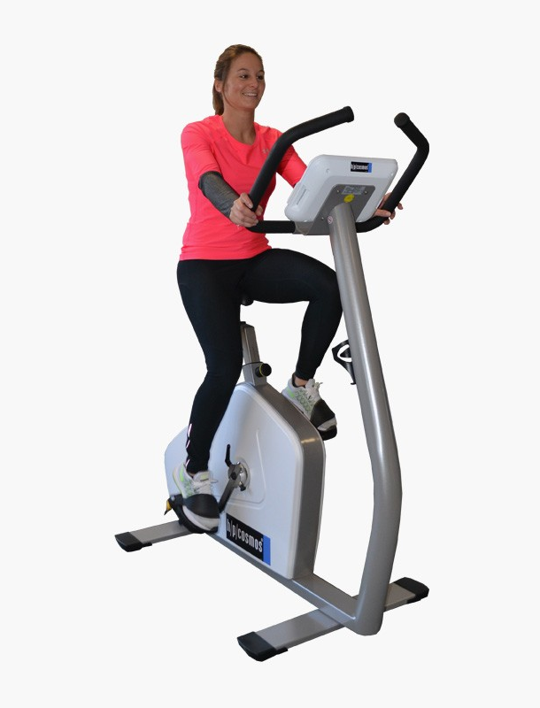
Second stage of rehabilitation
Model A:
Low risk
High exercise tolerance
Continuous endurance training on a bicycle ergometer or treadmill
Resistance training
General improvement exercises
Time 60-90min
60-80% Heart rate reserve
https://www.hpcosmos.com/sites/default/files/styles/produktbild/public/uploads/images/20170110_cos30021emf-med600_torqualizer_01_web.jpg?itok=UHjM648D

Slide 11
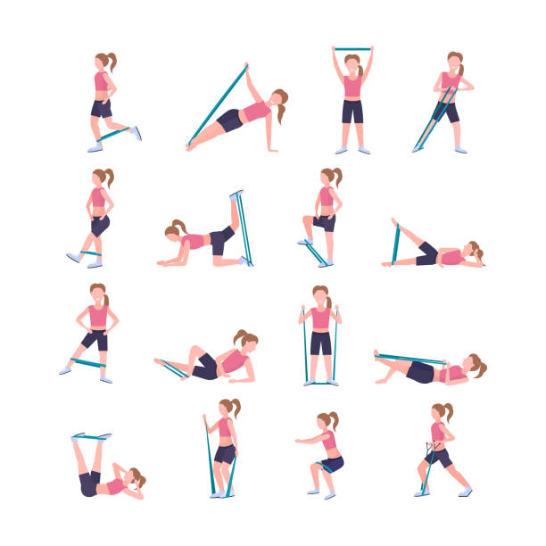
Second stage of rehabilitation
Model B:
Medium risk
High and medium exercise tolerance
Continuous or interval endurance training on a bicycle ergometer or treadmill
Resistance training
General improvement exercises
Time 45-60min
50-60% Heart rate reserve
https://media.istockphoto.com/vectors/set-sporty-woman-doing-different-exercises-with-resistance-band-girl-vector-id1140186982?k=20&m=1140186982&s=612x612&w=0&h=MveAKEmIblYDbaAjrutEl3EQZgUX978_CwQ00xoaQ5o=

Slide 12
Second stage of rehabilitation
Model C:
Medium risk
Low exercise tolerance
Interval endurance training on a bicycle ergometer and treadmill
Time 45min
40-50% heart rate reserve

Slide 13
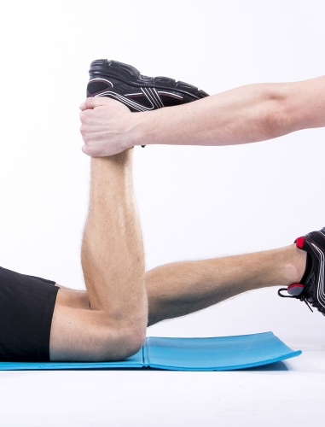
Second stage of rehabilitation
Model D:
Medium and high risk
Very low exercise tolerance
Individual exercises
Time 30-45min
Less than 20% heart rate reserve
https://centrumsportowca.pl/wgrane_pliki/big_cwiczenia-125.jpg

Slide 14


Third stage of rehabilitation
Reducing the risk of relapse
Avoiding stress
Adequate amount of sleep
Balanced diet
Long walks
Swimming
Cycling
Running
https://dziendobry.tvn.pl/cdn-zdjecie-zrgy8q-fot-jecapix-getty-images-5234180/a3cadad0-a081-4651-86e9-393429b4095e.jpeg
https://i.wpimg.pl/730x0/m.fitness.wp.pl/gettyimages-628558134-7a830343e5.jpg

Slide 15
Vocabulary
Risk factors-czynniki ryzyka
Lack of physical activity-brak aktywności fizycznej
Hypertension-nadciśnienie tętnicze
Obesity-otyłość
Nausea-mdłości
Cold sweat-zimne poty
Myocardial infarction-zawał mięśnia sercowego
Cardiac insufficiency/heart failure-niewydolność serca
Swelling-obrzęk,opuchlizna
Wheezing-świszczący oddech
Stroke-udar
Coronary artery disease-choroba wieńcowa
Atrial fibrillation-migotanie przedsionków
Peripheral arterial disease-choroba tętnic obwodowych
Chronic kidney disease-przewlekła choroba nerek
Tobacco cessation-zaprzestanie palenia
Treadmill-bieżnia
Resistance training-trening oporowy
Heart rate reserve-rezerwa tętna
Relapse-nawrót czegoś
General improvement exercises-ćwiczenia ogólnokondycyjne

Slide 16
References:
https://www.ncbi.nlm.nih.gov/pmc/articles/PMC8445013/
https://www.ahajournals.org/doi/10.1161/CIR.0000000000000663
https://www.ncbi.nlm.nih.gov/pmc/articles/PMC7953385/
https://journals.viamedica.pl/kardiologia_polska/article/view/KP.a2021.0066/63478
https://www.nature.com/articles/s41569-021-00611-7#Sec1
https://www.mayoclinic.org/diseases-conditions/heart-failure/symptoms-causes/syc-20373142

