Slide 1
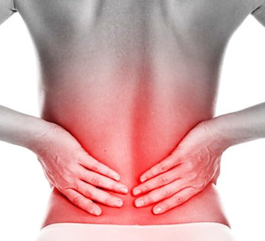

Miłosz Kędra
Fizjoterapia niestacjonarnie 3rok JMN
10.01.2025 , rok akademicki 2024/2025
Introduction to Low Back Pain
Causes and Risk Factors
Symptoms of LBP
Common Conditions Leading to LBP
Diagnostic Methods
Prevention and Management Strategies
BACK PAIN

Slide 2
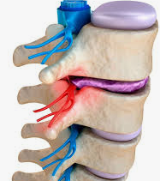
Low back pain (LBP) is a musculoskeletal condition with various causes, primarily intervertebral disc degeneration, which can range from mild and self-resolving to severe and chronic.

Slide 3

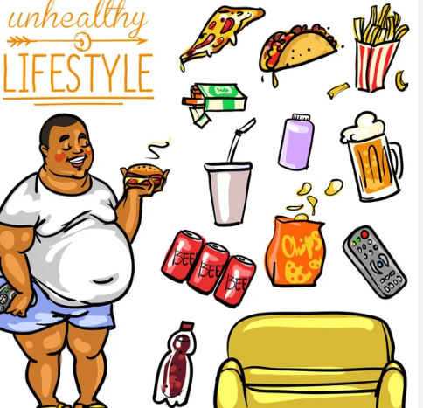
Causes and Risk Factors
Fitness level
Weight gain
Job-related risk factors
Stress level
Age
Heredity

Slide 4
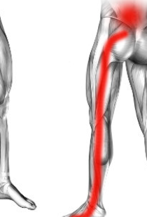
Symptoms of Back Pain
Back pain can vary from localized to widespread pain, sometimes radiating to the buttocks, legs, or abdomen. It may worsen with lifting, bending, resting, or sitting, and can come and go. Other symptoms may include pins and needles or tingling sensations.

Slide 5
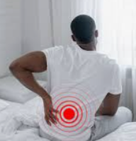
Morning stiffness, pain radiating to the legs or hips, and numbness or weakness in the legs or feet are common back pain symptoms.

Slide 6
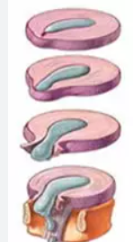
Causes of Back Pain
Back pain can result from issues in the spine, discs, muscles, ligaments, tendons, or nerve compression, including conditions like sprains, strains, and degenerative disc disease. Herniated discs, where a disc compresses nearby nerves, are also a common cause, often affecting the lumbar or cervical spine.

Slide 7
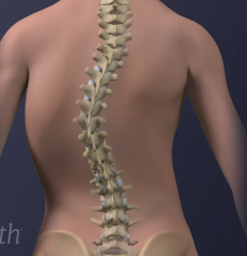
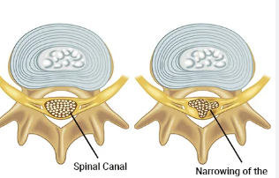
Spinal stenosis:
Fractured vertebrae.
Scoliosis
Myofascial pain:

Slide 8
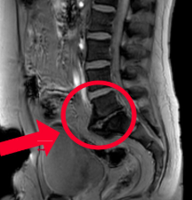
How is lower back pain diagnosed?
Spine X-ray:
MRI:
CT scan:

Slide 9
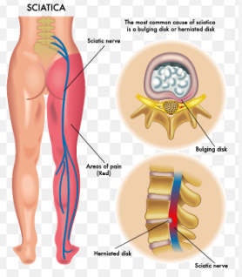
Sciatica is a common symptom of back pain
Sciatica symptoms can include:
Pain
Tingling or “pins and needles” (paresthesia)
Numbness
Muscle weakness.

Slide 10
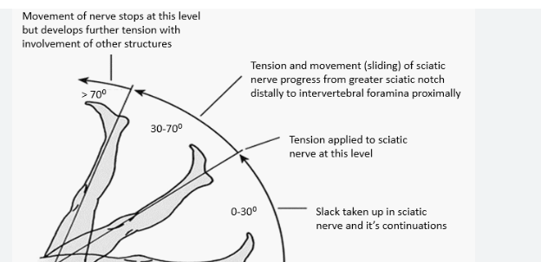
Walking. One should observe the patient's gait, step length, and step quality
Straight leg raise test. This test is used to assess pain complaints

Slide 11
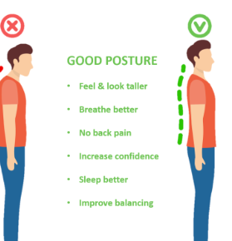
How to Prevent Back Pain?
Maintain Good Posture
2. Exercise Regularly

Slide 12
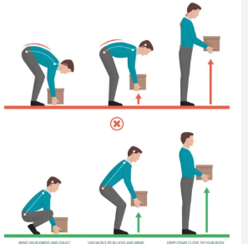
3. Lift Properly
4. Maintain a Healthy Weight

Slide 13
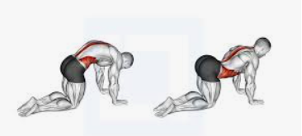
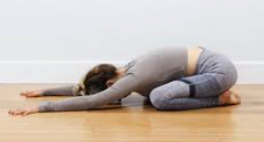
Exercises
1. Cat-Cow Stretch
Purpose: Improves flexibility in the spine and relieves tension.
2. Child's Pose
Purpose: Stretches the lower back, hips, and thighs.

Slide 14
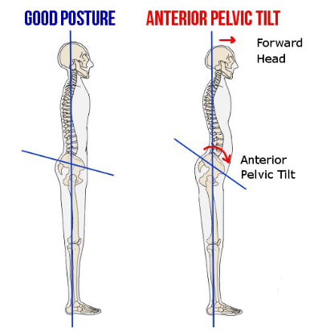
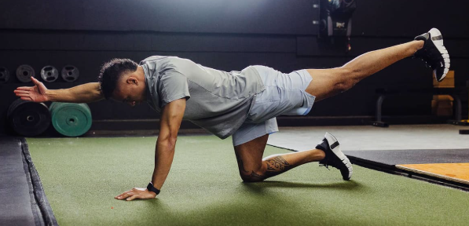
Questions
What is an important exercise to help relieve back pain?
A: Sitting for long periods without moving.
B: Lifting heavy weights without support.
C: The Cat-Cow Stretch helps improve flexibility in the spine and relieves tension.
D: Running on hard surfaces without stretching.
What should you do to avoid back pain when lifting heavy objects?
A: Bend at the waist and twist your body while lifting.
B: Lift the object as quickly as possible without using your legs.
C: Bend your knees, keep the object close to your body, and avoid twisting.
D: Lift with your back instead of your legs.

Slide 15
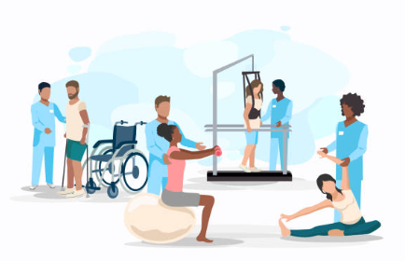
Thank you for your attention

Slide 16

Pins and needles/tingling – mrowienie
Numbness – brak czucia/zrętwienie
Strain - nadwyrężenie
Stiffness – sztywność
Sprain – uraz z naciągnięciem więzadeł
Spinal stenosis - zwężenie kanału kręgowego
Sciatica – rwa kulszowa
Fractured vertebrae – złamanie kręgu
Scoliosis - skolioza
Myofascial pain- Ból mięśniowo-powięziowy
degeneration of intervertebral discs- degeneracja krążków międzykręgowych

Slide 17
Bibliography
Sarah D. Liddle i Victorii Pennick pt. Interventions for preventing and treating low-back and pelvic pain during pregnancy (DOI: 10.1002/14651858.CD001139.pub4).
Chang Liu, Giovanni E. Ferreira, Christina Abdel Shaheed, Qiuzhe Chen, Ian A. Harris, Christopher S. Bailey, Wilco C. Peul, Bart Koes oraz Chung-Wei Christine Lin pt. Surgical versus non-surgical treatment for sciatica: systematic review and meta-analysis of randomised controlled trials (DOI: 10.1136/bmj-2022-070730).
Isma Liza Mohd Isa, Seong Lin Teoh, Nurul Huda Mohd Nor oraz Sabarul Afian Mokhtar pt. Discogenic Low Back Pain: Anatomy, Pathophysiology and Treatments of Intervertebral Disc Degeneration (DOI: 10.3390/ijms24010208).
Ji Ma, Teng Zhang, Yapeng He, Xin Li, Haoyang Chen oraz Qian Zhao pt. Effect of aquatic physical therapy on chronic low back pain: a systematic review and meta-analysis (DOI: 10.1186/s12891-022-05981-8).
Common Causes of Back Pain - Types & Treatment | NIAMS

