Slide 1

Musculoskeletal system
Natalia Pitura
Iii r fizjoterapia jmgr stacjonarne
17.12.2022 rok akademicki 2022/23 sem. zimowy

Slide 2
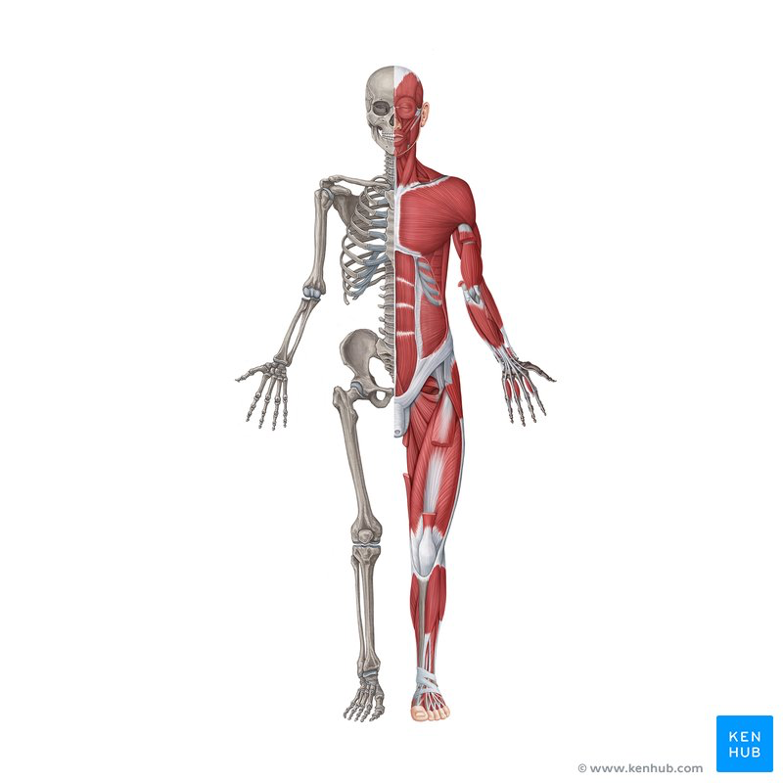
Musculoskeletal system
The human musculoskeletal system is an organ system that gives humans the ability to move using their muscular and skeletal systems. The musculoskeletal system provides form, support, stability, and movement to the body.

Slide 3
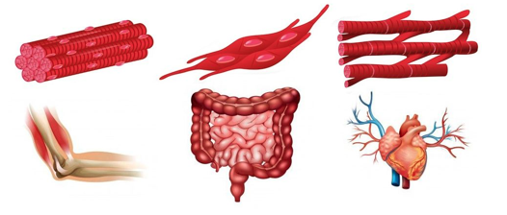
Types of muscles
Skeletal muscles
Smooth
muscles
HEART MUSCLE

Slide 4
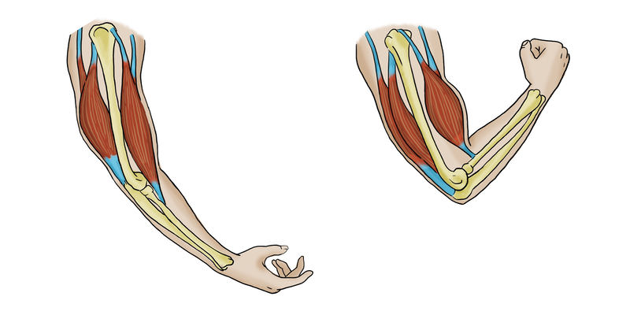
Skeletal Muscles
Skeletal muscles are organs of the vertebrate muscular system and typically are attached by tendons to bones of a skeleton. The muscle cells of skeletal muscles are much longer than in the other types of muscle tissue, and are often known as muscle fibers.

Slide 5
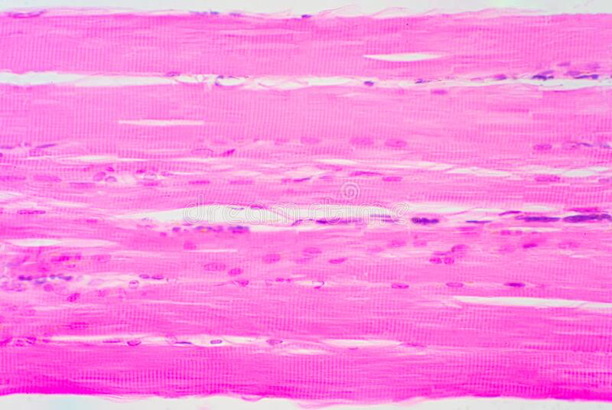
SKELETAL MUSCLES

Slide 6
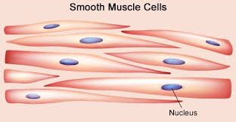
Smooth Muscles
Smooth muscle is a type of muscle that contracts without any voluntary control, and it is made of a thin form of layers, which is made up of spindle-shaped, unstriated cells with only one nucleus and present in inner organs walls

Slide 7
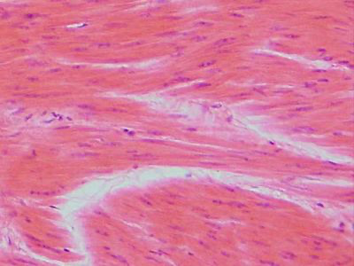
SMOOTH MUSCLES

Slide 8
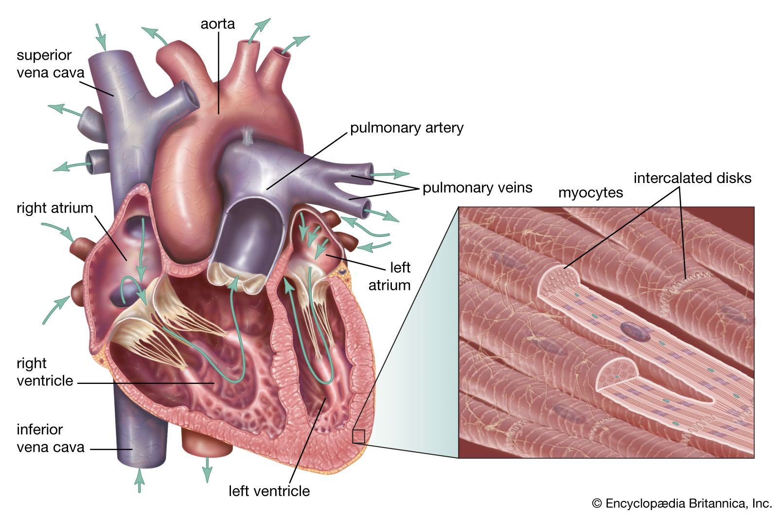
Heart muscle
Cardiac muscle makes up the thick middle layer of the heart. The myocardium is surrounded by a thin outer layer called the epicardium and an inner endocardium.

Slide 9
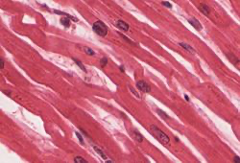
Heart Muscle

Slide 10
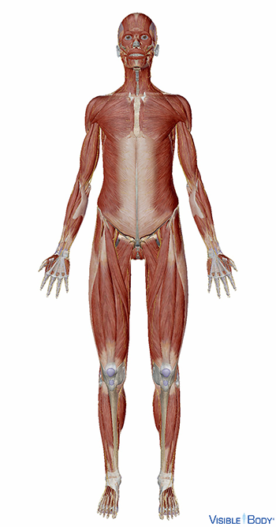
Muscle Function
Works with skeletal system to produce voluntary movement; helps to circulate blood and move food through the digestive system.

Slide 11
The effect of Multiple sclerosis on the muscular system
Patients with multiple sclerosis, due to demyelinating changes within practically the entire CNS, have problems with paresis that impairs independent movement, sensory disturbances, tremor, spasticity, pain, and balance disorders. Of these symptoms, the most significant impacts on quality of life are impaired independent movement, pain, and spasticity.

Slide 12
Rehabilitation in SM
Rehabilitation in SM must be based mainly on working with the musculoskeletal system.
The rehabilitation program for patients with MS can be divided into:
-neuromuscular re-education,
-gait reeducation,
-hand function re-education,

Slide 13
BIBliography
Glossary of the Muscular System | Learn Muscular Anatomy
Cardiac muscle - Wikipedia
Cardiac muscle | Definition, Function, & Structure | Britannica
https://fizjoplaner.pl/masaz-sportowy.html
Mięsień Szkieletowy Człowieka Pod Mikroskopem Zdjęcie Stock - Obraz złożonej z mikroskopijny, mikrosekunda: 219719316
https://journals.viamedica.pl/polski_przeglad_neurologiczny/article/viewFile/36912/26420
https://www.praktycznafizjoterapia.pl/artykul/program-rehabilitacji-w-stwardnieniu-rozsianym

