Slide 1
Lordotic posture
Prepared by:
Anna Pokrywka (117006)
Fizjoterapia JMS, III rok
Grupa D

Slide 2
What Is Lordosis?
Lordosis is the natural curve of the lower back (lumbar) area of the spine. With an extreme curve, the lower spine will have a deep curve, causing the abdomen (stomach area) to stick out and causing the pelvis (hip areas) to curve back and up. These extreme curves can be brought on from bad posture, family genetics (passed from father or mother), injury, illnesses of the spine, or surgery to the spine.

Slide 3
SYMPTOMS
C-shape back when seen from a lateral aspect, with the buttocks being more prominent
A large gap between the lower back and the floor when lying on one’s back
Pain and discomfort in the lower back
Problems in moving in certain ways.

Slide 4
SYMPTOMS
Lumbar hyperlordosis (anterior pelvis tilt) has an impact on the height of individuals suffering from this medical issue, a height loss of 0.5-2.5 inches is common.

Slide 5
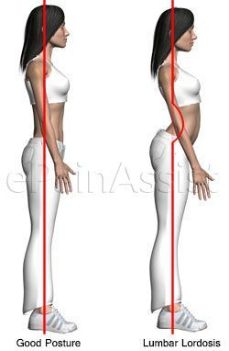
What causes lordosis?
Congenital changes:
●spondylolysis (L4-L5)
● spondylolisthesis
a type of concave back on a constitutional basis is the incorrect positioning of the sacrum
other irregularities:
●sacralization of L5
●lumbalization S1

Slide 6
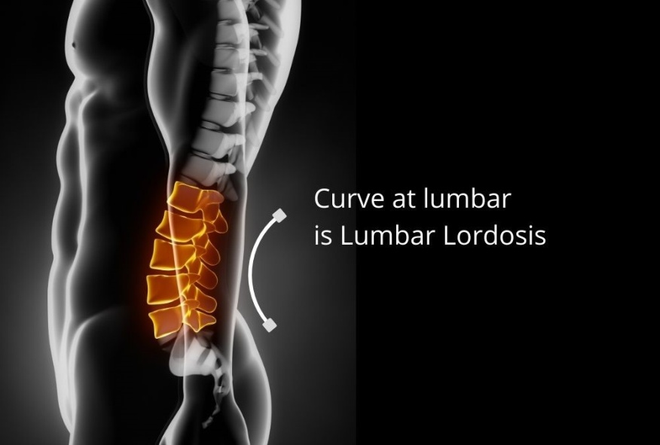
What causes lordosis?
Posture
Overweight
Trauma
Surgery
Neuromuscular conditions
Hip problems

Slide 7
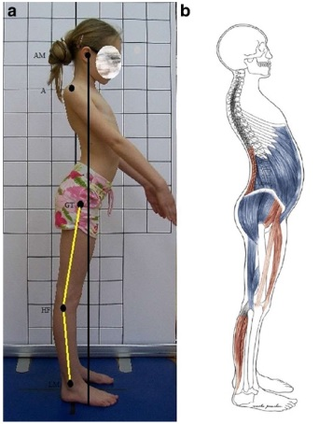
Characteristics of the lordotic posture
Lordotic posture in a 9-year-old girl. Habitual position sideways. Note the hyperextension of the knees and plantar flexion of the foot

Slide 8
Characteristics of the lordotic posture
Diagram of shortened (red) and elongated (blue) muscles AM - external auditory meatus, A - acromion, GT - greater trochanter, HF - fibula head, LM - lateral cost

Slide 9
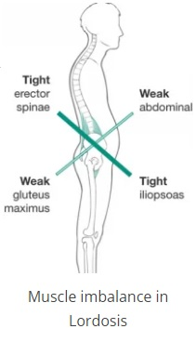
EXAMINATION
Physical examination
Neurological Evaluation
Radiographic

Slide 10
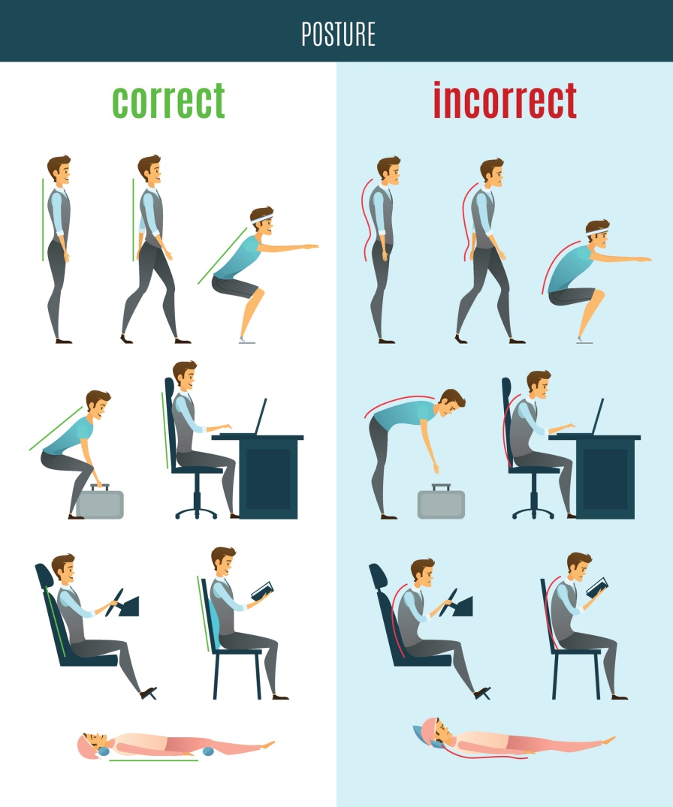
Preventive Measure (Care of Spine )
Regular Back Flexion Exercise.
Stretching And Range of motion exercise to avoid stiffness and tightness.
shoulder shrugging exercise
Neck Active movements

Slide 11
Preventive Measure (Care of Spine )
Regular Yoga Position
Straight leg raises (SLR)
pelvic tilt on a Exercise ball.
Good Diet

Slide 12
Bibliography
„Lumbar lordosis” – EllaBeen, Leonid Kalichman - The Spine Journal, Volume 14, Issue 1, 1 January 2014, Pages 87-97
„Etiology of lumbar lordosis and its pathophysiology: a review of the evolution of lumbar lordosis, and the mechanics and biology of lumbar degeneration” - Carolyn J. Sparrey, Jeannie F. Bailey, Michael Safaee, Aaron J. Clark, Virginie Lafage, Frank Schwab, Justin S. Smith, and Christopher P. Ames
„Hip-Spine Syndrome: Acetabular Anteversion Angle Is Associated with Anterior Pelvic Tilt and Lumbar Hyperlordosis in Patients with Acetabular Dysplasia” - Yaichiro Okuzu, Koji Goto, Yuki Okutani, Yutaka Kuroda, Toshiyuki Kawai, Shuichi Matsuda
„Lumbosacral ailments resulting from deviation of the lumbar lordosis” - Wioletta Jagucka-Mętel, Anna Machoy-Mokrzyńska, Adam Nowicki, Adam Figeland, Ewa Sobolewska
„The prevention of spinal pain - a systematic review” - Kałużna, Anna; Kałużny, Krystian; Wołowiec, Łukasz; Płoszaj, Ola; Żukow, Walery; Kochański, Bartosz; Hagner, Wojciech

