Slide 1

Fractures
Arkadiusz Gąsior
II r Ratownictwa Medycznego niestacjonarne studia 1st. Rok akademicki 2022/2023

Slide 2
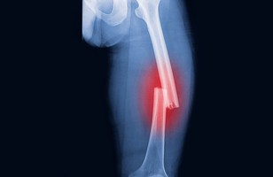
Definition of a fracture
A break in the continuity of bone
It is a break of any bone in a body
Caused by external factors
Origin: 123RF

Slide 3
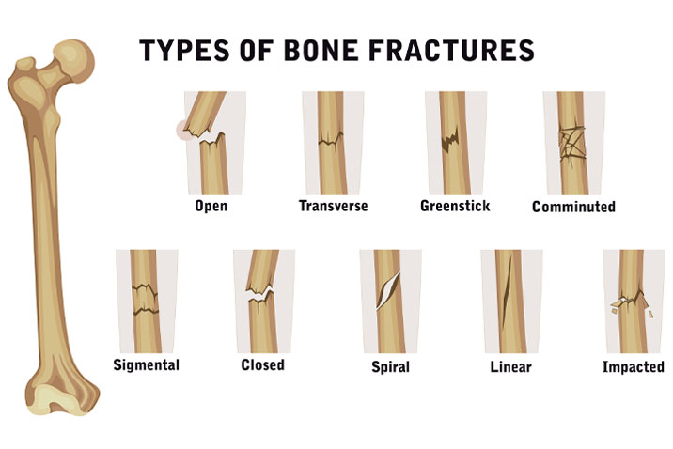
Origin:https://www.google.com/url?sa=i&url=https%3A%2F%2Fwww.shutterstock.com%2Fsearch%2Ffractured&psig=AOvVaw0YKV5AqUytwwZUDj6YAMsk&ust=1681755260688000&source=images&cd=vfe&ved=0CBIQjhxqFwoTCPCa7dqAr_4CFQAAAAAdAAAAABAE

Slide 4
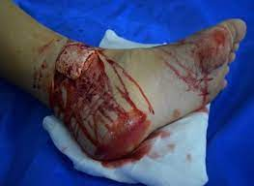
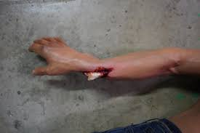
Most dangerous – open fracture
A fracture in which the bone is sticking through the skin. Also called compound fracture.
Origin: Etsy.com
Origin:https://www.dappercadaver.com/products/dura-jack-body-with-compound-fracture

Slide 5
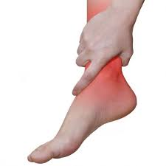
Symptoms of fractures
Sudden pain
Trouble using or moving the injured area or nearby joints
Swelling
Obvious deformity
Warmth, bruising, or redness

Slide 6

Diagnosis of fractures
♦ Physical examination
♦ X- ray
♦ CT scan
♦ MRI scan

Slide 7
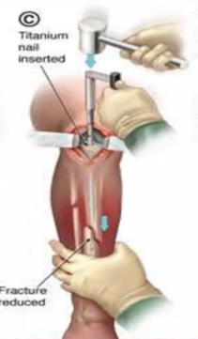
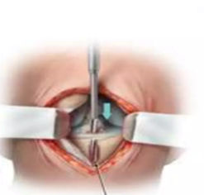
First Aid Treatment
Internal fixation
Origin:https://pt.slideshare.net/AnvinThomas/fracture-1-82225324?next_slideshow=true

Slide 8
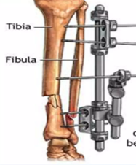
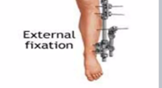
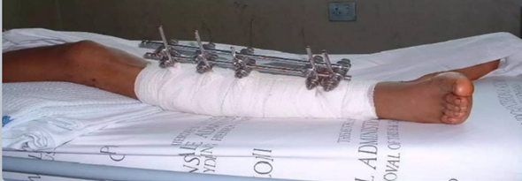
•External fixation
Origin:https://drsoleymanha.com/

Slide 9
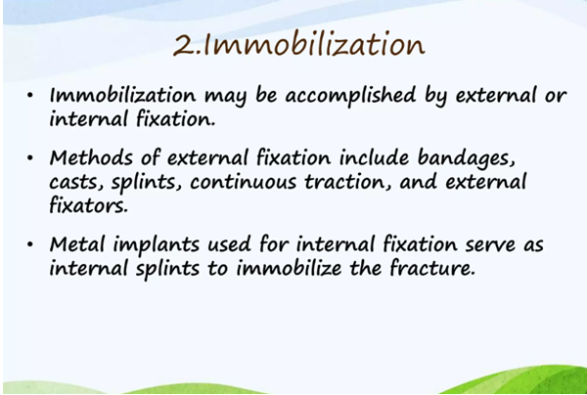

Slide 10
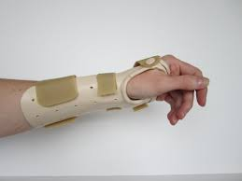
Splinting
The most common procedure for immobilizing an injury
Origin: Wikipedia.com

Slide 11
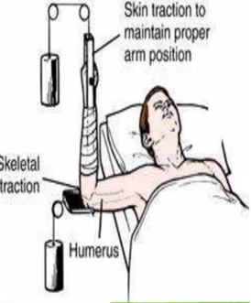
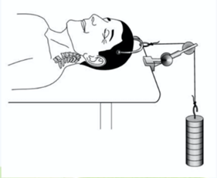
Traction
It is the use of weight, ropes and pulleys to apply force to tissues surrounding a broken bone.
Origin:https://www.webmd.com/pain-management/what-is-skeletal-traction

Slide 12
Vocabulary
External factors- czynniki zewnętrzne
Sigmental – sygmentalne
Impacted – wklinowane
Compound fracture – Złamanie złożone
Swelling – obrzęk
Bruising – siniak
Internal fixation – mocowanie wewnętrzne
External fixation – mocowanie zewnętrzne

Slide 13
Bibliography:
https://www.hopkinsmedicine.org/health/conditions-and-diseases/fractures
https://www.hss.edu/condition-list_compound-fracture.asp
https://www.medicalnewstoday.com/articles/173312
https://www.envrad.com/difference-between-x-ray-ct-scan-and-mri/
https://www.nwooc.com/internal-and-external-fixation-of-foot-and-ankle-fractures-orthopaedic-surgeons-ok.html
https://www.aafp.org/pubs/afp/issues/2009/0901/p491.html
https://www.merriam-webster.com/dictionary/traction
https://en.wikipedia.org/wiki/Immobilization

Slide 14
Thank you for your attention

