Slide 1
First Aid treatment of burn injuries
PIOTR HALASTRA
Faculty of Medical Sciences, University of Rzeszów
Bachelor's degree in Medical Rescue, year 2

Slide 2
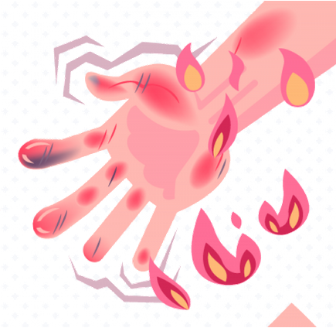
What is burn?
A burn is a skin injury caused by heat, electircity or chemicals. Such injuries can vary from minor (can be treated at home) to very serious (needing emergency treatment at a hospital).
As paramedic it is important to be able to see the difference between serious and less serious burns.
https://www.makatimed.net.ph/blogs/a-guide-to-burns-types-degrees-and-treatment-methods/

Slide 3
Types of burns and their causes

Slide 4

thermal burns
https://www.makatimed.net.ph/blogs/a-guide-to-burns-types-degrees-and-treatment-methods/

Slide 5

electrical burns
https://www.makatimed.net.ph/blogs/a-guide-to-burns-types-degrees-and-treatment-methods/

Slide 6
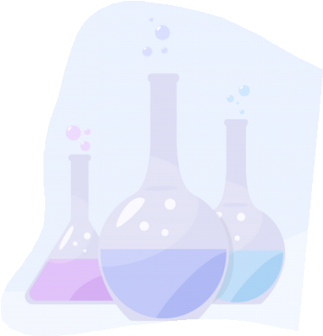
chemical burns
https://www.makatimed.net.ph/blogs/a-guide-to-burns-types-degrees-and-treatment-methods/

Slide 7
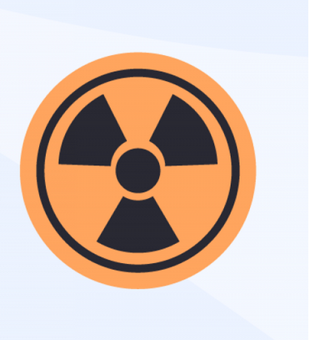
radiation burns
https://www.makatimed.net.ph/blogs/a-guide-to-burns-types-degrees-and-treatment-methods/

Slide 8
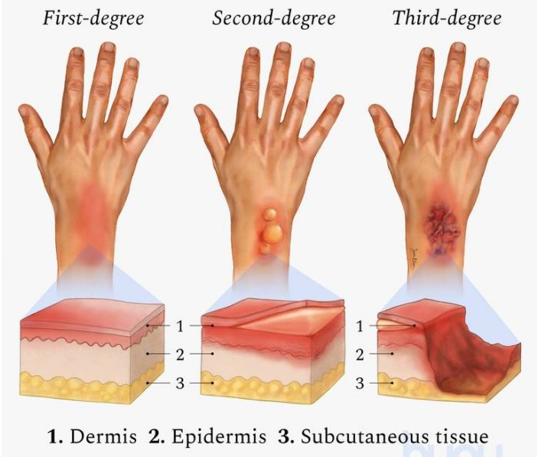
How do we clasify burns?
First-degree Second-degree Third-degree
1.Epidermis 2. Dermis 3. Hypodermis
https://dailyinfographic.com/the-types-of-burns

Slide 9
First Aid position statement
https://www.researchgate.net/figure/Summary-poster-for-Burn-First-Aid-including-from-left-to-right-translations-into_fig1_260870938

Slide 10
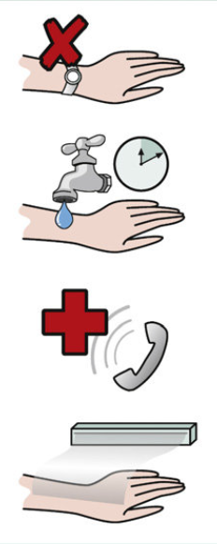
S
T
O
P
First Aid for burns
STOP of burning
Strip hot clothes & jewellery
Turn on cool tap (never use ice). Run burn under cool water for 10 minutes. Keep the rest of the person warm.
https://www.researchgate.net/figure/Summary-poster-for-Burn-First-Aid-including-from-left-to-right-translations-into_fig1_260870938
Organise medical assistance (112)
Protect burn with cling film or clean cloth (Do not use dressings, fluffy cloth, creams or lotions)

Slide 11
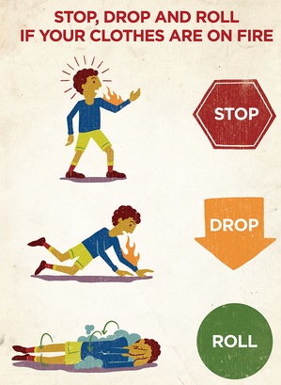
Prevention
1. Don't smoke in bed.
2. Avoid kitchen burn.
3. Stop, Drop and Roll if your clothes are on fire.
https://www.westerncape.gov.za/general-publication/protecting-children-fires

Slide 12
VOCABULARY:
Epidermis - naskórek
Dermis – skóra właściwa
Hypodermis – warstwa podskórna
Injuries - urazy
Strip - zdjąć
BIBLIOGRAPHY
Allison K & Porter, K. Consensus on the prehospital approach to burns patient management. Emerg Med J, 2004;21: 112-114
Burninstitute.org “First Aid for Burns”
Cuttle L & Kimber, RM First aid treatment of burn injuries. Wound Practice and Research, 2010;(18):6-13
Skinner A & Peat, B. Burns treatment for children and adults: a study of initial burns first aid and hospital care. The New Zealand Medical Journal, 2002; 115:1-9

Slide 13
Thank you for your attention!

