Slide 1



Urinary Incontinence
Natalia Michalska
III R Fizjoterapia JMGR stacjonarne
Rok akademicki 2022/23
Semestr zimowy

Slide 2
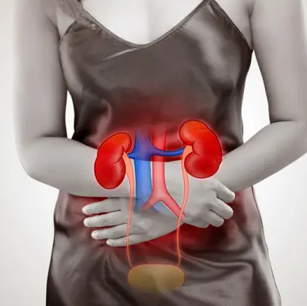
Urinary incontinence
Urinary incontinence (UI) characterized by involuntary loss of urine.
https://ncez.pzh.gov.pl

Slide 3
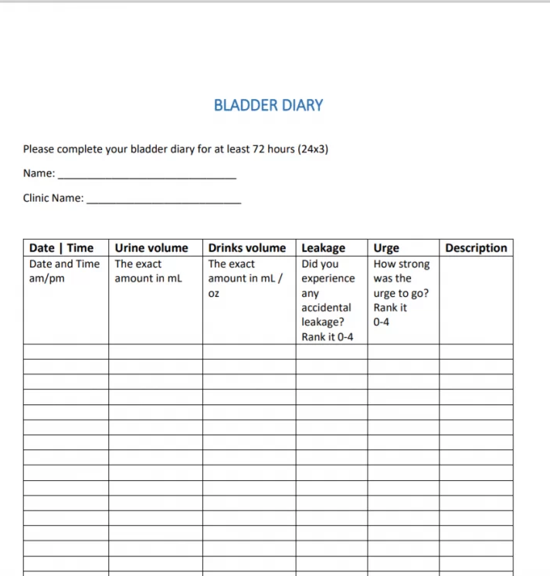
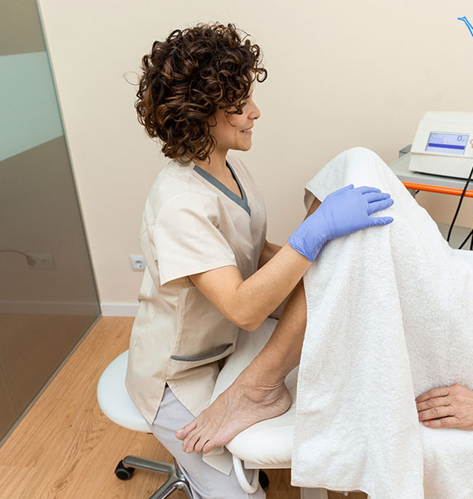
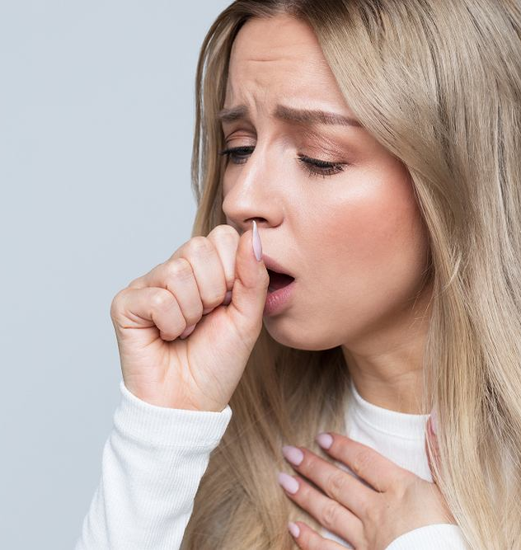
Diagnosis
Voiding diary
Physical examination
A cough stress test
Diagnosis is made by using a patient questionnaire, such as
1. 3 Incontinence Questions
2. Other medical problems
And a next step is A review of the patient's completed voiding diary, next one is a physical examination, and, if stress incontinence is suspected, we can do a cough stress test

Slide 4
Voidng diary
The next step is a w review of the patient's completed voiding diary which is an assessment tool that allows patients to record how much liquid they drink, how often they urinate and when they experience urine leakage

Slide 5

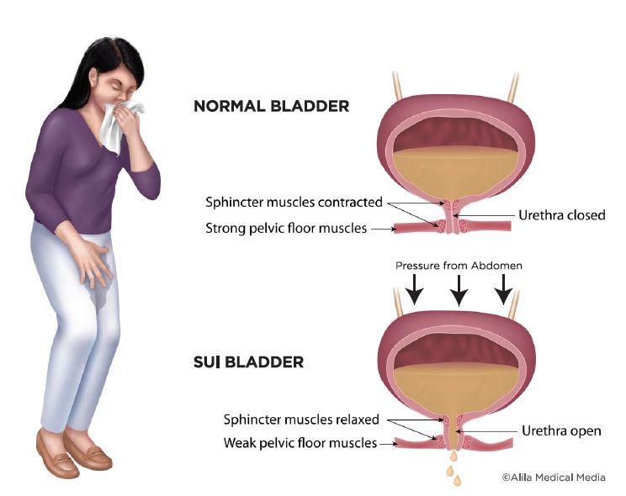
The main types of UI stress UI
The main types are stress, urge, and mixed urinary incontinence
Stress UI is characterized by loss of urine during for example coughing, sneezing, or jumping
https://www.chistvincent.com

Slide 6
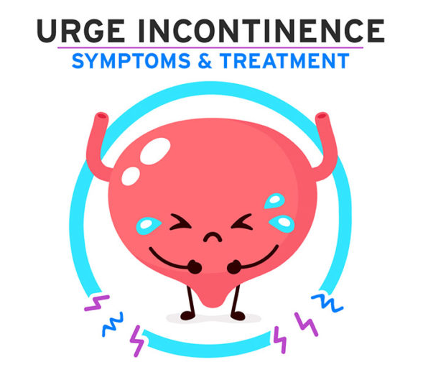
Urge UI
The main symptom is a sensation of the need to urinate that becomes progressively stronger, is very difficult to ignore, and ultimately results in urine leakage
https://www.coreexercisesolutions.com

Slide 7
Mixed UI
This type is characterized by involuntary leakage associated with urgency as well as exercise, sneezing and coughing

Slide 8

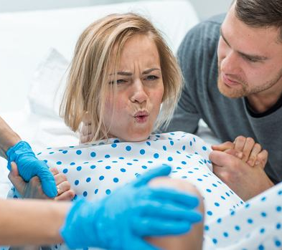
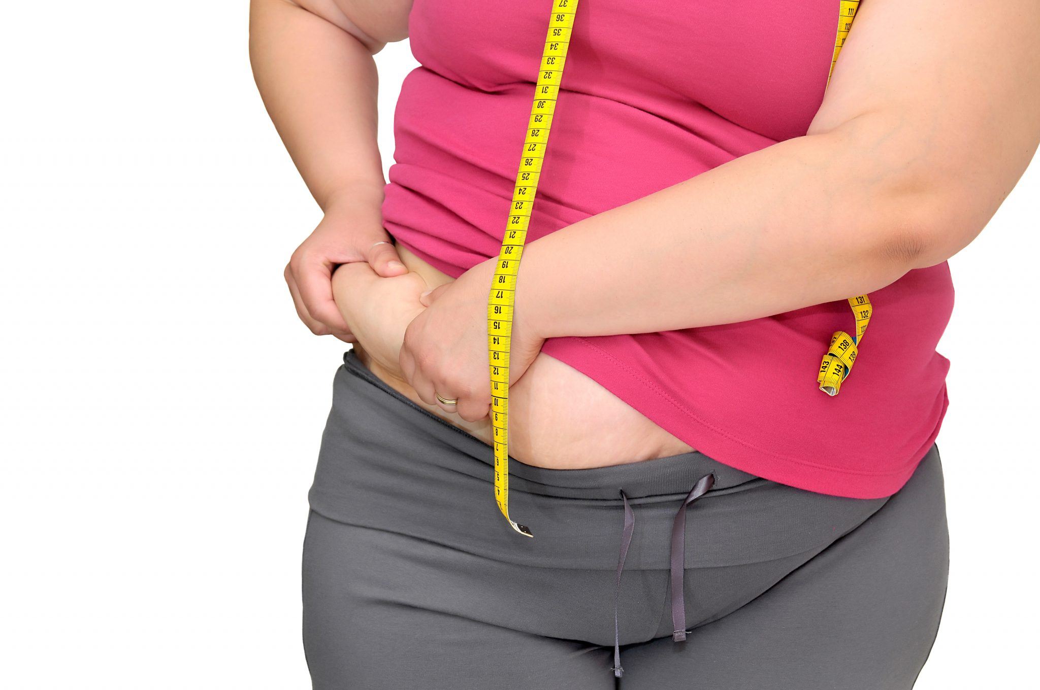
The main risk factors
https://www.poradnikzdrowie.pl
https://www.edziecko.pl
https://instytut-mikroekologii.pl
Genetic factors often influence the appearance of this disease
Surgery and births can damge the pelvic floor muscles
Overweight overloads all systems, including the urianry system

Slide 9
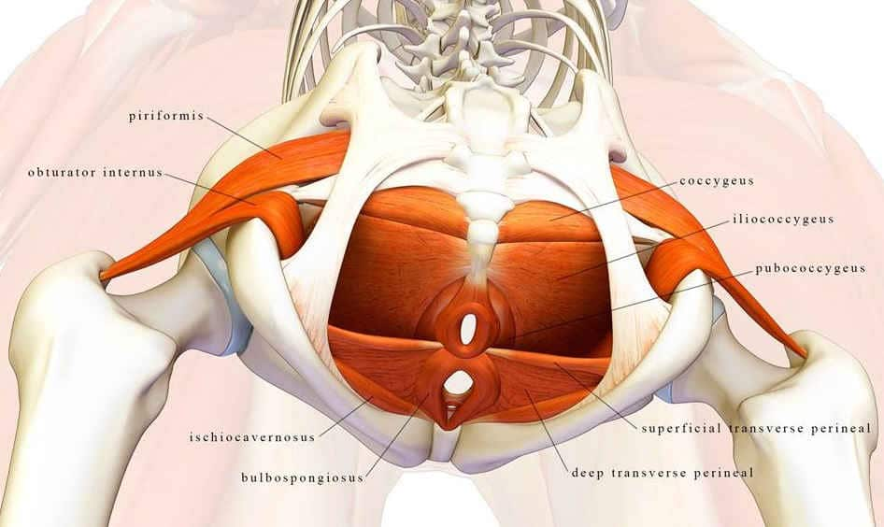
The pelvic floor
The pelvic floor consists of ligaments, muscles that support the bladder and reproductive organs
https://aktywnaklinika.pl

Slide 10
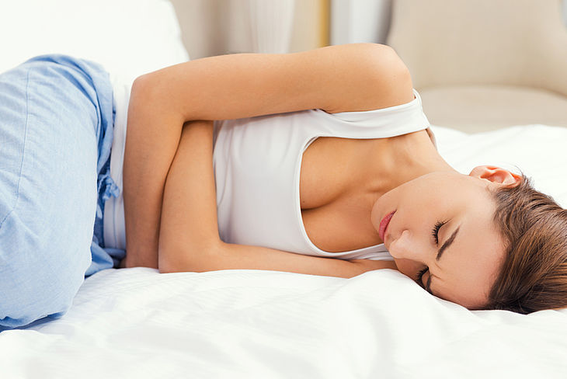
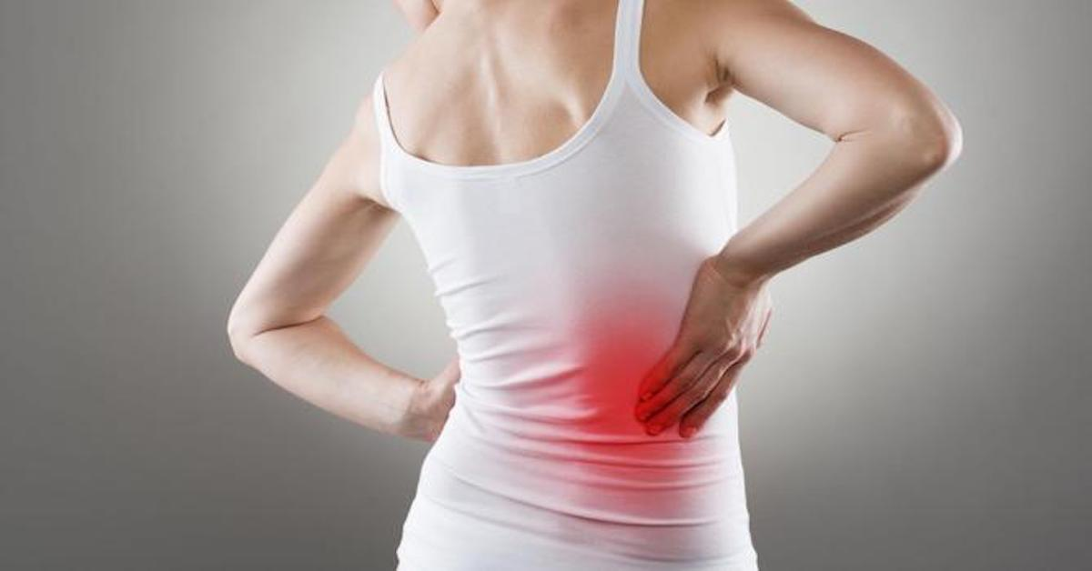
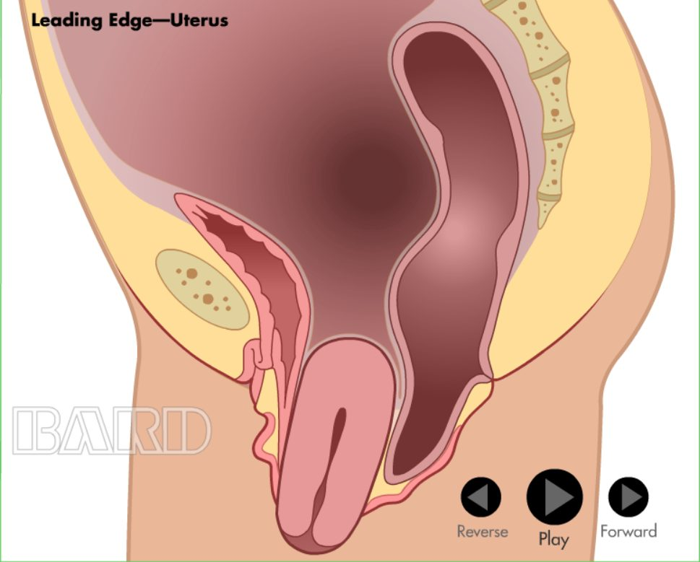
Problems that may accompany urinary incontinence
https://apteline.pl
https://oyneckpie.live
https://kalmed.co.uk
Painful menstruation
Back pain, abdominal pain
Uterine prolapse

Slide 11
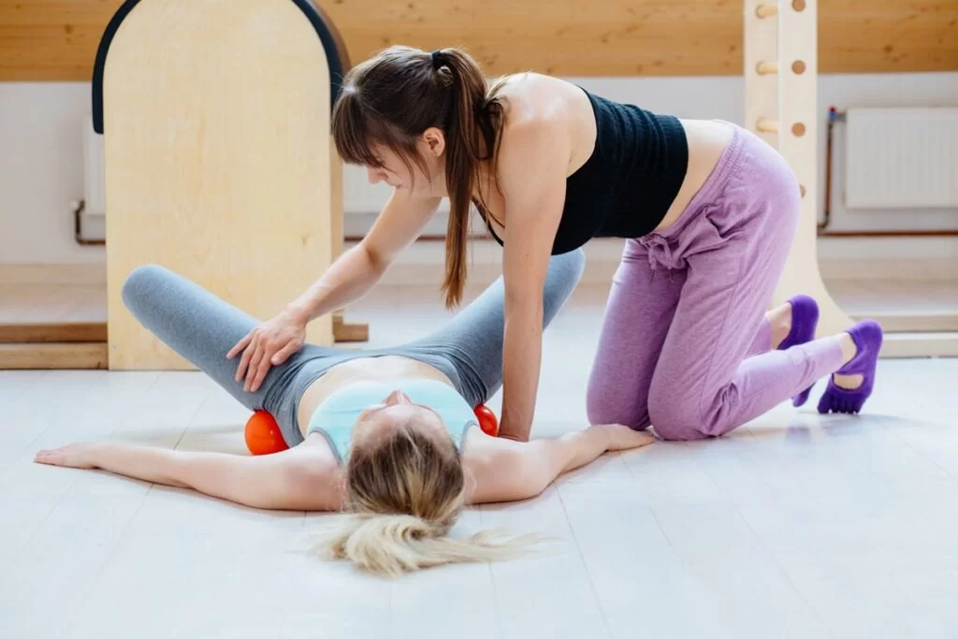

Physiotherapy
https://www.fizjomama.pl/
The most important part is Physioterapy which focuses on PFM therapy during which we use biofeedback, electrostimulation and vaginal cones.

Slide 12




How to do the exercise
The effectiveness of PFME is determined by the frequency and intensity of exercise. Performing 15 repetitions of 2 to 4 seconds of contraction in an exercise program with 3 sets per day for 8 weeks.
https://www.supercoloring.com
https://www.supercoloring.com
https://indiannewslink.co
https://www.supercoloring.com
repetitions
seconds
sets
weeks

Slide 13
Observations
From these observations, we concluded that
The main types are stress, urge, and mixed urinary incontinence
Plan for physiotherapy care should be individualized for each patient.
PFME with biofeedback or electrical stimulation improve strength of the muscles

Slide 14
vocabulary
Urinary incontinence – nietrzymanie moczu
PFME – ćwiczenia mięśni dna miednicy
Abdominal - brzuszny
Frequency - częstotliwość
Contraction – skurcz
Involuntary loss – mimowolna utrata ( moczu)
Urine – mocz
Urge – naglące
Stress - wysiłkowe
The pelvic floor - mięsnie dla miednicy

Slide 15
BIBLIOGRAPHY
Ghaderi, Fariba, and Ali E. Oskouei. "Physiotherapy for women with stress urinary incontinence: a review article." Journal of physical therapy science 26.9 (2014): 1493-1499.
Mazur-Bialy, Agnieszka Irena, et al. "Urinary incontinence in women: modern methods of physiotherapy as a support for surgical treatment or independent therapy." Journal of clinical medicine 9.4 (2020): 1211.
Dumoulin, Chantale, et al. "Physiotherapy for persistent postnatal stress urinary incontinence: a randomized controlled trial." Obstetrics & Gynecology 104.3 (2004): 504-510.
Bø, Kari. "Physiotherapy management of urinary incontinence in females." (2020).
Petros, Peter E. Papa, and Ulf I. Ulmsten. "An integral theory and its method for the diagnosis and management of female urinary incontinence." (1993).

