Slide 1
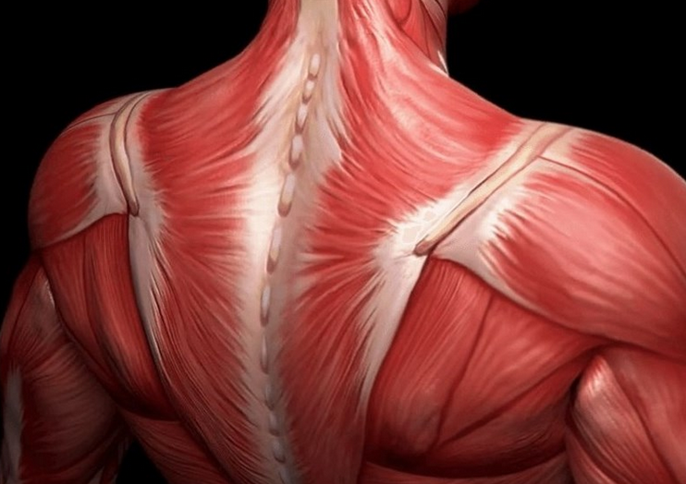

The muscular system
Prepared by: Wiktoria Woszczyna
Fizjoterapia JMS
2022/2023
https://www.osgpc.com/fun-facts-about-the-musculoskeletal-system/

Slide 2
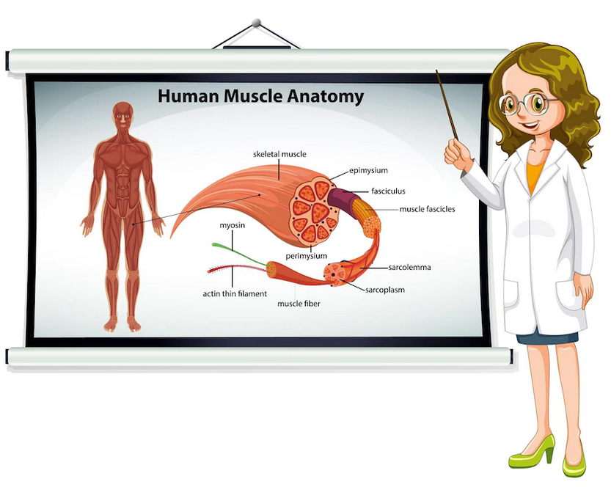
Contents
What is the muscular system?
The most important functions
of the muscles
The structure of the muscle
Types of muscle tissue
Muscle work
Physical fitness
https://facetkaodbiologii.pl/miesnie/

Slide 3
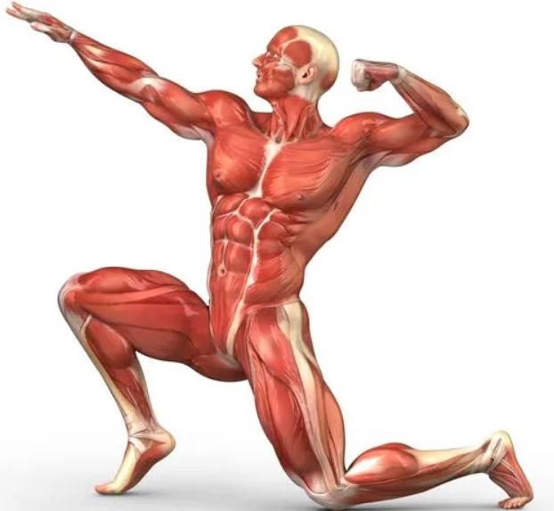
What is the muscular system?
It is an organ system consisting of smooth muscle, skeletal muscle and the heart.
The muscular system is built of muscle and connective tissue.
About 640 muscles builds the human body.
https://www.osgpc.com/fun-facts-about-the-musculoskeletal-system/

Slide 4
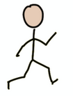


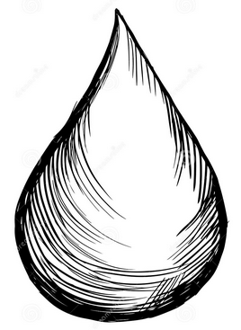

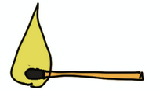
The most important functions of muscles
locomotion,
support the cardiovascular system,
enable ventilation of the lungs,
regulation the amount of fluids in the body,
maintain correct posture,
produce heat in the body,
https://facetkaodbiologii.pl/miesnie/

Slide 5
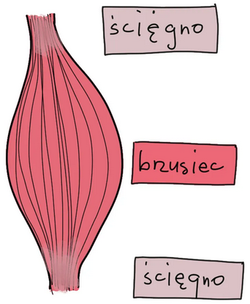
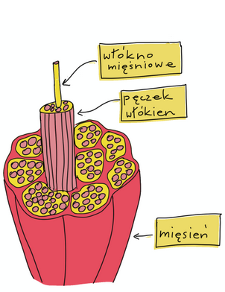
The structure of the muscle
tendon
belly
muscle fiber
bunch of fibers
tendon
muscle
https://facetkaodbiologii.pl/miesnie/

Slide 6
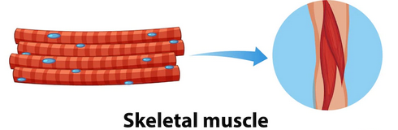
Types of muscle cells
https://facetkaodbiologii.pl/miesnie/

Slide 7
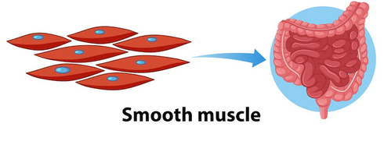
Types of muscle cells
https://facetkaodbiologii.pl/miesnie/

Slide 8
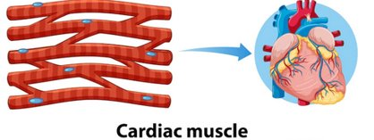
Types of muscle cells
https://facetkaodbiologii.pl/miesnie/

Slide 9

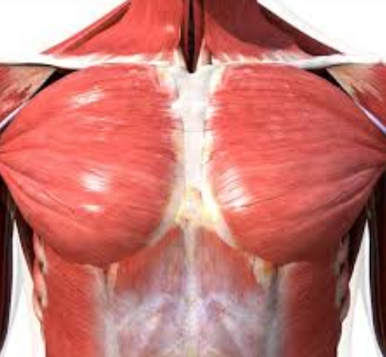
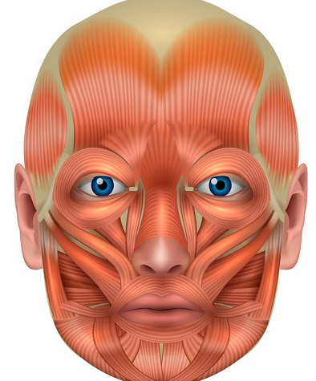
Types of muscle connections
Bone - muscle - bone
Bone - muscle – skin
Skin - muscle - skin
https://www.osgpc.com/fun-facts-about-the-musculoskeletal-system/

Slide 10

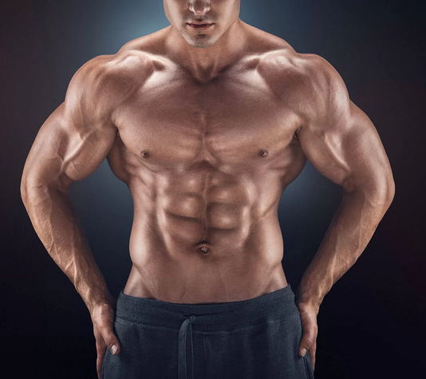
Muscles work
Muscles perform two types of work
Dynamic - there is movement of bones and movement of the body,
Static - only muscle tension changes, (while sitting, standing).
https://www.osgpc.com/fun-facts-about-the-musculoskeletal-system/

Slide 11
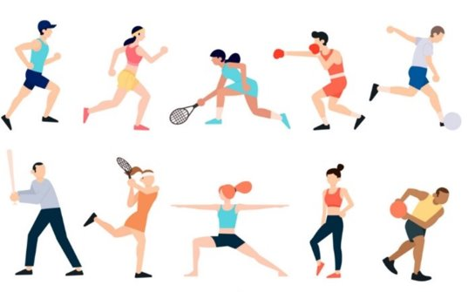
Physical fitness
The development of human physical fitness can be divided into several stages:
-mastery of basic motor skills
-increasing coordination and accuracy of movements
-further coordination
https://www.osgpc.com/fun-facts-about-the-musculoskeletal-system/

Slide 12
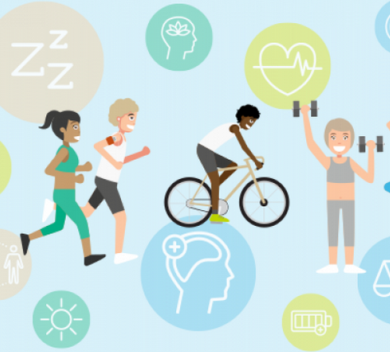
Benefits of systematic physical exercise:
- strengthening muscles, bones, joints,
- increase the efficiency of the heart and lungs,
- improved well-being,
- reducing the risk of heart disease,
- counteracting obesity
https://www.osgpc.com/fun-facts-about-the-musculoskeletal-system/

Slide 13
QUIZ
How many muscles we have in our body?
500
390
200
640
What are the types of muscle tissue:
Long striated muscle tissue
Transverse striated muscle tissue
Cardiac smooth muscle tissue
What is the minimum amount of daily physical activity should be:
5 min.
10 min
30 min.
1h

Slide 14
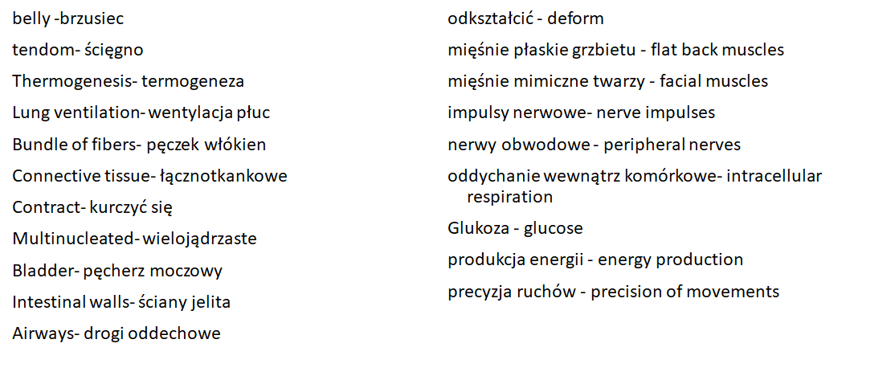
DICTIONARY/SŁOWNIK

Slide 15

Bibliography
Caterson I., Sambrook P., Fransen M., Marchh L. 2008. The impact of obesity on the musculoskeletal system. International Journal of Obesity 32:211-222.
Hedge A. 2013. Structure and Function of the Musculoskeletal System. Cornell Universi
https://facetkaodbiologii.pl/miesnie/
https://www.kenhub.com/en/library/anatomy/the-musculoskeletal-system
https://www.osgpc.com/fun-facts-about-the-musculoskeletal-system/
https://www.uc.edu/content/dam/uc/ce/images/OLLI/Page%20Content/Muscular%20System%20s.pdf
O’Neill S., Schrieber L., Moopanar T., Walter W. 2022. The Musculoskeletal System. Elsevier Health Sciences, 3-245.

Slide 16
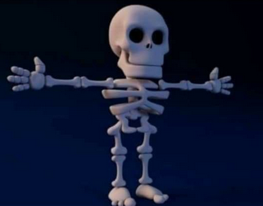
Thank you for your attention
https://www.osgpc.com/fun-facts-about-the-musculoskeletal-system/

