Slide 1
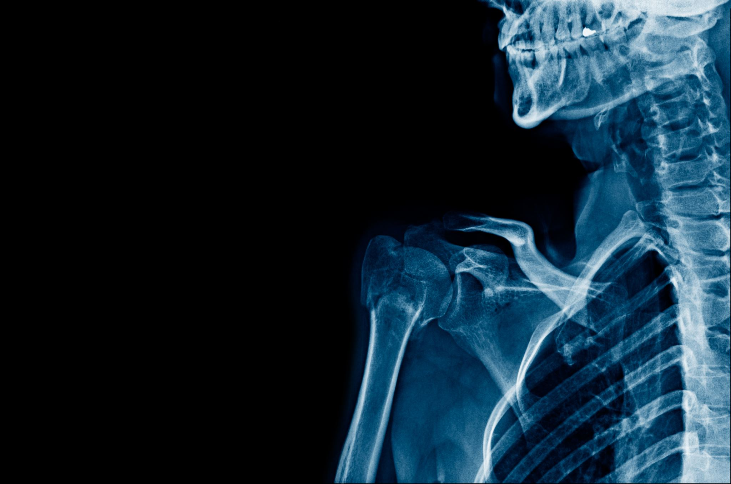
The joints
Karolina Spieczny
III R Fizjoterapia JMGR stacjonarne
2022/2023 semestr zimowy

Slide 2
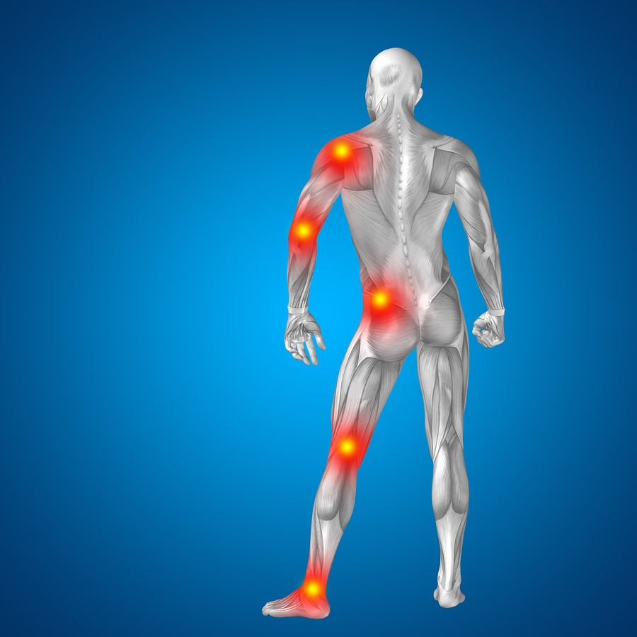
What are the joints?
A joint is the part of the body where two or more bones meet to allow movement.

Slide 3
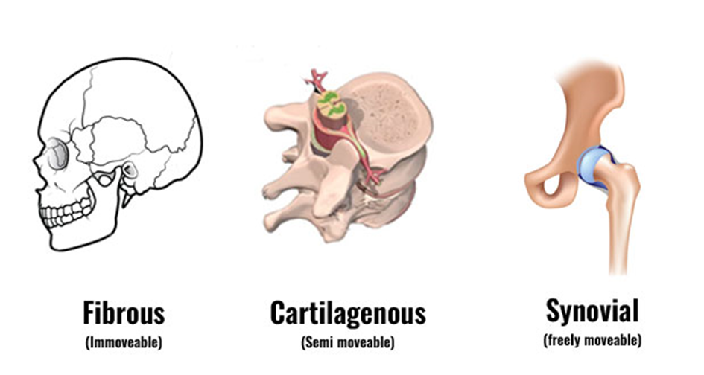
Classification joints
Fibrous
directly connected to each other by fibrous connective tissue
2. Cartilaginous
the bones are entirely joined by cartilage
3. Synovial
the type of joint found between bones that move against each other

Slide 4
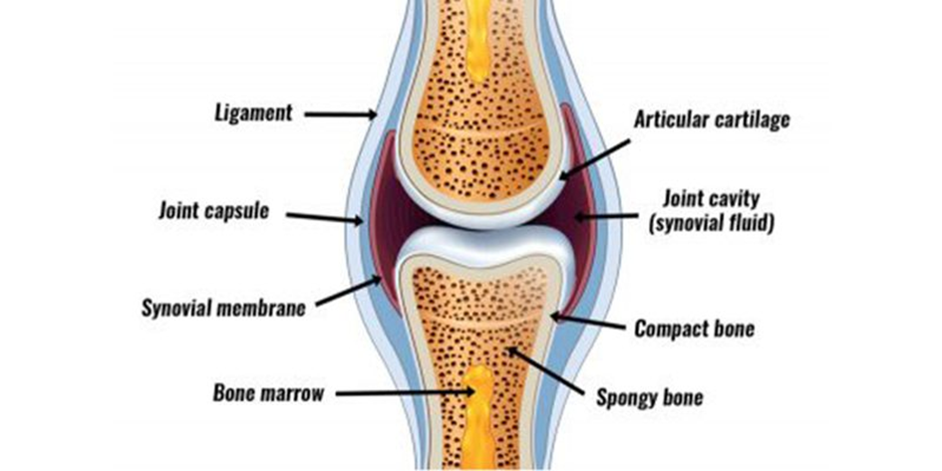
Construction the synovial joint
Joint capsule
Ligaments
Synovial fluid
Synovial membrane

Slide 5
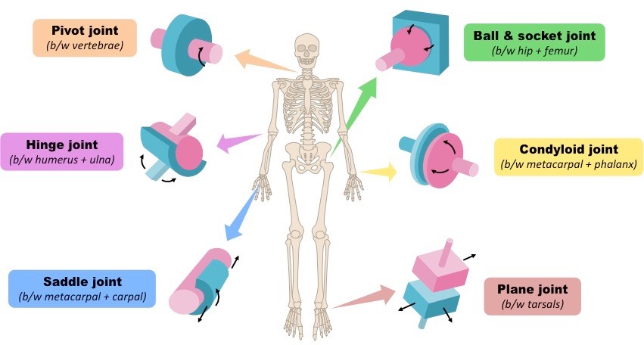
Types of synovial joints

Slide 6
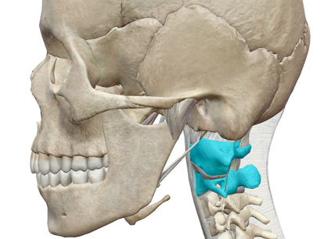
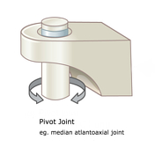
Pivot joint
Uniaxial
supination and pronation
Radial elbow joint, atlantoaxial joint

Slide 7
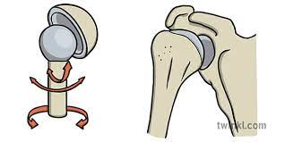
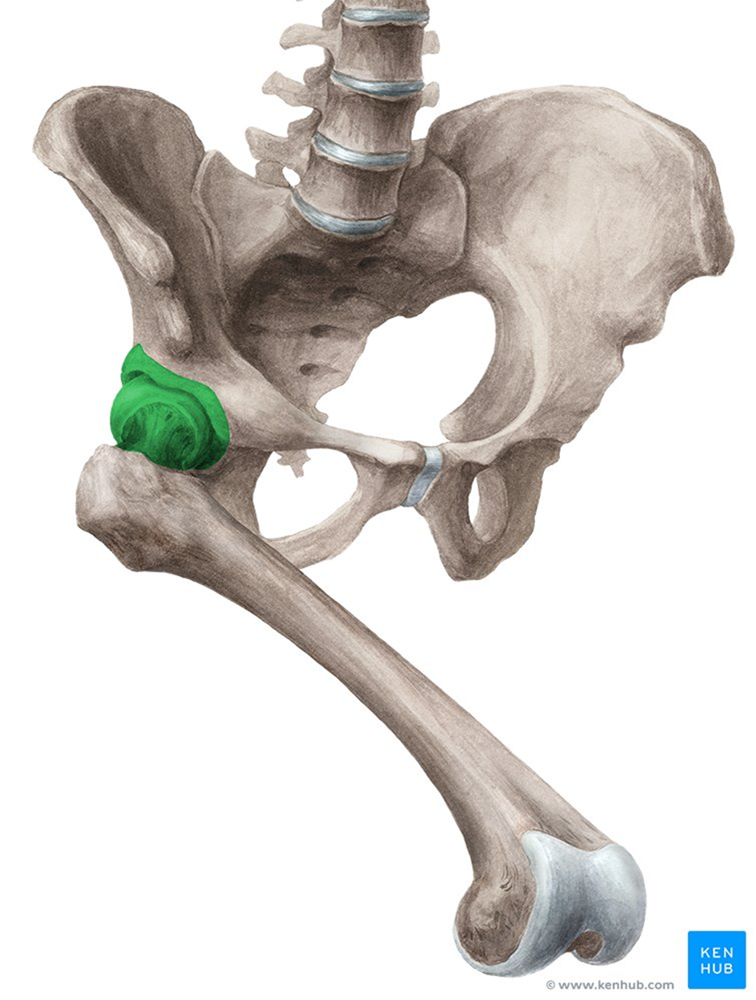
Ball-and-socket joint
Multiaxial
flexion, extension, abduction, adduction, rotation and circumduction
shoulder and hip joints

Slide 8
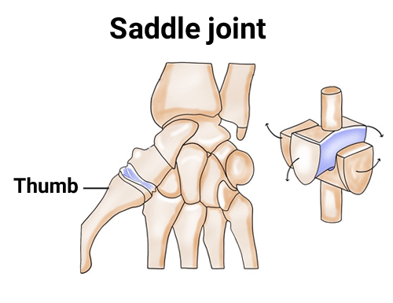
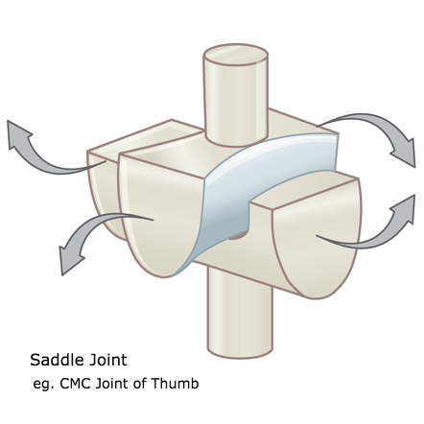
Saddle joints
biaxial
flexion or extension and abduction or adduction
carpometacarpal joint

Slide 9
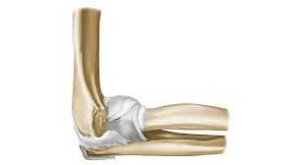
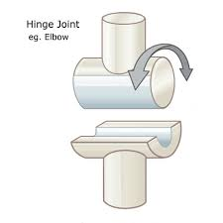
Hinge joints
uniaxial
flexion, extension,
Elbow or Knee joint

Slide 10
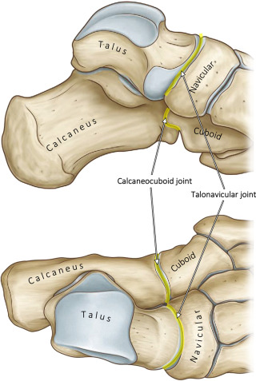
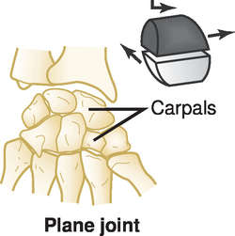
Plane joint
Multiaxial
sliding movements in the plane of articular surfaces
carpals or tarsals

Slide 11
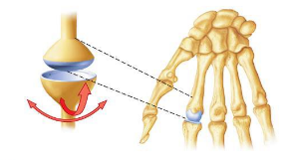
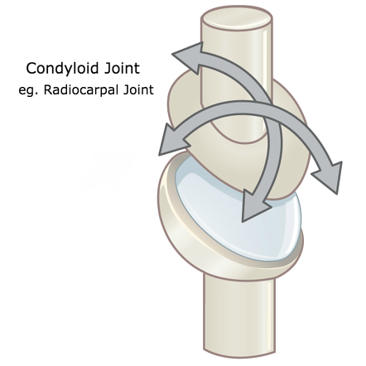
Condyloid joints
biaxial
forward-backward and side to side movement and do not allow rotation
radiocarpal joint of the wrist

Slide 12
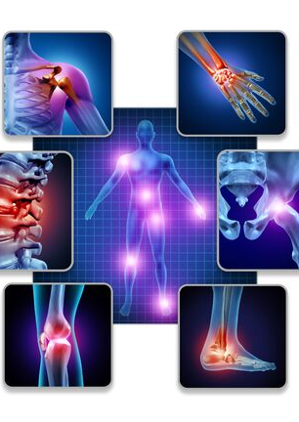
Interesting facts about joints:
The largest joint is the knee joint.
There are 360 joints in the adult human body
The most prone to injury is the knee.
The most mobile joints are the hip and shoulder joints.
Not all human joints are movable. An example is the skull.

Slide 13
Dictionary:
Joint capsule- torebka stawowa
Ligaments- więzadła
Synovial fluid- maź stawowa
Synovial membrane- błona maziowa
Pivot joint- staw obrotowy
Ball-and-socket joint- stawo kulisto- panewkowy
Saddle joints- staw siodełkowy
Hinge joints- staw zawiasowy
Plane joint- staw płaski
Condyloid joints- staw kłykciowy
Fibrous- włóknisty
Cartilaginous- chrzęstny
Synovial- maziowy

Slide 14
Bibliography:
Text
2. Pictures
,,Monitoring Methods of Human Body Joints: State-of-the-Art and Research Challenges” Abu Ilius Faisal 1, Sumit Majumder, Tapas Mondal, David Cowan, Sasan Naseh and M.Jamal Deen 2019 , 19 (11), 262
https://open.oregonstate.education/aandp/chapter/9-4-synovial-joints/
https://www.diki.pl/slownik-angielskiego?q=hyaline
https://www.teachpe.com/anatomy-physiology/structure-of-a-synovial-joint
https://www.britannica.com/science/ball-and-socket-joint
https://en.wikipedia.org/wiki/Synovial_joint
https://teachmeanatomy.info/the-basics/joints-basic/synovial-joint/
https://ib.bioninja.com.au/higher-level/topic-11-animal-physiology/112-movement/joints.html
https://radiopaedia.org/articles/pivot-joint?lang=us
https://www.twinkl.pl/illustration/ball-and-socket-joint
https://radiopaedia.org/articles/saddle-joint
https://radiopaedia.org/articles/hinge-joint
https://medical-dictionary.thefreedictionary.com/gliding+joint
https://radiopaedia.org/articles/condyloid-joint?lang=us
https://opentextbc.ca/biology/chapter/19-3-joints-and-skeletal-movement/
https://www.teachpe.com/anatomy-physiology/types-of-joints
https://www.teachpe.com/anatomy-physiology/structure-of-a-synovial-joint

Slide 15
Thank you for your attention!

