Slide 1
Wykonał:
Sebastian Włoch
Fizjoterapia rok 3 JMS
Nr albumu: 117030

Slide 2
Parkinson's disease

Slide 3
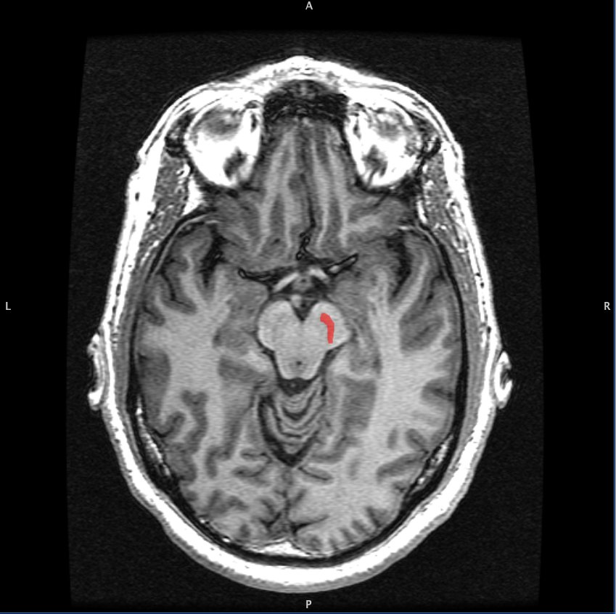
Parkinson's disease is caused by a loss of nerve cells in part of the brain called the substantia nigra. This leads to a reduction in a chemical called dopamine in the brain.
Most people with Parkinson's start to develop symptoms when they're over 50, although some people with the condition first experience symptoms when they're under 40.
Men are slightly more likely to get Parkinson's disease than women.
https://www.imaios.com
https://www.imaios.com

Slide 4
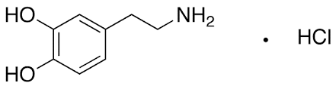
The role of dopamine in the nervous system
Normally, dopamine operates in a delicate with other neurotransmitters to help coordinate the millions of nerve and muscle cells involved in movement. Without enough dopamine, this balance is disrupted, which causes typical symptoms of Parkinson’s disease
https://www.trc-canada.com

Slide 5
Symptoms of Parkinson’s disease
Parkinson’s has four main symptoms:
-Tremor in hands, arms, legs, jaw, or head
-Muscle stiffness, where muscle remains contracted for a long time
-Slowness of movement
-Impaired balance and coordination, sometimes leading to falls
Other symptoms may include:
-Depression and other emotional changes
-Difficulty swallowing, chewing, and speaking
-Urinary Problems or constipation
-Skin problems

Slide 6
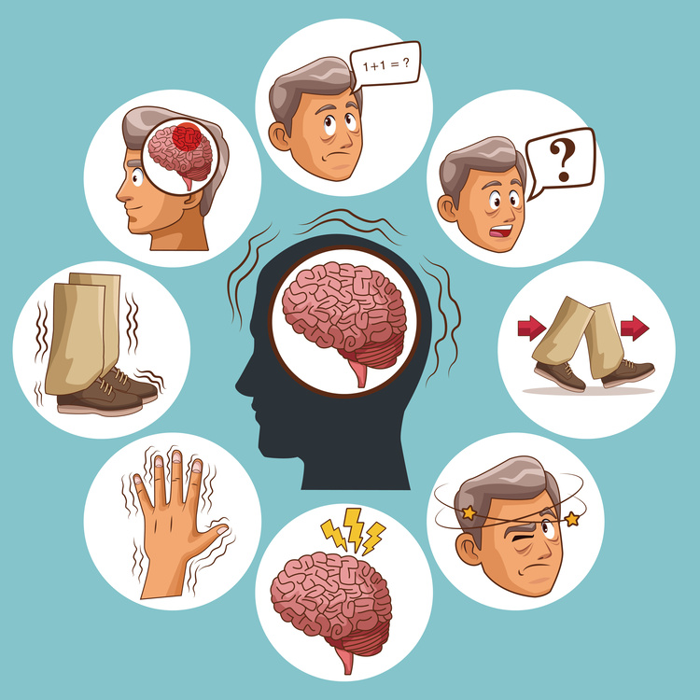
The symptoms of Parkinson’s and the rate of progression differ among individuals. Early symptoms of this disease are subtle and occur gradually. For example, people may feel mild tremors or have difficulty getting out of a chair. They may notice that they speak too softly, or that their handwriting is slow and looks cramped or small. Friends or family members may be the first to notice changes in someone with early Parkinson’s. They may see that the person’s face lacks expression and animation, or that the person does not move an arm or leg normally.
https://opiekun-pomocnadlon.pl

Slide 7
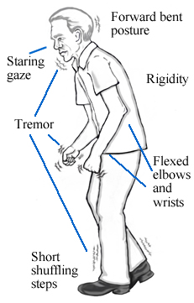
Typical body posture in Parkinson's disease
People with PD characteristically walk and even sit in a stooped posture, with their shoulders hunched forward. This tends to tip a person’s center of gravity forward and can contribute to falls. A pronounced manifestation of this may result in a festinating gait in which a person takes small, rapid steps, which can resemble running, in an attempt to “catch up” with their center of gravity which is propelled forward due to stooped posture.
humanphysiology.academy
humanphysiology.academy

Slide 8
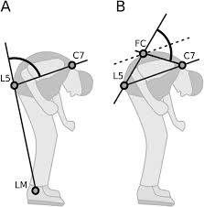
Dropped head syndrome and camptocormia

Slide 9
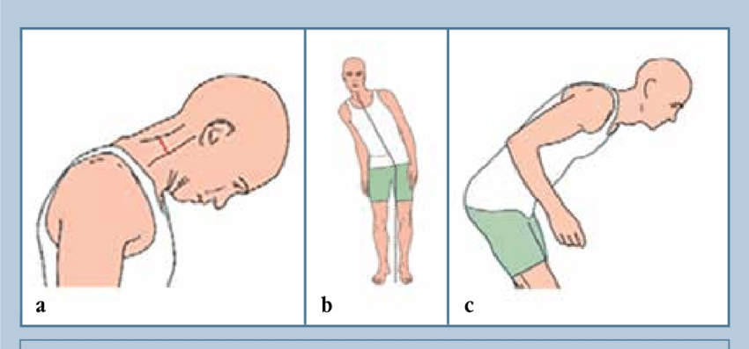
Approximately 5-10% of people with PD have a more pronounced problem with their posture. One potential difficulty is a pronounced forward flexion of their head, called dropped head syndrome (DHS). Another, is a pronounced flexion of their entire trunk, called camptocormia or bent spine syndrome (often defined as a greater than 45-degree flexion of the spine). These two conditions have many causes besides PD including other neurodegenerative

Slide 10

causes of Parkinson's disease
Genetics
A number of genetic factors have been shown to increase a person's risk of developing Parkinson's disease, although exactly how these make some people more susceptible to the condition is unclear.
Parkinson's disease can run in families as a result of faulty genes being passed to a child by their parents. But it's rare for the disease to be inherited this way
https://www.medonet.pl

Slide 11
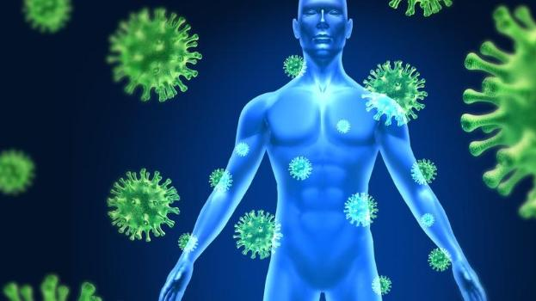
Environmental factors
Some researchers also feel environmental factors may increase a person's risk of developing Parkinson's disease.
It's been suggested that pesticides and herbicides used in farming and traffic or industrial pollution may contribute to the condition.
But the evidence linking environmental factors to Parkinson's disease is inconclusive.
http://www.leksykon.com.pl

Slide 12
Parkinson's disease treatment
There are several therapies that can make living with Parkinson's disease easier and help you deal with your symptoms on a day-to-day basis. Therapy mainly focused on:
-Physiotherapy
-Occupational therapy
-Speech and language therapy
-Diet advice
-Medication

Slide 13
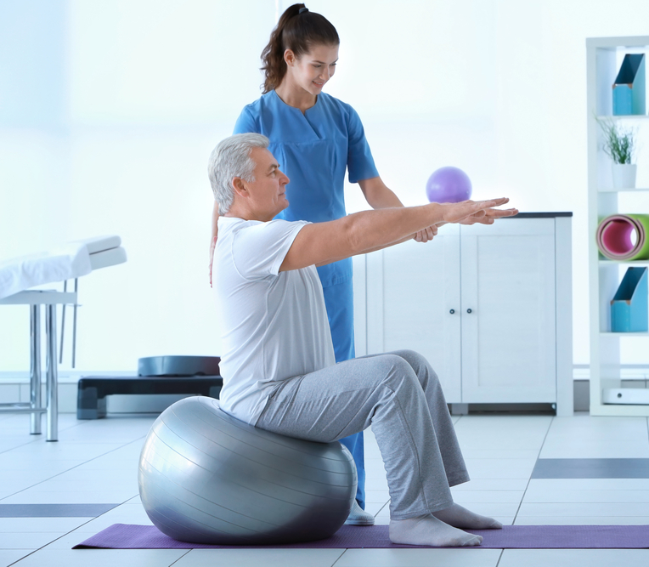
physiotherapy in parkinson's disease

Slide 14
Physiotherapy aims to keep you moving safely and independently, with your body in as good a working condition as possible.
The key aims of physiotherapy in Parkinson's are:
-functional inprovement
-posture correction
-inproved balance
-improvement of the gait pattern
-improving manual skills
-teach relaxation techniques

Slide 15
Vocabulary:
substantia nigra-Istota czarna
Tremor- drżenie
Jaw- szczęka
Impaired- upośledzenie
occur gradually- następować stopniowo
Hunched- pochylony
Intherited- dziedziczny
Occupational therapy- terapia zajęciowa

Slide 16
Bibliography:
1. Parkinson's disease: a review. Beitz JM
2.The clinical symptoms of Parkinson's disease. Sveinbjornsdottir S.
3. Parkinson's Disease: Clinical Review and Update. Cabreira V, Massano J.
4. Motor assessment in Parkinson`s disease. Opara J, Małecki A, Małecka E, Socha T
5. Instrumental or Physical-Exercise Rehabilitation of Balance Improves Both Balance and Gait in Parkinson's Disease. Giardini M, Nardone A, Godi M, Guglielmetti S, Arcolin I, Pisano F, Schieppati M

