Slide 1

Osteoporosis
https://www.ur.edu.pl/pl/uniwersytet/aktualnosci/logo-uniwersytetu-rzeszowskiego,20638
Agata Wiśniewska
III Rok Fizjoterapia
JMGR stacjonarne
Rok akademicki 2022/2023
16.01.2023 r.

Slide 2
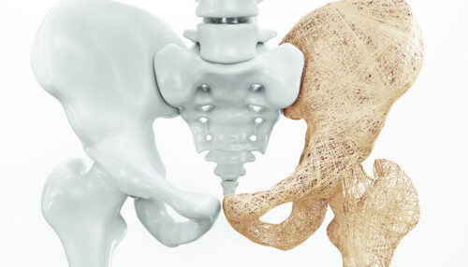
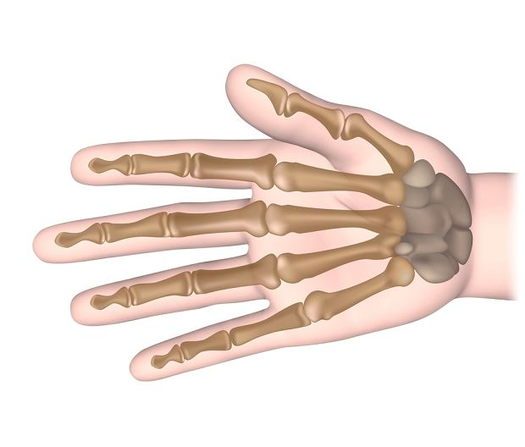
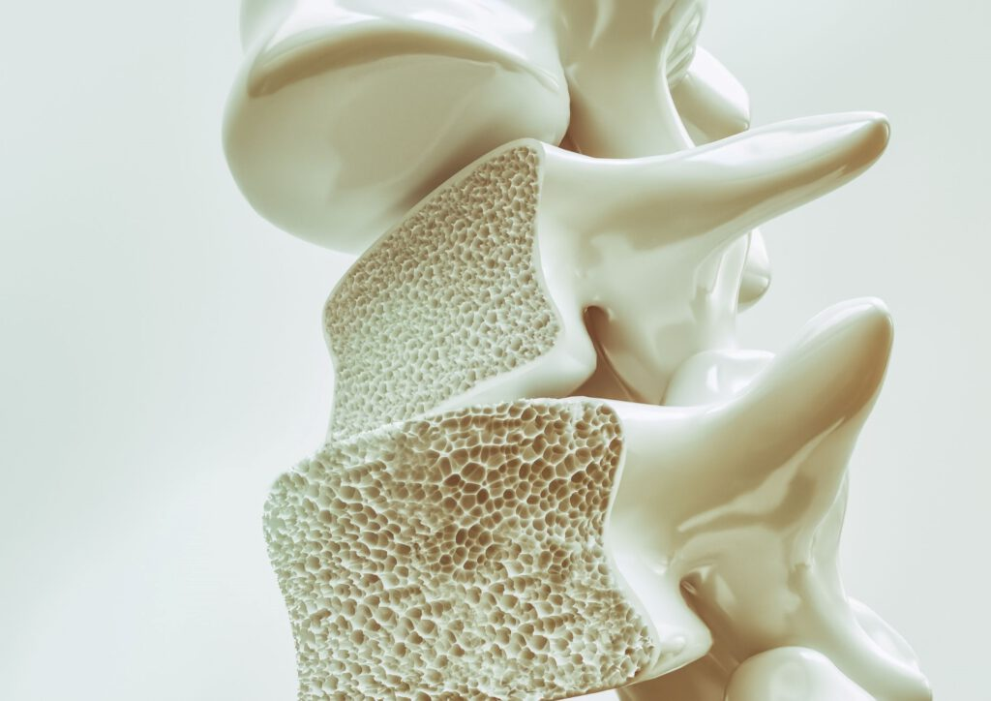
Osteoporosis
https://www.wibroterapia.pro/schorzenia-i-dolegliwosci/osteoporoza/
Osteoporosis causes bones to become weak.
Osteoporosis-related fractures most commonly occur in the:
hip,
wrist,
spine;
https://zdrowie.gazeta.pl/Zdrowie/7,140283,23606740,kosci-reki-jak-zbudowana-jest-nasza-reka-i-jakie-funkcje-pelnia.html
https://cmwum.pl/osteoporoza/

Slide 3
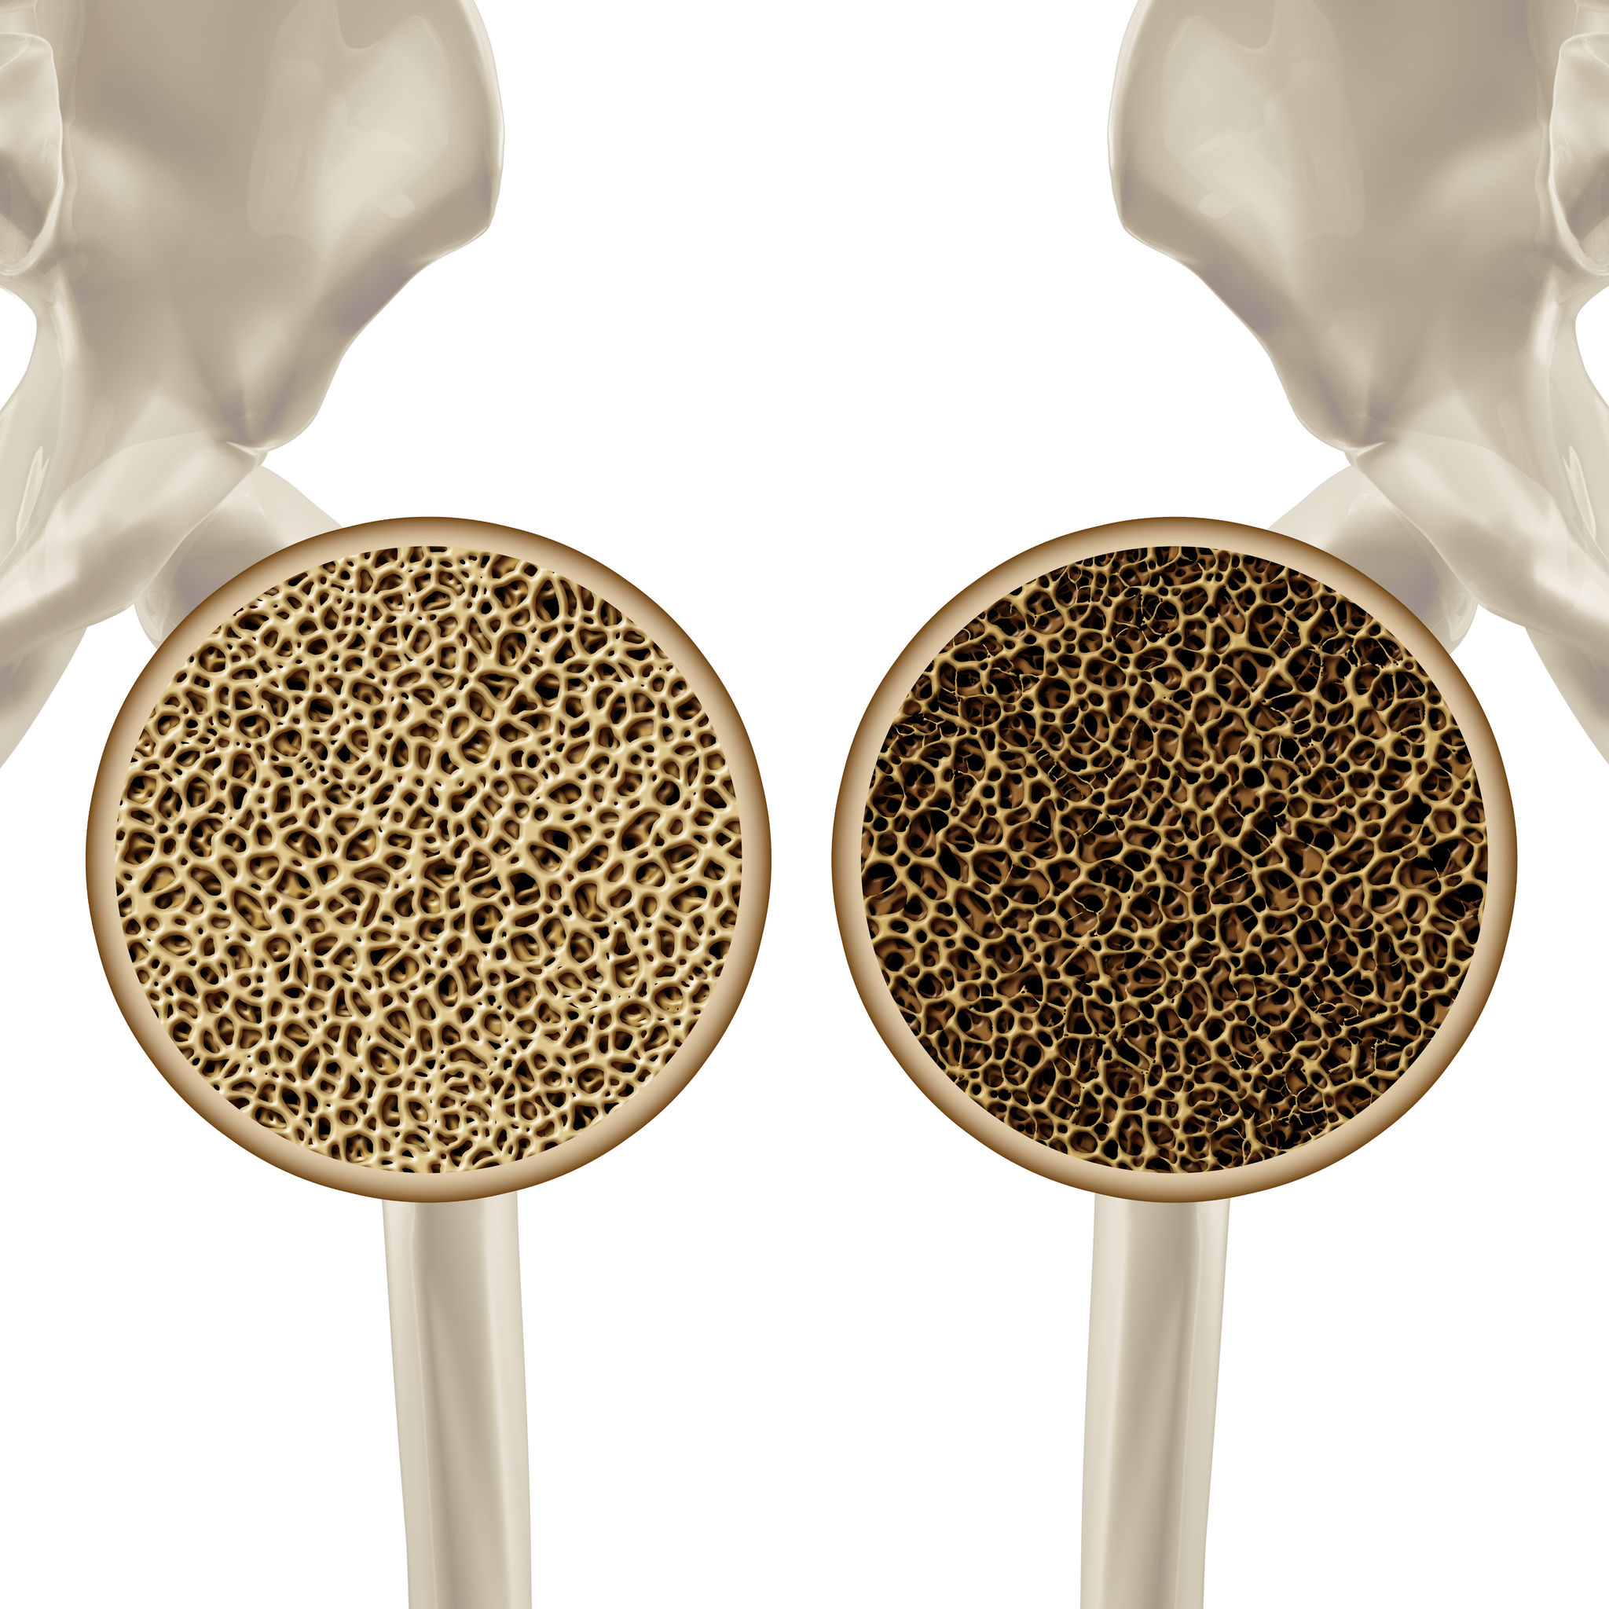
Bone is living tissue that is constantly being broken down and replaced.
Osteoporosis occurs when the creation of new bone doesn't keep up with the loss of old bone.
https://www.pharmasis.pl/blog/post/osteoporoza/

Slide 4
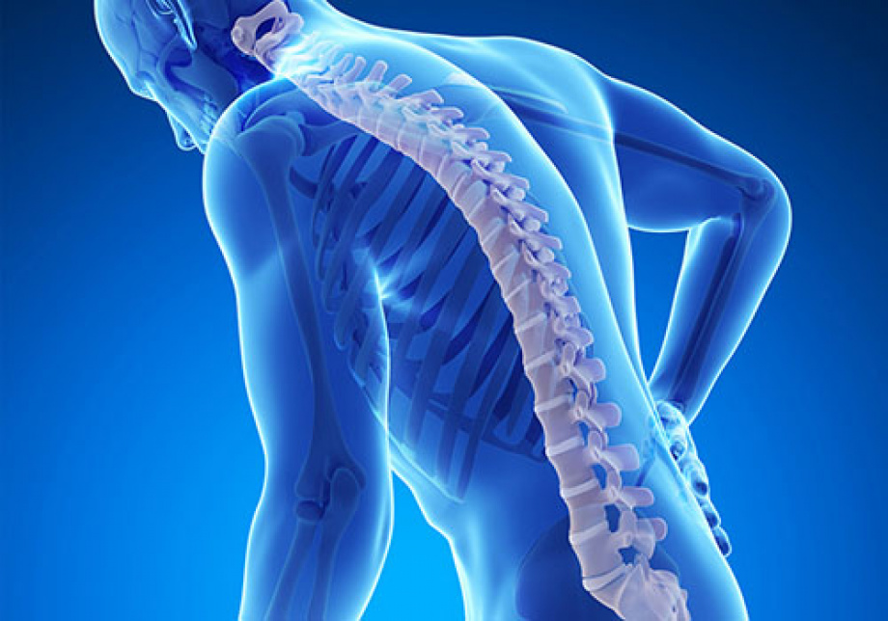
Symptoms
Back pain
Stooped posture
Breaks bones
https://www.dobrystan.pl/artykuly/osteopenia--przyczyny--objawy--leczenie

Slide 5
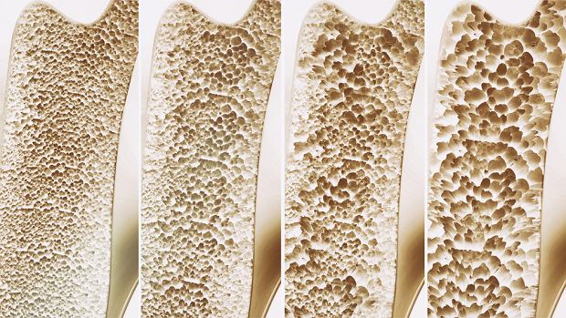
Causes
Human bones are in a constant state of renewal new bone is made and old bone is broken down.
https://www.edziecko.pl/rodzice/7,79361,24954391,osteoporoza-objawy-leczenie-profilaktyka.html

Slide 6
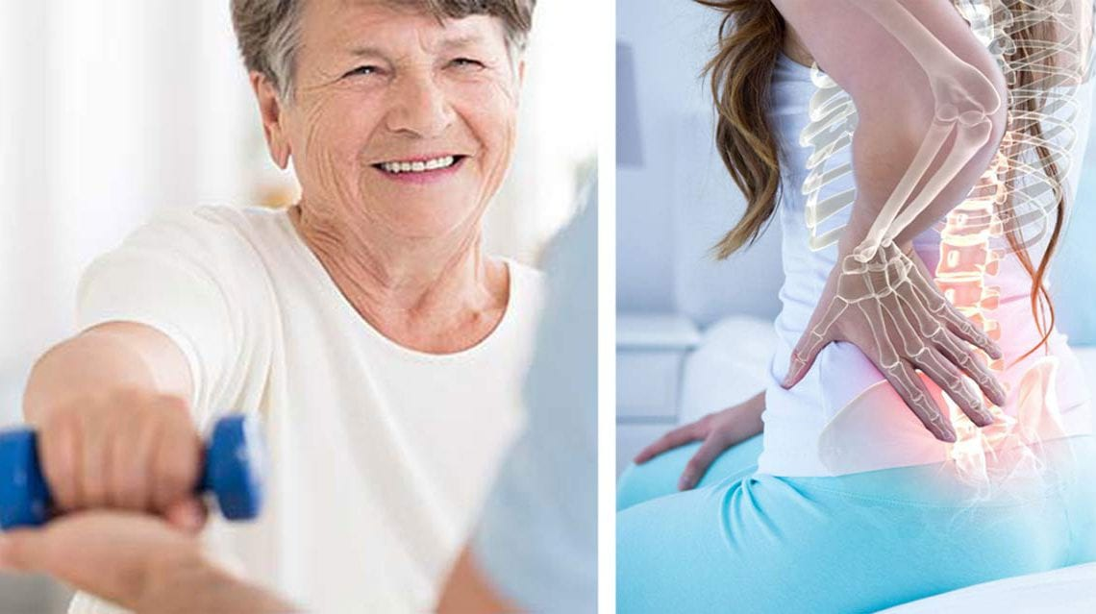
Risk factors
age,
race,
lifestyle choices,
medical conditions,
treatments
https://cotozachoroba.pl/zagrozenie-osteoporoza/

Slide 7
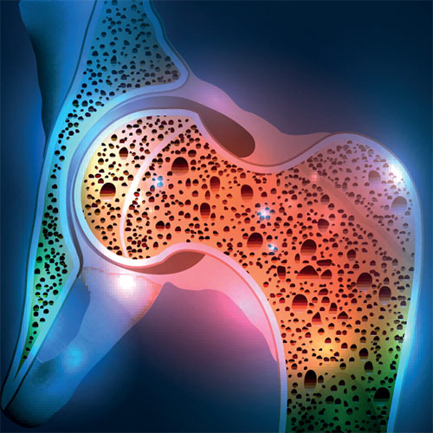
Unchangeable risk
Sex,
Age,
Race,
Family history,
https://www.sluzbazdrowia.com.pl/artykul.php?numer_wydania=2991&art=9

Slide 8

Lifestyle choices
Sedentary lifestyle.
Excessive alcohol consumption.
Tobacco use.
https://warszawa.naszemiasto.pl/palenie-i-picie-alkoholu-powinno-byc-zakazane-na-ulicach-i/ar/c8-2529228

Slide 9
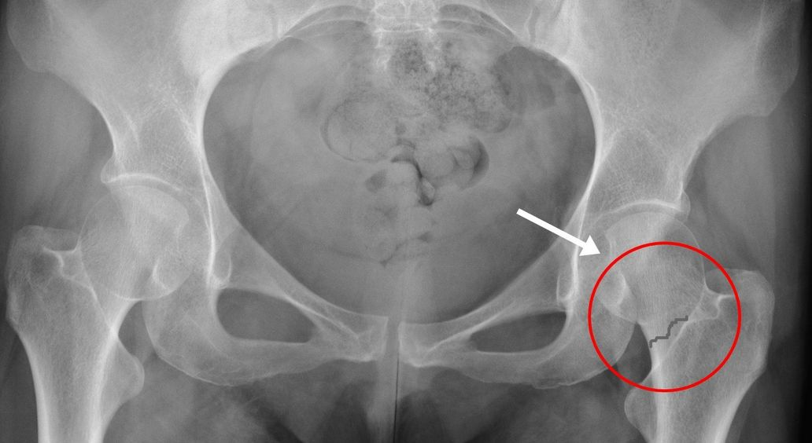
Complications
Hip fractures often are caused by a fall and can result in disability.
https://swiatrehabilitacji.pl/zlamanie-szyjki-kosci-udowej-objawy-leczenie-operacja-rehabilitacja/

Slide 10
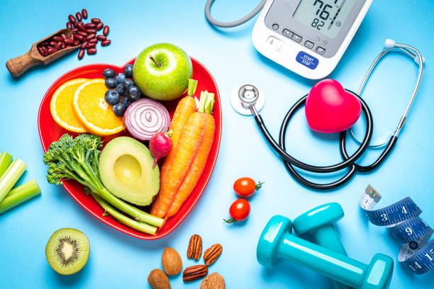
Prevention
Good nutrition and regular exercise are essential for keeping patients' bones healthy throughout their life.
https://www.istockphoto.com/pl/obrazy/zdrowy-styl-%C5%BCycia

Slide 11
Calcium
Good sources of calcium include:
Low-fat dairy products,
green vegetables,
salmon,
soy products,
orange juice.
Vitamin D
Vitamin D improves the body's ability to absorb calcium and improves bone health.
People can get some of their vitamin D from sunlight
Dietary sources of vitamin D
salmon,
many types of milk;

Slide 12
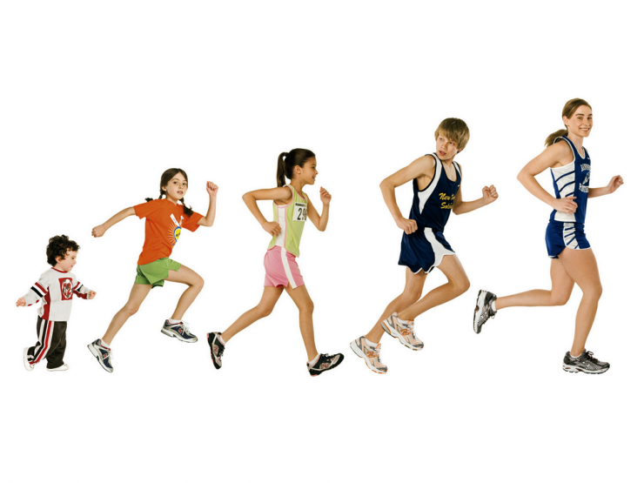
Exercise
Exercise can help patients build strong bones and slow bone loss. Exercise will benefit patients' bones no matter when they start.
https://www.runners-world.pl/trening/Jak-moga-trenowac-bieganie-dzieci,48078,1

Slide 13
Vocabulary:
Stooped posture - postawa zgrabiona
Breaks bones - złamanie kości
Unchangeable risks - niezmienne ryzyko
vertebrae - kręgi
calcium - wapń

Slide 14
Bibliography:
Osteopenia and osteoporosis among patients with human immunodeficiency virus infection - Grażyna Biesiada, Tomasz Mach, Aleksander Garlicki, 2012;
Osteoporosis, Osteomalacia, Primary Hyperparathyroidism - Waldemar Misiorowski 2008;
Osteoporosis Update - Davidson M, DeSimone ME. Clinician Reviews 2002;
Fracture prevention with vitamin D supplementation. A meta-analysis of randomized controlled trials - Bischoff-Ferrari HA, Willett WC, Wong JB 2005;
Vitamin D deficiency. - Holick MF 2007;
http://www.verba-medica.pl/ - słownik medyczny

Slide 15

Thank you for your attention!
https://verseo.pl/thank-you-page/

