Slide 1
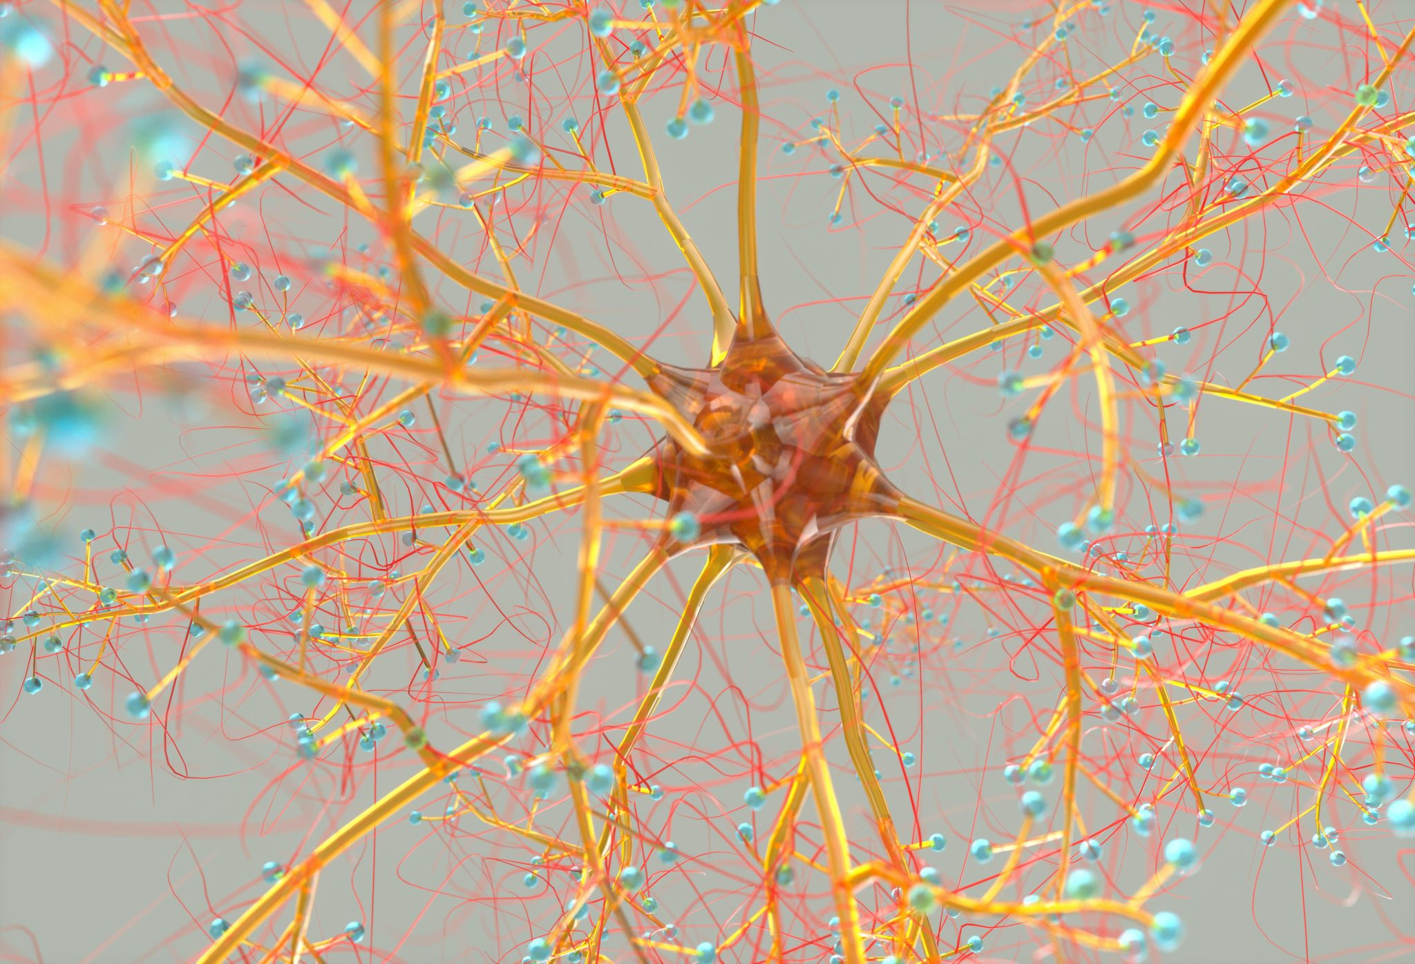
Nervous System
Kacper Ziomek
III Rok Fizjoterapia JMS
rok akademicki 2022/2023

Slide 2
What is the nervous system responsible for?
The nervous system uses specialized cells called neurons to send signals or messages all over the body. These electrical signals travel between the brain, skin, organs, glands and muscles.

Slide 3
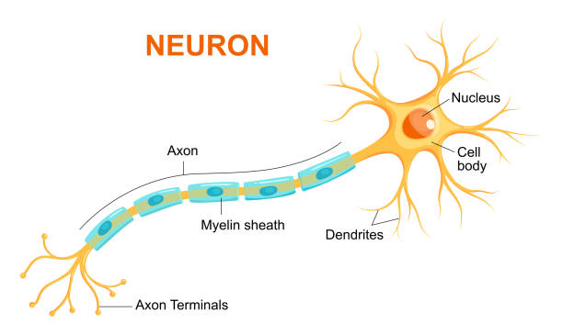
Neuron
A nerve cell that carries information between the brain and other parts of the body.
https://training.seer.cancer.gov/anatomy/nervous/tissue.html

Slide 4
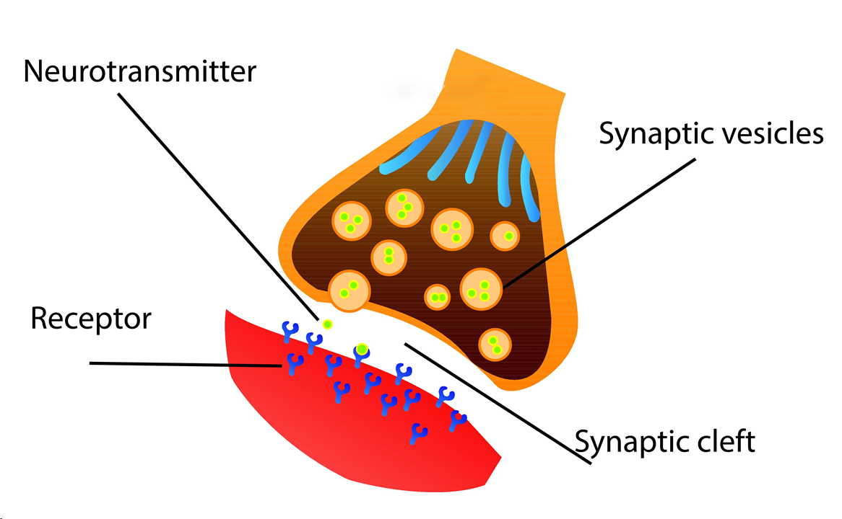
Synapse
A synapse is a small gap between two neurones.
https://mood-disorders.co.uk/glossary/what-is-a-synapse

Slide 5
https://courses.lumenlearning.com/suny-hccc-ss-151-1/chapter/parts-of-the-nervous-system/

Slide 6
Nervous system disorders
Autoimmune disorders
Trauma
Infections
Degeneration
Structural defects
Tumors
Blood flow disruption
The nervous system is vulne-rable to various disorders. It can be damaged by the following:

Slide 7
Parkinson's Disease
Parkinson’s disease is a brain disorder that causes unintended or uncontrollable movements, such as shaking, stiffness, and difficulty with balance and coordination.
https://neurologysleepcentre.com/blog/what-is-parkinsons-disease/

Slide 8
Causes
In Parkinson’s disease, certain nerve cells (neurons) in the brain gradually break down or die. Many of the symptoms are due to a loss of neurons that produce a chemical messenger in your brain called dopamine.
Genes.
Environmental triggers.

Slide 9
Risk factors
Risk factors for Parkinson’s disease include:
Age.
Heredity.
Sex.
Exposure to toxins.

Slide 10
Alzheimer's Disease
Alzheimer's disease is a progressive neurologic disorder that causes the brain to shrink (atrophy) and brain cells to die.
https://healthblog.uofmhealth.org/brain-health/everything-you-know-about-alzheimers-wrong

Slide 11
How do I keep my nervous system healthy?
We must remember that this system is the command center for your entire body. It needs care to keep working correctly.
See your doctor regularly, eat a healthy diet, avoid drugs, and only drink alcohol in moderation.

Slide 12
Thank you for your attention

Slide 13
Vocabulary
Autoimmune disorders – Zaburzenia autoimmunologiczne
Trauma – Uraz
Degeneration – Zwyrodnienie
Structural defects – Wady strukturalne
Tumors – Nowotwory
Rigidity - Sztywność
Environmental triggers – Wyzwalacze środowiskowe
Risk factors – Czynniki ryzyka
Heredity - Dziedziczność
Central nervous system - Ośrodkowy układ nerwowy
Peripheral nervous system – Obwodowy układ nerwowy

Slide 14
Reference
English-Polish dictionary
Robert L. Nussbaum, M.D., and Christopher E. Ellis, Ph.D. (April 3, 2003) Alzheimer's Disease and Parkinson's Disease. N Engl J Med 2003; 348:1356-1364
Nervous System, from https://my.clevelandclinic.org/health/articles/21202-nervous-system
https://qbi.uq.edu.au/brain/brain-anatomy/what-neuron
https://mood-disorders.co.uk/glossary/what-is-a-synapse
https://www.kenhub.com/en/library/anatomy/the-nervous-system
https://www.hopkinsmedicine.org/health/conditions-and-diseases/overview-of-nervous-system-disorders
https://neurologysleepcentre.com/blog/what-is-parkinsons-disease/
https://www.mayoclinic.org/diseases-conditions/alzheimers-disease/symptoms-causes/syc-20350447

