Slide 1

UNIWERSYTET RZESZOWSKI KOLEGIUM NAUK MEDYCZNYCH INSTYTUT NAUK O ZDROWIU
BONE FRACTURES
Julia Serafin
Fizjoterapia JMS 3 rok

Slide 2
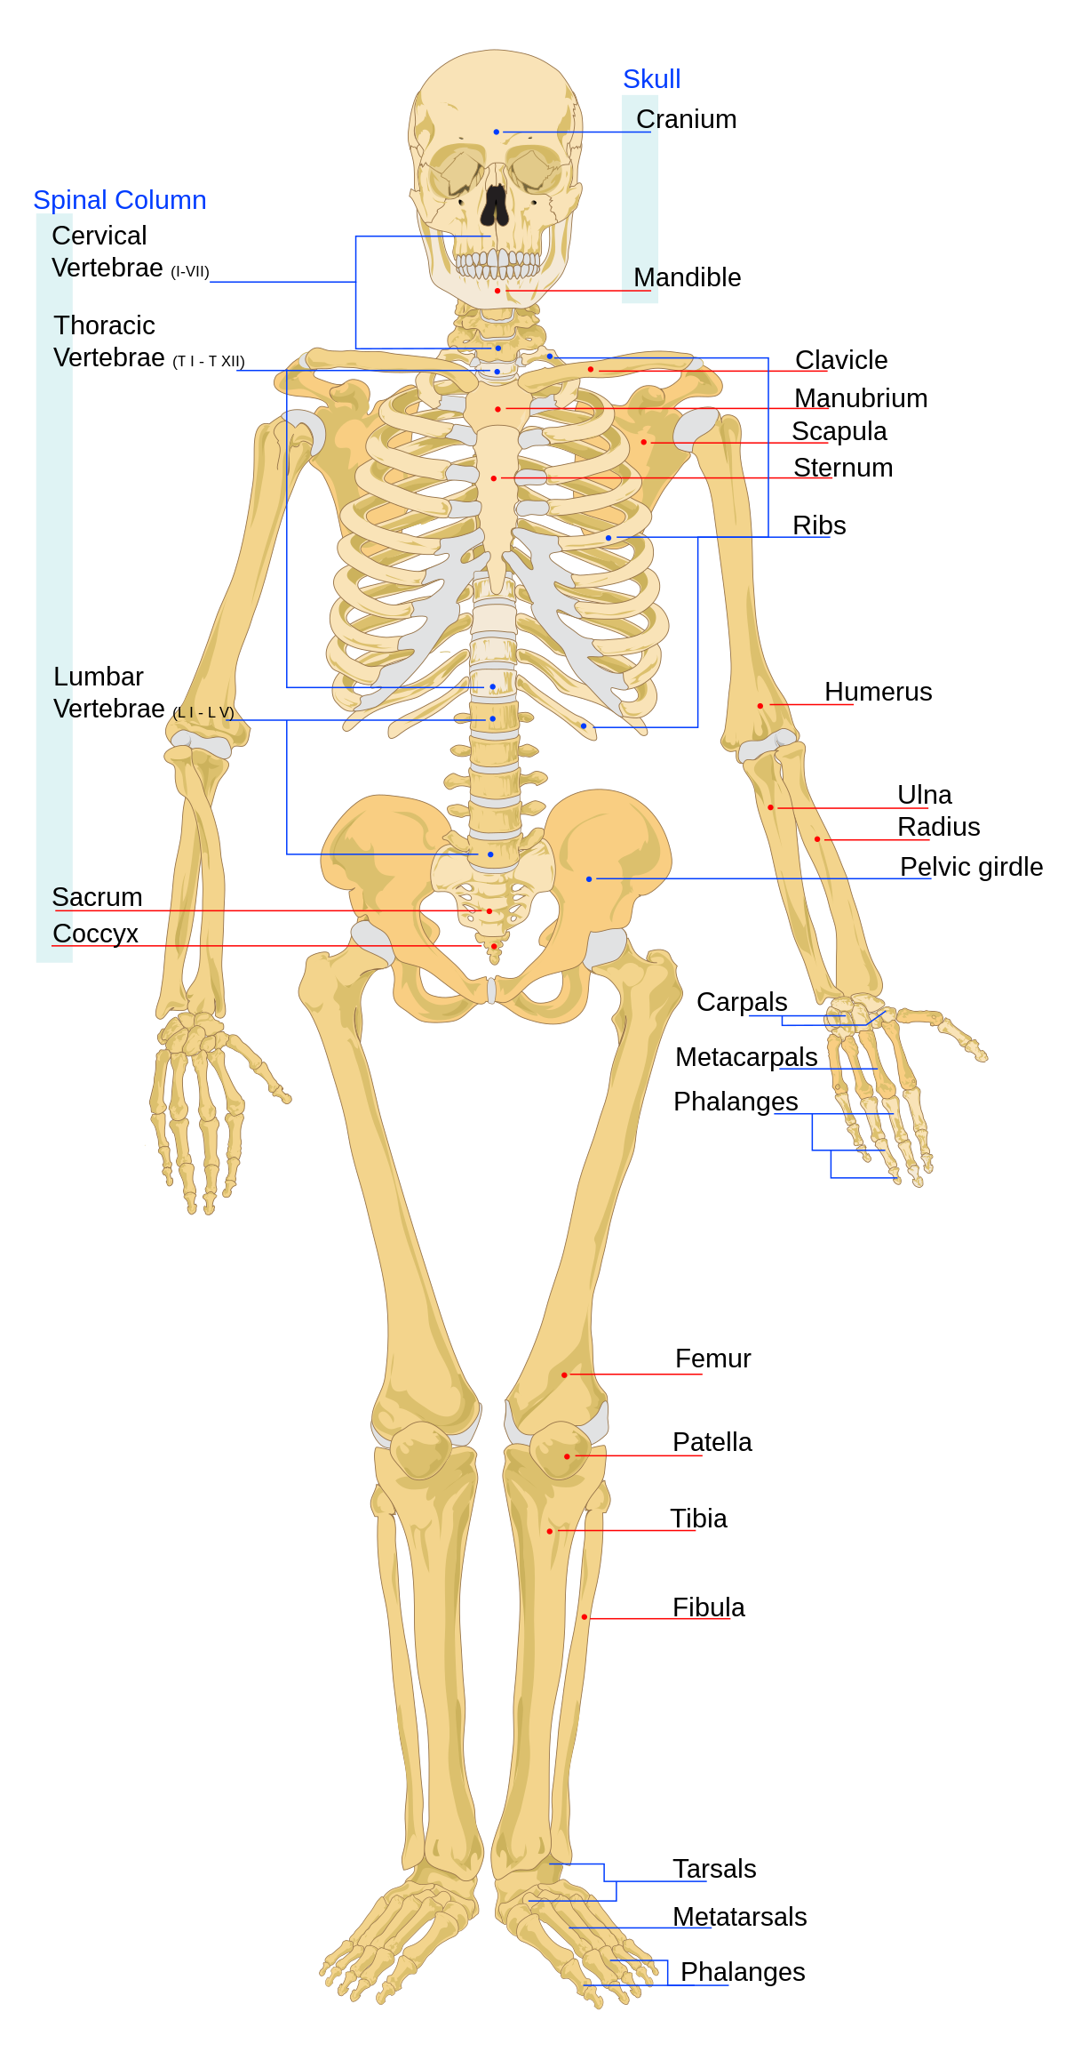
SKELETAL SYSTEM
In an adult human, the skeleton consists of about 206 bones
https://www.google.com/url?sa=i&url=https%3A%2F%2Fen.wikiversity.org%2Fwiki%2FSkeletal_System&psig=AOvVaw3A12AUk-23N8H8t-wyaULU&ust=1673908032407000&source=images&cd=vfe&ved=0CBAQjRxqFwoTCMjx_anQyvwCFQAAAAAdAAAAABAE

Slide 3
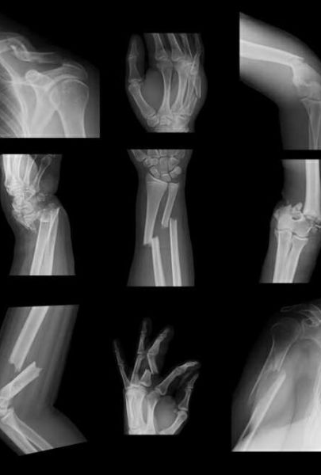
WHAT IS A BONE FRACTURE?
https://www.google.com/url?sa=i&url=https%3A%2F%2Fwww.1888bonedoc.net%2Fposts%2Fbone-fracture-surgery&psig=AOvVaw0DE9ZpJNLpIaIUMmS6iSpa&ust=1673908100472000&source=images&cd=vfe&ved=0CBAQjRxqFwoTCMj8wMrQyvwCFQAAAAAdAAAAABAE

Slide 4
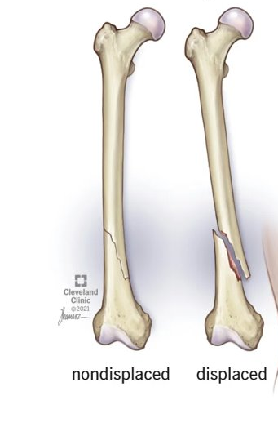
FRACTURES DIAGNOSED BY PATTERN OR SHAPE
OBLIQUE FRACTURE
https://www.google.com/url?sa=i&url=https%3A%2F%2Fmy.clevelandclinic.org%2Fhealth%2Fdiseases%2F22185-oblique-fracture&psig=AOvVaw3XLMzHkv3qzimmHG6-uOeJ&ust=1673908174834000&source=images&cd=vfe&ved=0CBAQjRxqFwoTCKCG5O3QyvwCFQAAAAAdAAAAABAE

Slide 5
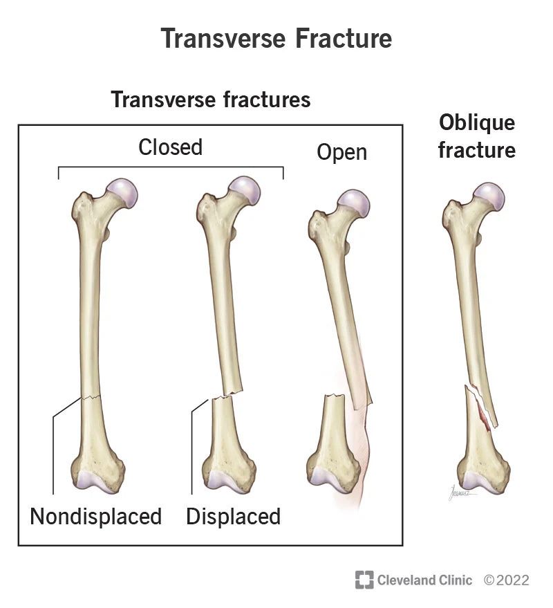
FRACTURES DIAGNOSED BY PATTERN OR SHAPE
https://www.google.com/imgres?imgurl=https%3A%2F%2Fmy.clevelandclinic.org%2F-%2Fscassets%2FImages%2Forg%2Fhealth%2Farticles%2F22956-transverse-fracture&imgrefurl=https%3A%2F%2Fmy.clevelandclinic.org%2Fhealth%2Fdiseases%2F22956-transverse-fracture&tbnid=R_AmYxqpco8ItM&vet=12ahUKEwi7moCb0Mr8AhUlDRAIHRRWC-0QMygAegUIARC6AQ..i&docid=O6sx1-gscS-SfM&w=800&h=879&q=transverse%20fracture&client=opera&ved=2ahUKEwi7moCb0Mr8AhUlDRAIHRRWC-0QMygAegUIARC6AQ

Slide 6
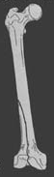
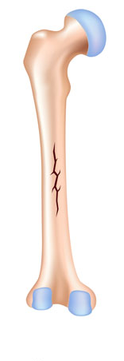
FRACTURES DIAGNOSED BY PATTERN OR SHAPE
LONGITUDINAL FRACTURE
https://www.google.com/imgres?imgurl=https%3A%2F%2Forthopedic-institute.org%2Fwp-content%2Fuploads%2F2015%2F03%2Ffractures.jpg&imgrefurl=https%3A%2F%2Fwww.orthopedic-institute.org%2Ffracture-care%2Ftypes-of-fractures%2F&tbnid=WouuN8-UNQoPIM&vet=12ahUKEwim74Sv0Mr8AhVKvCoKHbGKDsAQMygJegUIARDLAQ..i&docid=w-7m3H_f1ZyOcM&w=1300&h=586&q=longitudinal%20fracture&client=opera&ved=2ahUKEwim74Sv0Mr8AhVKvCoKHbGKDsAQMygJegUIARDLAQ
https://www.google.com/imgres?imgurl=https%3A%2F%2Fintroductiontoradiology.net%2Fcourses%2Frad%2Fext%2F0intro%2Ffractures.jpg&imgrefurl=https%3A%2F%2Fintroductiontoradiology.net%2Fcourses%2Frad%2Fext%2F0intro%2F01anatomy.html&tbnid=-nVL9wjJeZjB0M&vet=12ahUKEwim74Sv0Mr8AhVKvCoKHbGKDsAQMygGegUIARDFAQ..i&docid=Cw-MqelcTjchzM&w=500&h=229&q=longitudinal%20fracture&client=opera&ved=2ahUKEwim74Sv0Mr8AhVKvCoKHbGKDsAQMygGegUIARDFAQ

Slide 7
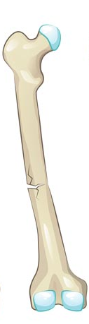
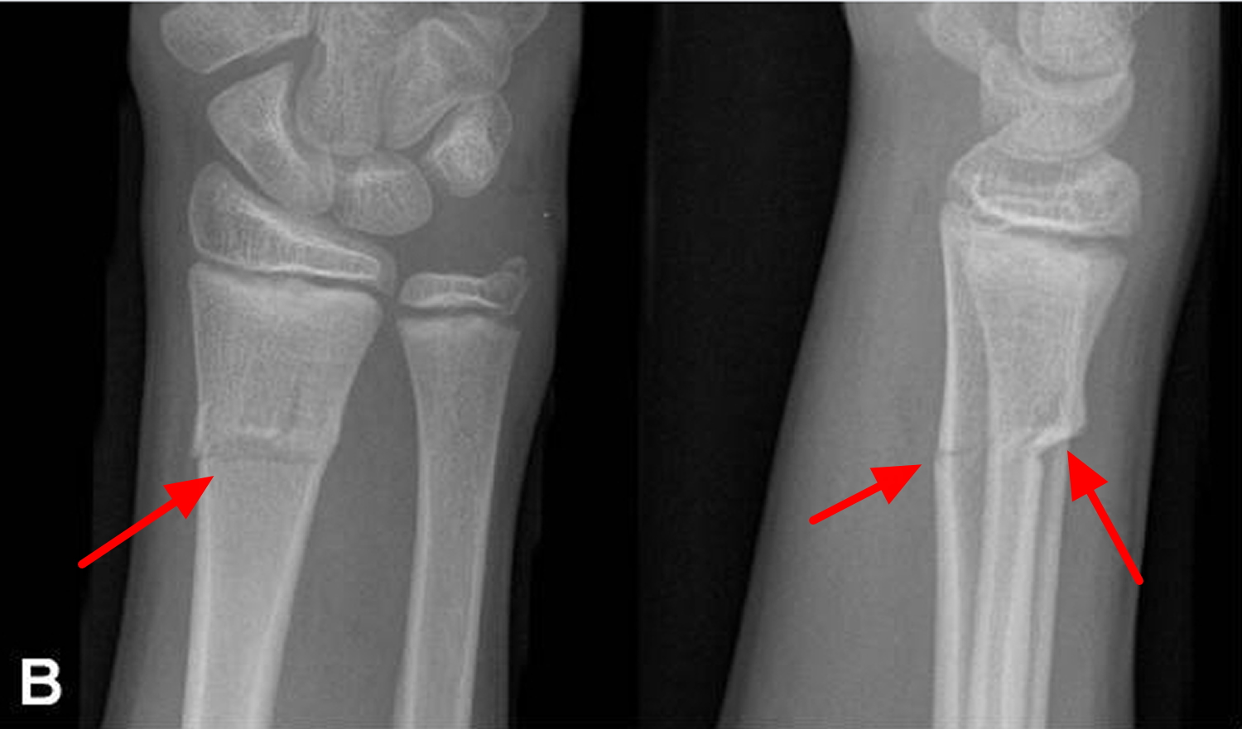
FRACTURES DIAGNOSED BY PATTERN OR SHAPE
GREENSTICK FRACTURE
https://www.google.com/imgres?imgurl=https%3A%2F%2Fhealthjade.com%2Fwp-content%2Fuploads%2F2018%2F03%2FGreenstick-fracture.jpg&imgrefurl=https%3A%2F%2Fhealthjade.net%2Fgreenstick-fracture%2F&tbnid=OTh7zbZSvQ9IqM&vet=12ahUKEwj3mpbY0Mr8AhVi_SoKHUwIDbgQMygLegUIARDRAQ..i&docid=UVKZHE_lMBG2uM&w=1500&h=881&q=greenstickfracture&client=opera&ved=2ahUKEwj3mpbY0Mr8AhVi_SoKHUwIDbgQMygLegUIARDRAQ
https://www.google.com/imgres?imgurl=https%3A%2F%2Fwww.drsatishortho.com%2Fimages%2Fresources%2Forthopedic_conditions%2Fpaediatric_orthopaedics%2Fgreenstick_fractures.jpg&imgrefurl=https%3A%2F%2Fwww.drsatishortho.com%2Findex.php%2Fresources%2Forthopedic-conditions%2Fpaediatric-orthopaedics%2Fgreenstick-fractures&tbnid=USHi3M6Ykpju_M&vet=12ahUKEwj3mpbY0Mr8AhVi_SoKHUwIDbgQMygCegUIARC_AQ..i&docid=_sQj2lcjEgmZNM&w=900&h=600&q=greenstickfracture&client=opera&ved=2ahUKEwj3mpbY0Mr8AhVi_SoKHUwIDbgQMygCegUIARC_AQ

Slide 8
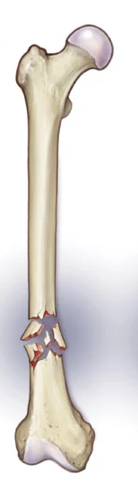
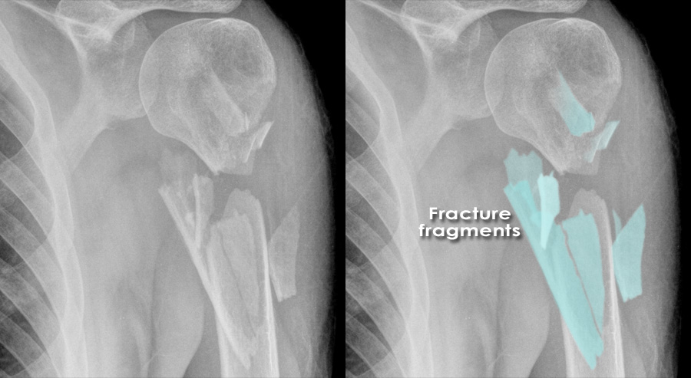
FRACTURES DIAGNOSED BY PATTERN OR SHAPE
COMMINUTED FRACTURE
https://www.google.com/imgres?imgurl=https%3A%2F%2Fwww.radiologymasterclass.co.uk%2Fimages%2Fmusculoskeletal-images%2Ftrauma%2Fcomminuted_fracture.jpg%3Fmtime%3D20210304211359%26focal%3Dnone&imgrefurl=https%3A%2F%2Fwww.radiologymasterclass.co.uk%2Ftutorials%2Fmusculoskeletal%2Ftrauma%2Ftrauma_x-ray_page2&tbnid=-cblUlqtUsgV8M&vet=12ahUKEwicu_C50cr8AhVFlYsKHRJbBsUQMygOegUIARDYAQ..i&docid=K246iYsOw61YRM&w=900&h=493&q=communited%20racture&client=opera&ved=2ahUKEwicu_C50cr8AhVFlYsKHRJbBsUQMygOegUIARDYAQ
https://www.google.com/imgres?imgurl=https%3A%2F%2Fmy.clevelandclinic.org%2F-%2Fscassets%2FImages%2Forg%2Fhealth%2Farticles%2F15241-bone-fractures&imgrefurl=https%3A%2F%2Fmy.clevelandclinic.org%2Fhealth%2Fdiseases%2F15241-bone-fractures&tbnid=G52-986xo33JpM&vet=12ahUKEwicu_C50cr8AhVFlYsKHRJbBsUQMygAegUIARC6AQ..i&docid=JZvh3giS2A4V2M&w=800&h=772&q=communited%20racture&client=opera&ved=2ahUKEwicu_C50cr8AhVFlYsKHRJbBsUQMygAegUIARC6AQ

Slide 9
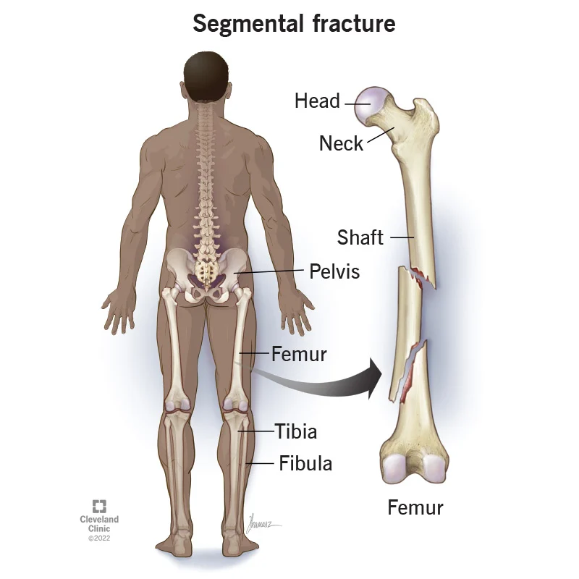
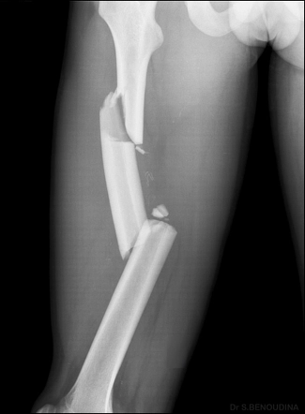
FRACTURES DIAGNOSED BY PATTERN OR SHAPE
https://www.google.com/imgres?imgurl=https%3A%2F%2Fmy.clevelandclinic.org%2F-%2Fscassets%2FImages%2Forg%2Fhealth%2Farticles%2F22234-segmental-fracture&imgrefurl=https%3A%2F%2Fmy.clevelandclinic.org%2Fhealth%2Fdiseases%2F22234-segmental-fracture&tbnid=Xx8TlRKrln_JXM&vet=12ahUKEwi3tK360cr8AhUDiIsKHc_kAtwQMygAegUIARC-AQ..i&docid=l3RpASdxXomGjM&w=800&h=800&q=segmental%20racture&client=opera&ved=2ahUKEwi3tK360cr8AhUDiIsKHc_kAtwQMygAegUIARC-AQ
https://www.google.com/imgres?imgurl=https%3A%2F%2Fprod-images-static.radiopaedia.org%2Fimages%2F25257143%2F2b821a5c55bcf437d53f04c926bcac_gallery.jpeg&imgrefurl=https%3A%2F%2Fradiopaedia.org%2Farticles%2Fsegmental-fracture-1&tbnid=L1c4KIUiULrD5M&vet=12ahUKEwi3tK360cr8AhUDiIsKHc_kAtwQMygBegUIARDAAQ..i&docid=vcnkgIkAVqWH7M&w=325&h=442&q=segmental%20racture&client=opera&ved=2ahUKEwi3tK360cr8AhUDiIsKHc_kAtwQMygBegUIARDAAQ

Slide 10
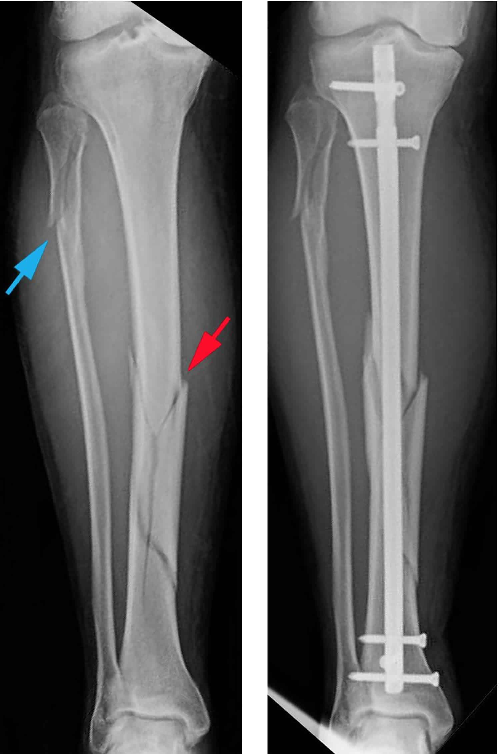
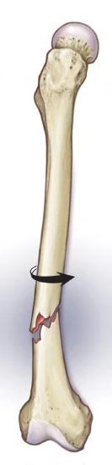
FRACTURES DIAGNOSED BY PATTERN OR SHAPE
SPIRAL FRACTURE
https://www.google.com/imgres?imgurl=https%3A%2F%2Fhealthjade.net%2Fwp-content%2Fuploads%2F2019%2F05%2Fspiral-fracture.jpg&imgrefurl=https%3A%2F%2Fhealthjade.net%2Fspiral-fracture%2F&tbnid=4V0pa1j_NuKnKM&vet=12ahUKEwig2KGZ0sr8AhXGGHcKHVJAAOUQMygCegUIARDCAQ..i&docid=Bhh6O763RnOF5M&w=1500&h=2261&q=spiral%20racture&client=opera&ved=2ahUKEwig2KGZ0sr8AhXGGHcKHVJAAOUQMygCegUIARDCAQ
https://www.google.com/imgres?imgurl=https%3A%2F%2Fmy.clevelandclinic.org%2F-%2Fscassets%2FImages%2Forg%2Fhealth%2Farticles%2F22241-spiral-fractures&imgrefurl=https%3A%2F%2Fmy.clevelandclinic.org%2Fhealth%2Fdiseases%2F22241-spiral-fracture&tbnid=Q1Iz_rWPAF7EfM&vet=12ahUKEwig2KGZ0sr8AhXGGHcKHVJAAOUQMygAegUIARC-AQ..i&docid=q5XAuIhEwSQjTM&w=800&h=772&q=spiral%20racture&client=opera&ved=2ahUKEwig2KGZ0sr8AhXGGHcKHVJAAOUQMygAegUIARC-AQ

Slide 11
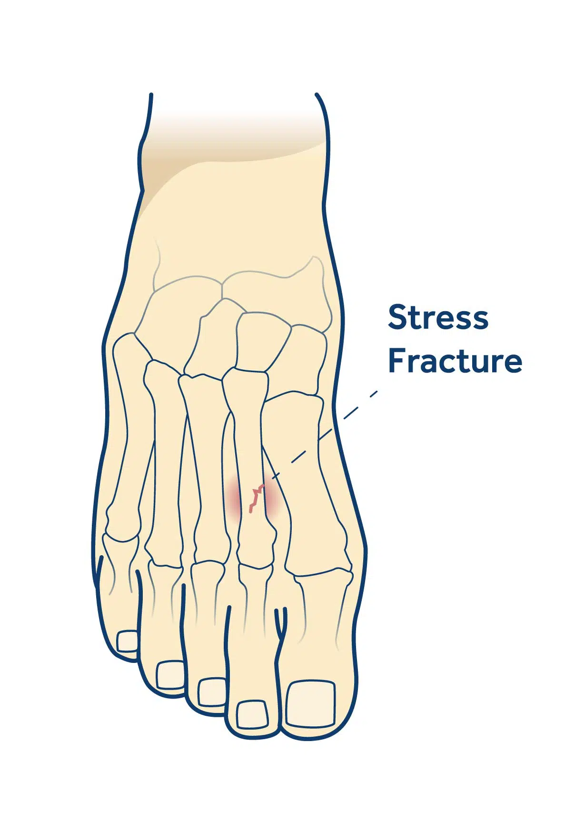
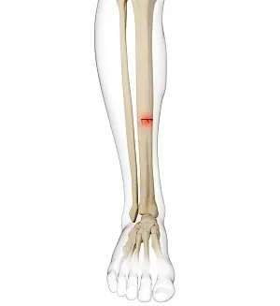
FRACTURES DIAGNOSED BY CAUSE
STRESS FRACTURE
https://www.google.com/imgres?imgurl=http%3A%2F%2Fshellharbourpodiatry.com.au%2Fwp-content%2Fuploads%2F2021%2F11%2Fstress-fractures.jpg&imgrefurl=https%3A%2F%2Fshellharbourpodiatry.com.au%2Fcondition%2Fstress-fractures%2F&tbnid=d2zSSvXQbkY_sM&vet=12ahUKEwjQoLS80sr8AhVsi8MKHT2eASsQMygKegUIARDTAQ..i&docid=ulunlnuQHPl7pM&w=1187&h=1750&q=stress%20racture&client=opera&ved=2ahUKEwjQoLS80sr8AhVsi8MKHT2eASsQMygKegUIARDTAQ
https://www.google.com/imgres?imgurl=https%3A%2F%2Fassets.yourpractice.online%2F2259%2F3d-images%2Fstress-fracture-of-the-tibia.jpg&imgrefurl=https%3A%2F%2Fwww.advancedosm.com%2Fstress-fracture-of-tibia-orthopaedic-sports-medicine-specialist-cypress-houston-tx%2F&tbnid=7TJm0SKVai_CWM&vet=12ahUKEwjQoLS80sr8AhVsi8MKHT2eASsQMygHegUIARDNAQ..i&docid=RC1segrHGSE6sM&w=300&h=327&q=stress%20racture&client=opera&ved=2ahUKEwjQoLS80sr8AhVsi8MKHT2eASsQMygHegUIARDNAQ

Slide 12
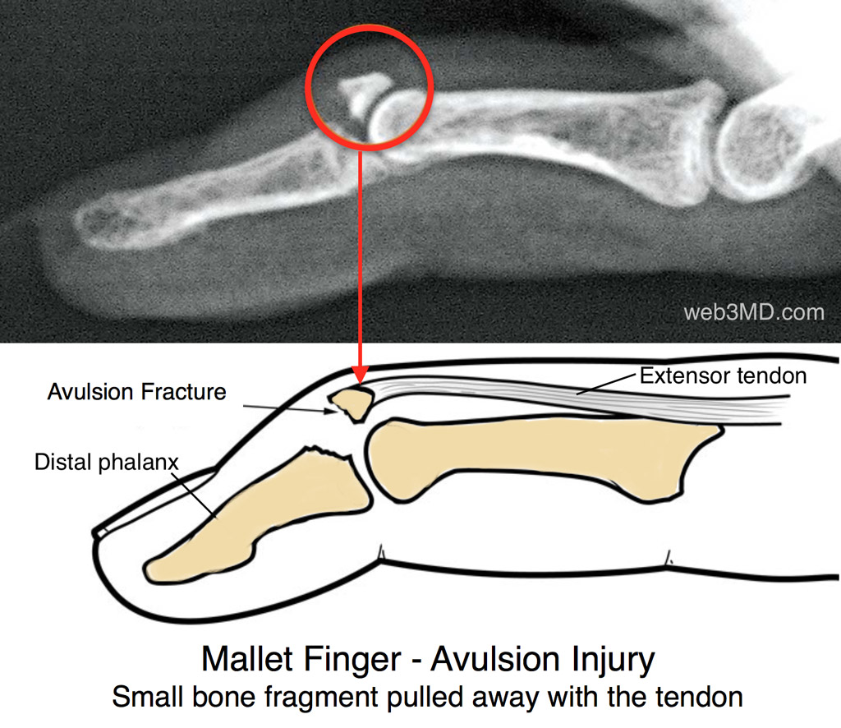
FRACTURES DIAGNOSED BY CAUSE
AVULSION FRACTURE
https://www.google.com/imgres?imgurl=https%3A%2F%2Fwww.osmifw.com%2Fwp-content%2Fuploads%2F2016%2F03%2Fmallet-finger-avulsion-fracture-1024.jpg&imgrefurl=https%3A%2F%2Fwww.osmifw.com%2Fhand-therapy-center-in-fort-worth%2Fmallet-finger%2Fmallet-finger-avulsion-fracture-1024%2F&tbnid=GMuTSHiRyfQ75M&vet=12ahUKEwj44v7g0sr8AhVLEXcKHRc6C2cQMygFegUIARDRAQ..i&docid=7WGUgjIXZS8v2M&w=1024&h=886&q=avulsion%20racture&client=opera&ved=2ahUKEwj44v7g0sr8AhVLEXcKHRc6C2cQMygFegUIARDRAQ

Slide 13
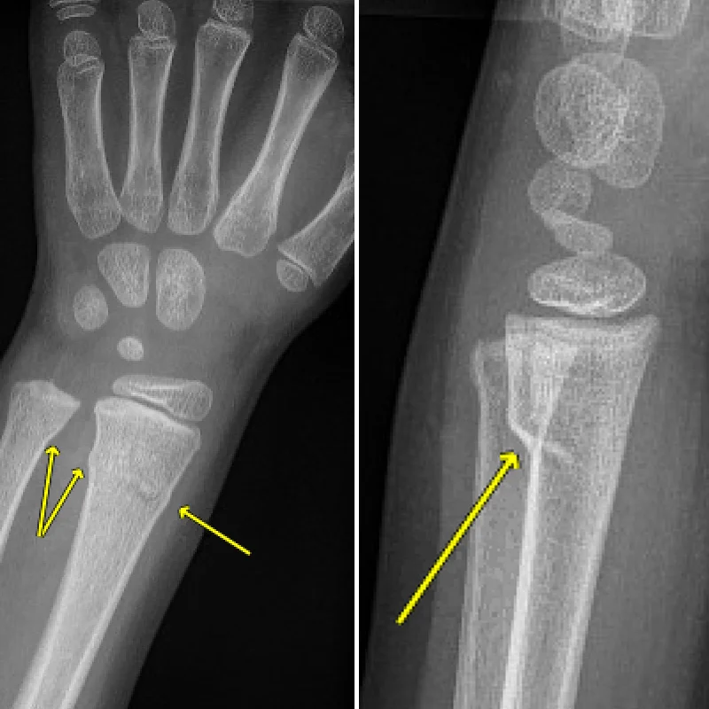
FRACTURES DIAGNOSED BY CAUSE
BUCKLE FRACTURE
https://www.google.com/imgres?imgurl=https%3A%2F%2Fmy.clevelandclinic.org%2F-%2Fscassets%2FImages%2Forg%2Fhealth%2Farticles%2F22235-buckle-fracture&imgrefurl=https%3A%2F%2Fmy.clevelandclinic.org%2Fhealth%2Fdiseases%2F22235-buckle-fracture&tbnid=Z8rLAjvo1kBAYM&vet=12ahUKEwjfn9_z0sr8AhXDiIsKHeMYAvQQMygAegUIARDFAQ..i&docid=2o_zEV0ReJ0NEM&w=800&h=800&q=buckle%20racture&client=opera&ved=2ahUKEwjfn9_z0sr8AhXDiIsKHeMYAvQQMygAegUIARDFAQ

Slide 14
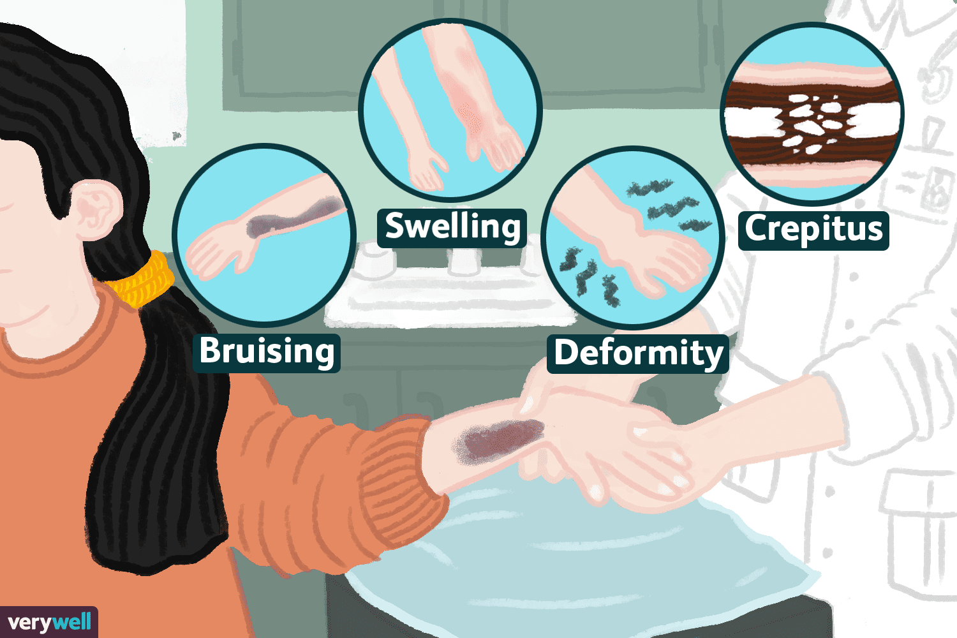
WHAT ARE THE SYMPTOMS OF A BONE FRACTURE?
https://www.google.com/imgres?imgurl=https%3A%2F%2Fwww.verywellhealth.com%2Fthmb%2FDvnF3cWyLsaxSUn_kxX-I6Pd8nk%3D%2F1500x0%2Ffilters%3Ano_upscale()%3Amax_bytes(150000)%3Astrip_icc()%2FBroken-Arm_v3-5a284a9faad52b0036dc3e79.png&imgrefurl=https%3A%2F%2Fwww.verywellhealth.com%2Fdo-i-have-a-broken-bone-4143129&tbnid=Rq0974irBOb2DM&vet=12ahUKEwjw6YGL08r8AhVjkosKHYjlBdoQMygBegUIARC7AQ..i&docid=g4GS4ZCU9u92GM&w=1500&h=1000&q=sympthoms%20of%20bone%20fracture&client=opera&ved=2ahUKEwjw6YGL08r8AhVjkosKHYjlBdoQMygBegUIARC7AQ

Slide 15
DICTIONARY
Oblique fracture – złamanie skośne
Transverse fracture – złamanie poprzeczne
Non-displaced fracture – złamanie bez przemieszczenia
Displaced fracture – złamanie z przemieszczeniem
Longitudinal fracture – złamanie wzdłuż kości
Greenstick fracture – „złamanie zielonej gałązki”, częściowe złamanie
Comminuted fracture – złamanie wieloodłamowe
Avulsion fracture – złamanie awulsyjne

Slide 16
BIBLIOGRAPHY
"Bone fracture and bone fracture repair" - N. L. Fazzalari; Osteoporosis International volume 22, pages 2003–2006 (2011)
"Temporal Bone Fractures: Traditional Classification and Clinical Relevance" - Stacey L. Ishman MD, David R. Friedland MD, PhD; January 2009
"Do wrist buckle fractures in children need follow-up? Buckle fractures’ follow-up" - Riera-Álvarez, Luis; Pons-Villanueva, Juan; Journal of Pediatric Orthopaedics B 28(6):p 553-554, 2019
"Management of Segmental Bone Defects" - Mauffrey, Cyril MD, FRCS, FACS; Barlow, Brian Thomas MD; Smith, Wade MD; Journal of the American Academy of Orthopaedic Surgeons 23(3):p 143-153,2015
"Greenstick Fracture "- Atanelov Z, Thomas P. Bentley TP.; StatPearls Publishing, Treasure Island (FL), 2018
https://my.clevelandclinic.org/health/diseases/15241-bone-fractures

