Slide 1

Bone fractures
Dorota Wołosz
Fizjoterapia 3JMS
Semestr zimowy 2022/23

Slide 2
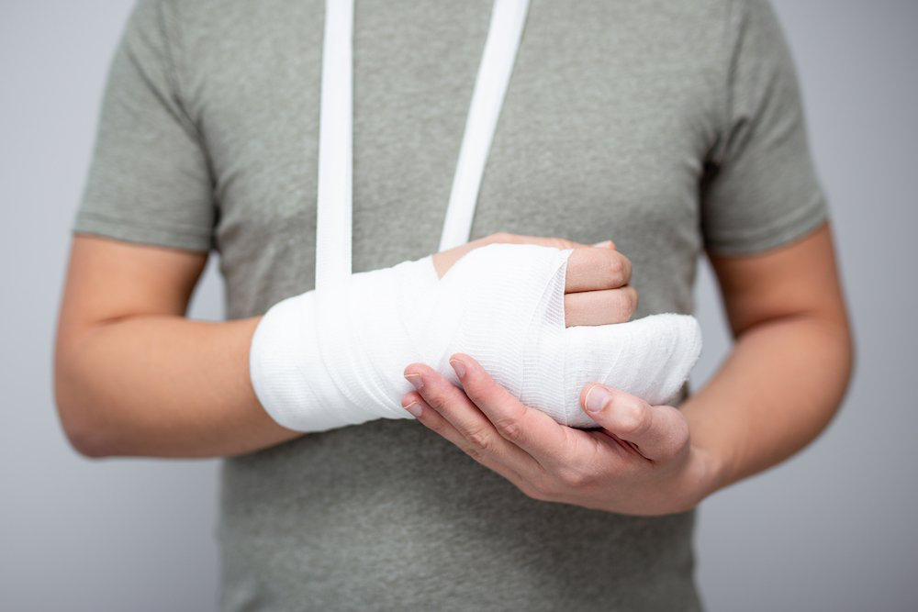
What is a bone fracture?
A bone fracture is a break in the continuity of a bone.
A significant percentage of bone fractures occur because of high force impact or stress.
fracture-and-broken-bones.jpg

Slide 3
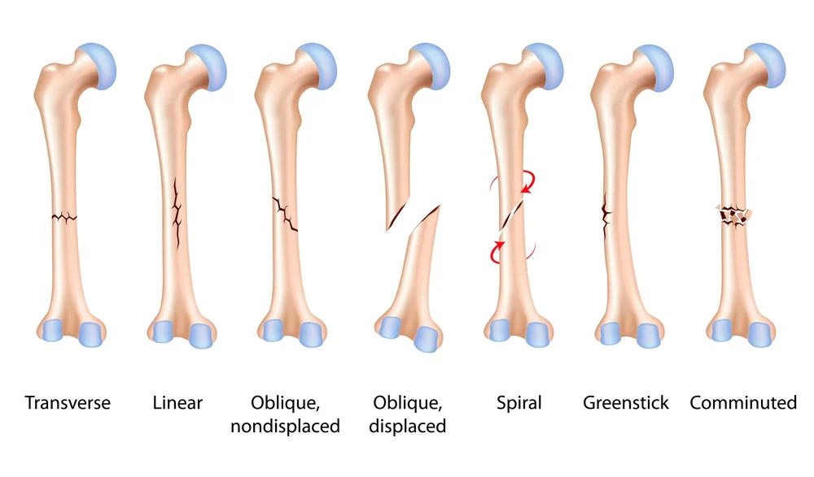
Types of fractures
Divided by pattern:
types-of-bone-fracture.jpg

Slide 4
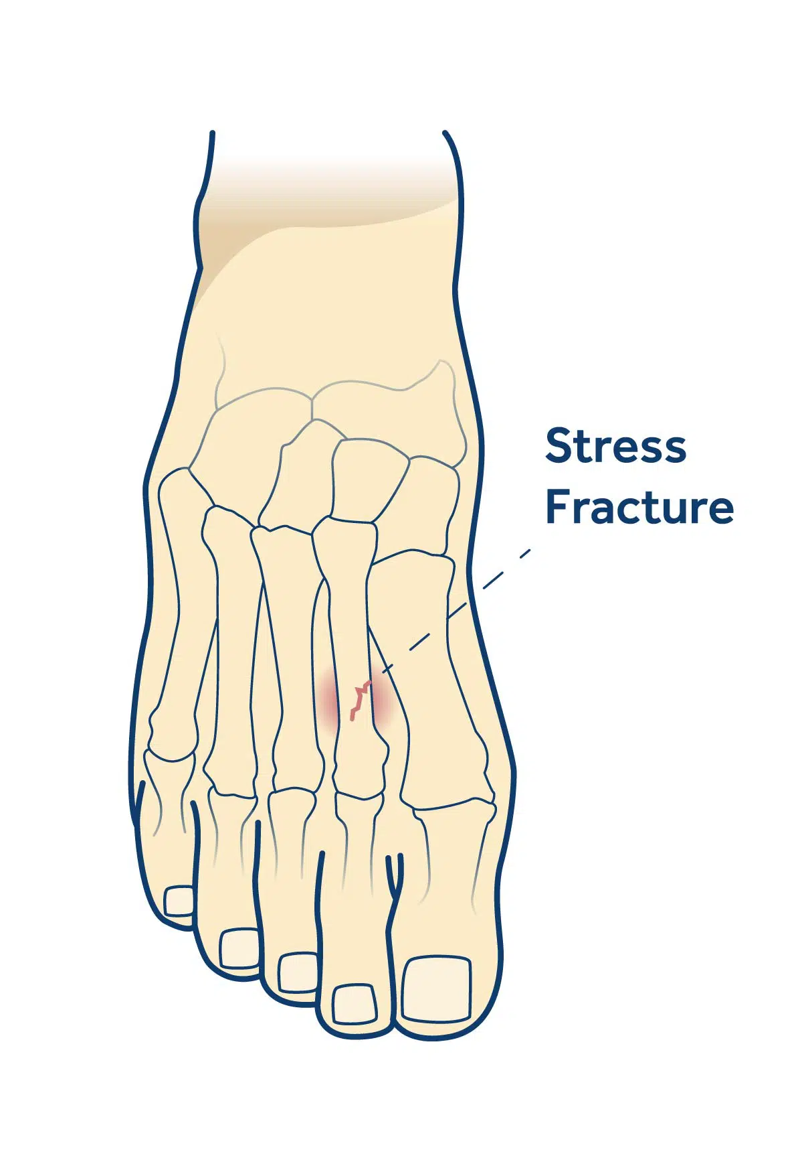
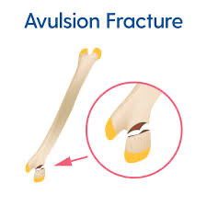
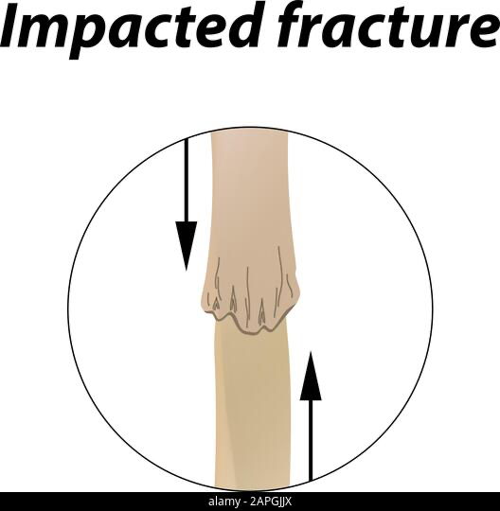
Types of fractures
Divided by cause:
Stress-fractures.jpg
images
2apgjjx.jpg

Slide 5
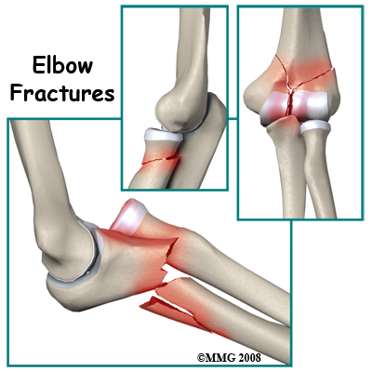
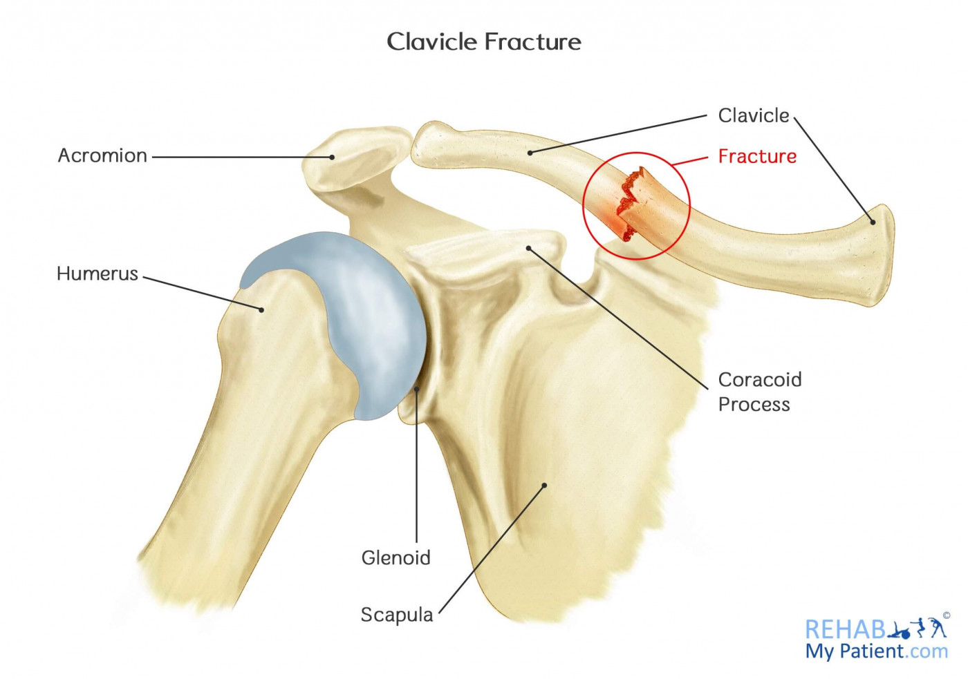
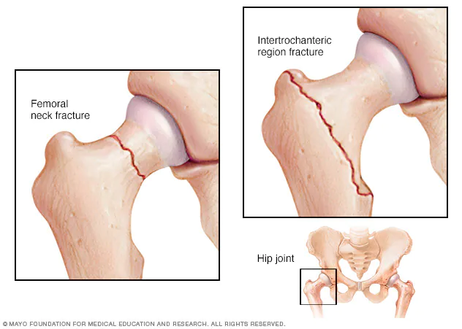
Types of fractures
Divided by location:
elbow_fracture.jpg
Clavicle_fracture.jpg
ds00185_im02383_mcdc7_hip_fracturethu_jpg.jpg

Slide 6

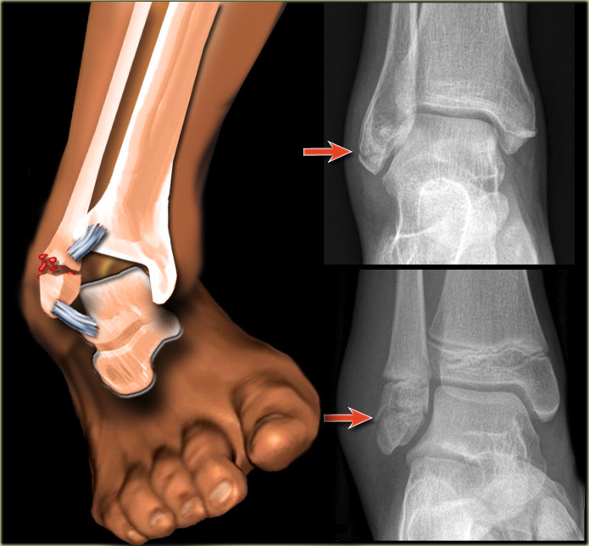
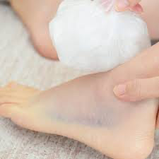
Symptoms
Swelling and tenderness around the injury
Bruising
Deformity — a limb may look out of place, or a part of the bone may puncture through the skin
Images
Ankle-fractures.jpg
iStock-1031796326-1024x683.jgStock-1031796326-1024x683.jpg

Slide 7
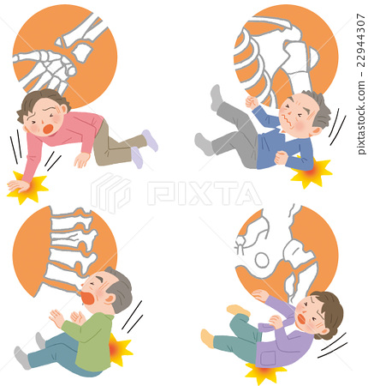
Cause
Trauma. A fall, motor vehicle accident, or tackle during a football game can all result in fractures.
Osteoporosis. This disorder weakens bones and makes them more likely to break.
Overuse. Repetitive motion can tire muscles and place more force on bone. This can result in stress fractures. Stress fractures are more common in athletes.
22944307.jpg

Slide 8
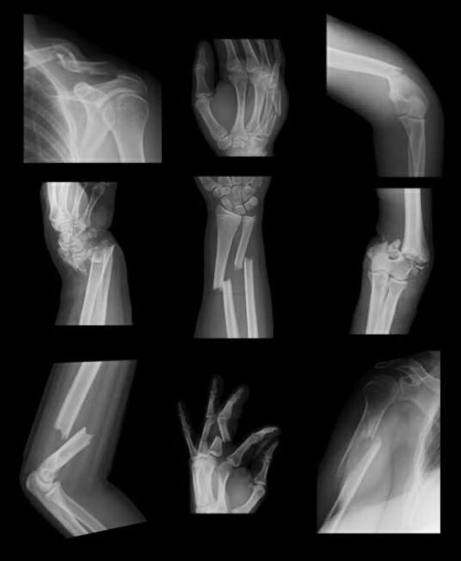
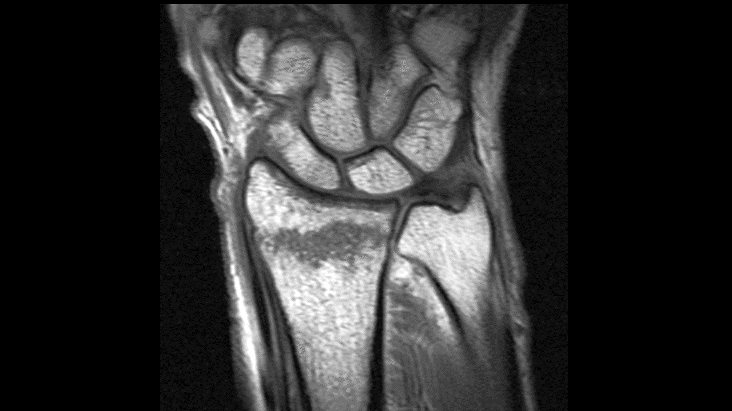
Diagnosis
X-ray
Magnetic resonance imaging (MRI)
Computed tomography scan (also called a CT or CAT scan)
Bone-fracture-493x600.jpg
MR_DRF.gif

Slide 9
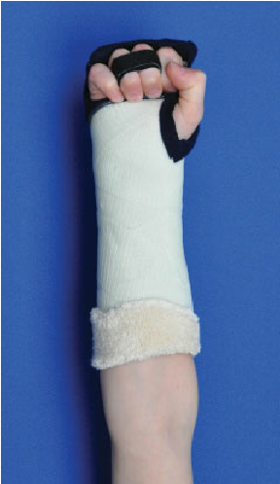
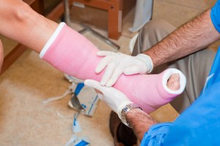
Treatment
Splint or cast
Traction
Surgery
cast immobilization
functional cast
E12200f145caa6ff91c5a7d677b41a3c-300x199.jpg
Functional-forearm-cast-The-metacarpophalangeal-joints-are-blocked-in-70-to-90-degrees.png

Slide 10
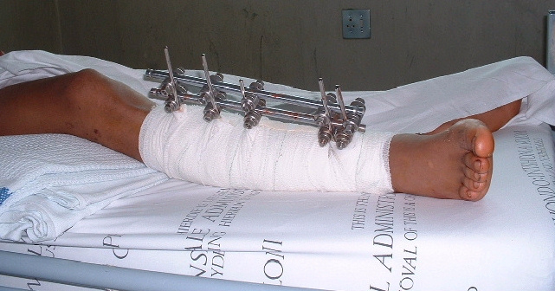
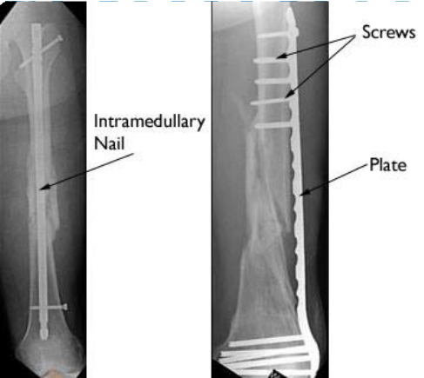
external fixation
internal fixation
Internal-Fixation1.png
uniplanar_exfix-tibia.jpg

Slide 11


Recovery
Fractures can take several weeks to several months to heal, depending on their severity.
After the bone has healed, it may be necessary to restore muscle strength and mobility to the affected area through physical therapy.
iStock-623674402.jpg
iStock-984277450.jpg

Slide 12
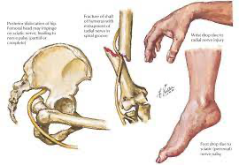
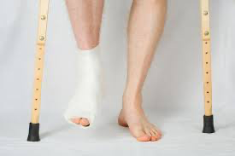
Complications
Bone heals in the wrong position
Disruption of bone growth
Bone or bone marrow infection
Bone death
Images
fracture1.jpg

Slide 13
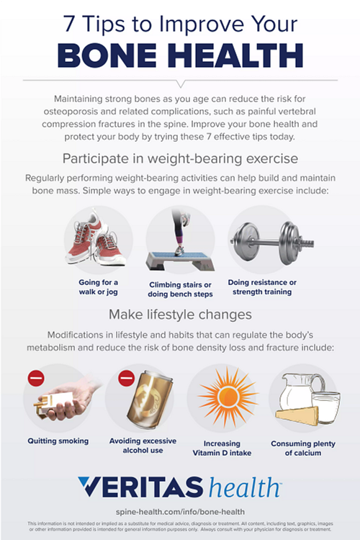
Prevention
Bone-Health-100520.png

Slide 14
Dictionary
Longitudinal fracture- podłużne złamanie
Comminuted fracture- złamanie wieloodłamowe
Protrusion- zgrubienie
Grating- drażniący
Cast immobilization- unieruchomienie gipsowe
External fixation- zewnętrzne umocowanie złamanej kości
Bone marrow- szpik kostny
Weight- bearing exercises- ćwiczenia obciążające

Slide 15
References
https://www.medicalnewstoday.com/articles/173312#prevention
https://orthoinfo.aaos.org/en/diseases--conditions/fractures-broken-bones/
https://my.clevelandclinic.org/health/diseases/15241-bone-fractures
https://www.hopkinsmedicine.org/health/conditions-and-diseases/fractures
Baig M (August 28, 2017) A Review of Epidemiological Distribution of Different Types of Fractures in Paediatric Age. Cureus 9(8): e1624. doi:10.7759/cureus.1624

