Slide 1
Alzheimer’s disease
UNIWERSYTET RZESZOWSKI
KOLEGIUM NAUK MEDYCZNYCH
INSTYTUT NAUK O ZDROWIU
Łucja Zajdel
Fizjoterapia III Rok
JMGR stacjonarne
Rok akademicki 2022/2023 sem. zimowy

Slide 2
Definition
Alzheimer’s disease, which is the most common form of dementia, is an incurable degenerative disease. Neurons in certain parts of the brain are destroyed which leads to deficits in cognitive functions, such as memory, language skills, and behavior. Dementia affects 5-8% of all people above 60 years of age, increasing to around 40% of people older than 90 years.
https://medicine.umich.edu/sites/default/files/images/lede/news/mnet_AlzheimersDiseaseBrainGraphic-768x433.jpg

Slide 3
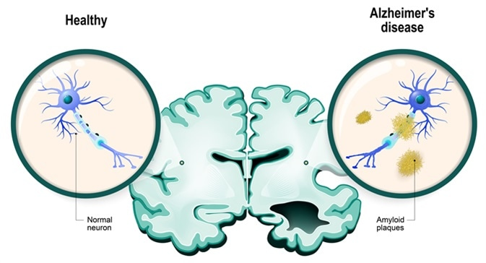
Causes
Like all types of dementia, Alzheimer’s develops due to the death of brain cells. It is a neurodegenerative condition, which means that the brain cell death happens over time.
https://www.news-medical.net/image.axd?picture=2018%2F6%2Fshutterstock_582277528.jpg

Slide 4
Risk factors
Age
Family history
Genetics

Slide 5
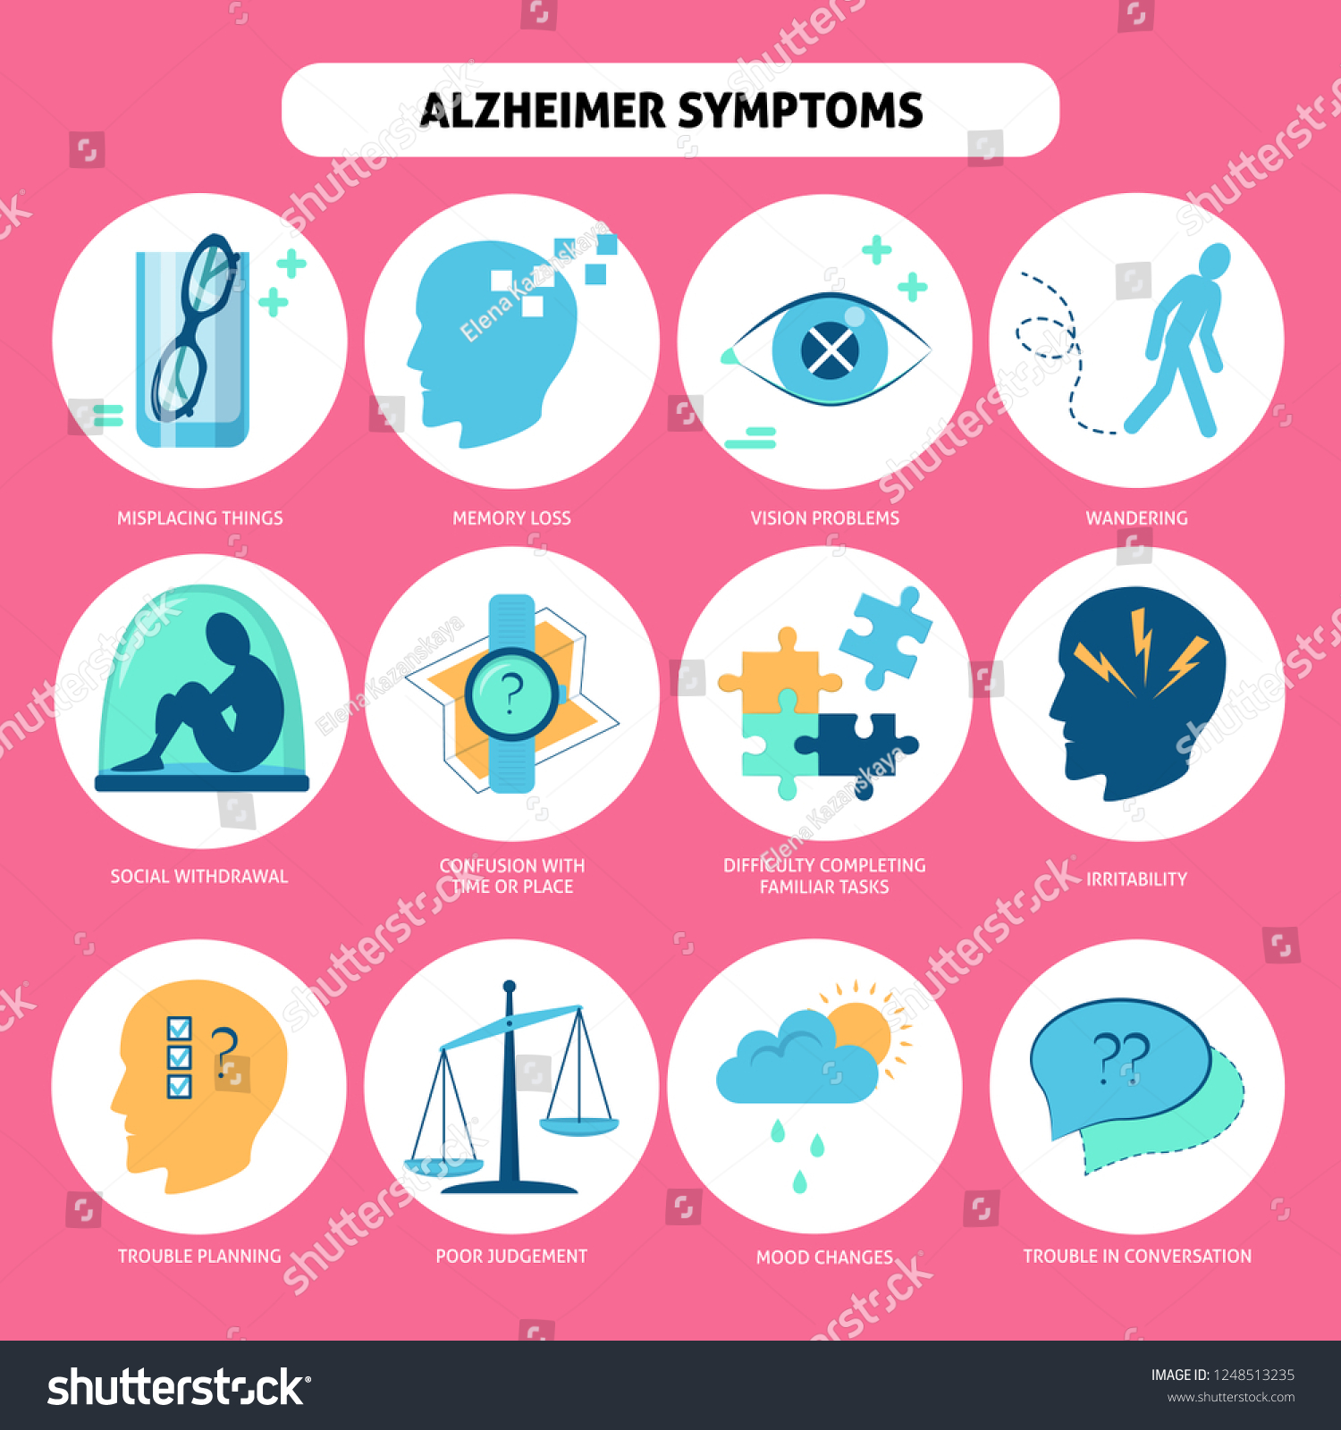
https://image.shutterstock.com/z/stock-vector-set-of-alzheimer-s-disease-symptoms-icons-in-flat-style-1248513235.jpg

Slide 6
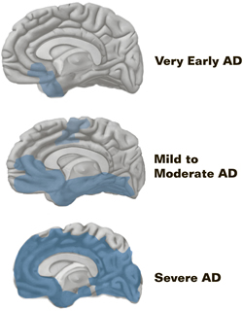
Stages
Stage 1: Mild Alzheimer’s disease
Stage 2: Moderate Alzheimer’s disease
Stage 3: Severe Alzheimer’s disease
https://alzheimersdiseasebiol2095.files.wordpress.com/2014/09/alzheimersdiseasestages.jpg

Slide 7
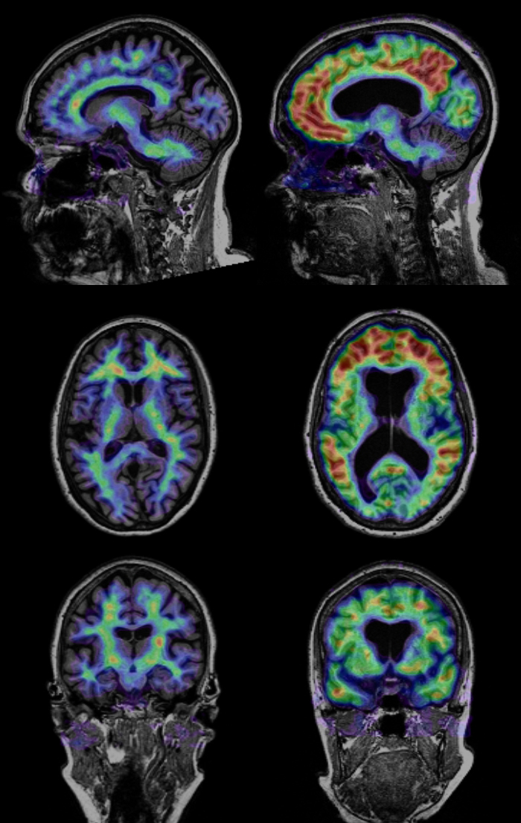
Diagnosis
mental status test
physical exam
neurological exam
brain-imaging studies (Magnetic resonance imaging (MRI), Computer tomography (CT), Positron emission tomography (PET)
https://scx2.b-cdn.net/gfx/news/hires/1-uncoveringea.jpg

Slide 8
Treatment
Medications
Regular doctor visits
Treating other health conditions
Planning how the person can be as independent as possible
Rehabilitation

Slide 9
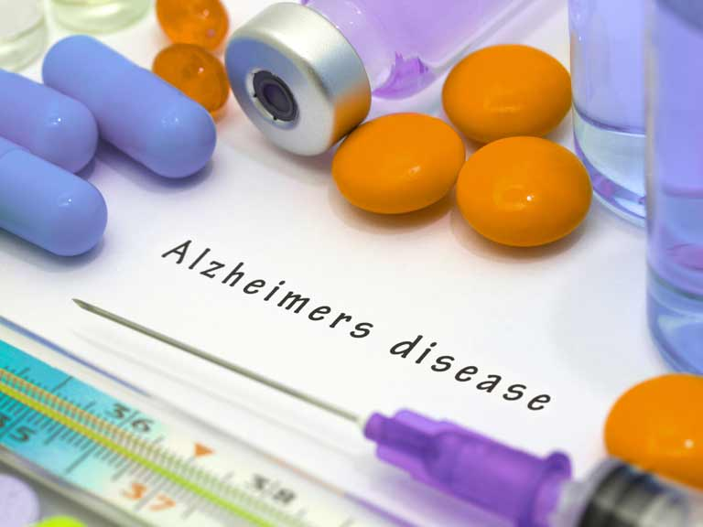
Medications for cognitive symptoms
Types of drugs:
cholinesterase inhibitors
donepezil (Aricept)
galantamine (Razadyne),
rivastigmine (Exelon),
https://www.saga.co.uk/contentlibrary/saga/publishing/verticals/health-and-wellbeing/treatments-and-therapies/medicines/alzheimers-disease-shutterstock_332694590-768x576.jpg

Slide 10
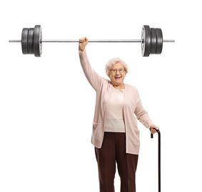
Rehabilitation methods
Sight, sound and touch cues
Mirroring
Task breakdown
Hand-over-hand guidance
Muscle training
https://movefreephysio.com.sg/wp-content/uploads/Geriatric-Rehabilitation.jpg
https://palermophysio.ca/wp-content/uploads/2018/04/Oakville-Physio-palermo-physio-283x270.jpg

Slide 11
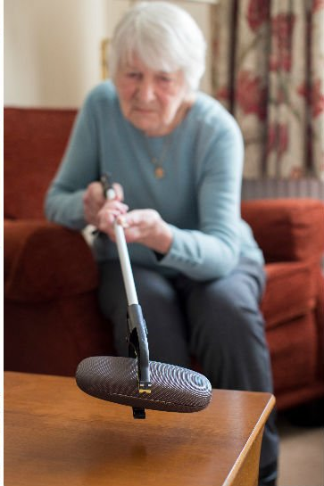
Training Family Members and Caregivers
Physiotherapist may learn how to:
Use equipment such as: Special seating,Canes, Long-handled reaching tools (reachers).
Lift and Transfer someone
Prevent injuries
https://img.seniorsmatter.com/quill/b/6/c/b/0/0/b6cb009873cf0113afca8cb832473017bd053078.jpg
https://st3.depositphotos.com/13194036/18504/i/1600/depositphotos_185049020-stock-photo-doctor-assisting-male-patient-cane.jpg

Slide 12
Prevention
getting regular exercise
maintaining a healthy cardiovascular system
managing the risk of cardiovascular disease, diabetes, obesity, and high blood pressure
following a varied and healthful diet
keeping the brain active throughout life

Slide 13
Vocabulary
brain cell- komórka mózgowa
mild - łagodny
moderate- umiarkowany
severe- ciężki
cognitive functions- funkcje poznawcze
brain-imaging studies- badania obrazowe mózgu
health conditions- problemy ze zdrowiem
independent- niezależny
cue – sygnał, wskazówka
long-handled reaching tools – długie narzędzia sięgające
canes – laski
task breakdown- rozbijanie zadania na czynniki pierwsze

Slide 14
Bibliography
Maileen Gloriane Ulep, Simrit Kaur Saraon, Samantha McLea,Alzheimer Disease,The Journal for Nurse Practitioners,Volume 14, Issue 3,2018,Pages 129-135
B. Dubois, H Feldman, C, Jacova,, Revising the defi nition of Alzheimer’s disease Published online October 11, 2010
Hebert LE, et al. (2013). Alzheimer disease in the United States (2010–2050) estimated using the 2010 census
Sobol NA, Hoffmann K, Vogel A, et al. Associations between physical function, dual task performance and cognition in patients with mild Alzheimer’s disease. Aging Ment Health. 2016;20(11):1139–1146
Staedtler AV, Nunez D. Nonpharmacological therapy for the management of neuropsychiatric symptoms of Alzheimer’s disease: linking evidence to practice. Worldviews Evid Based Nurs. 2015;12(2):108–115

