Slide 1

The Stroke
Prepared by:
Karolina Brydak
3rd year of Physiotherapy
2023/2024
University of Rzeszów
Medical College

Slide 2
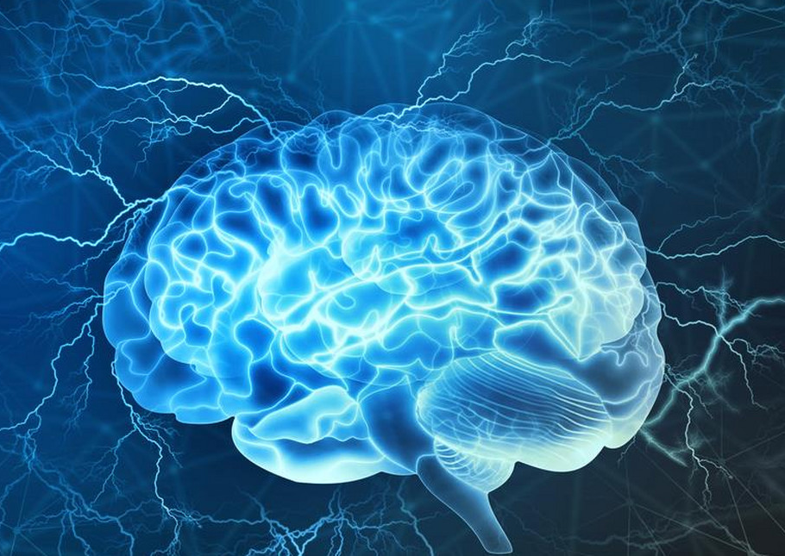
What is a stroke?
Stroke is a clinically defined syndrome of acute, focal neurological deficit attributed to vascular injury of the central nervous system. Most (85%) strokes are ischaemic, predominantly caused by small vessel arteriolosclerosis, cardioembolism and large artery athero-thromboembolism. Approximately 15% of strokes worldwide are the result of intracerebral haemorrhage, which can be deep, cerebellar or lobar.

Slide 3
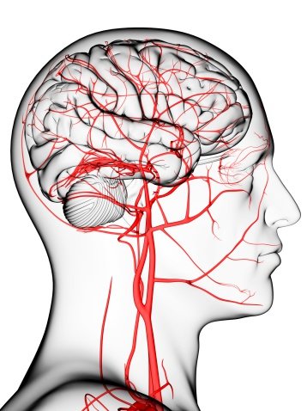
What happens in the brain during a stroke?
The brain needs a constant supply of oxygen and nutrients in order to work well. If blood supply is stopped even for a short time, this can cause problems. Brain cells begin to die after just a few minutes without blood or oxygen.

Slide 4
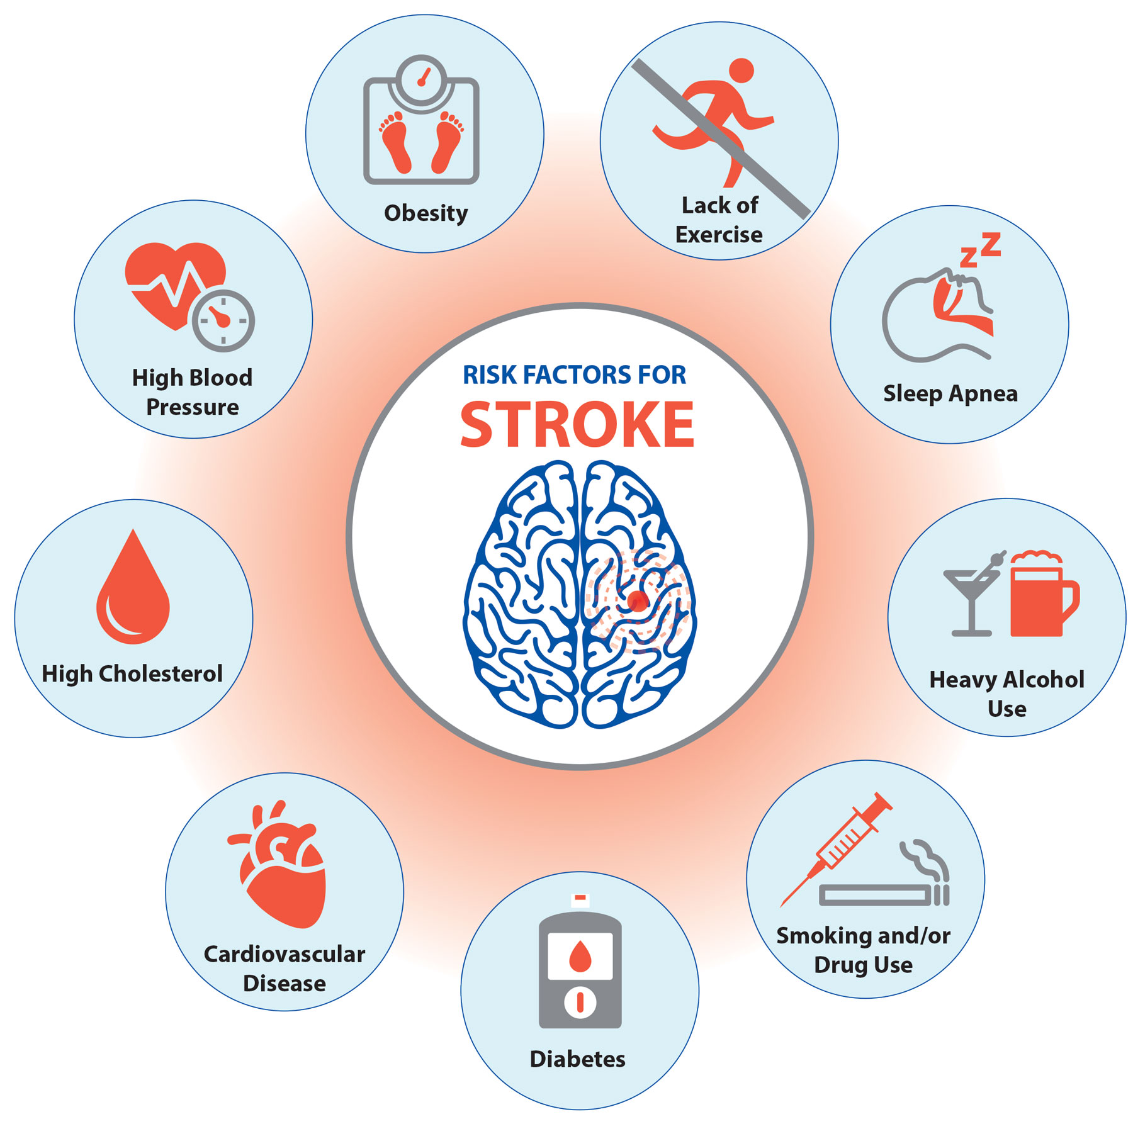
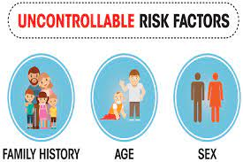
Causes of a stroke

Slide 5
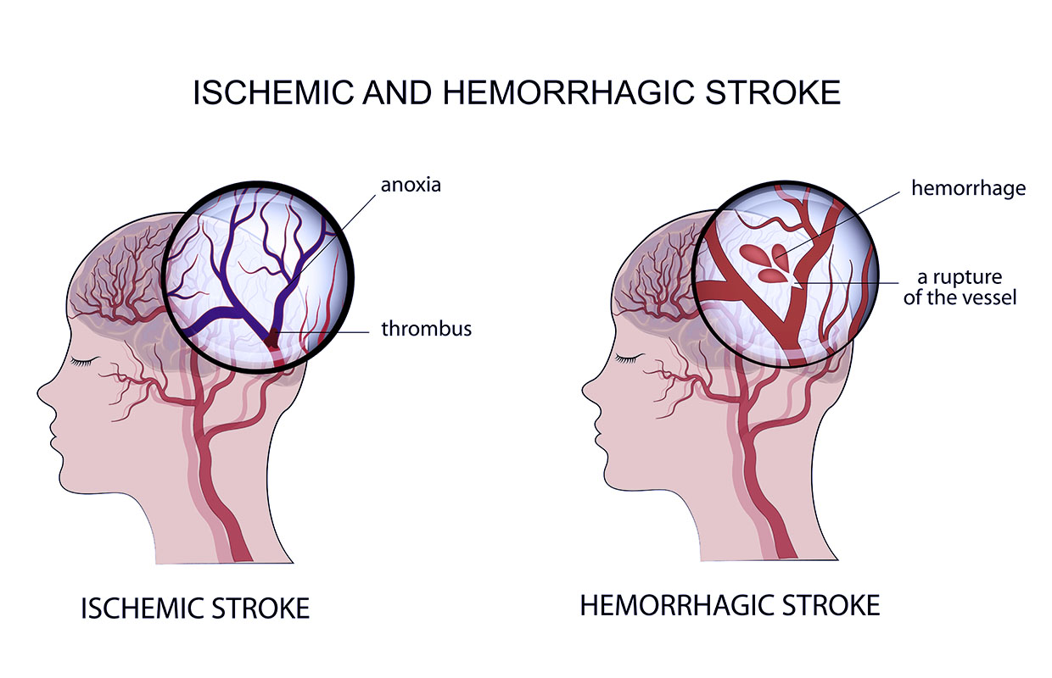
What are the types of stroke?
Ischemic stroke.
Hemorrhagic stroke.
A transient ischemic attack (TIA) is sometimes called a “mini-stroke.”

Slide 6
Symptoms of a stroke
Speech
Face,arm,leg
Eyes
Headache
Trouble walking

Slide 7
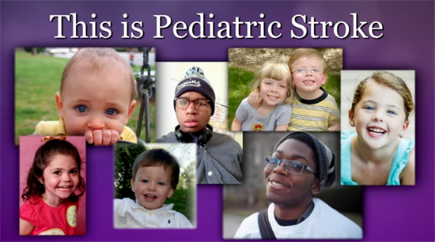
Stroke in children
Children at risk of stroke include:
Newborns, especially full-term infants
Older children with sickle cell anemia, congenital heart defects, immune disorders or problems with blood clotting
Previously healthy children who are found to have hidden disorders such as narrow blood vessels or a tendency to form blood clots easily

Slide 8
Treating a stroke
Anticoagulants
Antiplatelets
Medication for other health conditions
Physical therapy
Speech therapy
Occupational therapy
Cognitive remediation
Exercise and diet

Slide 9
What are post-stroke side effects?
A stroke to the right side of the brain can cause:
Left-side weakness.
Impulsive behavior.
Overconfidence in abilities.
Vision problems.
A left-side stroke can cause:
Right-side weakness.
Speech and language problems.
Slow behavior.

Slide 10
What are the effects of post-stroke depression?
Physical and psychological symptoms of depression can include:
Sudden mood changes,
Feeling anxious, worried, pessimistic, or hopeless,
Having thoughts of death,
Loss of energy,
Increase or decrease in appetite,
Problems sleeping or sleeping too much,
Trouble concentrating, remembering, thinking, or making decisions,
Headache,
Digestive problems,
Sexual problems.

Slide 11
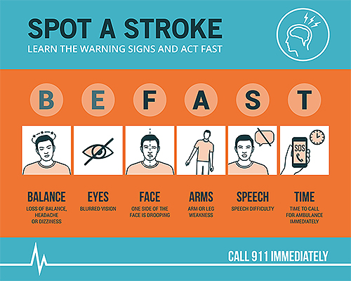
When to see a doctor?

Slide 12
Stroke rehabilitation
Physical activities might include:
Motor-skill exercises,
Mobility training,
Constraint-induced therapy,
Range-of-motion therapy.
Technology-assisted physical activities might include:
Functional electrical stimulation,
Robotic technology,
Wireless technology,
Virtual reality.

Slide 13
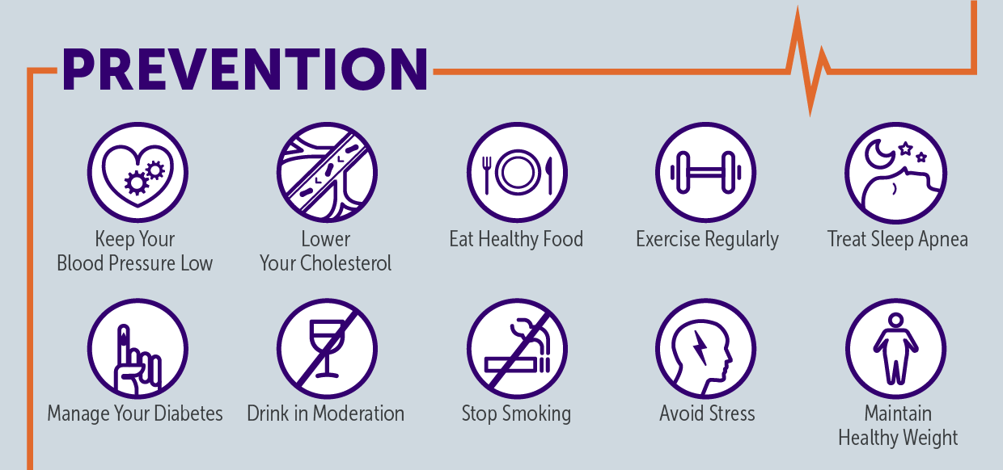
Preventing a stroke

Slide 14
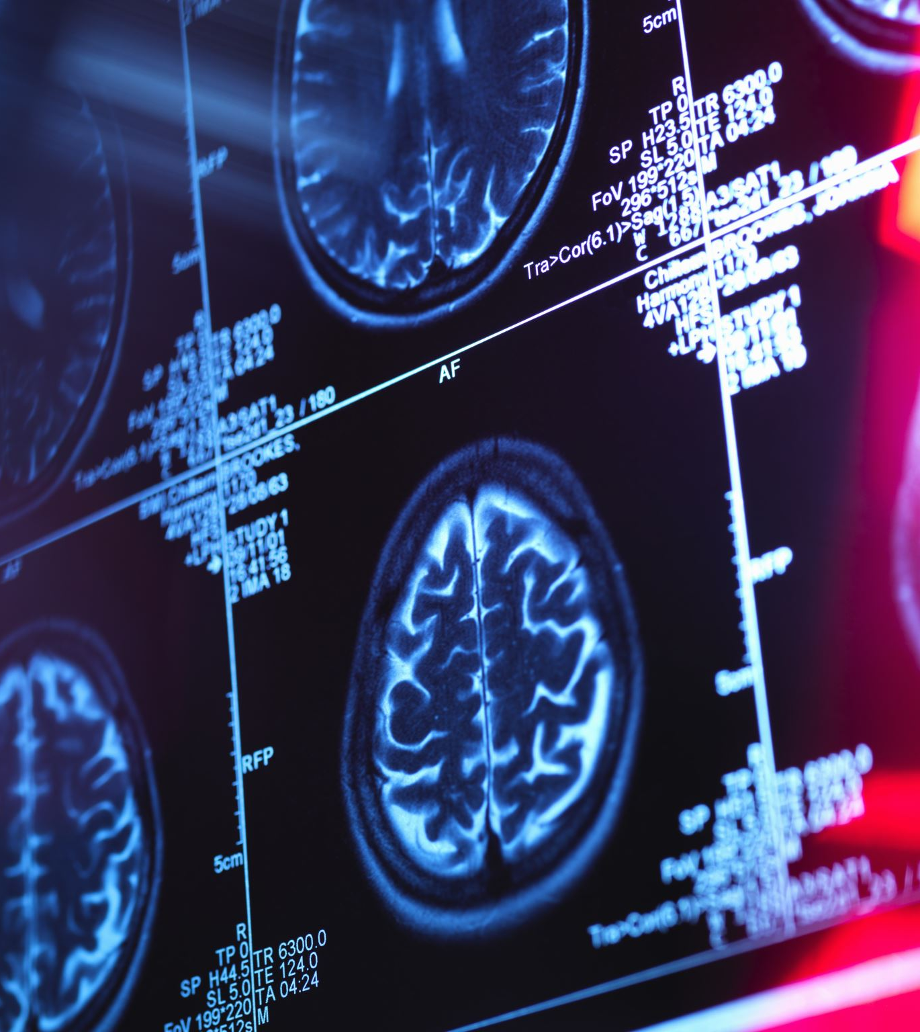
Dictionary
Haemorrhage stroke - udar krwotoczny
ischaemic stroke - udar niedokrwienny
transient ischemic attack - przemijający atak niedokrwienny
stroke risk factors- czynniki ryzyka udaru
vascular injury - uraz naczyniowy
vessel arteriolosclerosis - miażdżyca naczyń krwionośnych
Cardioembolism - choroba zatorowo-zakrzepowa
artery athero-thromboembolism - miażdżyca tętnic - choroba zakrzepowo-zatorowa
intracerebral haemorrhage - krwotok śródmózgowy
cerebellar or lobar - móżdżkowy lub płatowy
blood clotting- krzepnięcie krwi
congenital heart -wrodzona wada serca
sickle cell anemia - niedokrwistość sierpowatokrwinkowas

Slide 15
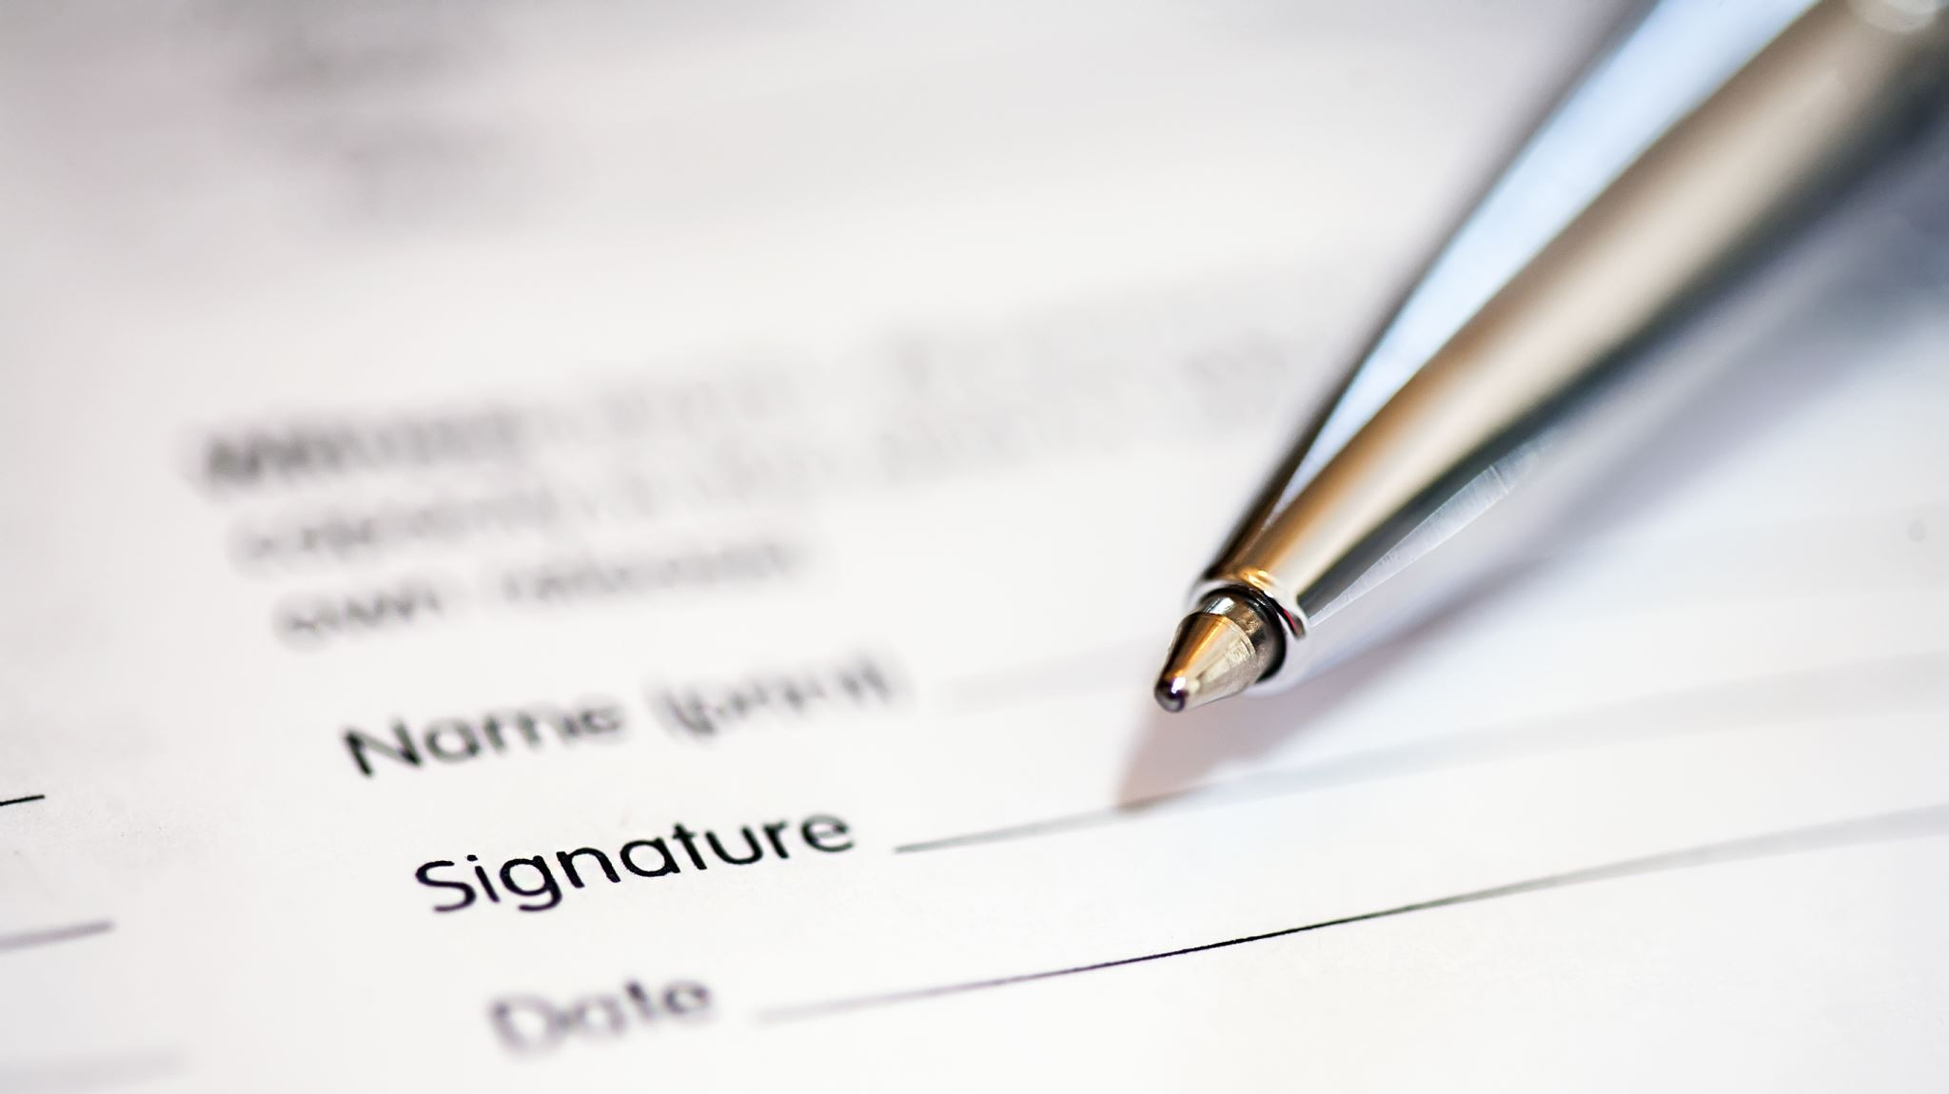
Bibliography
https://integrisok.com/resources/articles/stroke-quiz
https://www.urmc.rochester.edu/encyclopedia/content.aspx?contenttypeid=40&contentid=StrokeQuiz2
https://www.premierhealth.com/your-health/articles/women-wisdom-wellness-/what-happens-during-a-stroke-
https://www.cdc.gov/stroke/about.htm
https://www.google.com/url?sa=i&url=https%3A%2F%2Fwww.chihealth.com%2Fen%2Fservices%2Fneuro%2Fneurological-conditions%2Fstroke%2Fstroke-prevention.html&psig=AOvVaw0HxwLETy4hrlqcDnfU1PWP&ust=1700778504719000&source=images&cd=vfe&opi=89978449&ved=0CBEQjRxqFwoTCOD5gefT2IIDFQAAAAAdAAAAABAY
https://www.google.com/imgres?imgurl=https%3A%2F%2Fcih.com.vn%2Fimages%2F20190417-5-uncontrollable-risk-factors-resized.png&tbnid=p9cm8rQEyo_-rM&vet=12ahUKEwiW15jm09iCAxXFi_0HHfSQBfYQMygNegQIARBs..i&imgrefurl=https%3A%2F%2Fcih.com.vn%2Fen%2Fcardiology-neuroscience%2F1217-stroke-risk-factors-what-you-can-and-cannot-controla.html&docid=bHs3PQqrisvaJM&w=600&h=400&q=stroke%20risk%20factors&ved=2ahUKEwiW15jm09iCAxXFi_0HHfSQBfYQMygNegQIARBs
https://www.hopkinsmedicine.org/health/conditions-and-diseases/stroke
https://www.google.com/url?sa=i&url=https%3A%2F%2Fwww.neuroskills.com%2Fbrain-injury%2Fstroke%2Fwhat-are-the-signs-and-symptoms-of-a-stroke%2F&psig=AOvVaw3FZLAh9SoMSAph2enTMnqj&ust=1700779024114000&source=images&cd=vfe&opi=89978449&ved=0CBEQjRxqFwoTCIC-0t7V2IIDFQAAAAAdAAAAABAE
https://www.google.com/url?sa=i&url=https%3A%2F%2Fwww.memorialcare.org%2Fservices%2Fstroke-care%2Fstroke-prevention&psig=AOvVaw2LhpjLin3yKOm_JWg2QFQV&ust=1700779989421000&source=images&cd=vfe&opi=89978449&ved=0CBEQjRxqFwoTCOjN
https://www.google.com/url?sa=i&url=https%3A%2F%2Fwww.medonet.pl%2Fzdrowie%2Fzdrowie-dla-kazdego%2Cmozg%2Cartykul%2C1580681.html&psig=AOvVaw0OTSAZBCOzhsIAvcbw6VEA&ust=1700781867641000&source=images&cd=vfe&ved=0CBEQjRxqFwoTCNCLpKrg2IIDFQAAAAAdAAAAABAE9KrZ2IIDFQAAAAAdAAAAABAo
https://www.google.com/url?sa=i&url=https%3A%2F%2Fwww.covenanthealth.com%2Fcumberland%2Fservices%2Fstroke-care%2Ftypes-of-stroke%2F&psig=AOvVaw2LG_hU8QZBvWXHQYZ_4bJ0&ust=1700781928519000&source=images&cd=vfe&opi=89978449&ved=0CBEQjRxqFwoTCJiGxMfg2IIDFQAAAAAdAAAAABAE
https://www.google.com/url?sa=i&url=https%3A%2F%2Fwww.ohsu.edu%2Fbrain-institute%2Funderstanding-stroke&psig=AOvVaw2LG_hU8QZBvWXHQYZ_4bJ0&ust=1700781928519000&source=images&cd=vfe&opi=89978449&ved=0CBEQjRxqFwoTCJiGxMfg2IIDFQAAAAAdAAAAABAa
https://www.google.com/url?sa=i&url=https%3A%2F%2Fmedschool.cuanschutz.edu%2Fhemophilia-thrombosis%2Fresources%2Fpediatric-stroke&psig=AOvVaw1JdvPfP85JyMFcuI_Nbuuo&ust=1700782188089000&source=images&cd=vfe&opi=89978449&ved=0CBEQjRxqFwoTCOCElsPh2IIDFQAAAAAdAAAAABAJ
David H Saunders, Mark Sanderson, Sara Hayes, Maeve Kilrane, Carolyn A Greig, Miriam Brazzelli, Gillian E Mead. „Physical fitness training for stroke patients” doi: 10.1002/14651858.CD003316.pub6.
Beth Clark, Jill Whitall, Gert Kwakkel, Jan Mehrholz, Sean Ewings, Jane Burridge. “The effect of time spent in rehabilitation on activity limitation and impairment after stroke”. DOI: 10.1002/14651858.CD012612.pub2
Juan Li, Dongling Zhong, Jing Ye, Mingxing He, Xicen Liu, Hui Zheng, Rongjiang Jin, Shao-Lan Zhang. “Rehabilitation for balance impairment in patients after stroke: a protocol of a systematic review and network meta-analysis”. DOI: 10.1136/bmjopen-2018-026844
Kałużny K.,. Kałużna A,. Kochański B, Cichosz M., Płoszaj O., Pawiłan M., Zukow W., Hagner W. “The influence of neurological rehabilitation on the functioning of patients after ischemic stroke –a retrospective
Stephano Silva, Lorenna Rdm Borges, Lorenna Santiago, Larissa Lucena, Ana R Lindquist, Tatiana Ribeiro. “Motor imagery for gait rehabilitation after stroke”. DOI: 10.1002/14651858.CD013019.pub2

Slide 16
Short quiz
1. Strokes are caused by
A. A blood clot
B. A rupture in a major artery to the brain
C. Both A and B
D. None of the above
2. What is another name for a stroke?
A. Heart attack
B. Brain attack
C. Myocardial infarction
D. None of the above
3. The risk factor that has the greatest impact for lowering your risk for stroke is:
A. Smoking
B. Lack of exercise
C. High blood pressure
D. High cholesterol
E. None of the above
4. Which of these is a symptom of stroke?
A. Sudden confusion
B. Sudden weakness in an arm or leg
C. Sudden severe headache with no cause
D. Sudden trouble seeing
E. All of the above
5. The sudden onset of slurred speech, loss of speech or inability to understand speech can be a warning sign of stroke.
True
False
6. Warning signs of stroke can also include:
A. Trouble seeing in one or both eyes
B. Weakness, numbness or paralysis
C. Severe headaches with no known cause
D. Confusion, dizziness or loss of balance or coordination
E. All of the above
7. The most appropriate response to a possible stroke is:
A. Go to bed and rest
B. Call the doctor
C. Call a neighbor or friend
D. Call 911
8. If a person has an ischemic stroke, how quickly should the person be treated to minimize long-term problems?
A. Within 30 minutes
B. Within 1 hour
C. Within 2 hours
D. Within 3 hours

